Slide 1
HORT 308
MEDICINAL AND AROMATIC PLANTS

Slide 2
Celery

Slide 3
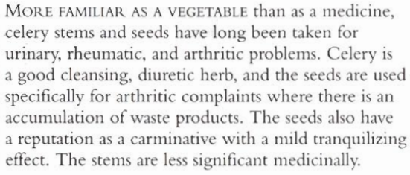
B.N Apium graveolens Family: Umbelliferae

Slide 4
Habitat and Cultivation
Native to Britain and Europe
Now widely Cultivated as a vegetable

Slide 5
Key Constituents
Volatile Oil (1.5% - 3%) containing limonene (60% - 70%), phthalides and beta-selinene
Coumarins
Furanocoumarins
Flavonoids

Slide 6
Key Actions
Antirheumatic
Carminative
Antispasmodic
Diuretic
Lowers Blood Pressure
Urinary antiseptic

Slide 7
Research
1970 – 1980 in Germany and China that the essential oil has a calming effect on central nervous system and treatment in high blood pressure.

Slide 8
Traditional and Current Uses
Ancient herb from 3000 years ago used as medicine
Cleansing: Seed for rheumatic and gout. Improve blood flow and improve kidney functions
Diuretic for cystitis
Nutritious Drink (Celery + Organic carrot juice)
Other Uses: Chest problems (Asthma and Bronchitis)

Slide 9
Parts Used
Stems
Leaves
Seeds

Slide 10
Key Preparations
Infusion of seeds
Tincture of seeds
Juice with carrot

Slide 11
Cautions
Avoided during pregnancy and kidney disorder.

Slide 12
Deadly Nightshade

Slide 13
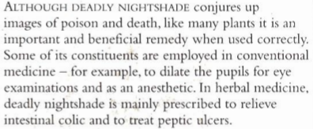
B.N Atropa belladona Family: Solanaceae

Slide 14
Habitat and Cultivation
Native to Europe, Western Asia and Northern America
Now cultivated worldwide
Grows in chalky soils, in woods and wastegrounds
Leaves harvested in summer and roots in autumn

Slide 15
Key Constituents
Tropane alkaloids
Flavonoids
Coumarins
Volatile bases (nicotine)

Slide 16
Key Actions
Smooth muscle antispasmodic
Narcotic
Reduces sweating
Sedative

Slide 17
Research
Reduce saliva, gastric, intestinal and bronchial secretions.
Increase heart rate
Dilate pupils

Slide 18
Traditional and Current Uses
Folklore: Help witches to fly, used by Italian women to dilate their pupils
Relaxant: Relaxes organs specially stomach and intestine , helps in peptic ulcers, relaxes spasms of urinary tubules
Parkinson’s Disease: Improve speech and mobility
Anesthetic

Slide 19
Parts used
Leaves (Fresh and dried)
Roots

Slide 20
Key Preparation
Tincture from leaves and roots

Slide 21
Caution
Use very carefully, A little overdose can cause respiratory paralysis, coma and death

