Slide 1
TRAITS OF ECONOMIC IMPORTANCE IN POLITRY
Economic traits of poultry:
Age at sexual maturity
Egg weight
Egg production
Growth rate
Feed conversion efficiency
Percent fertility
Percent hatchability
Dressing percentage

Slide 2
Cont…
Shell thickness
Mortality
Livability
Egg quality
Body weight at maturity

Slide 3
AGE AT SEXUAL MATURITY
Sexual maturity is the age or stage when an organism can reproduce.
It also termed as puberty and adulthood.
species | Age at sexual maturity
Japanese quail | 6-7 weeks
Turkey | 28-30 weeks
Duck | 20-24 weeks

Slide 4
EGG WEIGHT
Egg weight mainly depends on the body wt. of the birds.
Birds at later stage of production are comparatively older
heavier and lay larger sized eggs.
The quality of feed, management factor, age , strain etc.
species | Egg weight
Turkey | 65-70gm
Duck | 70-75gm

Slide 5
EGG PRODUCTION
Egg production depends upon:
Strain of bird.
Feed quality ( protein , energy , vitamins , minerals
Climate
Managemental factors
System of feeding.
Water quality.
Vaccination and other disease control measures.

Slide 6
Cont…
species | Egg production (per annuma)
Japanese quail | 280
Turkey | 80-100
Duck | 180

Slide 7
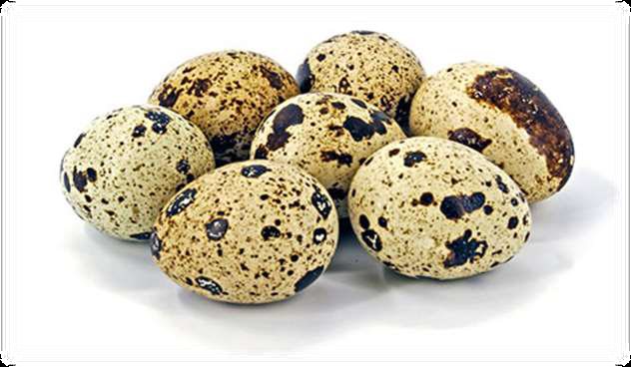
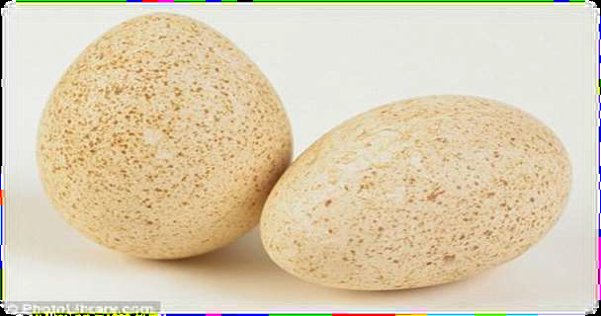
JAPANESE QUAIL AND TURKEY EGG
Jja

Slide 8
SHELL TEXTURE

Slide 9
FEED CONVERSION RATIO
FCR= Total amount of feed consumed
Total body wt. gain
SPECIES | FCR
Japanese quail | 1.75-1.80
Turkey | 2.7-2.8
Duck | 2.3-2.7

Slide 10
PERCENT FERTILITY
%Fertility=No. of fertile eggs × 100
Total no. eggs

Slide 11
FACTORS EFFECTING FERTILITY
Genetic factors: Many genes influence fertility
Breed: Lighter breeds is more fertile than heavier breeds.
Environmental factors: Excessive high and low temperature reduces fertility due to poor mating.
Sex ratio: Both higher and lower males to female ratio will reduce fertility.
Disease conditions: Many diseases like disease, Salmonella etc., affect fertility.
Nutritional factors: Some deficiencies like vitamin A, E

Slide 12
PERCENTAGE HATCHABILITY
Measured in two forms:
1) Hatchability on total number of eggs set.
2) Hatchability on number of fertile eggs.
Highest hatching percent was obtained between 35.5 and 36.5 ˚ c

Slide 13
DRESSING PERCENTAGE
The dressing % is the percent of the live animal that ends up as carcass.
Dressing % = (carcass weight / live weight)x100

Slide 14
EGG QUALITY
Egg size
Shape
Shell colour

Slide 15
Egg quality
Egg size
Shape
Shell colour

Slide 16
EGG SHAPE IS EXPRESSED
Shape Index= Avarage width x100
Average length
Normal egg 70-74 range
Speharical
Elongated

Slide 17
SHELL THICKNESS
Fertile eggs with thick & strong shells are known to have a better chance of hatching rather than weak thin shell eggs.
Eggshells are composed of 97% calcium so the should provided in the sufficient amount in the diet.

Slide 18
% LIVEABILITY
The expression used to describe the number of survivors in a flock.
Mortality
•The ratio of deaths in an area to the population of that area expressed per 1000 per year.

Slide 19
AGE AT STARTING EGG PRODUCTION
species | Age at starting egg production
Japanese quail | 7-8 weeks
Turkey | 30 weeks
Duck | 120 days

Slide 20
BODY WEIGHT
species | Body weight at birth
Japanese quail | 8-10gm
Turkey | 50gm
Duck | 47-48

