Slide 2
General & Medical GENETICS
Biochemical Genetics Disorders of Metabolism

Slide 3
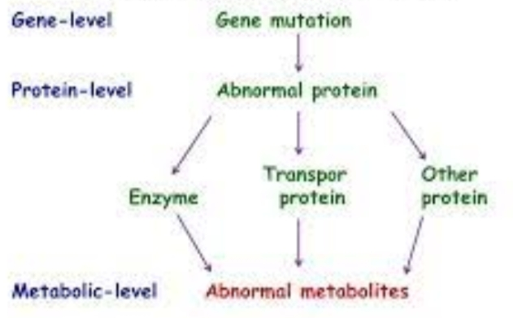
Biochemical Genetics ??
Metabolic disorders ??

Slide 4
What is metabolic process ?
Role of genes in metabolic process
Variants of genes cause disease
AKU is a Black urine disease
In 1902 discovered that AKU caused by enzyme deficiency
Later HGO was discovered
That confirmed the hypothesis of Garrod

Slide 5
Variants of metabolism
Inborn errors of metabolism are rare
Genetic diseases associated with metabolism are common
Incidence of monogenic disorders is 10%
Mutation can arise risk for common diseases
Diagnosis of metabolic disorder is challenging
In 1970’s Reye syndrome was diagnosed
As phenocopy of urea cycle defect

Slide 7
Phenylalanine metabolism pathway

Slide 8
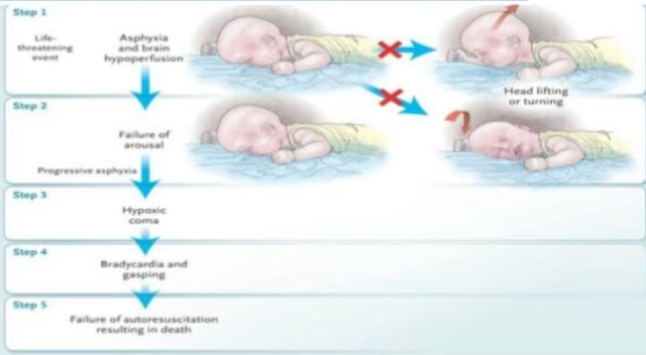
SIDS is a phenocopy of fatty acid metabolic defect

Slide 9
Inheritance of Metabolic Defects
Autosomal recessive pattern
Carrier testing and prenatal diagnosis done for metabolic disorders
Various types of metabolic processes
Defects of metabolic processes
Enzymes act as catalysts
Role in Biomolecules & metabolic pathways
Defects in functioning cause disease

Slide 10
Carbohydrate Metabolism
Most abundant organic compound
Function as substrates & metabolic products
Galactose
Monogenic disorder
Classic galactosemia
Incidence rate
Mutation in gene GAL-1-
Other genes mutation
UDP-G-4 rpimerase

Slide 11
Galactose
Most common monogenic disorder
Classic galactosemia
Incidence rate is 1 in 50,000 births
Mutation in gene GAL-1-uridyl transferase
Single missense mutation in exon 6,p.Q188R
Manifests in newborn period
If left untreated sepsis,hyperammonemia,shock ….. Death
Cataracts is associated with this
New born screening is helpful in eliminating dietary glucose

Slide 12
Other genes mutation encoding galactokinase
That cause cataracts but not cause long term disabilities
Treatment is dietary therapy
Mutation in gene encoding UDP-galactose-4 epimerase
Symptoms similar to classic galactosemia
dietary therapy but not as sever as classic galactosemia

Slide 13
Major pathway of galactose metabolism

Slide 14
Fructose
Mutation in gene encoding hepatic fructokinase
Asymptomatic Fructosuria
Mutation in gene encoding fructose-1,6-bisphosphate aldolase
Asymptomatic HFI that results in poor feeding, hepatic and renal insufficiency ..death
Symptomatic infants
Prevelance is high 1 in 20,000 births
Deficiency of FBPase cause impaired gluconeogenesis,hyperglycemia and acidemia
Survival rate is short

Slide 15
Summary of glucose, fructose & glycogen metabolism

Slide 16
Metabolic Disorders
GLUCOSE;
Glucose metabolism has abnormalities associated with it.
The disorders can be due to elevated glucose levels in blood that are classified as;
T1DM -is associated with reduction or absence of plasma insulin.
T2DM -is characterized by insulin resistance
MODY -

Slide 17
Cont..
Lactose;
Lactose metabolism is regulated by LPH.
The activity of LPH most commonly diminishes after infants are weaned from maternal milk.
However in some populaces it persists as recessive trait (5-90%).
LPH is encoded by the lactase gene (LCT) on chromosome 2.
In European populations its polymorphism is at upstream gene named mini-chromosome maintenance 6 (MCM6).
In sub-Saharan African, Central Asian, and Arabian peninsular populations this polymorphism of lactase persistence is either absent or with low frequency. They have other polymorphisms.

Slide 18
Cont..
Glycogen;
Glycogen- the main storage form of carbohydrates, some enzyme deficiencies lead to serious disorders.
Most commonly affects liver and muscles.
TYPE | DEFFECT | MAJOR AFFECTED TISSUE
Ia (Von Gierke) | Glucose-6-phosphatase | Liver, kidney, intestine
Ib | Microsomal glucose-6-phosphate transport | Liver, kidney, intestine, neutrophils
II (Pompe) | Lysosomal acid β-glucosidase | Muscle, heart

Slide 19
AMINO ACID METABOLISM
Proteins are essential biomolecules, of which amino acids are building blocks.
Phenylalanine; defects in its metabolism causes hyperphenylalaninemias.
Mostly disorders of this amino acid are due to disorders in the metabolism of gene encoding phenylalanine hydroxylation (PAH) pathways; results in phenylketonuria.
Mutations may include insertions, deletions or substitutions
Less commonly, hyperphenylalaninemias is caused by defects in the synthesis of tetrahydrobiopterin, or by a deficiency of dihydropteridine reductase.
Hyperphenylalaninemias are treated by restricting dietary intake of phenylalanine-containing foods.

Slide 20
Cont..
Tyrosine; is the essential component of many biomolecules like catecholamines, thyroid hormones, melanin pigments.
Hereditary tyrosinemia type 1 (HT1) is the most common metabolic defect of tyrosine and is caused by a deficiency of fumarylacetoacetate hydrolase (FAH), which catalyzes the last step in tyrosine catabolism.
Accumulation of the substrates of FAH leads to neurological, kidney, and liver dysfunction. Although liver transplantation has been the cornerstone of treatment for HT1.
Tyrosinemia type 2 (oculocutaneous tyrosinemia) is caused by a deficiency of tyrosine aminotransferase.
Tyrosinemia type 3 is associated with reduced activity of 4-hydroxyphenylpyruvate dioxygenase.

Slide 21
Cont..
Branched chain amino acids;
Most of the amino acids of animals are branched chain,
Their metabolism produces an intermediate state compound α-ketoacids, further its metabolism is regulated by a complex, branched-chain α-ketoacid dehydrogenase.
BCKAD is encoded by six genes
Deficiency of any of the components leads to disorder known as maple syrup urine disease.

Slide 22
Lipid metabolism
Lipids are essential biomolecules
The metabolism involves the catabolism of fatty acids that follows certain pathway
Different steps are involved, disturbance in any step can lead to defects such as hyperlipidemias

Slide 24
Steroid Hormones
Steroid hormone, a group of hormones
They are secreted by “steroid glands”—the adrenal cortex, testes, and ovaries—and during pregnancy by the placenta
Steroid hormones help control metabolism, inflammation, immune functions, salt and water balance, development of sexual characteristics
steroid hormones are typically mediated by binding to an intracellular receptor
Defects in the synthesis of steroid hormones or their receptors can cause clinical abnormalities

Slide 25
Example
Congenital adrenal hyperplasia (CAH)
Genetically heterogeneous autosomal recessive disorder
CAH are caused by mutations in CYP21A2, the gene that encodes 21-hydroxylase
cortisol deficiency
deficiency of aldosterone
excess of androgens
CYP21A2 is located on chromosome 6p21

Slide 26
21 hydroxylase activity change
overproduction of cortisol precursor
excess adrenal androgens
aldosterone deficiency
loss of salt

Slide 27
People between 7 and 14 days of age weight loss, dehydration, hyponatremia (decreased plasma Na+ concentration), and hyperkalemia (increased plasma K+ concentration)
Treatment of CAH consists of replacing cortisol, suppressing adrenal androgen secretion, and providing mineralocorticoids to return electrolyte concentrations to normal

Slide 28
Defects of steroid hormone receptors are rare
Mutations in the gene that encodes the glucocorticoid receptor can produce hereditary resistance to the actions of cortisol
mutations in the X-linked gene that encodes the androgen receptor (AR) are relatively common
complete or partial androgen insensitivity syndromes (CAIS or PAIS) are transmitted in an X-linked recessive pattern
More than 95% of persons with CAIS have mutations in the AR gene

Slide 29
Proxisomal enzymes
Peroxisomes are membrane-bound organelles in most eukaryotic cells proxisomes contain enzymes involved in lipid metabolism and the conversion of reactive oxygen species such as hydrogen peroxide into safer molecules like water and oxygen
Proxisomes disorder
Prosisome biogenesis disorder (PBDs)
Proxisomal enzyme deficiency (PEDs)

Slide 30
PBD comprises four groups
Zellweger syndrome
Neonatal adrenoleukodystrophy
Infantile refsum
Rhizomalic condrodysplasia
PBDs caused by the mutation in PEX genes that encode the peroxins
PEDs persons with these enzyme defects have widely disparate clinical characteristics depending on which peroxisomal function is primarily impaired
One of the most common is X-linked adrenoleukodystrophy (ALD), which involves faulty β-oxidation of very long chain fatty acids (VLCFA).

Slide 31
Degrative pathways
Most biomolecules are dynamic, recycled as part of the normal metabolic state of a cell
Existing molecules are degraded into their constituents to produce substrates for building new molecule
The byproducts of energy production, substrate conversions, and anabolism also need to be processed and eliminated
Errors in these degradative pathways result in the accumulation of metabolites recycled or eliminated

Slide 32
Lysosomal Storage Disorders
The lysosomal storage disorders inborn errors of metabolism
accumulation of substrate
Accumulation of undegraded molecules results in cell, tissue, and organ dysfunction
Most of the lysosomal disorders are caused by enzyme deficiencies
some are caused by the inability to activate an enzyme

Slide 33
Mucopolysaccharidoses
Keratan sulphate, condroitin sulphate are glycosaminoglycan
Glycosaminoglycans are degradation products of proteoglycan
MPS disorders caused by a reduced ability to degrade one or more glycosaminoglycans
All MPS disorders are characterized by chronic and progressive multisystem deterioration, which causes hearing, vision, joint, and cardiovascular dysfunction

Slide 34
MPSI disorder.
severe, moderate, and mild disease
produces a spectrum of phenotype
MPSII disorder
categorized into mild and severe phenotype
occurs between 2 and 4 years of age
Affected children develop coarse facial features, short stature, skeletal deformities, joint stiffness, and intellectual disability
Treatment :
bone marrow transplantation (BMT) or enzyme replacement with recombinant enzyme.

Slide 35
sphingolipidoses
Defects in the degradation of sphingolipids result in their gradual accumulation, which leads to multiorgan dysfunction
Gaucher disease
Dediciency of glucosylceramidase enzyme
accumulation of glucosylceramide
multiorgan failure, and skeletal diseas
Gaucher disease is caused by more than 400 different mutations in GBA, the gene that encodes glucosylceramidase

Slide 36
Type 1 Gaucher disease
most common and does not involve the central nervous system
Type 2 Gaucher disease
the most severe, often leading to death within the first 2 years of life
Type 3 Gaucher disease
intermediate between the other two forms
Treatment :
enzyme replacement
BMT

Slide 37
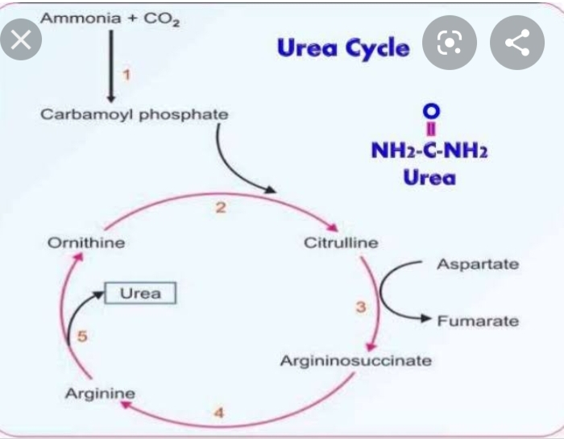
1.UREA CYCLE DISORDERS:
Primary role of urea cycle

Slide 38
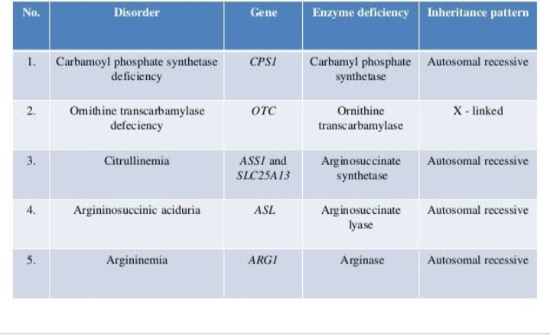
UCD(urea cycle disorders)
Due to defficiencies of enzymes

Slide 39
2.ENERGY PRODUCTION:
OXPHOS(Oxidative phosphorylation) Role
ATP synthesis in the presence of ATP synthase enzyme.
NAD+ and FAD+ are electron carrier.
ETF and ETF(QO) proteins are nuclear proteins

Slide 40
DISORDERS:

Slide 41
3.TRANSPORT SYSTEM:
Transfer of molecules across barriers like organelles membranes to cytoplasm and to other cell.
1.CYSTINE:
Derivative of cysteine, crystalline amino acid.
DISORDERS:
Abnormal flow of cystine in cells causes 2 disorders in our body.

Slide 42
CYSTEINURIA AND CYSTINOSIS:
CYSTEINURIA:
Due to too much cystine in the urea and form crystals and cause kidney stones.
It produces 3 phenotypes…..TYPE 1,has missense mutation and SLC3A1 gene mutation ……..TYPE 2,and TYPE 3, by SLCA9 gene mutation.
Cystinosis:
It is lysosome storage disease,accumulationof cystine in lysosome of most tissues.
Mutation in gene CTNS.

Slide 43
2.HEAVY METALS:

Slide 44
DISORDERS:
1.(MND) Menkes disease
X linked recessive disease
Due to mutation in gene ATP7A…encode trans membrane protein.
CAUSES:
Body absorb less iron, growth failure and causes anemia
Kinky hairs

Slide 46
2. (WND)Wilson disease
Autosomal recessive disease also called hepatolenticular degeneration.
CAUSES:
Destruction of liver and brain
Acute liver disease in childhood
Arthropathy
Cardiomyopathy
Mutation in gene ATP7B

Slide 48
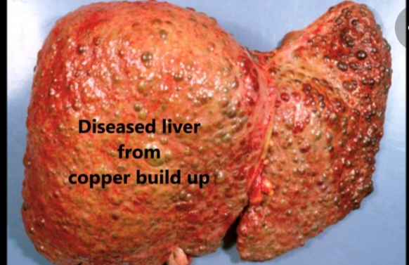
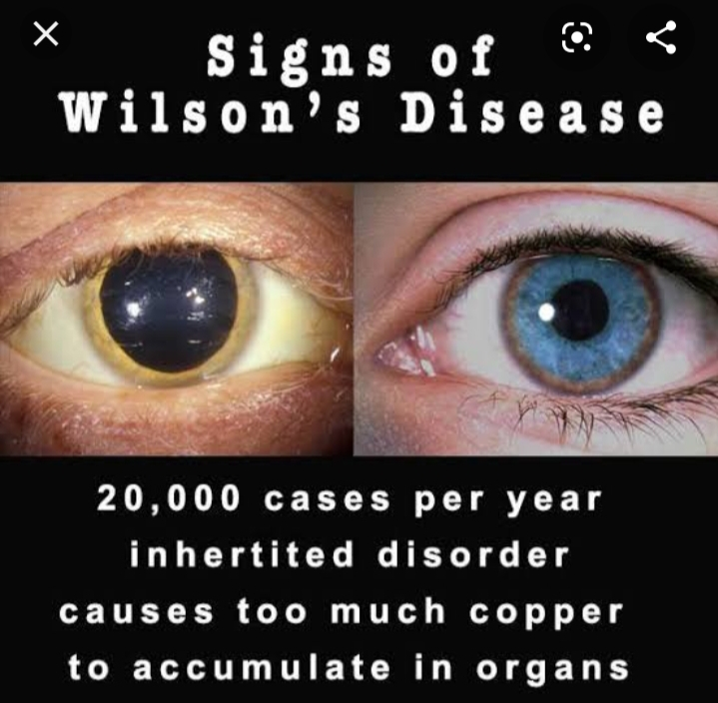

Slide 50
DISORDERS:
Acrodermatitis enteropathica(AE)
Caused by defect in absorption of zinc from intestinal tract.
Mutation in gene SLC39A4
SYMPTOMS:
Diarrhea
Dysfunction of immune system
Severe dermatitis(inflamation of skin)

