Slide 2
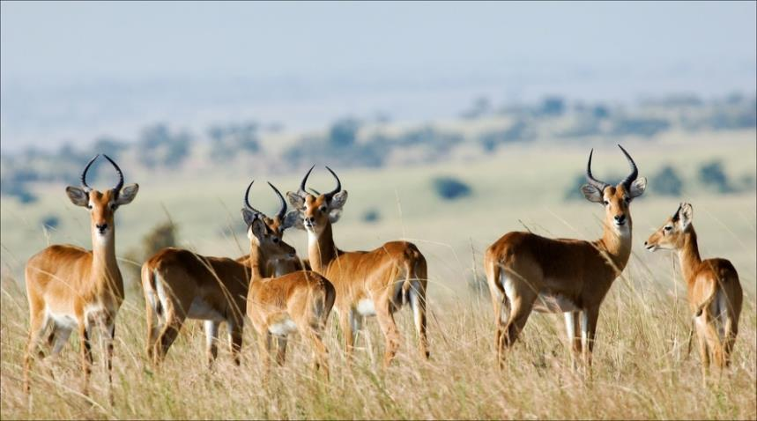
Wildlife Management
Is the science of managing wildlife, habitats and ecosystems to find the balance between the needs of wildlife and the needs of people

Slide 3
Wildlife Management
Was established as a profession in the United States in the 1930s
Aldo Leopold becomes the first professor of wildlife management at the University of Wisconsin in 1933
Aldo Leopold published a textbook titled “Game Management” in 1933
the first Cooperative Wildlife Research Centers were established in 1935
the Wildlife Society was founded in 1937
the Journal of Wildlife Management began publishing in 1937

Slide 4
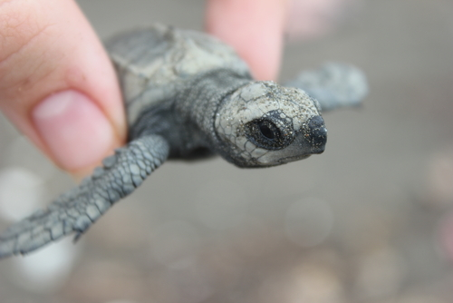
Wildlife Management
Helps sustain wildlife species
Lessens significant economic loss
Controls the spread of transmittable diseases
Minimizes or prevents severe habitat alteration
Protects endangered, threatened or native species
Provides recreation, such as hunting

Slide 5
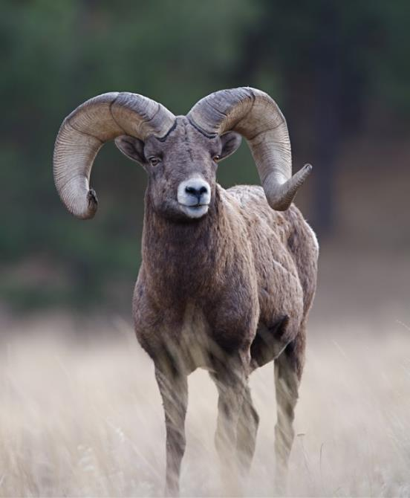
Wildlife Management
Includes the following:
conservation
preservation
management

Slide 6
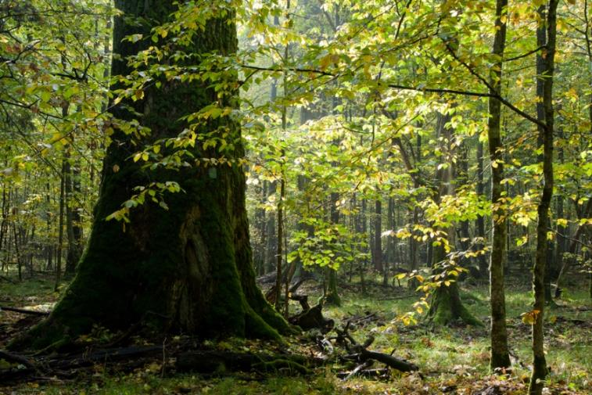
Conservation
Is maintaining and using natural resources sensibly in an effort to increase the likelihood those resources will be available for the future

Slide 7
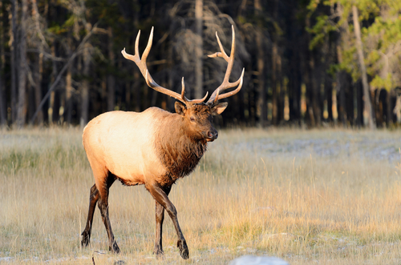
Wildlife Conservation
Is the planned use, protection and control of wildlife by applying ecological principles, such as:
carrying capacity
disturbance
succession
environmental conditions

Slide 8
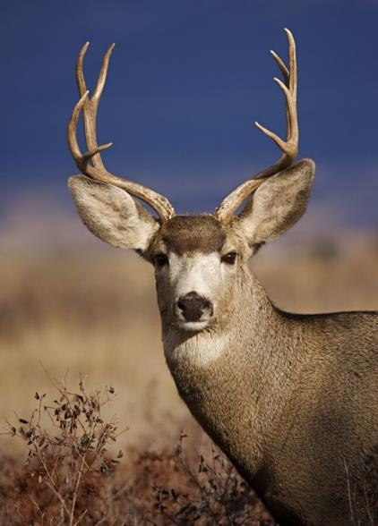
Carrying Capacity
Is the maximum population size of a species which the environment can handle
Considerations include:
food
habitat
water

Slide 9
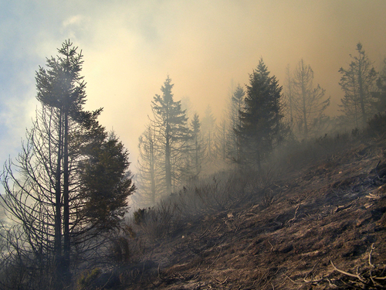
Disturbance
Is a change in environmental conditions which causes a distinct change in an ecosystem
Examples include:
fires
floods
windstorms
insect outbreaks
deforestation

Slide 10
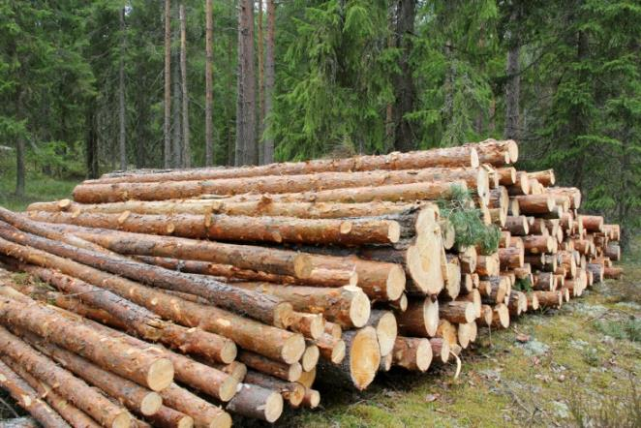
Succession
Is followed by disturbance
Is adapting to the gradual changes between types of communities or ecosystems
Can include the changes after the following:
lava flow
landslide
fire
logging

Slide 11
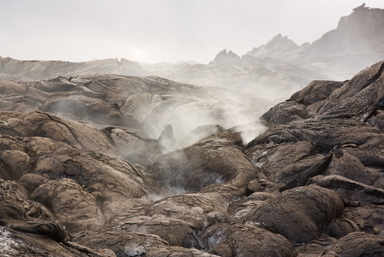
Environmental Conditions
Are the state of the environment
Include the following:
amount of pollution
amount of erosion
amount of plant life
population
climate
glaciation
meteorological conditions

Slide 12
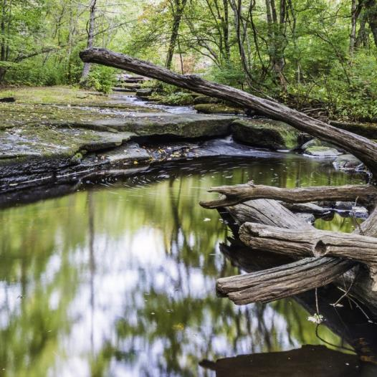
Preservation
Is a component of conservation
Is when natural resources are left alone without human disturbance or change
Goals include maintaining the integrity of the environment

Slide 13
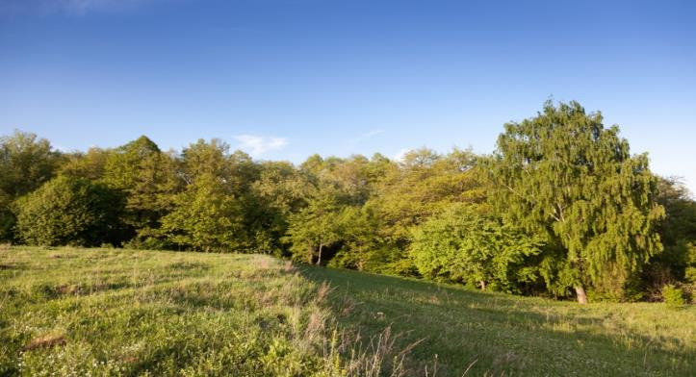
Management
Is also a component of conservation
Includes:
controlling
directing
manipulating wildlife habitats
manipulating wildlife populations

Slide 14
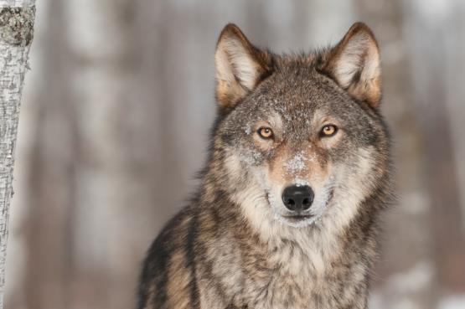
Controlling
Is the removal of nuisance animals
Is important for the following:
diversity
agricultural damage
deer-vehicle collisions
Can be done through:
trapping
hunting

Slide 15
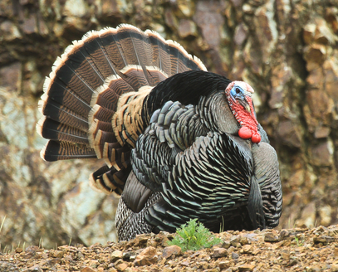
Hunting Seasons
Manage wildlife throughout the year by designating times of year when certain wildlife species can be legally hunted
allows for surplus animals to be removed
Manage wildlife through bag limits
the maximum number of fish or game animals allowable by law to be caught or killed by one person within a given period

Slide 16
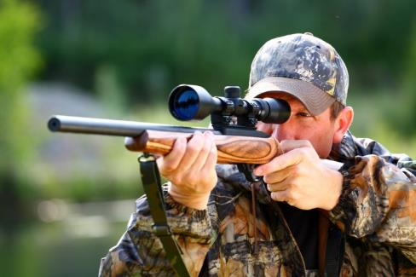
Hunting Seasons
Include:
open seasons
wildlife is allowed to be hunted
limited seasons
number of animals taken is controlled
closed seasons
wildlife is protected from being hunted

Slide 17
Directing
Involves moving or restricting the movement of species to improve their distribution among habitats

Slide 18
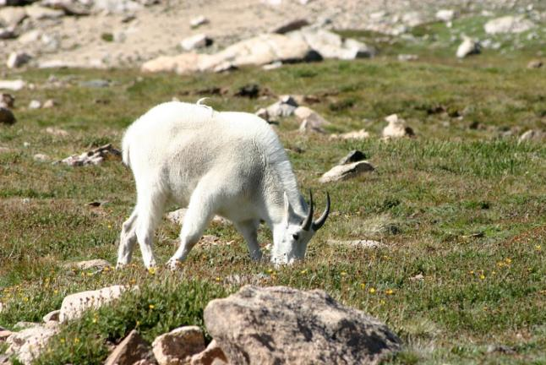
Manipulating Wildlife Habitats
Involves controlling the types, amount or arrangement of food, water and cover within an animals range
By making a habitat more suitable for a specific species or group of species

Slide 19
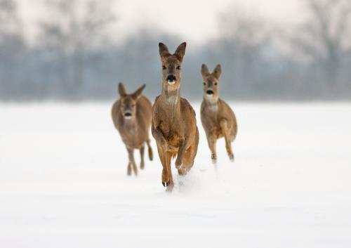
Manipulating Wildlife Populations
May be done by providing important habitat components
Is used to create a sustainable yield
May be done by harvesting animals
Sustainable yield – is the number of species which can be taken from a specie’s stock without hurting the population

Slide 20
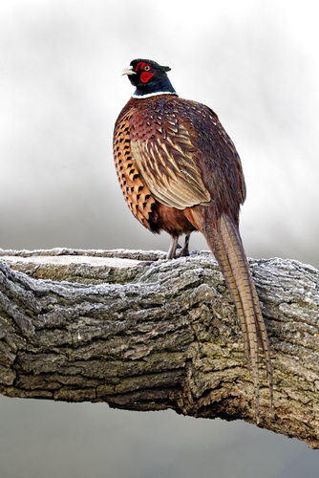
Benefits of Wildlife Habitats
Include:
aesthetic
recreational
economic
educational
ecological services

Slide 21
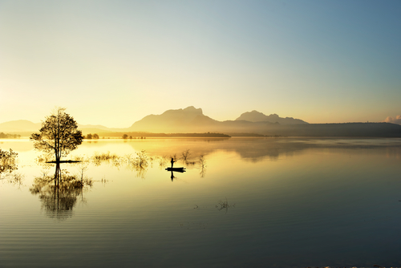
Aesthetics
Are the value people place on wildlife for its beauty and appeal
Include the following:
landscaping appreciation
privacy and opportunities for seclusion
structure to the land

Slide 22
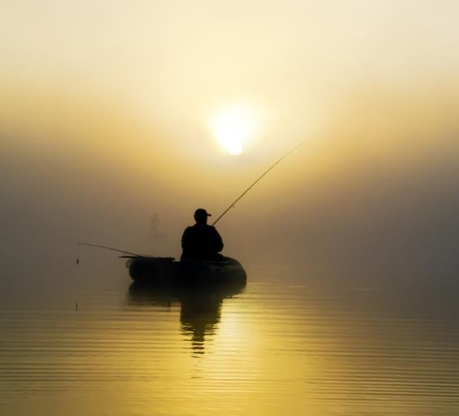
Recreation
Is the benefit of doing something for relaxation or enjoyment
Provides opportunities, such as:
wildlife photography
bird watching
fishing
hunting

Slide 23
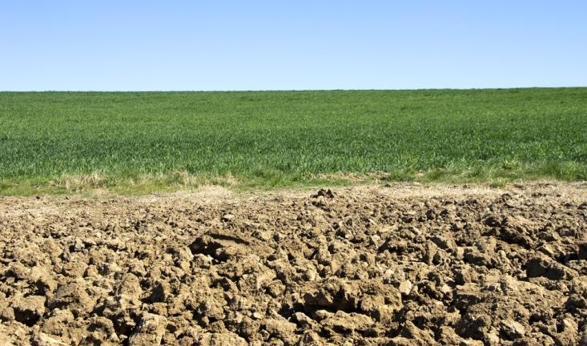
Economics
Is the process of producing, developing and managing wildlife habitats for a cost-effective approach to land management
Benefits include:
reducing wind and soil erosion
improving water quality
increasing soil moisture

Slide 24
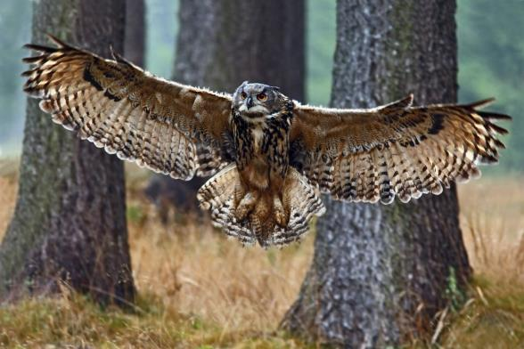
Education
Is the process of receiving or giving instruction on wildlife habitats
Benefits include:
learning to identify plants and animals
understanding how human and environmental needs can be balanced

Slide 25
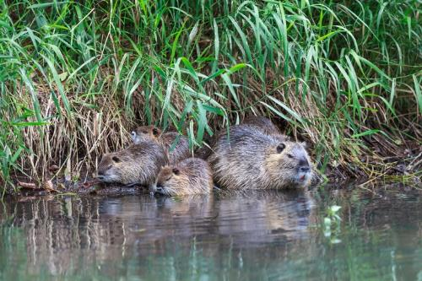
Ecological Services
Are any natural process arising from the management of healthy ecosystems
Include the following services provided by wildlife:
purification of water and air
for example:
beavers create dams which slow the movement of water, where it is cleaned by biological processes

Slide 26
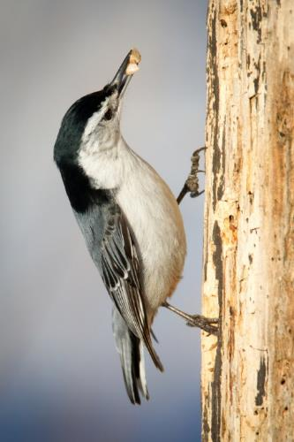
Ecological Services
Include the following services provided by wildlife:
pollination of plants
for example:
birds carry seeds and fruit which allows for plant reproduction
decomposition of waste
for example:
a deer may eat leaves and other tissues helping to reduce nitrogen for plants and trees to make new leaves, stems and wood

Slide 27
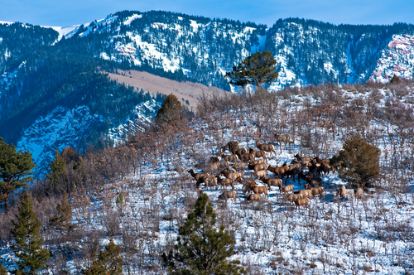
Wildlife Conservation Society
Was established in 1895
Has a mission to save wildlife and habitats throughout the world through the following:
science
conservation action
education
inspiring people to value nature

Slide 28
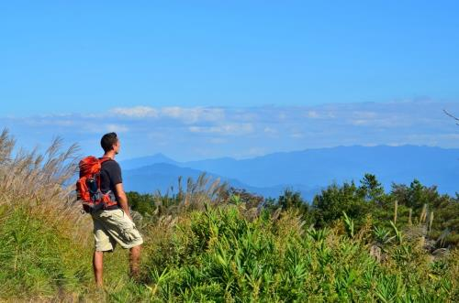
National Wildlife Federation
Was established in 1936
Has a mission to motivate Americans to protect wildlife for future generations
Includes the three main areas:
connecting people to nature
reversing global warming
protecting and restoring wildlife habitats

Slide 29
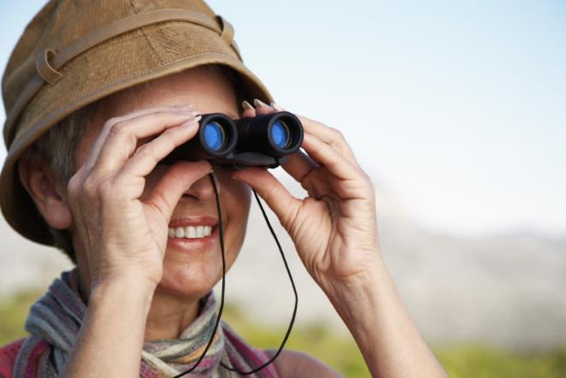
National Wildlife Federation
Unites the following people who share a concern for wildlife:
sportsmen
outdoor enthusiasts
bird-watchers
wildlife gardeners
nature lovers

Slide 30
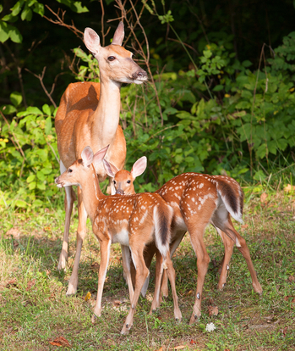
The Wildlife Society
Was established in 1937
Is an organization dedicated to excellence in wildlife management through science and education
Works to improve wildlife conservation by the following:
advancing the science of wildlife management
encouraging continued education

Slide 31
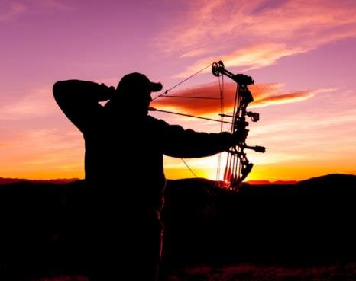
Enhancement Techniques
Include:
improving habitat
setting hunting regulations
hunting
controlling predators
manipulating populations through artificial stocking
controlling or preventing the spread of disease
managing funds and programs
monitoring wildlife populations

Slide 32
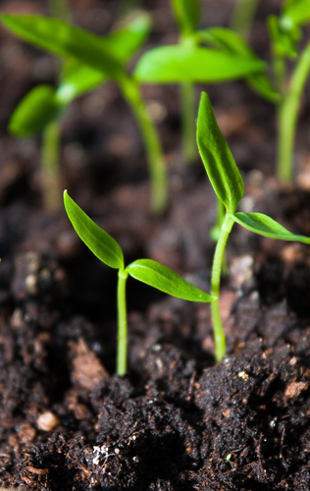
Habitat Improvement
Relies on succession
natural replacement of vegetation or wildlife populations following a disturbance
Enables wildlife managers to increase productivity of various species
for example:
cutting down or burning forested areas to encourage new growth

Slide 33
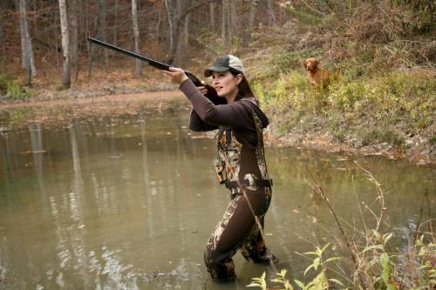
Hunting
Is the management of wildlife through designating times of the year when several wildlife species can be legally hunted
allows for surplus animals to be removed
Practices help wildlife managers keep animal populations stable within their habitat
Provides funding for wildlife management

Slide 34
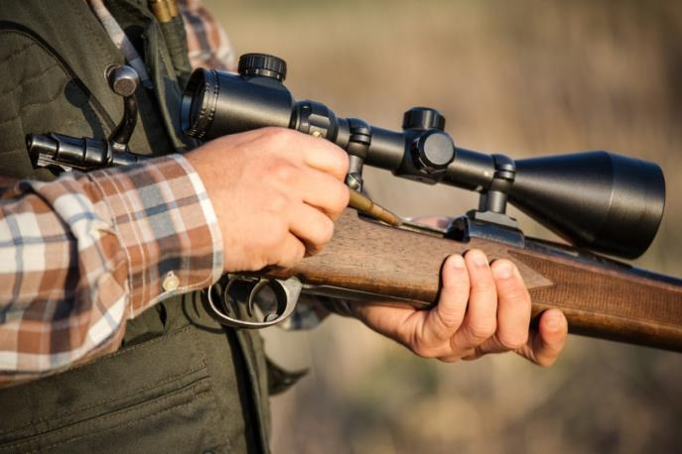
Hunting Regulations
Protect habitats and restore animal populations
Include setting daily and seasonal bag limits, time limits and legal means for the taking of wildlife

Slide 35
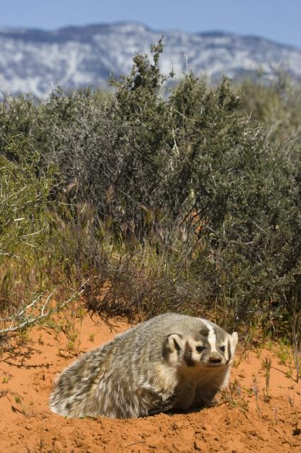
Predator Control
Enables wildlife populations to establish stable numbers, including threatened or endangered species
Includes:
predator hunting
trapping

Slide 36
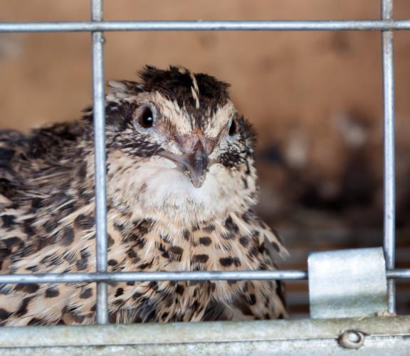
Artificial Stocking
Is trapping animals in areas were they are plentiful and releasing them in other areas of appropriate habitat
Has been successful in many parts of the world

Slide 37
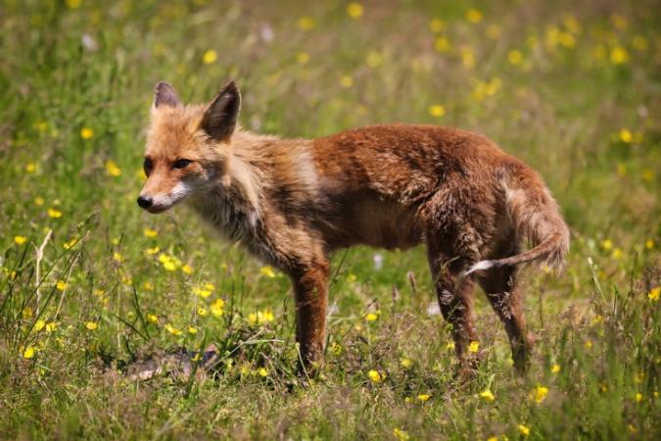
Controlling Diseases
Is important as it is one of the highest wildlife mortality factors
Can be done through the following:
monitoring
trapping
testing

Slide 38
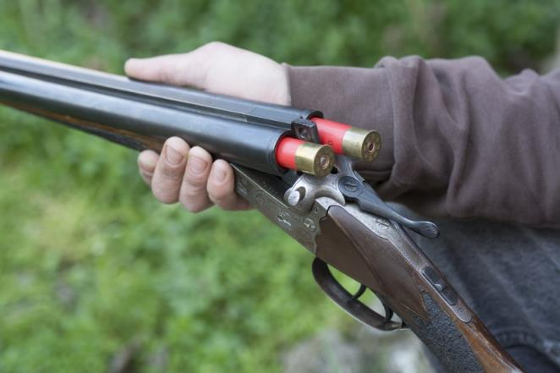
Management/Funding Programs
Help finance conservation efforts
Include providing funds through excise tax on the following:
firearms
ammunition
archery equipment

Slide 39
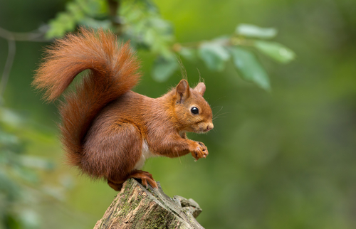
Monitoring Wildlife Populations
Provides the information needed to set hunting and fishing regulations
Determines if other wildlife management practices are needed to protect a number of wildlife species
Includes monitoring:
birth rates
death rates
condition of habitats
food sources

Slide 40
Monitoring
Includes observing the following:
air and climate
geology and soils
water
biological integrity
human use
landscapes

