Slide 1
The Special Senses

Slide 2
Eye and Associated Structures
70% of all sensory receptors are in the eye
Most of the eye is protected by a cushion of fat and the bony orbit
Accessory structures include eyebrows, eyelids, conjunctiva, lacrimal apparatus, and extrinsic eye muscles

Slide 3
Eyebrows
Functions include:
Shading the eye
Preventing perspiration from reaching the eye

Slide 4
Palpebrae (Eyelids)
Protect the eye anteriorly
Palpebral fissure – separates eyelids
Canthi – medial and lateral angles (commissures)

Slide 5
Palpebrae (Eyelids)
Lacrimal caruncle – contains glands that secrete a whitish, oily secretion (Sandman’s eye sand)
Tarsal plates of connective tissue support the eyelids internally
Eyelashes
Project from the free margin of each eyelid
Initiate reflex blinking

Slide 6
Palpebrae (Eyelids)
Lubricating glands associated with the eyelids
Meibomian glands (modified sebaceous glands)
Ciliary glands lie between the hair follicles (sweat and sebaceous glands)

Slide 7
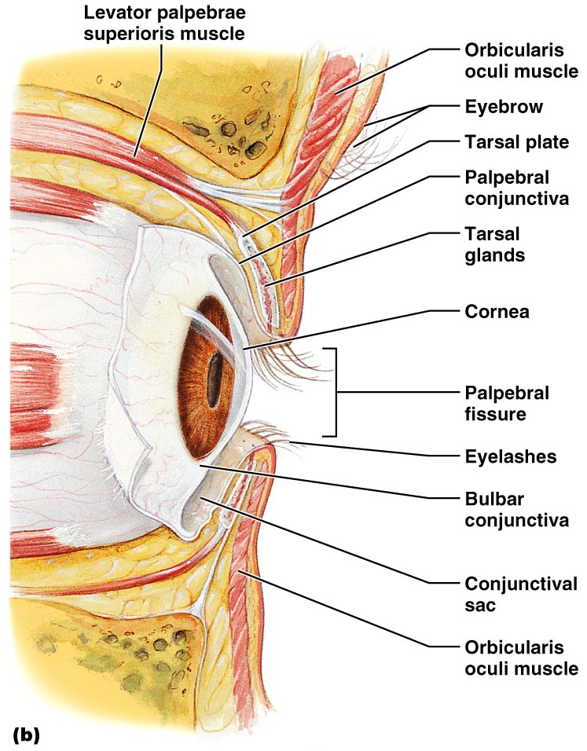
Palpebrae (Eyelids)
Figure 15.1b

Slide 8
Conjunctiva
Transparent mucous membrane that:
Lines the eyelids as the palpebral conjunctiva
Covers the whites of the eyes as the ocular or bulbar conjunctiva
Lubricates and protects the eye

Slide 9
Lacrimal Apparatus
Consists of the lacrimal gland and associated ducts
Lacrimal glands secrete tears
Located on the lateral portion of the eye

Slide 10
Lacrimal Apparatus
Tears
Contain mucus, antibodies, and lysozyme
Enter the eye via superolateral excretory ducts
Exit the eye medially via the lacrimal punctum
Drain into lacrimal canaliculus, lacrimal sac and then into the nasolacrimal duct

Slide 11
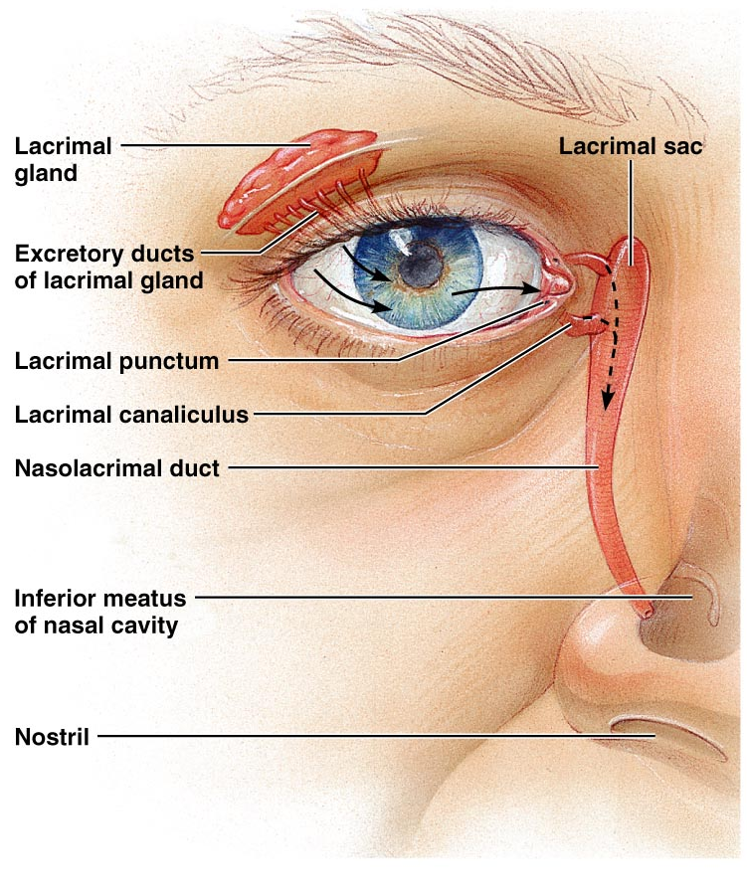
Lacrimal Apparatus
Figure 15.2

Slide 12
Extrinsic Eye Muscles
Six extrinsic eye muscles
Enable the eye to follow moving objects
Maintain the shape of the eyeball

Slide 13
Structure of the Eyeball
A slightly irregular hollow sphere with anterior and posterior poles
The wall is composed of three tunics – fibrous, vascular, and sensory
The internal cavity is filled with fluids called humors
The lens separates the internal cavity into anterior and posterior segments

Slide 14
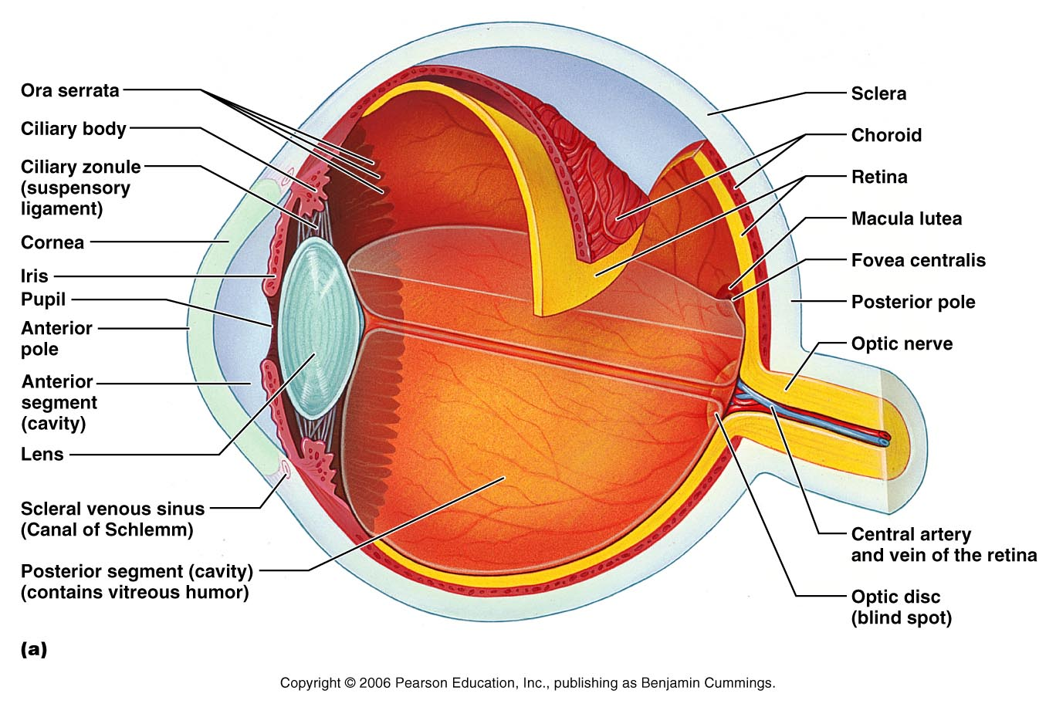
Structure of the Eyeball
Figure 15.4a

Slide 15
Fibrous Tunic
Forms the outermost coat of the eye and is composed of:
Opaque sclera (posteriorly)
Clear cornea (anteriorly)
The sclera protects the eye and anchors extrinsic muscles
The cornea lets light enter the eye

Slide 16
Vascular Tunic or Uvea
Has three regions: choroid, ciliary body, and iris
Choroid region
A dark brown membrane that forms the posterior portion of the uvea
Supplies blood to all eye tunics

Slide 17
Vascular Tunic or Uvea
Ciliary body
A thickened ring of tissue surrounding the lens
Composed of the ciliary muscles (smooth muscle)
anchor the suspensory ligament that holds the lens in place
Ciliary processes
Secrets the aqueous humor

Slide 18
Vascular Tunic: Iris
Pupil – central opening of the iris
Regulates the amount of light entering the eye during:
Close vision and bright light – pupils constrict
Distant vision and dim light – pupils dilate
Changes in emotional state – pupils dilate when the subject matter is appealing or requires problem-solving skills

Slide 19
Pupil Dilation and Constriction
Figure 15.5

Slide 20
Sensory Tunic: Retina
A delicate two-layered membrane
Pigmented layer – the outer layer that absorbs light and prevents its scattering
Neural layer, which contains:
Photoreceptors that transduce light energy
Bipolar cells and ganglion cells
Horizontal and amacrine cells

Slide 21
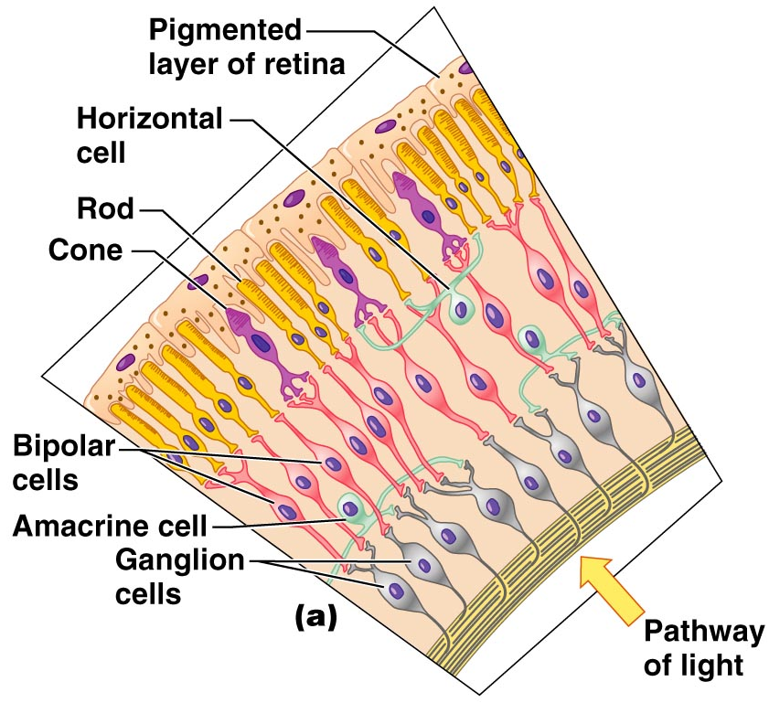
Sensory Tunic: Retina
Figure 15.6a

Slide 22
The Retina: Ganglion Cells and the Optic Disc
Ganglion cell axons:
Run along the inner surface of the retina
Leave the eye as the optic nerve
The optic disc:
Is the site where the optic nerve leaves the eye
Lacks photoreceptors (the blind spot)

Slide 23
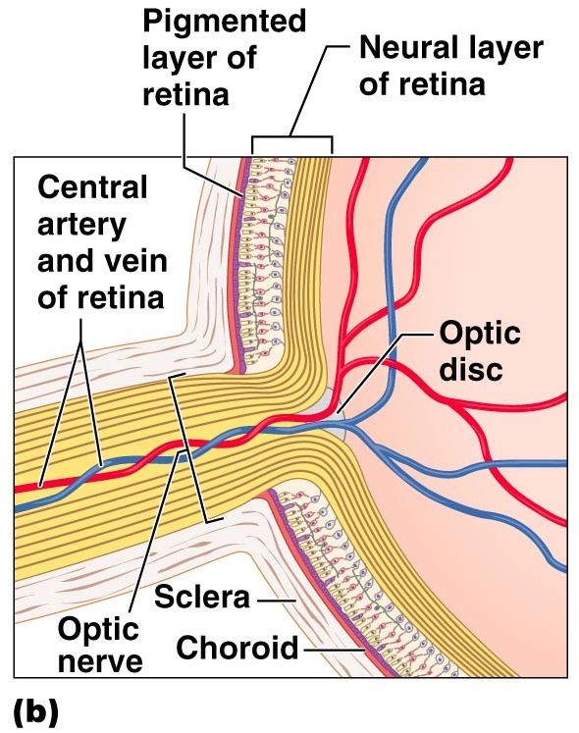
The Retina: Ganglion Cells and the Optic Disc
Figure 15.6b

Slide 24
The Retina: Photoreceptors
Rods:
Respond to dim light
Are used for peripheral vision
Cones:
Respond to bright light
Have high-acuity color vision
Macula lutea – mostly cones
Fovea centralis – only cones

Slide 25
Blood Supply to the Retina
The neural retina receives its blood supply from two sources
The outer third receives its blood from the choroid
The inner two-thirds is served by the central artery and vein
Small vessels radiate out from the optic disc and can be seen with an ophthalmoscope

Slide 26
The Special Senses
P A R T B

Slide 27
Inner Chambers and Fluids
The lens separates the internal eye into
Anterior segment
Anterior chamber
Posterior chamber
Posterior segment

Slide 28
Inner Chambers and Fluids
The posterior segment is filled with a clear gel called vitreous humor that:
Transmits light
Supports the posterior surface of the lens
Holds the neural retina firmly against the pigmented layer
Contributes to intraocular pressure

Slide 29
Anterior Segment
Anterior Chamber– between the cornea and the iris
Posterior Chamber – between the iris and the lens
Aqueous humor
A plasmalike fluid that fills the anterior segment
Drains via the canal of Schlemm
Supports, nourishes, and removes wastes

Slide 30
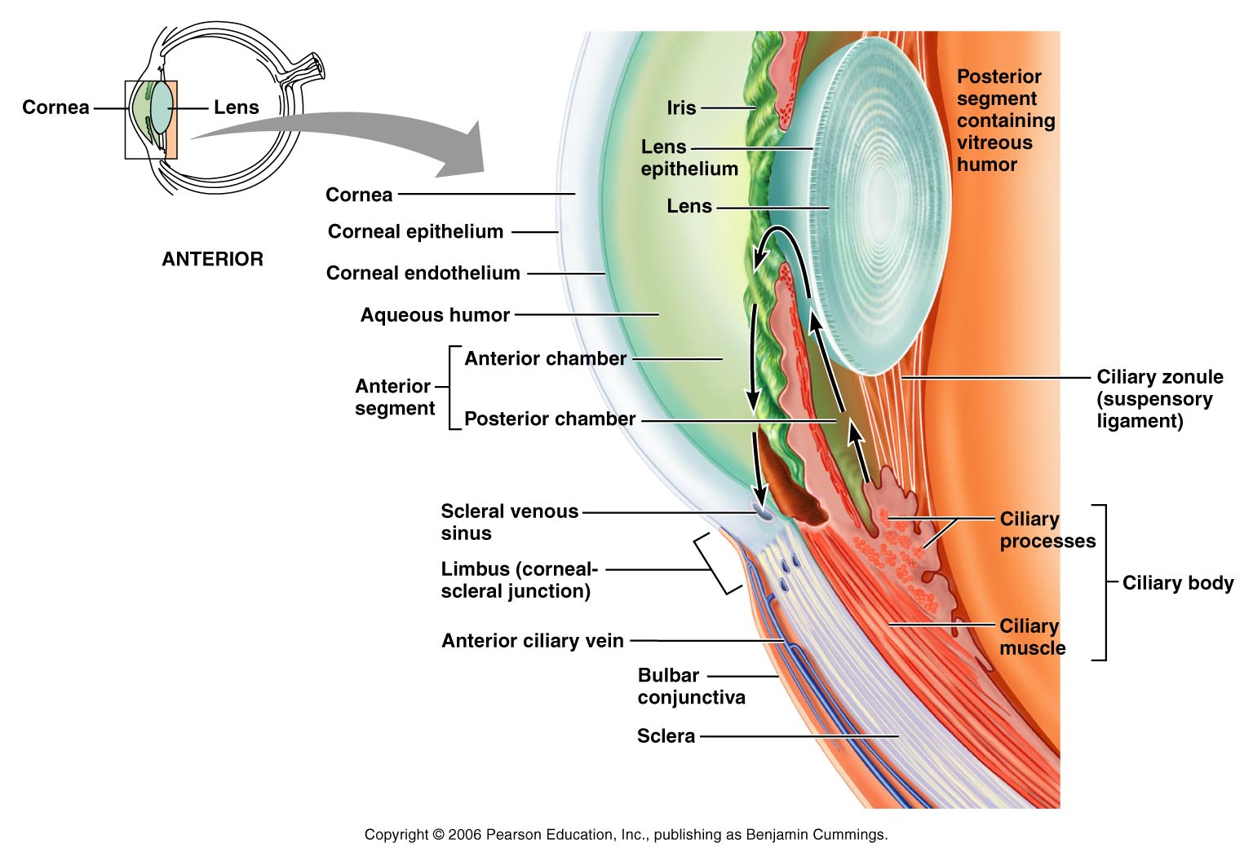
Anterior Segment
Figure 15.8

Slide 31
Lens
A biconvex, transparent, flexible, avascular structure that:
Allows precise focusing of light onto the retina
Is composed of epithelium and lens fibers

Slide 32
Lens
Lens epithelium – anterior cells that differentiate into lens fibers
Lens fibers – cells filled with the transparent protein crystallin
With age, the lens becomes more compact and dense and loses its elasticity

Slide 33
Light
Electromagnetic radiation – all energy waves from short gamma rays to long radio waves
Our eyes respond to a small portion of this spectrum called the visible spectrum
Different cones in the retina respond to different wavelengths of the visible spectrum

Slide 34
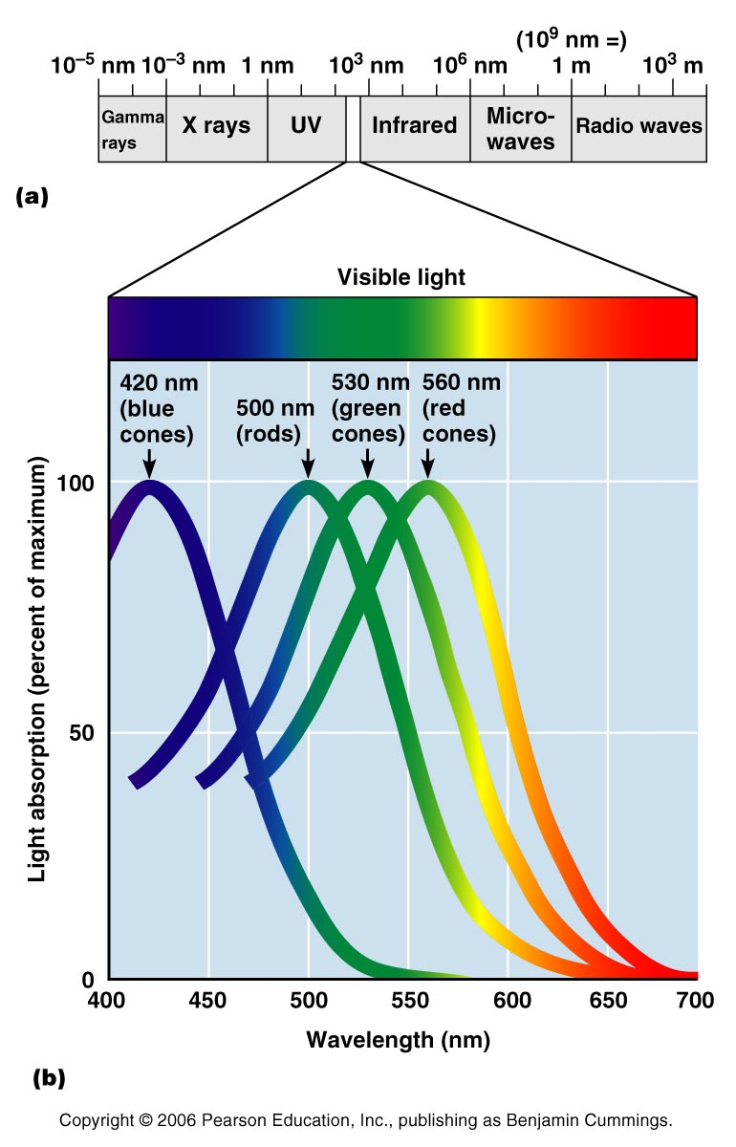
Light
Figure 15.10

Slide 35
Refraction and Lenses
When light passes from one transparent medium to another
Light passing through a convex lens (as in the eye) is bent so that the rays converge to a focal point
When a convex lens forms an image, the image is upside down and reversed right to left

Slide 36
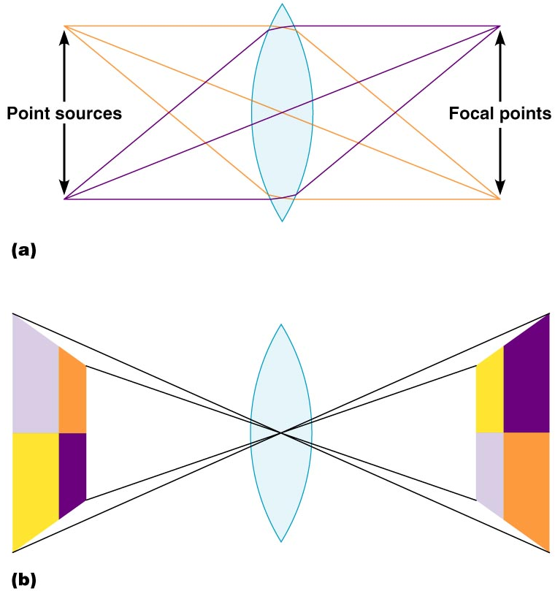
Refraction and Lenses
Figure 15.12a, b

Slide 37
Focusing Light on the Retina
Pathway of light entering the eye: cornea, aqueous humor, lens, vitreous humor, and the neural layer of the retina to the photoreceptors
Light is refracted:
At the cornea
Entering the lens
Leaving the lens
The lens curvature and shape allow for fine focusing of an image

Slide 38
Focusing for Distant Vision
Light from a distance needs little adjustment for proper focusing
Far point of vision – the distance beyond which the lens does not need to change shape to focus (20 ft.)
Figure 15.13a

Slide 39
Focusing for Distant Vision

Slide 40
Focusing for Close Vision
Close vision requires:
Accommodation – changing the lens shape by ciliary muscles to increase refractory power
Constriction – the pupillary reflex constricts the pupils to prevent divergent light rays from entering the eye
Convergence – medial rotation of the eyeballs toward the object being viewed

Slide 41
Focusing for Close Vision
Figure 15.13b

Slide 42
Problems of Refraction
Emmetropic eye – normal eye
Myopic eye (nearsighted) – the focal point is in front of the retina
Corrected with a concave lens
Hyperopic eye (farsighted) – the focal point is behind the retina
Corrected with a convex lens

Slide 43
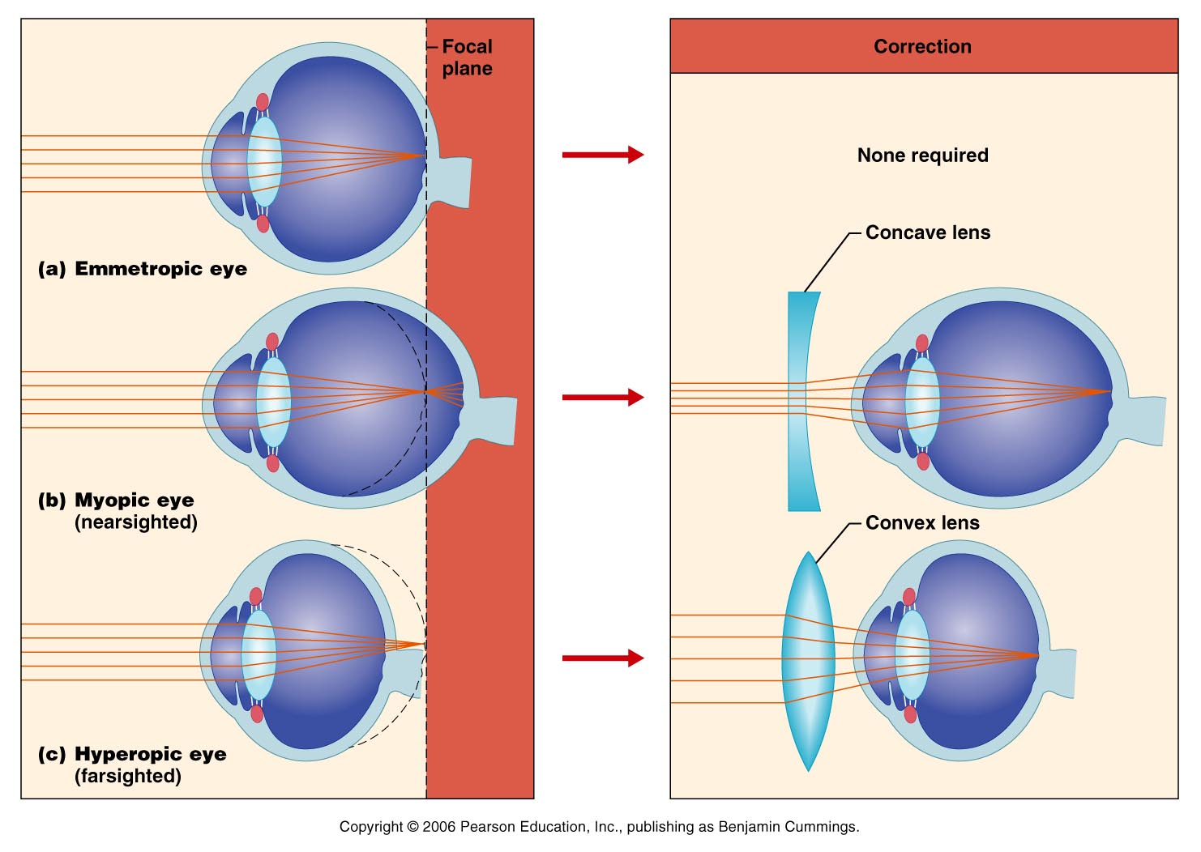
Problems of Refraction
Figure 15.14a, b

Slide 44
Photoreception
Photoreception – process by which the eye detects light energy
Rods and cones contain visual pigments (photopigments)
Arranged in a stack of disklike infoldings of the plasma membrane
Special epithelial cells - release neurotransmitters that stimulates neurons

Slide 45
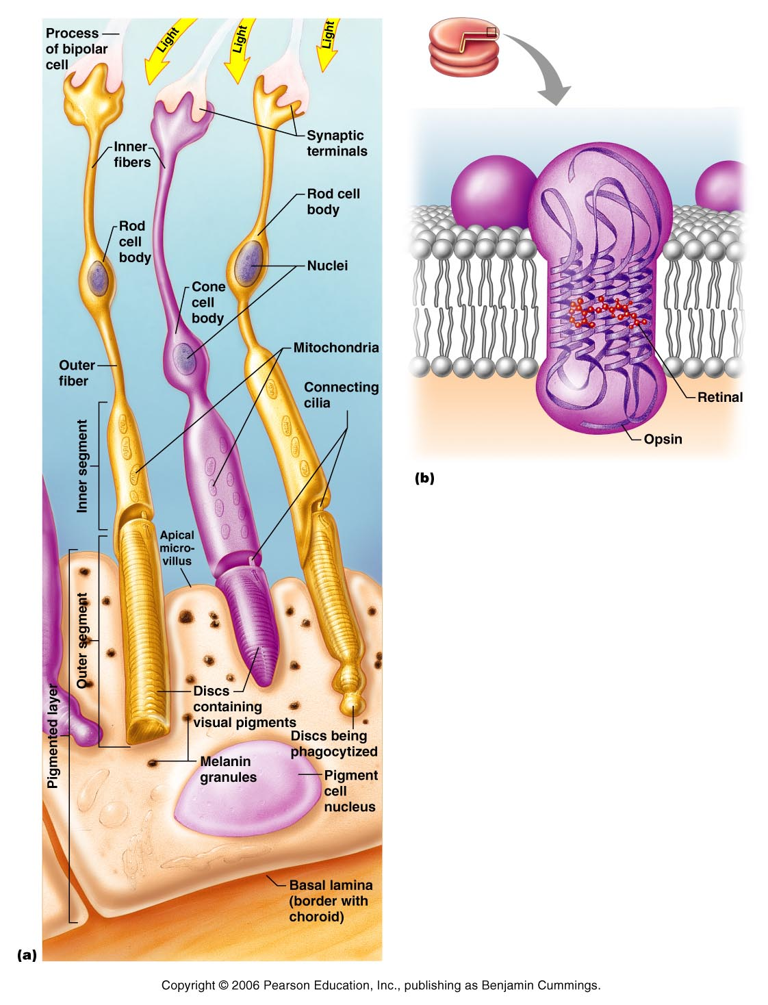
Figure 15.15a, b

Slide 46
Rods
Sensitive to dim light and best suited for night vision
Absorb all wavelengths of visible light
Perceived input is in gray tones only
Sum of visual input from many rods feeds into a single ganglion cell
Results in fuzzy and indistinct images
Notes:
Rods are derived from the same stem cells that produce ependymal cells of the brain.
Saladin page 621

Slide 47
Cones
Need bright light for activation (have low sensitivity)
Have pigments that furnish a vividly colored view
Each cone synapses with a single ganglion cell
Vision is detailed and has high resolution

Slide 48
Chemistry of Visual Pigments
Rhodopsin
Retinal is a light-absorbing molecule
Synthesized from vitamin A
Two isomers: 11-cis and 11-trans
Opsins – proteins
4 types that will absorb different wavelengths of light

Slide 49
Excitation of Rods
The visual pigment of rods is rhodopsin (opsin + 11-cis retinal)
Light phase
Rhodopsin breaks down into all-trans retinal + opsin (bleaching of the pigment)

Slide 50
Excitation of Rods
Dark phase
All-trans retinal converts to 11-cis form
11-cis retinal is also formed from vitamin A
11-cis retinal + opsin regenerate rhodopsin

Slide 51
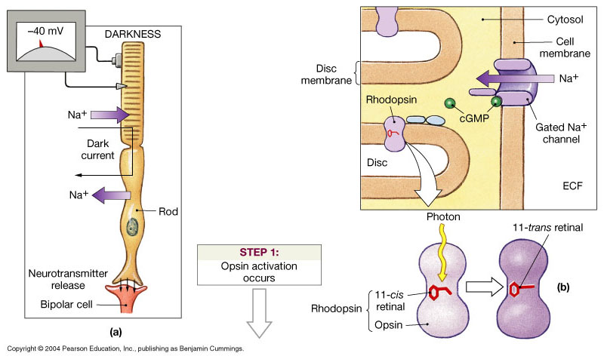
Photoreception

Slide 52
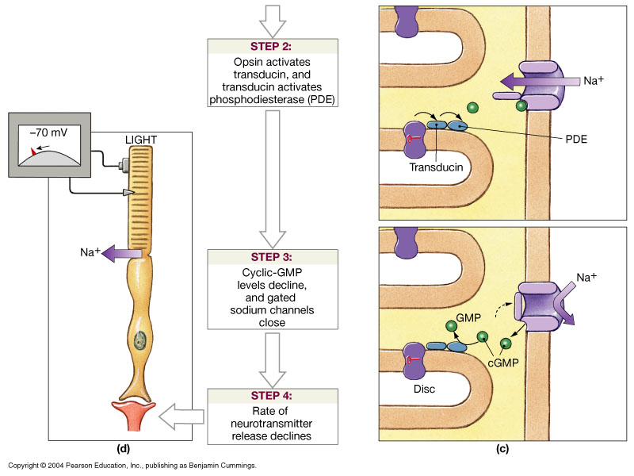
Photoreception

Slide 53
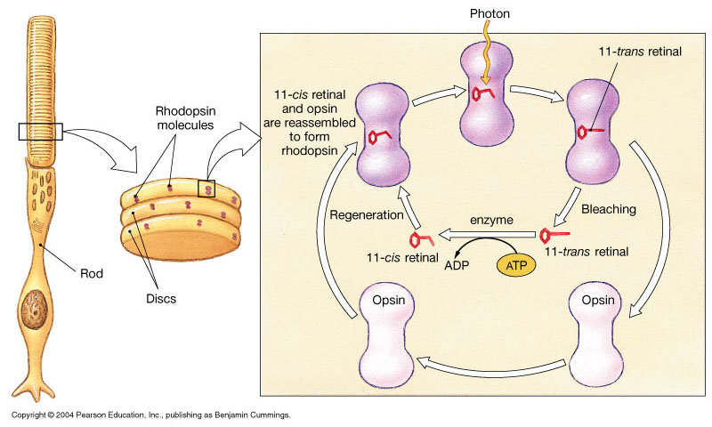
Bleaching and Regeneration of Visual Pigments

Slide 54
Phototransduction
Light energy splits rhodopsin into all-trans retinal, releasing activated opsin
The freed opsin activates the G protein transducin
Transducin catalyzes activation of phosphodiesterase (PDE)
PDE hydrolyzes cGMP to GMP and releases it from sodium channels
Without bound cGMP, sodium channels close, the membrane hyperpolarizes, and neurotransmitter cannot be released

Slide 55
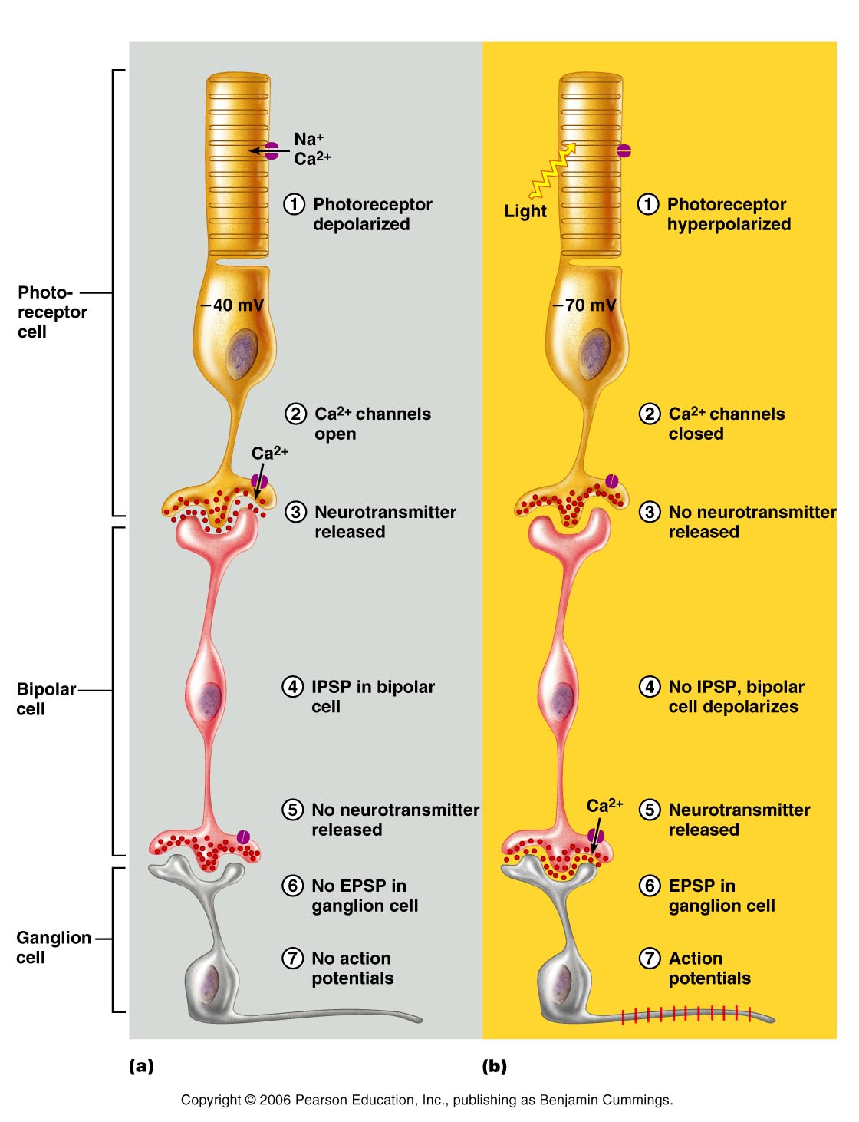
Signal Transmission in the Retina
Figure 15.17a
Notes:
There are 2 types of bipolar cells:
One is hyperpolarized by glutamate and depolarized when its secretion drops. This cell is excited by rising light intensity.
Another is excited by glutamate and inhibited when its secretion drops. This cell is excited by falling light intensity.
Saladin page 624

Slide 56
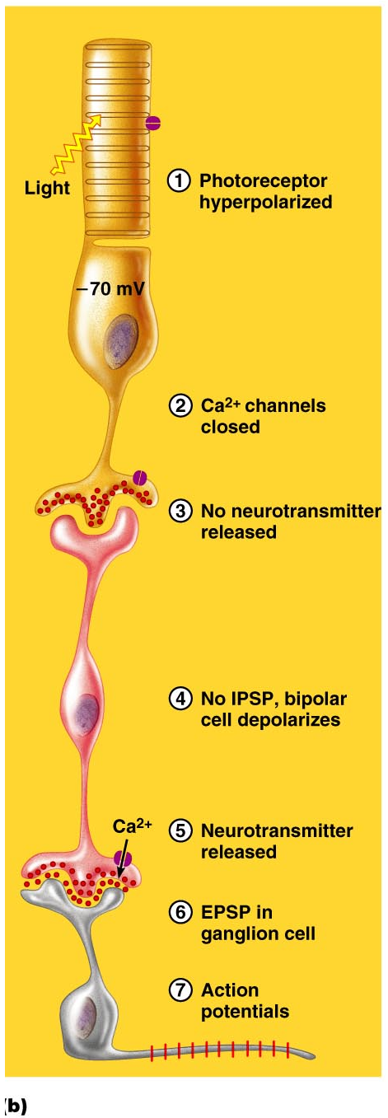
Signal Transmission
Figure 15.17b
Notes:
Ganglionic cells are the only retinal cells that produce an action potential. All others produce only local graded potentials.

Slide 57
Excitation of Cones
Visual pigments in cones are similar to rods (retinal + opsins)
There are three types of cones: blue, green, and red
Intermediate colors are perceived by activation of more than one type of cone
Method of excitation is similar to rods

Slide 58
Light Adaptation
Going from dark to light:
Fast bleaching of rods and cones
Glare
Rods are turned off
Retinal sensitivity is lost
Cones are turned on
Visual acuity is gained

Slide 59
Dark Adaptation
Going from light to dark:
Cones stop functioning and rods pigments have been bleached out by bright light
“We see blackness”
Rods are turned on
Rhodopsin accumulates in the dark and retinal sensitivity is restored

Slide 60
Visual Pathways
Axons of retinal ganglion cells form the optic nerve
Medial fibers of the optic nerve decussate at the optic chiasm
Most fibers of the optic tracts continue to the thalamus
Fibers from the thalamus form the optic radiation
Optic radiations travel to the visual cortex

Slide 61
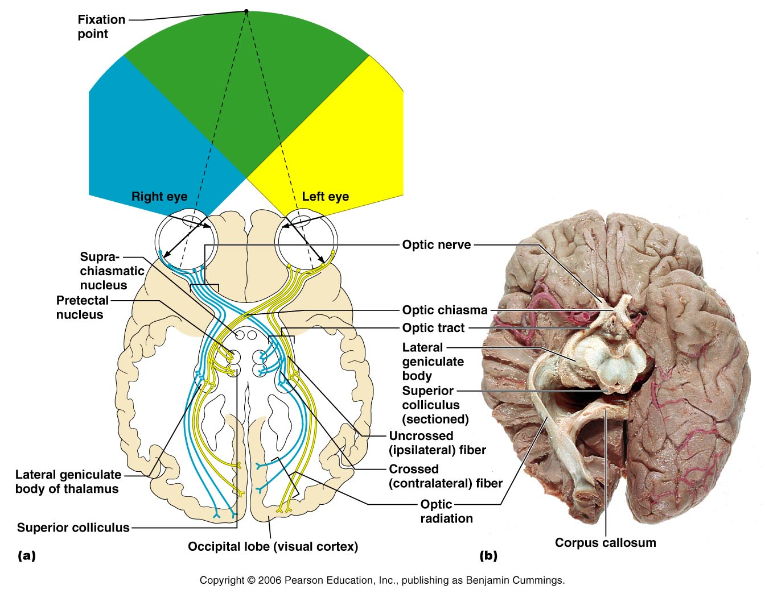
Visual Pathways
Figure 15.19

Slide 62
Visual Pathways
Some nerve fibers send tracts to the midbrain ending in the superior colliculi
A small subset of visual fibers contain melanopsin (circadian pigment) which:
Mediates pupillary light reflexes
Sets daily biorhythms

Slide 63
Depth Perception
Achieved by both eyes viewing the same image from slightly different angles
Three-dimensional vision results from cortical fusion of the slightly different images
If only one eye is used, depth perception is lost and the observer must rely on learned clues to determine depth

Slide 64
Thalamic Processing
The thalamus:
Relay information on movement
Segregate the retinal axons in preparation for depth perception
Emphasize visual inputs from regions of high cone density
Sharpen the contrast information received by the retina

Slide 65
Cortical Processing
Primary visual cortex (striate)
Basic dark/bright and contrast information
Visual association area (Prestriate)
Form, color, and movement
Visual information then proceeds anteriorly to the:
Temporal lobe – processes identification of objects
Parietal cortex and postcentral gyrus – processes spatial location

Slide 66
Chemical Senses
Chemical senses – gustation (taste) and olfaction (smell)
Their chemoreceptors respond to chemicals in aqueous solution
Taste – to substances dissolved in saliva
Smell – to substances dissolved in fluids of the nasal membranes

Slide 67
Sense of Smell
Olfactory epithelium
Superior nasal concha
Olfactory receptors
Bipolar neurons
Olfactory cilia
Supporting cells
Basal cells
Olfactory glands

Slide 68
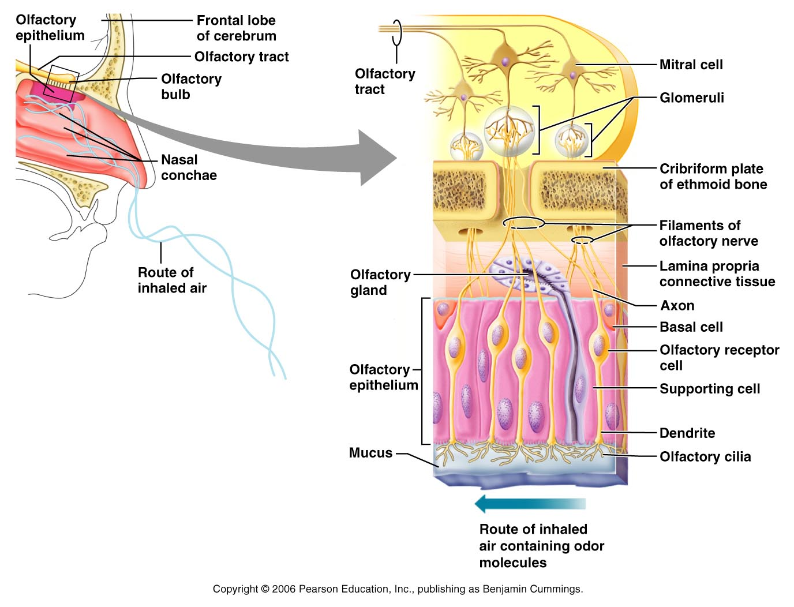
Olfactory Receptors

Slide 69
Physiology of Smell
Odorants dissolved in secretion bind to the receptor
G protein is activated
Adenylate cyclase is activated
cAMP is synthesized from ATP
Na and Ca channels open
Depolarization
Action potential

Slide 70
Olfactory Pathway
Olfactory receptor
Olfactory nerves
Synapse with mitral cells
Cells that process odor signals
Olfactory tract
The olfactory cortex
The hypothalamus, amygdala, and limbic system
No synapse on the thalamus

Slide 71
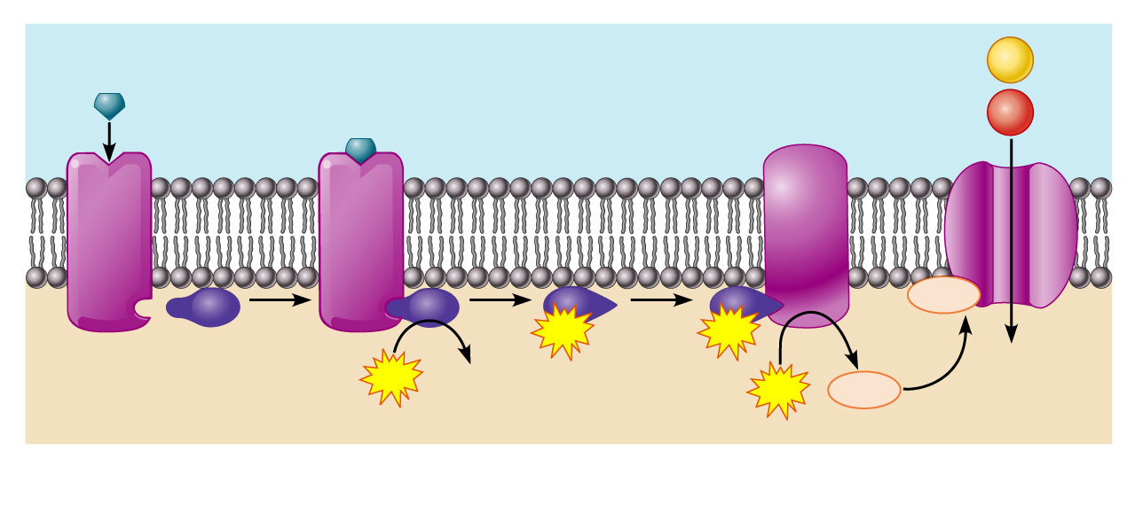
Olfactory Transduction Process
Extracellular fluid
Na⁺
Odorant
Adenylate cyclase
Ca²⁺
1
cAMP
2
GTP
3
GTP
4
Receptor
G_{olf}
GTP
GDP
cAMP
5
ATP
Cytoplasm

Slide 72
Taste Buds
Most of the 10,000 or so taste buds are found on the tongue
Taste buds are found in papillae of the tongue mucosa
Papillae come in three types: filiform, fungiform, and circumvallate
Fungiform and circumvallate papillae contain taste buds

Slide 73
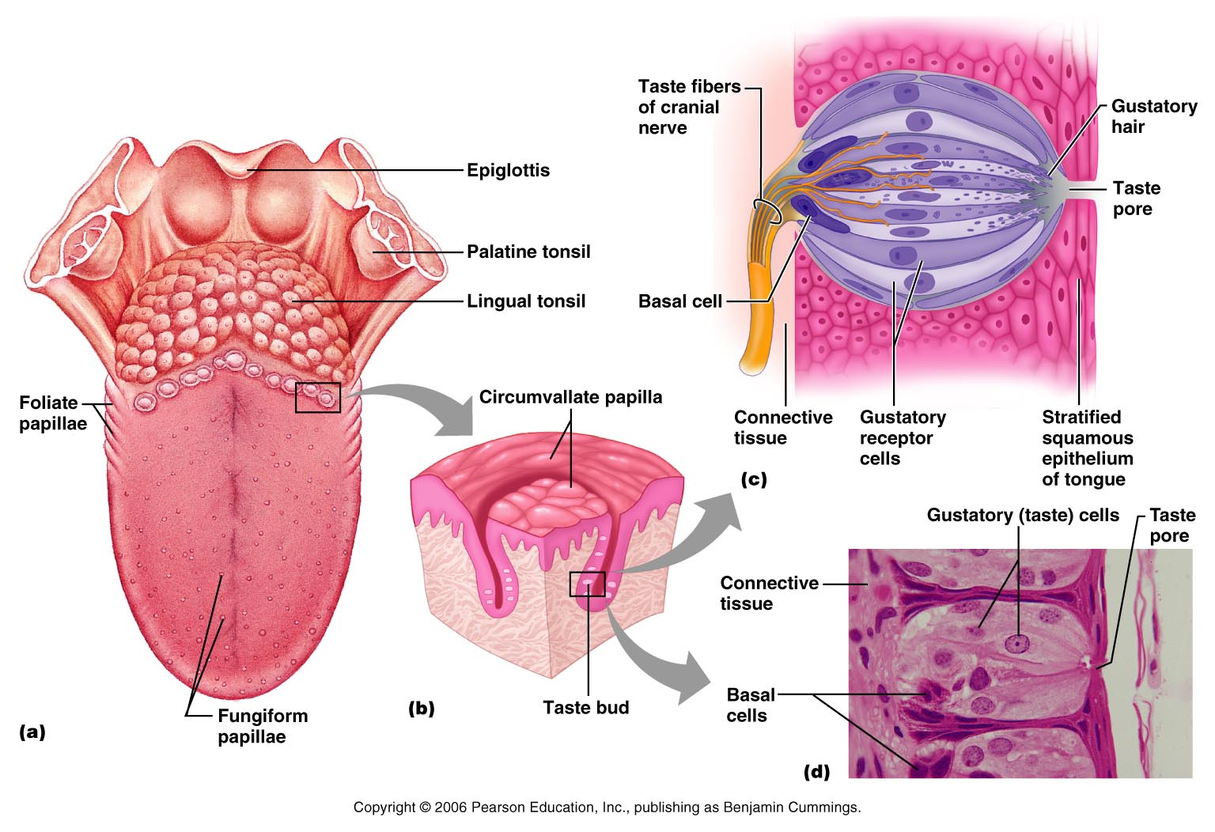
Taste Buds

Slide 74
Structure of a Taste Bud
Taste bud consists of three major cell types
Supporting cells – insulate the receptor
Basal cells – dynamic stem cells
Gustatory cells (taste cells) – special epithelial cells
Gustatory hair
Taste pores

Slide 75
Taste Sensations
There are five basic taste sensations
Sweet – sugars, saccharin, alcohol, and some amino acids
Salt – metal ions
Sour – hydrogen ions
Bitter – alkaloids such as quinine and nicotine
Umami – elicited by the amino acid glutamate

Slide 76
Physiology of Taste
In order to be tasted, a tastant:
Must be dissolved in saliva
Must contact gustatory hairs
Binding of the food chemical:
Depolarizes the taste cell membrane, releasing neurotransmitter
Initiates a generator potential that elicits an action potential

Slide 77
Taste Transduction
The stimulus energy of taste is converted into a nerve impulse by:
Na⁺ influx in salty tastes
H⁺ in sour tastes
The G protein (gustducin) in sweet and bitter tastes

Slide 78
Gustatory Pathway
Facial nerve
Anterior 2/3 of the tongue
Glossopharyngeal
Posterior 1/3 of the tongue
Vagus
Pharynx
To the solitary nucleus of the medulla

Slide 79
Gustatory Pathway
These impulses then travel to the thalamus, and from there fibers branch to the:
Gustatory cortex (taste)
Hypothalamus and limbic system (appreciation of taste)
Trigeminal nerve provide other information about the food

Slide 80
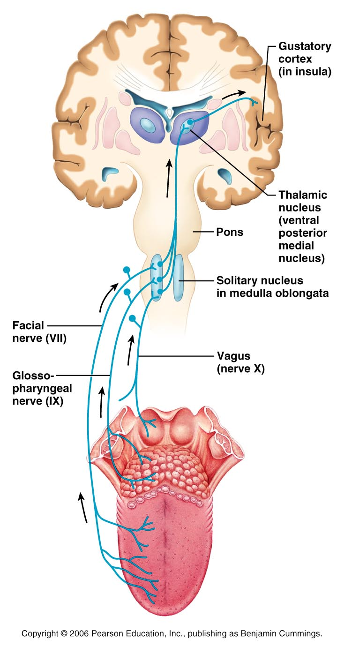

Slide 81
Influence of Other Sensations on Taste
Taste is 80% smell
Thermoreceptors, mechanoreceptors, nociceptors also influence tastes
Temperature and texture enhance or detract from taste

Slide 82
The Special Senses
P A R T C

Slide 83
The Ear: Hearing and Balance
The three parts of the ear are the inner, outer, and middle ear
The outer and middle ear are involved with hearing
The inner ear functions in both hearing and equilibrium
Receptors for hearing and balance:
Respond to separate stimuli
Are activated independently

Slide 84
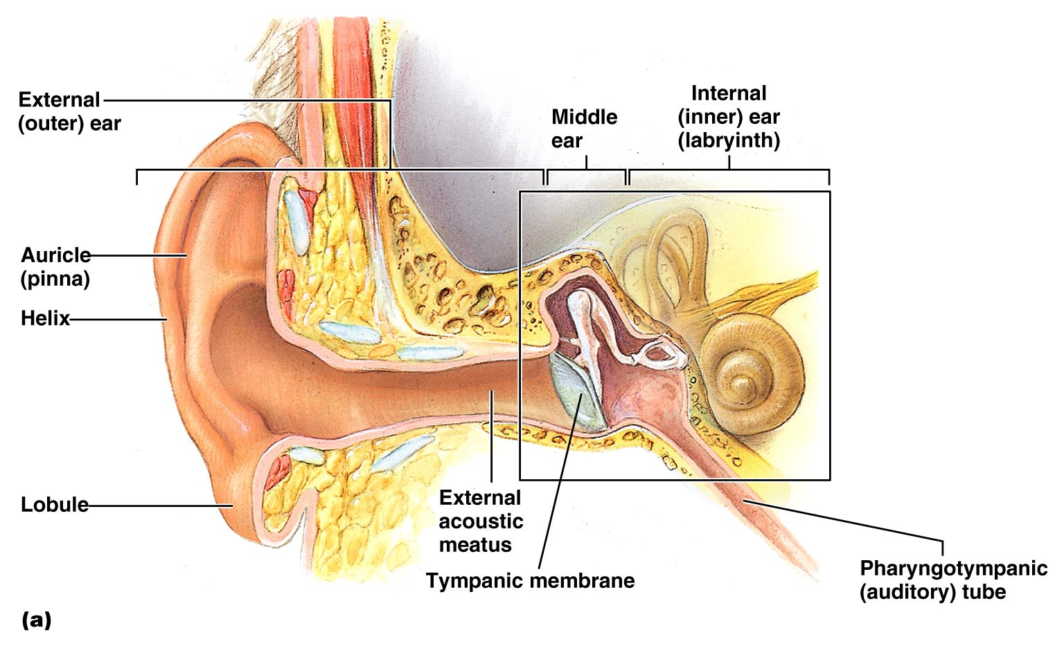
The Ear: Hearing and Balance

Slide 85
Outer Ear
The auricle (pinna) is composed of:
The helix (rim)
The lobule (earlobe)
External auditory canal
Short, curved tube filled with ceruminous glands

Slide 86
Outer Ear
Tympanic membrane (eardrum)
Thin connective tissue membrane that vibrates in response to sound
Transfers sound energy to the middle ear ossicles
Boundary between outer and middle ears

Slide 87
Middle Ear (Tympanic Cavity)
A small, air-filled, mucosa-lined cavity
Flanked laterally by the eardrum
Flanked medially by the oval and round windows
Middle ear communicates with mastoid cells

Slide 88
Middle Ear (Tympanic Cavity)
Pharyngotympanic tube – connects the middle ear to the nasopharynx
Equalizes pressure in the middle ear cavity with the external air pressure

Slide 89
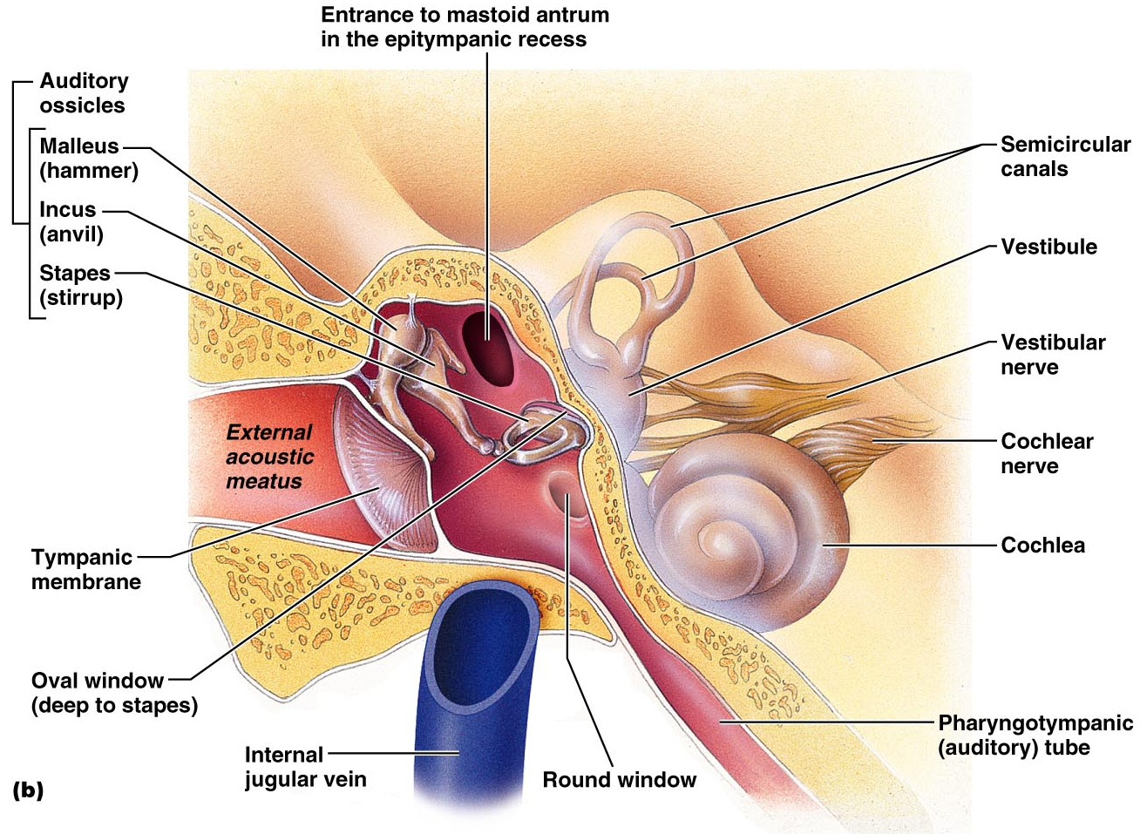
Middle and Internal Ear

Slide 90
Ear Ossicles
The tympanic cavity contains three small bones: the malleus, incus, and stapes
Transmit vibratory motion of the eardrum to the oval window
Dampened by the tensor tympani and stapedius muscles

Slide 91
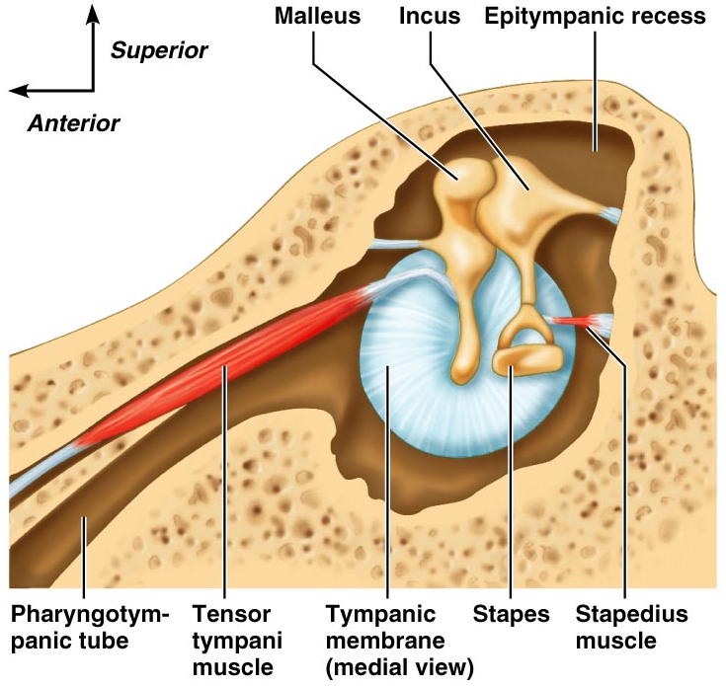
Ear Ossicles

Slide 92
Inner Ear
Bony labyrinth
Tortuous channels worming their way through the temporal bone
Contains the vestibule, the cochlea, and the semicircular canals
Filled with perilymph
Membranous labyrinth
Series of membranous sacs within the bony labyrinth
Filled with endolymph

Slide 93
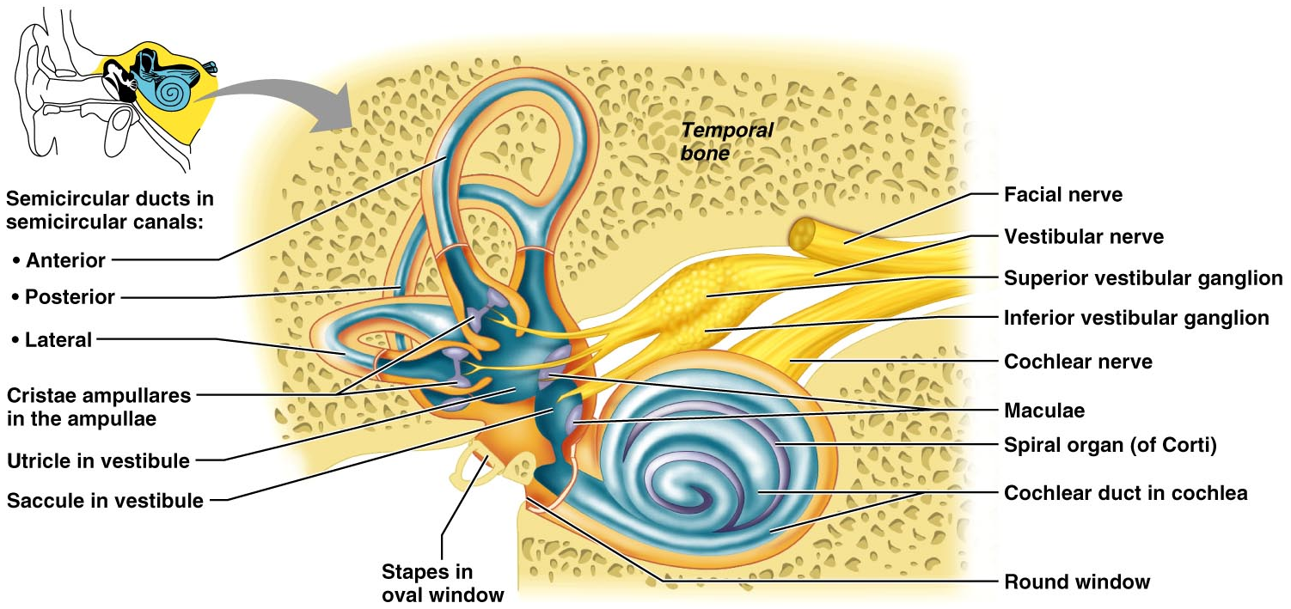
Inner Ear

Slide 94
Mechanisms of Equilibrium and Orientation
Vestibular apparatus – equilibrium receptors in the semicircular canals and vestibule. Also special type of epithelial cells
Maintains our orientation and balance in space
Vestibular receptors monitor static equilibrium
Semicircular canal receptors monitor dynamic equilibrium

Slide 95
The Vestibule
The central egg-shaped cavity of the bony labyrinth
Suspended in its perilymph are two sacs: the saccule and utricle
The saccule extends into the cochlea

Slide 96
The Vestibule
The utricle extends into the semicircular canals
These sacs:
House equilibrium receptors called maculae
Respond to static equilibrium
Respond to linear dynamic equilibrium (acceleration)

Slide 97
The Vestibule

Slide 98
Anatomy of Maculae
Contain supporting cells and hair cells
Each hair cell has stereocilia and kinocilium embedded in the otolithic membrane

Slide 99
Anatomy of Maculae
Otolithic membrane – jellylike mass studded with tiny stones called otoliths
Utricular hairs respond to horizontal movement
Saccular hairs respond to vertical movement

Slide 100
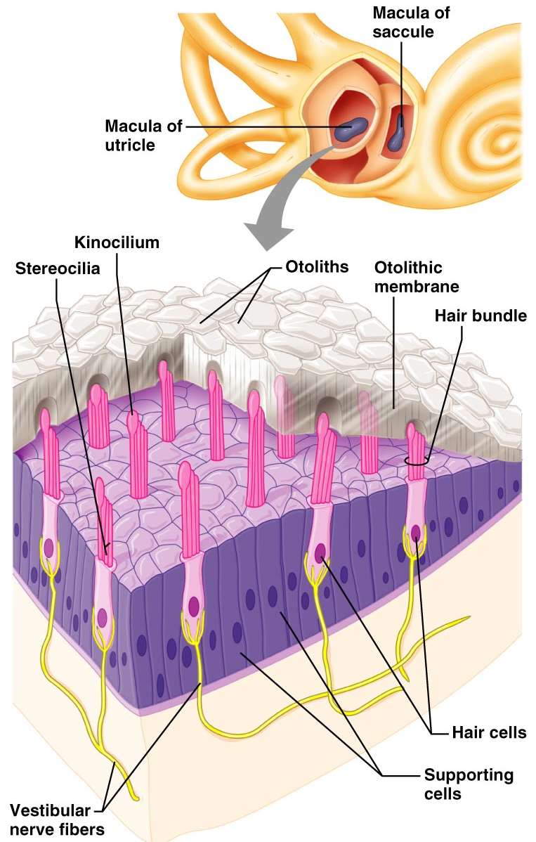
Anatomy of Maculae

Slide 101
Effect of Gravity on Utricular Receptor Cells
Otolithic movement in the direction of the kinocilia:
Depolarizes vestibular nerve fibers
Increases the number of action potentials generated

Slide 102
Effect of Gravity on Utricular Receptor Cells
Movement in the opposite direction:
Hyperpolarizes vestibular nerve fibers
Reduces the rate of impulse propagation
From this information, the brain is informed of the changing position of the head

Slide 103
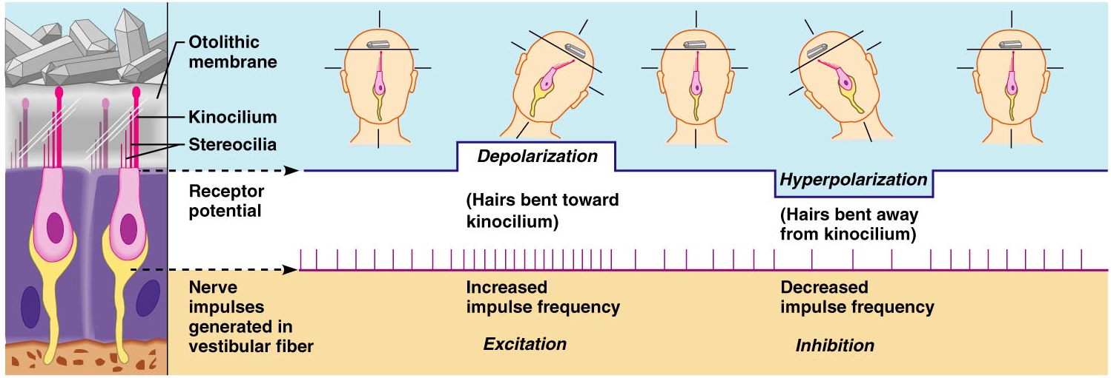
Effect of Gravity on Utricular Receptor Cells

Slide 104
The Semicircular Canals
Three canals that lie in the three planes of space
Membranous semicircular ducts line each canal and communicate with the utricle
The ampulla is the swollen end of each canal and it houses equilibrium receptors in a region called the crista ampullaris
These receptors respond to dynamic angular equilibrium

Slide 105
The Semicircular Canals

Slide 106
Crista Ampullaris and Dynamic Equilibrium
Each crista has support cells and hair cells that extend into a gel-like mass called the cupula
Dendrites of vestibular nerve fibers encircle the base of the hair cells

Slide 107
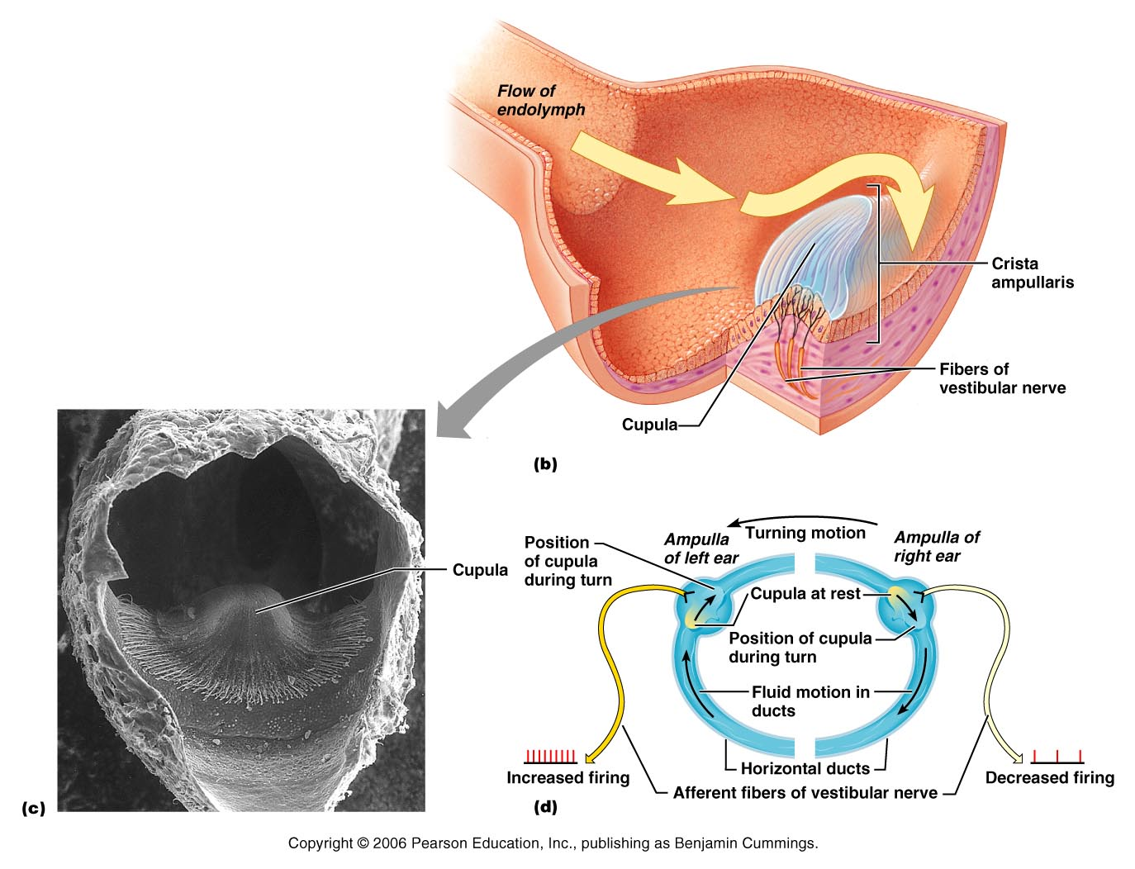
Crista Ampullaris and Dynamic Equilibrium

Slide 108
Activating Crista Ampullaris Receptors
Cristae respond to changes in velocity of rotatory movements of the head
Directional bending of hair cells in the cristae causes:
Depolarizations, and rapid impulses reach the brain at a faster rate
Hyperpolarizations, and fewer impulses reach the brain
The result is that the brain is informed of rotational movements of the head

Slide 109
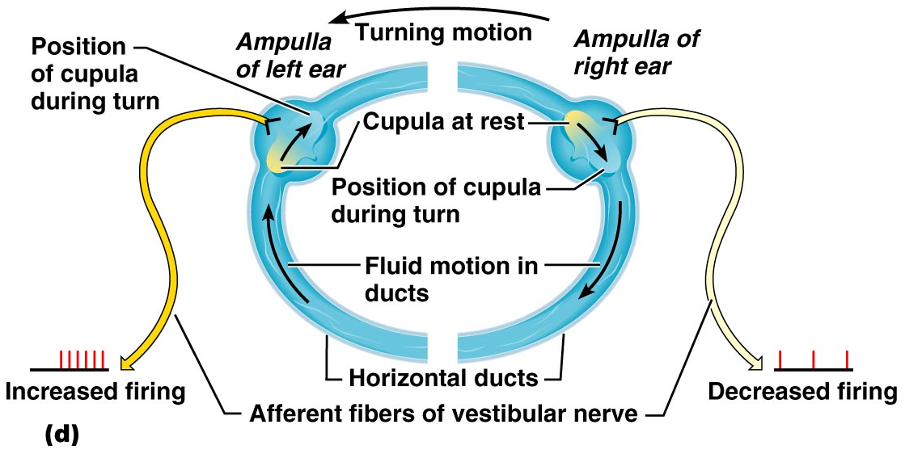
Rotary Head Movement

Slide 110
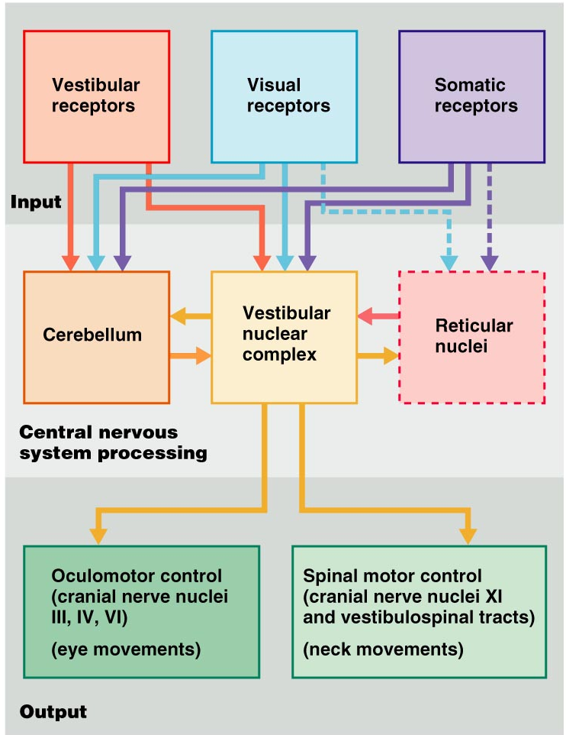
Balance and Orientation Pathways
There are three modes of input for balance and orientation
Vestibular receptors
Visual receptors
Somatic receptors
These receptors allow our body to respond reflexively
Figure 15.38

Slide 111
The Cochlea
A spiral, conical, bony chamber that:
Extends from the anterior vestibule
Coils around a bony pillar
Contains the cochlear duct, which ends at the cochlear apex
Contains the organ of Corti (hearing receptor)

Slide 112
The Cochlea
The cochlea is divided into three chambers:
Scala vestibuli
Scala media
Scala tympani

Slide 113
The Cochlea
The scala tympani terminates at the round window
The scalas tympani and vestibuli:
Are filled with perilymph
Are continuous with each other via the helicotrema
The scala media is filled with endolymph

Slide 114
The Cochlea
The “floor” of the cochlear duct is composed of:
The bony spiral lamina
The basilar membrane, which supports the organ of Corti
The cochlear branch of nerve VIII runs from the organ of Corti to the brain

Slide 115
The Organ of Corti
Is composed of supporting cells and outer and inner hair cells (special type of epithelial cells)
Afferent fibers of the cochlear nerve attach to the base of hair cells
The stereocilia (hairs):
Protrude into the endolymph
Touch the tectorial membrane

Slide 116
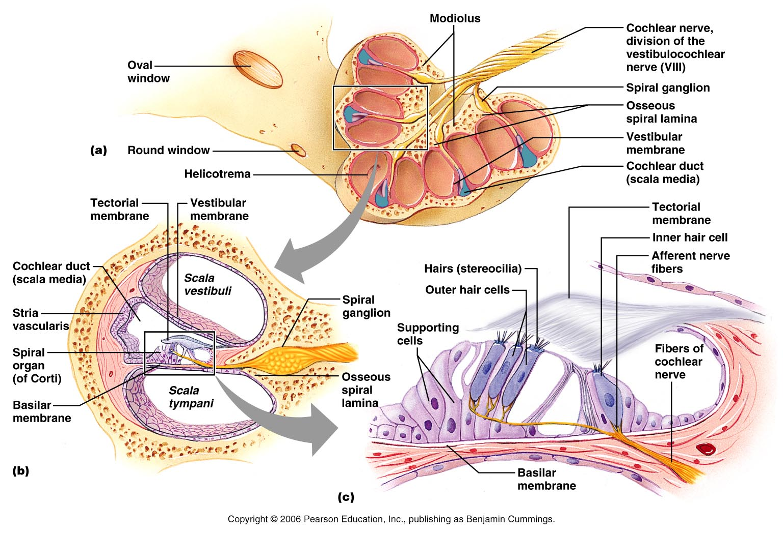
The Cochlea

Slide 117
Excitation of Hair Cells in the Organ of Corti
Bending cilia:
Opens mechanically gated ion channels
Causes a graded potential and the release of a neurotransmitter (probably glutamate)
The neurotransmitter causes cochlear fibers to transmit impulses to the brain, where sound is perceived

Slide 118
Sound and Mechanisms of Hearing
Sound vibrations beat against the eardrum
The eardrum pushes against the ossicles, which presses fluid in the inner ear against the oval and round windows
This movement sets up shearing forces that pull on hair cells
Moving hair cells stimulates the cochlear nerve that sends impulses to the brain

Slide 119
Properties of Sound
Sound is:
A pressure disturbance (alternating areas of high and low pressure) originating from a vibrating object
Represented by a sine wave in wavelength, frequency, and amplitude

Slide 120
Properties of Sound
Frequency – the number of waves that pass a given point in a given time
Pitch – perception of different frequencies (we hear from 20–20,000 Hz)

Slide 121
Properties of Sound
Amplitude – intensity of a sound measured in decibels (dB)
Loudness – subjective interpretation of amplitude

Slide 122
Properties of Sound

Slide 123
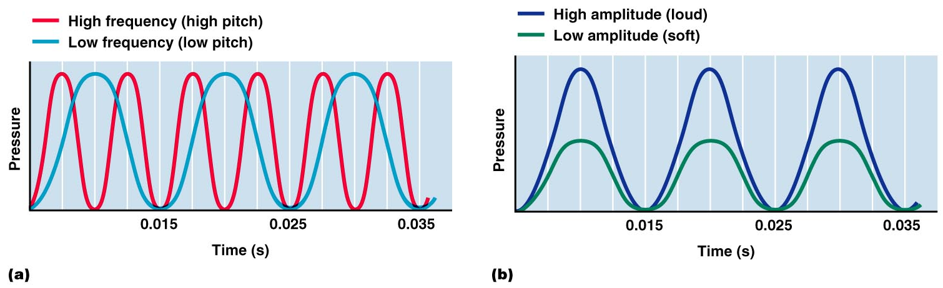
Frequency and Amplitude

Slide 124
Pathways of Sound
Outer ear – pinna, auditory canal
tympanic membrane vibrates
Middle ear – malleus, incus, and stapes
Amplifies the sound
Conducts the vibration to the oval window
Movement at the oval window applies pressure to the perilymph of the vestibular duct

Slide 125
Pathway of Sound
Pressure waves vibrate basilar membrane on the cochlear duct
Hair cells of the Organ of Corti are pushed against the tectorial membrane
Generation of impulses in the cochlear nerve

Slide 126
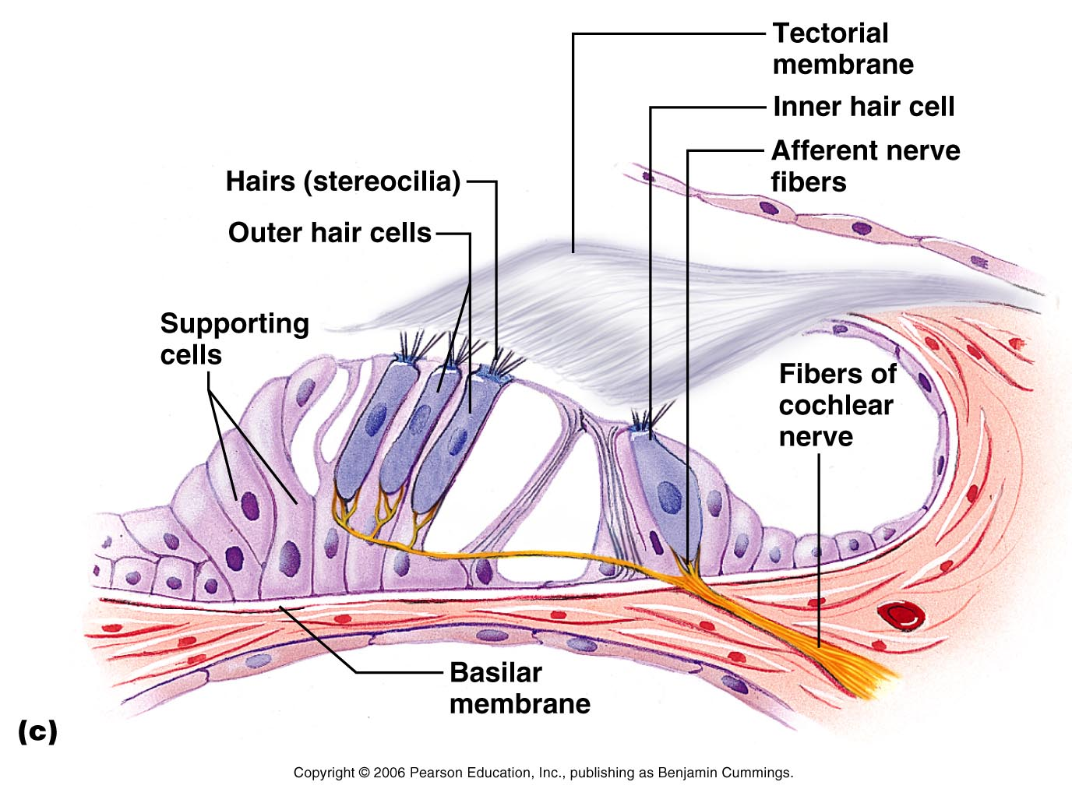
Excitation of Hair Cells in the Organ of Corti

Slide 127
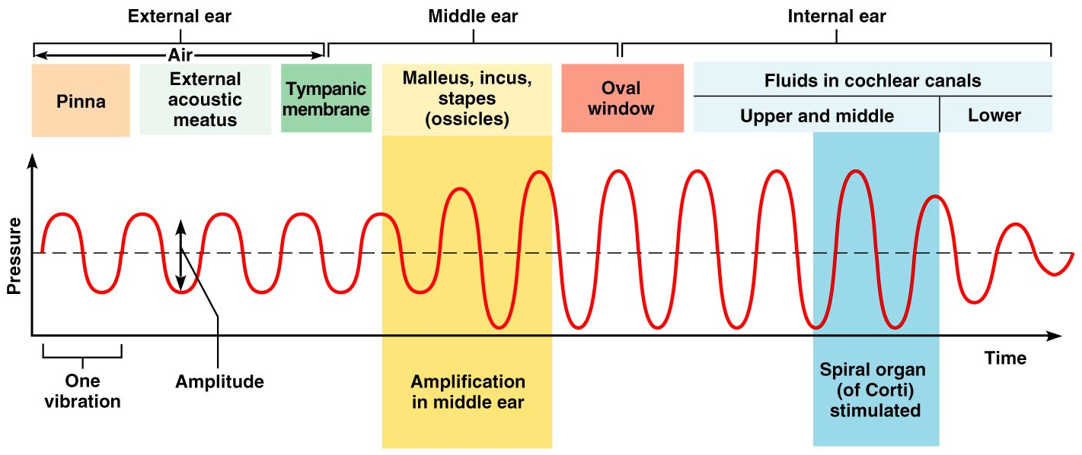
Transmission of Sound to the Inner Ear
Figure 15.31

Slide 128
Resonance of the Basilar Membrane
Sound waves of low frequency (inaudible):
Travel around the helicotrema
Do not excite hair cells
Audible sound waves:
Penetrate through the cochlear duct
Excite specific hair cells according to frequency of the sound

Slide 129
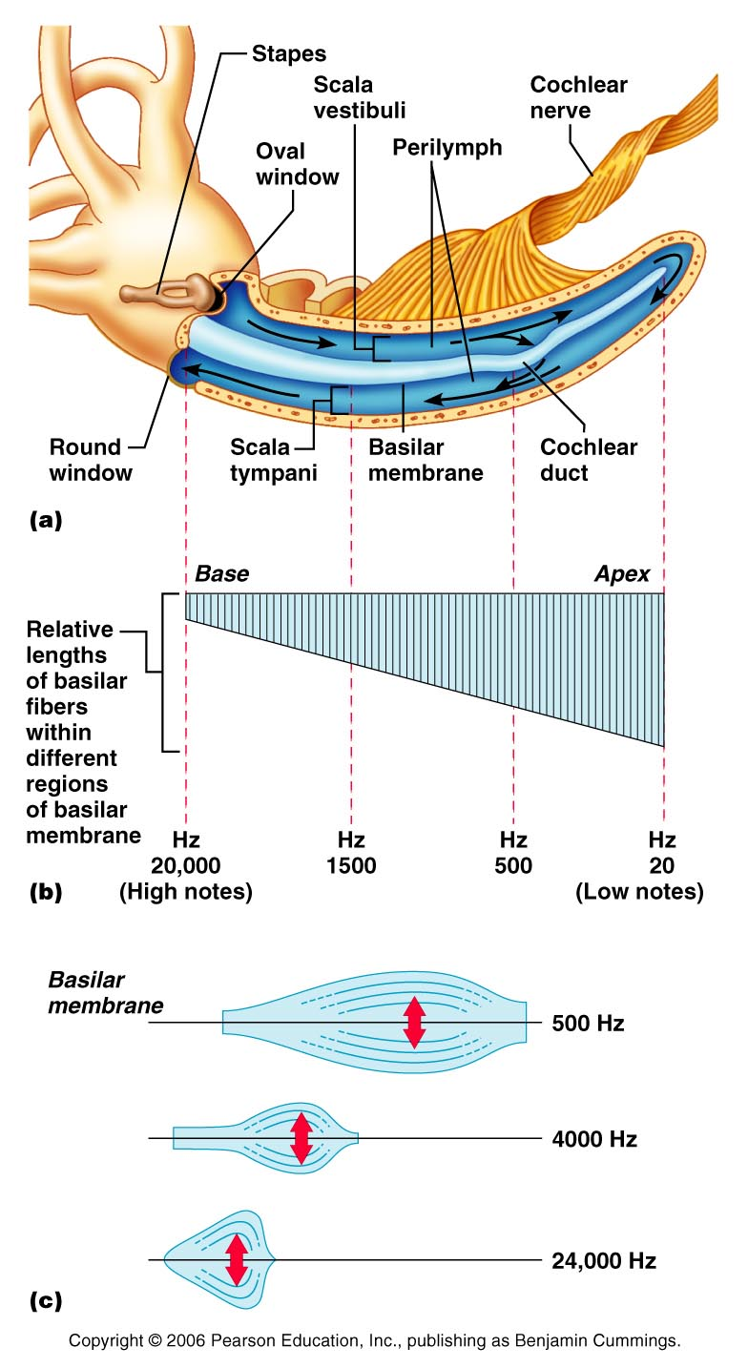
Resonance of the Basilar Membrane

Slide 130
Auditory Pathway to the Brain
Impulses from the cochlea pass via the spiral ganglion to the cochlear nuclei
From there, impulses are sent to the:
Superior olivary nucleus
Inferior colliculus (auditory reflex center)

Slide 131
Auditory Pathway to the Brain
From there, impulses pass to the auditory cortex
Auditory pathways decussate so that both cortices receive input from both ears

Slide 132
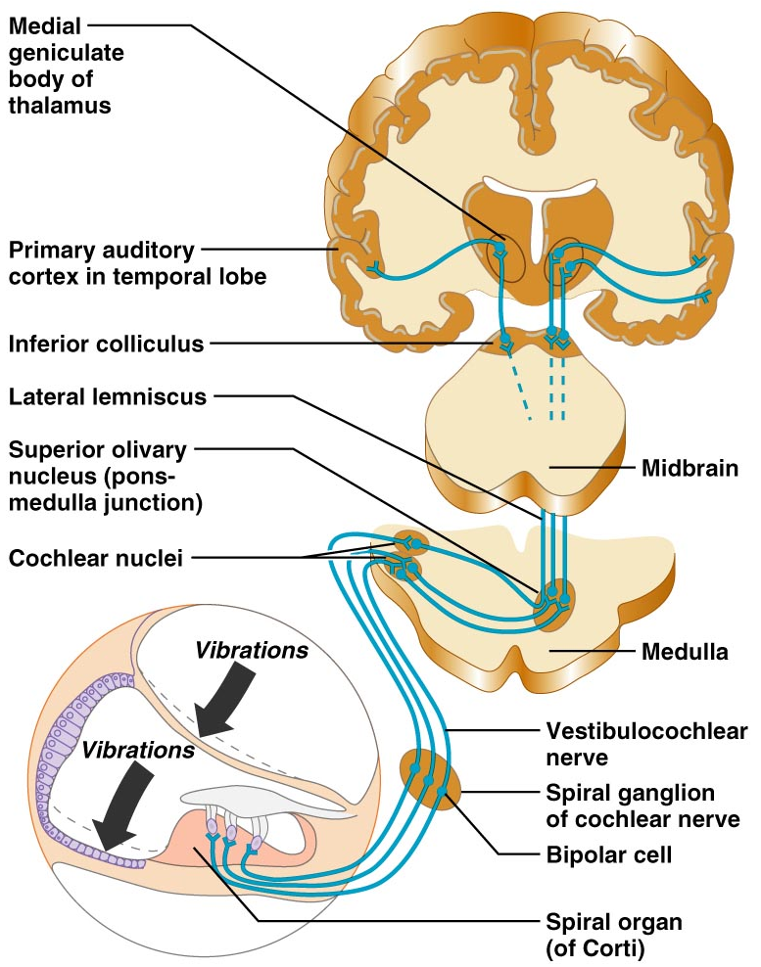
Simplified Auditory Pathways

Slide 133
Auditory Processing
Pitch is perceived by:
The primary auditory cortex
Cochlear nuclei
Depending on the position of the hair cell stimulated
Loudness is perceived by:
Varying thresholds of cochlear cells
The number of cells stimulated
Localization is perceived by superior olivary nuclei that determine sound

Slide 134
Deafness
Conduction deafness – something hampers sound conduction to the fluids of the inner ear (e.g., impacted earwax, perforated eardrum, osteosclerosis of the ossicles)
Sensorineural deafness – results from damage to the neural structures at any point from the cochlear hair cells to the auditory cortical cells

Slide 135
Deafness
Tinnitus – ringing or clicking sound in the ears in the absence of auditory stimuli
Meniere’s syndrome – labyrinth disorder that affects the cochlea and the semicircular canals, causing vertigo, nausea, and vomiting

Slide 136
Developmental Aspects
All special senses are functional at birth
Chemical senses – few problems occur until the fourth decade, when these senses begin to decline

Slide 137
Developmental Aspects
Vision is not fully functional at birth
Babies are hyperopic, see only gray tones, and eye movements are uncoordinated
Depth perception and color vision is well developed by age five and emmetropic eyes are developed by year six
With age the lens loses clarity, dilator muscles are less efficient, and visual acuity is drastically decreased by age 70

Slide 138
Developmental Aspects
Ear development begins in the three-week embryo
Inner ears develop first. They come from the ectoderm
Middle ear structures develop from the endoderm
The outer ear structures develop from ectoderm

