Slide 1
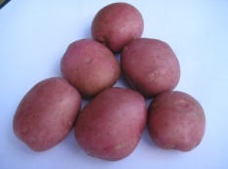
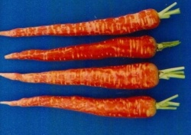
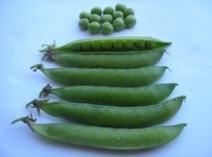
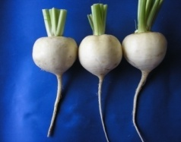
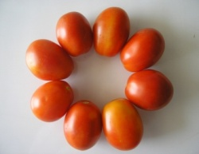
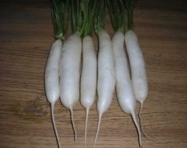
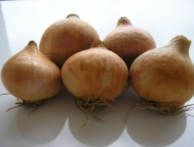
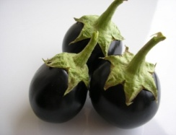
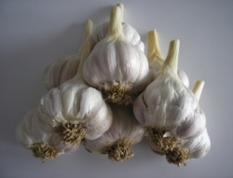
Horticulture?
HORT-201
University College of Agriculture,
University of Sargodha

Slide 2
Man dependence
INTRODUCTION
Use plants
Food
Fiber
Medicines
Nourishment
Clothes
Protection
Comfort
Pleasant surroundings

Slide 3
AGRICULTURE
Technology of raising plants and rearing animals
Major divisions
Agronomy
Forestry
Horticulture

Slide 4
HORTICULTURE
Term Horticulture introduced in 1631.
Derived from two Latin words
Hortus_______ garden
Colere_______ to cultivate

Slide 5
DEFINITIONS
1. Horticulture is an agricultural science which deals with the cultivation of fruits, vegetables and ornamental plants

Slide 6
DEFINITIONS
2. Baily (1939)
Horticulture is concerned with production within an enclosure

Slide 7
DEFINITIONS
3. Jules Janick (1986)
Horticulture is that branch of agriculture concerned with intensively cultured plants used for food, for medicinal purposes, or for aesthetic gratification.

Slide 8
Expanded scope
Today Horticulture covers much more than garden cultivation; as
Post-harvest technology
Plant tissue culture
Mutation breeding
Soil less culture
Vegetable forcing
Mushroom culture

Slide 9
Expanded scope
Now Horticulture is tremendous industry and has role in daily life.
1. Profession
Teaching
Agri. Research workers
Agri. Extension workers
Horticulturist in PIA garden centers
Assistant Directors in Development Authorities
Assistant Directors in Parks and Horticulture Authorities
Landscape architecture

Slide 10
Expanded scope
2. Occupation
Farmers
Nurserymen
Gardeners
3. Business
Salesman
4. Hobby
Aesthetic gratification

Slide 11
TERMS
ORCHARD
A plantation or enclosure containing fruit trees collectively
GARDEN
An enclosure for displaying to the public selected plants; also called botanical garden
Cultivation of fruits, herbs, vegetables and flowers in an enclosure

Slide 12
TERMS
CITRICULTURE
Cultivation of Citrus, and plantations are called citrus grooves
VITICULTURE
Cultivation of grapes, and plantations are called vine yards
MANGO CULTURE
The production of mango is called mango culture and the place where mangoes are produced is called mango groove.

