Slide 1
jQuery

Slide 2
What is jQuery?
jQuery is a lightweight, "write less, do more", JavaScript library.
The purpose of jQuery is to make it much easier to use JavaScript on your website.

Slide 3
Downloading Versions
There are two versions of jQuery available for downloading:
Production version - this is for your live website because it has been minified and compressed
Development version - this is for testing and development (uncompressed and readable code)

Slide 4
jQuery Syntax
Basic syntax is: $(selector).action()
A $ sign to define/access jQuery
A (selector) to "query (or find)" HTML elements
A jQuery action() to be performed on the element(s)
Examples:
$(this).hide() - hides the current element.
$("p").hide() - hides all <p> elements.
$(".test").hide() - hides all elements with class="test".
$("#test").hide() - hides the element with id="test".

Slide 5
The Document Ready Event
$(document).ready(function(){ // jQuery methods go here... });
This is to prevent any jQuery code from running before the document is finished loading (is ready).
Examples of actions that can fail if methods are run before the document is fully loaded:

Slide 6
The Document Ready Event (Cont.)
Trying to hide an element that is not created yet.
Trying to get the size of an image that is not loaded yet.
Shorter method for the document ready event:
$(function(){ // jQuery methods go here... });

Slide 7
jQuery Selectors
jQuery selectors are used to "find" (or select) HTML elements based on their name, id, classes, types, attributes, values of attributes and much more.
The element Selector
You can select all <p> elements on a page like this:
$("p")
$(document).ready(function(){
$("button").click(function(){ $("p").hide(); }); });

Slide 8
jQuery Selectors (Cont.)
The #id Selector
Uses the id attribute of an HTML tag to find the specific element:
$("#test")
$(document).ready(function(){ $("button").click(function(){ $("#test").hide(); }); });

Slide 9
jQuery Selectors (Cont.)
The .class Selector
Finds elements with a specific class.
$(".test")
$(document).ready(function(){ $("button").click(function(){ $(".test").hide(); }); });

Slide 10
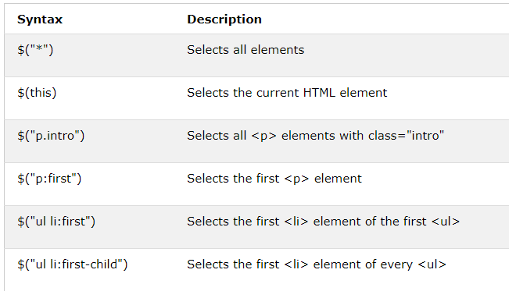

Slide 11
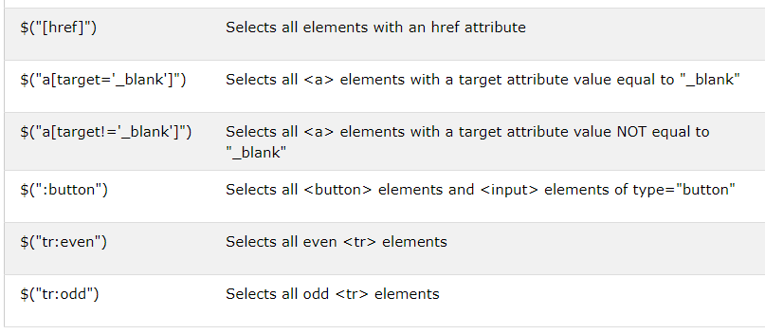

Slide 12
jQuery Event Methods

Slide 13
jQuery Syntax For Event Methods
$("p").click(function(){ $(this).hide(); });
$("p").dblclick(function(){ $(this).hide(); });

Slide 14
Attach multiple event handlers to a <p> element:
$("p").on({ mouseenter: function(){ $(this).css("background-color", "lightgray"); }, mouseleave: function(){ $(this).css("background-color", "lightblue"); }, click: function(){ $(this).css("background-color", "yellow"); } });

