Slide 1
Skewness and Kurtosis
Fundamentals statistics

Slide 2
Skewness
Skewness is a lack of symmetry in a distribution around mean
Skewness is the measure of asymmetry of the distribution of
Measures of skewness tell us the direction and the extent of Skewnes
the skewness of a distribution positive or negative skewness
The more the mean moves away from the mode, the larger the asymmetry or skewness
A distribution is said to be 'skewed' when the mean and the median fall at different points in the distribution, and the balance (or centre of gravity) is shifted to one side or the other-to left or right

Slide 3
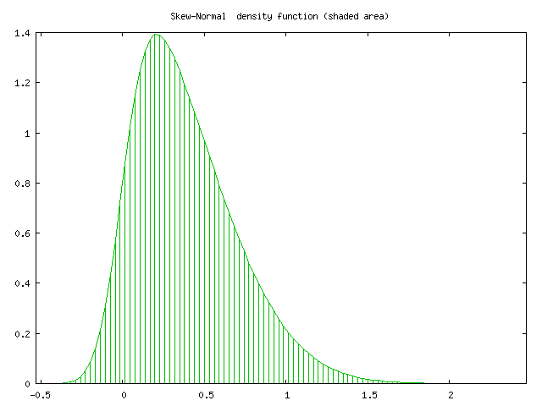
positive skewness Mean ˃ Median ˃ Mode

Slide 4
negative skewness Mean ˂ Median ˂ Mode

Slide 5
Computation of Skewness

Slide 6
KURTOSIS
KURTOSIS is a a measure of the &quot;peakedness
Kurtosis is another measure of the shape of a frequency curve.
While skewness signifies the extent of asymmetry, kurtosis measures the degree of peakedness of a frequency distribution.
Karl Pearson classified curves into three types on the basis of the shape of their peaks.
These are Mesokurtic, leptokurtic and platykurtic. These three types of curves

Slide 8
Computation of Kurtosis

Slide 9
Describe a Frequency Distribution:
To describe a major characteristics of a frequency distribution, we need the calculations of the following five quantities.
The number of observations that describes the size of the data.
A measure of central tendency such as the mean or median that provides information about the center or average value.
A measure of dispersion such as standard deviation that indicates the variability of the data.
A measure of skewness that shows the lack symmetry in the frequency distribution.
A measure of kurtosis that gives information about its peakedness.

