Slide 1
Lecture # 5&6
Biological Basis
of Behavior
(ENG-110)

Slide 2
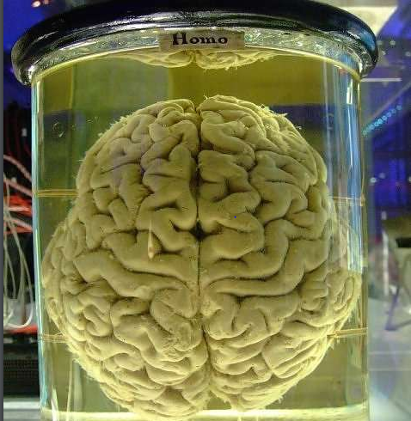
The Human Brain
The adult brain weighs about 3 pounds.
The brain is soft jelly like structure – feels
like a ripe pear.
Protected by the skull, the meninges
and cerebrospinal fluid.

Slide 3
Neurons: The Brain’s Communicators
The brain contains about 100 billion neurons, or neural cells.
There are more than 15 times as many neurons in the brain as there are people on Earth!
Each neuron receives, processes, and transmits messages to thousands of others.

Slide 4
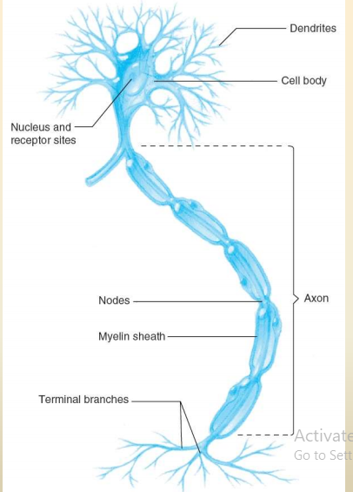
Structure of a Neuron
Dendrites … the “receivers”. They receive stimulation from other neurons.
Cell body….. contains the nucleus and is responsible
for the life processes of the cell
Axon ………a long, narrow tube that carries the
neural impulse toward the terminal branches.
Terminal button…..the "senders”. They contain
chemicals that neurons use to communicate
with each other.

Slide 5
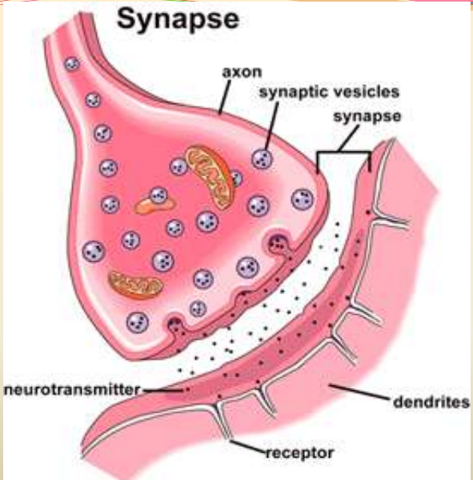
When neuron is sufficiently stimulated,
a tiny wave of electricity is generated and
travels along the axon to the terminal
branches. This is known as “action potential”.
When the action potential reaches
the terminal button, it triggers the
release of chemicals known as
“neurotransmitters”
“Synapse” is a junction/space between
terminal button of one neuron and
dendrites of another neuron

Slide 6
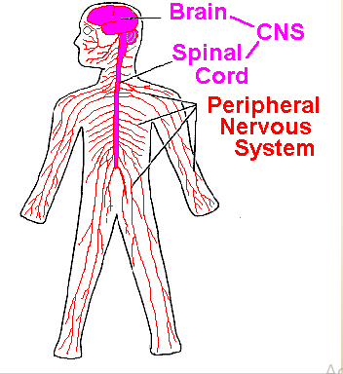
The Divisions of the Nervous System
The nervous system can be divided into two parts:
The central nervous system (CNS) - made up of the brain and spinal cord.
The peripheral nervous system (PNS) – consists of
neurons that lie outside the CNS.

Slide 7
The Central Nervous System
The central nervous system can be divided into different sections:
Brain
Cerebral cortex
Basal ganglia
Limbic system
Cerebellum
Brain stem
Spinal cord

Slide 8
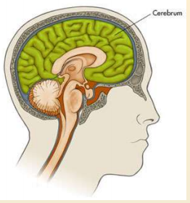
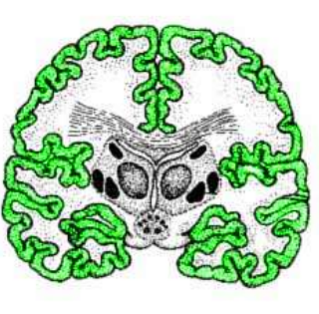
The Cerebral Cortex
The uppermost and largest area of the brain is the cerebrum.
The outer surface of the cerebrum is the cerebral cortex.
The cortex is divided into two halves known as cerebral hemispheres.
The two hemispheres are connected by the corpus callosum.

Slide 9
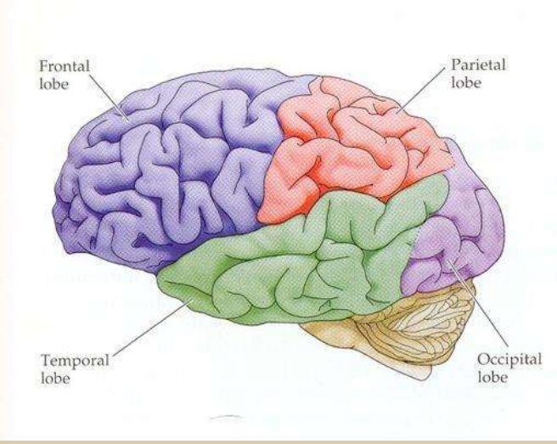
The cerebral cortex is the part of the brain primarily responsible for processes such as thinking, remembering, planning and analyzing sensory information.
Each hemisphere of the cerebral cortex
is divided into four regions called lobes:
Frontal
Parietal
Temporal
Occipital

Slide 10
Frontal lobes:
Assist in movement, speech production and memory.
They oversee and organize most other brain functions.
Contain the primary motor cortex which controls movements, and the prefrontal cortex, which is responsible for thinking, planning and language.
The prefrontal cortex also contributes to mood, personality and self-awareness.
Parietal lobes:
Contain the primary somatosensory cortex which processes information related to touch.
Integrate vision and touch

Slide 11
Temporal lobes:
Contain the primary auditory cortex which is responsible for hearing.
Allows us to understand language.
Storage of past memories.
Occipital lobes:
Contain the primary visual cortex, which is responsible for vision.

Slide 12
Basal Ganglia:
A set of structures buried deep inside the brain that help to control movement.
Limbic System:
A set of interconnected brain regions devoted to emotion, motivation, smell and memory.
Included in the limbic system are the amygdala and hippocampus.
The amygdala plays a role in fear, anger and excitement.
The hippocampus plays a role in memory, especially spatial memory, and helps us to convert short term memories to long term memories.

Slide 13
The Brain Stem
Consists of several structures, including:
Reticular activating system – plays a role in arousal
Cerebellum – plays a role in balance and coordination
Pons – involved in sleep and dreaming
Medulla – controls vital functions, such as breathing, heart rate and blood pressure.

Slide 14
The Spinal Cord
Extends from the brain stem to the lower back.
Conveys information between the brain and the rest of the body.
Made up of sensory neurons which carry information toward the brain and motor neurons which carry motor commands from the brain to the body.
The spinal cord also consists of interneurons which connect sensory and motor neurons.

Slide 15
The Peripheral Nervous System
The peripheral nervous system is divided into:
The somatic nervous system – controls voluntary movement.
The autonomic nervous system – controls involuntary actions of our internal organs and glands.
The autonomic nervous system, in turn, consists of two divisions:
The sympathetic nervous system – mobilizes the fighter-flight response.
The parasympathetic nervous system – active during rest and digestion.

