Slide 1
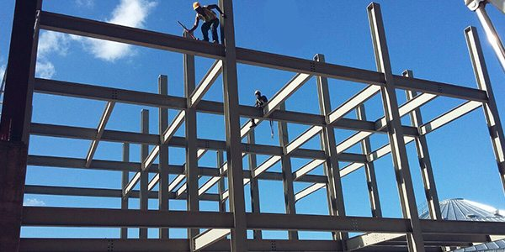
COLLEGE OF ENGINEERING AND TECHNOLOGY UNIVERSITY OF SARGODHA Theory Of Structures (CT-226) (B.S TECHNOLOGY)
26-March-2020
ONLINE LECTURE-1-PART-B
Slopes and Deflections
Engr. Aqeel Ahmed
Lecturer, CET, UOS, Sargodha

Slide 2
SLOPE: It is angular shift at any point of the beam between no load condition and loaded beam. Its value is different at different points on the length of the beam. It is represented by dy/dx or θ. Its units are radians. There is a maximum limit for slope for any loaded beam.
Deflection: It is the vertical shift of a point on the beam between no load condition and loaded beam. Its value is different at different points on the length of the beam. It is represented by y or 𝜹. Its units are mm. There is a limit for maximum deflection for any loaded beam.

Slide 4
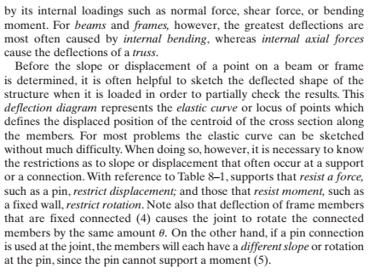

Slide 5
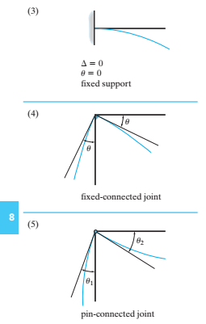
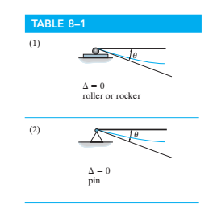

Slide 6
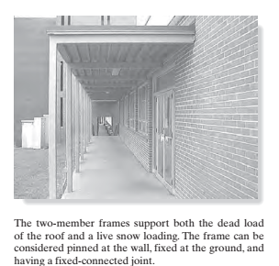

Slide 8
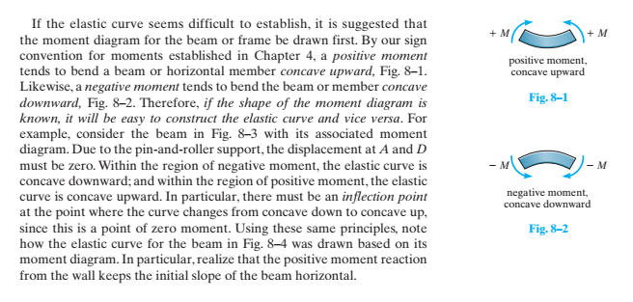

Slide 9
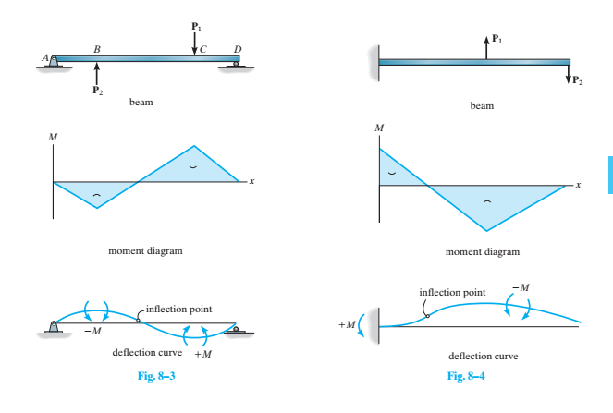

Slide 10
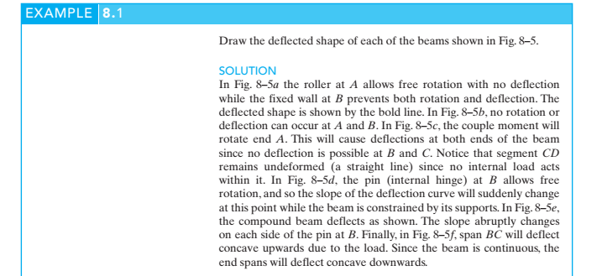

Slide 11
