Slide 2
FATS AND OILS
LECTURE 2
FST-403
B. Sc. (Hons). Food and Science and technology
Semester-7
INSTITUTE OF FOOD SCIENCE AND NUTRITION
UNIVERSITY OF SARGODHA, SARGODHA

Slide 3
LECTURE OUTLINE
Uses of fats and oils
Worldwide production
Consumption pattern
Role of fats in food industry

Slide 4
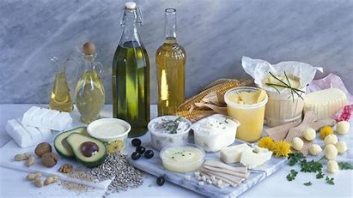
USES OF FATS AND OILS
Fats and oils are used throughout the world for both food applications and industrial uses
They are consumed in
butter, shortening and margarine
salad oils, and cooking oils
animal feeds
soaps and personal care products
biodiesel and paints (made from alkyd resins)
lubricants, and greases

Slide 5
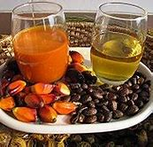
USES OF FATS AND OILS
The sources of fats and oils include
edible vegetable oils
palm oils
industrial oils
animal fats, and
marine oils

Slide 6
USES OF FATS AND OILS
Food applications account for the major share (about three-fourths) of the worldwide consumption of fats and oils. However, there has been a continued shift from food to industrial consumption, particularly in biodiesel
In Europe and the United States, this has been due mainly to the increased use of rapeseed (canola) oil and soybean oil for biodiesel production

Slide 7
WORLDWIDE PRODUCTION
Global production of fats and oils is led by Asia
Indonesia is the world’s largest producer, and accounts for more than half of the global production of palm oil.
China ranks second in total world production of fats and oils in 2018, and is a larger producer of soybean and rapeseed (canola) oils.

Slide 8
CONTINUE…
Malaysia ranks third in world production because of its place as the world’s second-largest palm oil producer. India also produces large volumes of canola and butter. Overall, Asia accounts for more than half of global fats and oils production in 2018.

Slide 9
WORLDWIDE CONSUMPTION
World consumption is also driven mainly by Asia, which accounts for almost 50% of the world total.
China and India together make up almost 30% of the world total. Chinese demand is mainly for soybean oil, followed by palm and canola oils. India is a major consumer of canola oil, as well as palm oil and butter
The main consumers include India, Indonesia, and China, as well as the rest of Asia, Europe, and Africa

Slide 10
CONTINUE…

Slide 11
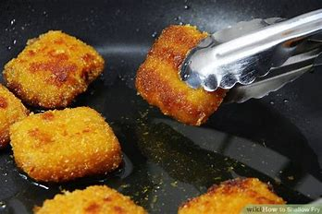
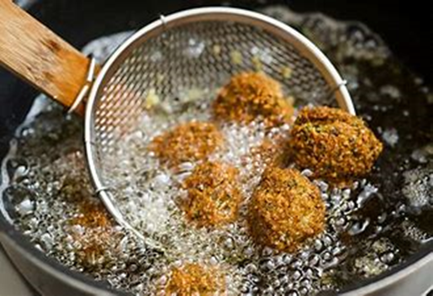
ROLE OF FAT IN FOOD INDUSTRY
I Fat/Oil used as medium of cooking
Fat is used in shallow and deep fat frying. Pan-frying is used to cook chapathis, omelettes, cutlets. Deep fat frying method is used in preparing snack and junk food

Slide 12
ROLE OF FAT IN FOOD INDUSTRY
II.Fat improves the texture of foods
Fat plays an important role in the proper development of texture in cakes, biscuits and cookies. Its function is particularly important in pastry where there is no sugar to contribute to tenderness
Fats help in leavening
The role of fat in the leavening process is its ability to trap air during the mixing process. So the fat is indirectly responsible for the tenderness of the cake
Thus fat contribute to the grain and volume of baked products

Slide 13
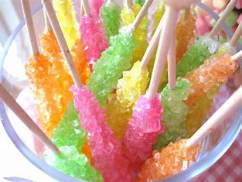
ROLE OF FAT IN FOOD INDUSTRY
Fat for smoothness
They limit the size of water crystals and help in maintaining smooth texture
They affect the smoothness of crystalline candies through the retardation of crystallization and the gelatinization of starch in starch thickened mixtures Fat prevents lump formation and brings smoothness

Slide 14
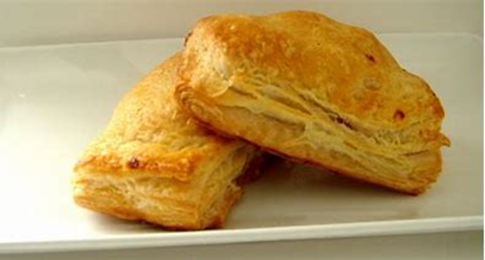
ROLE OF FAT IN FOOD INDUSTRY
Fat as a shortening agent
One of the most important function of fat is to shorten baked products which otherwise are solid masses firmly held together by strands of gluten
In biscuits, a hard fat must be used so that fat can be distributed in small pieces to give the desired flakiness to the biscuits. Shortened cakes are made using a plastic fat, which combines readily with the ingredients in the flour mixture. Butter is used in puff pastry

Slide 15
ROLE OF FAT IN FOOD INDUSTRY
III. Fats improve palatability
Fat gives taste and flavor to the food
Ghee and butter when used in the recipe improve the flavor
The ability of fats to take up or dissolve certain aromatic flavor substances is frequently used in food preparation
Onion, ginger, garlic, peppers and other flavorful foods are cooked in oil so initially flavor can be incorporation into other foods. Aromatic fruit and other flavors are also dissolved by fat
Coloring agents like turmeric, when added to oil helps in the distribution of color through out the food

Slide 16
Thank You ☺

