Slide 1
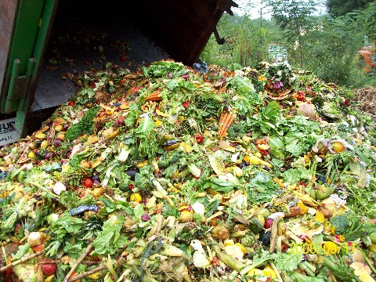
SOURCES OF
INDUSTRIAL WASTES
COURSE CODE:-Bot 735
COURSE TITLE:-Food industrial waste management
CREDIT HOUR:-3(2+1)
University of Sargodha
(Dept. of Botany)
BY:-
Dr. Abdul Ghani

Slide 2
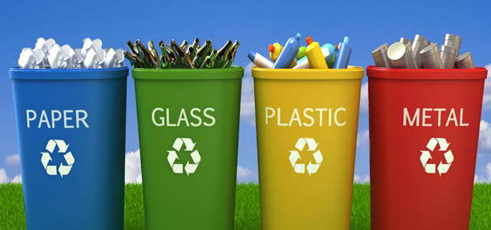
INTRODUCTION
The generation of waste is an inevitable (An unavoidable event) part of human activity.
It is produced either as a by product of production processes, or arises from the domestic or commercial sector when objects or materials are discarded after use.
It would appear that most environmental problems arise because the natural world cannot cope with these substances.

Slide 3
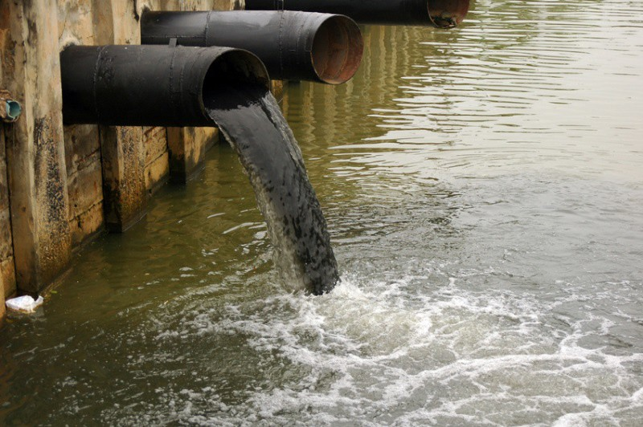
SOLID WASTE GENERATION
The solid waste generation originates from determined sources at determined times.
Sources
1- The place where something begins, where it springs into being.
2- A process by which energy or a substance enters in a system

Slide 4
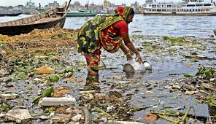
SOLID WASTE GENERATION
Aspects which influence the solid wastes generation are;
Geographic location
Season of the year
Collection frequency
Population characteristics
Population characteristics operations
Legislation (Law the “act of making”)
Public activities

Slide 5
Sources of Wastes
Solid waste sources could be urban or rural area. While rural area generates waste which is often organic rich and easily biodegradable the urban waste is characterized by culture and practices of society.
Sources of solid waste
1= Residential
2= Industrial
3= Commercials
4= Institutional
5= Construction and demolition
6= Municipal
7= services (Parks etc.)
8= Agriculture
9= Slaughter House
10= Fruits and Vegetable Market

Slide 6
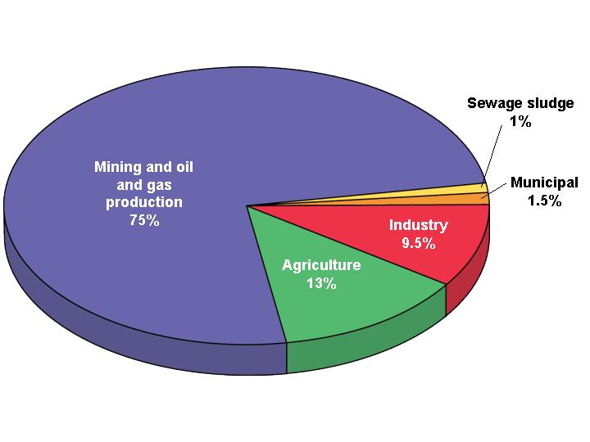
Contribution of Wastes

Slide 7
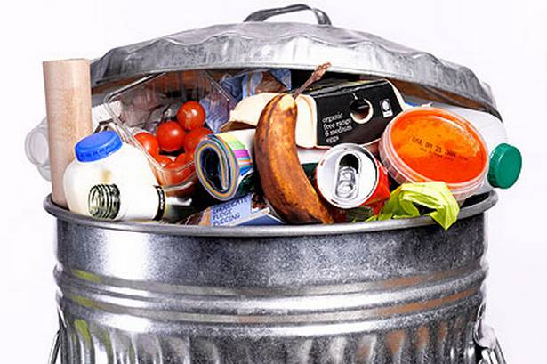
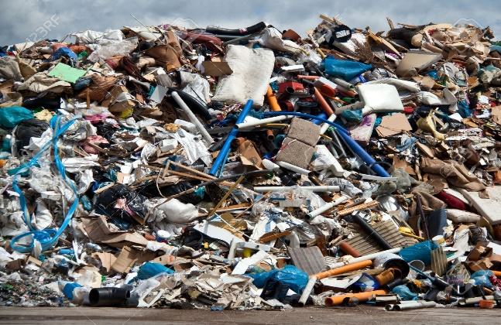
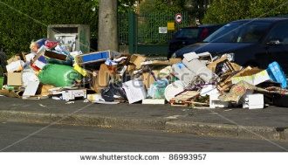
1= Residential
The Waste generated from households, hotels or offices are called residential wastes.
Types of wastes generated
Food wastes, paper, cardboard, plastics, textiles, leather, yard wastes, wood, glass, metals, ashes, special wastes (e.g. bulky items, consumer electronics, white goods, batteries, oil, tires), and household hazardous wastes

Slide 8
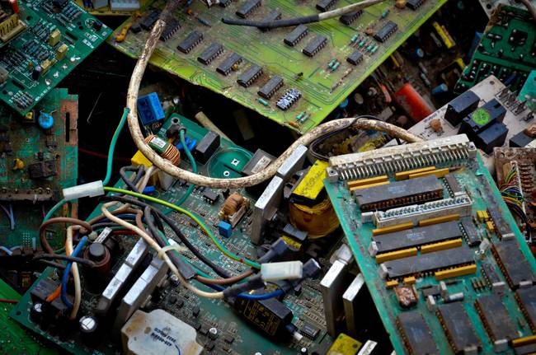
2= Industrial
The Waste generated from factories, industries and other manufacturing plants are called industrial wastes.
Types of wastes generated
Housekeeping wastes, packaging, food wastes, construction and demolition materials, hazardous wastes, ashes, special wastes.

Slide 9
3= Commercials
The Waste generated from Stores, hotels, restaurants,
markets, office buildings are called commercial wastes.
Types of wastes generated
Paper, cardboard, plastics, wood, food wastes, glass,
metals, special wastes, hazardous wastes

Slide 10
4= Institutional
The Waste generated from Schools, hospitals, prisons, government
centres are called institutional wastes.
Types of wastes generated
Same as commercial Paper, cardboard, plastics,
wood, food wastes, glass, metals, special wastes,
hazardous wastes

Slide 11
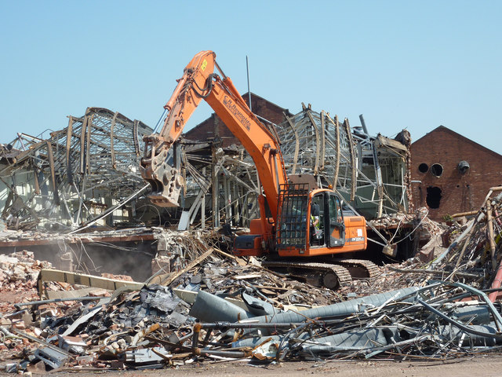
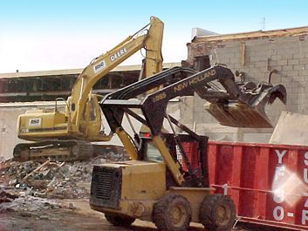
5= Construction and demolition
The Waste generated from New construction sites, road repair, demolition of building are called construction and demolition wastes.
Types of wastes generated
Wood, steel, concrete, dirt, etc.

Slide 12
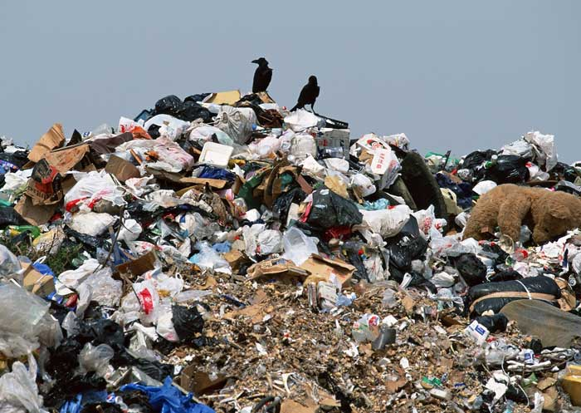
6= Municipal
The Waste generated from Street cleaning areas and consisting of everyday items that are discarded by the public are called municipal wastes.
Types of wastes generated
Street sweepings, landscape and tree trimmings, general
wastes from parks, beaches and other recreational area,
Sludge.

Slide 13
7= Services (Parks etc.)
The Waste generated from parks, beaches, other recreational areas, water and wastewater treatment plants are called service wastes.
Types of wastes generated
General wastes from parks, beaches, and other recreational area, sludge

Slide 14
8= Agriculture
The Waste generated from Crops, orchards, vineyards, dairies, feedlots, farms are called agricultural wastes.
Types of wastes generated
Spoiled food wastes, agricultural wastes(Chemicals, pesticides, herbicides, fungicides), hazardous wastes(Residue of toxic chemicals).

Slide 15
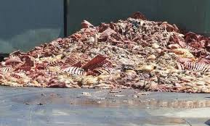
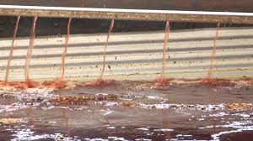
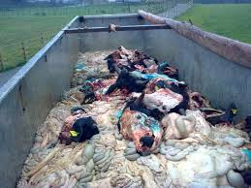
9= Slaughter House
These waste mainly comprises of hide (skin of an animal), hair, undigested and digested food, bones, blood and meat. The waste have pathogens that could cause diseases.

Slide 16
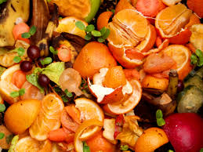
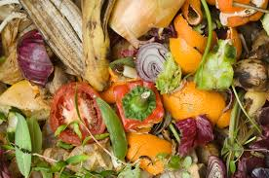
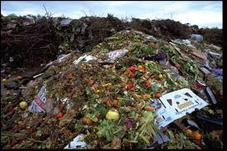
10= Fruits and Vegetable Market
Fruits and vegetable market prominently contains decomposable waste like rotten and damaged fruits and vegetables.
A small percentage of packaging like cardboard, plastic and paper may be present in the waste. Citrus and other sour fruits like pine apple may add to acidity of the waste

Slide 17
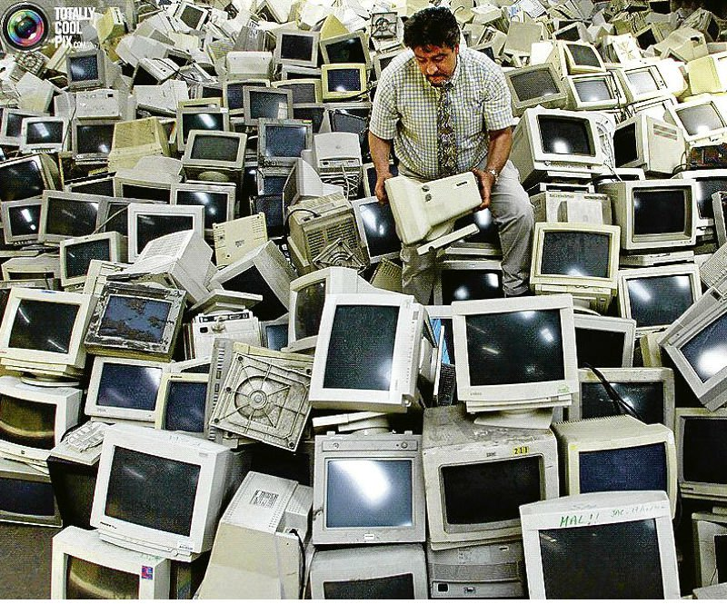
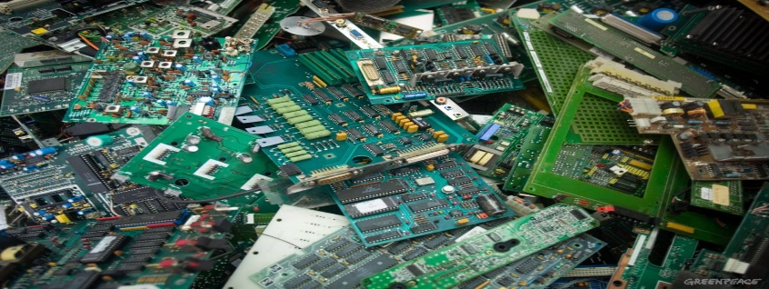
11= Electronic sources
This is waste from electronic and electrical devices.
DVD and music players, TV, Telephones, computers, vacuum cleaners and all the other electrical stuff in your home.
These are also called e-waste, e-scrap, or waste electrical and electronic equipment (WEEE)
Some e-waste (like TV) contains lead, mercury, cadmium, and brominated flame retardants.
These are harmful to humans and the environment.
It is therefore important that the right authorities ensure the proper disposal of such waste.

Slide 18
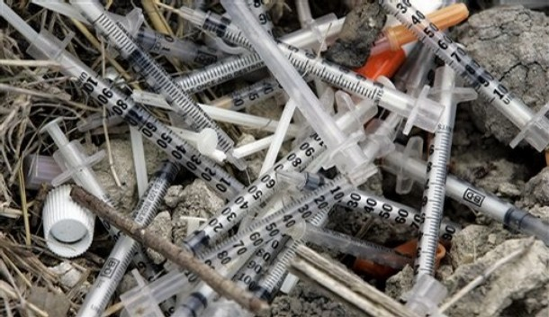
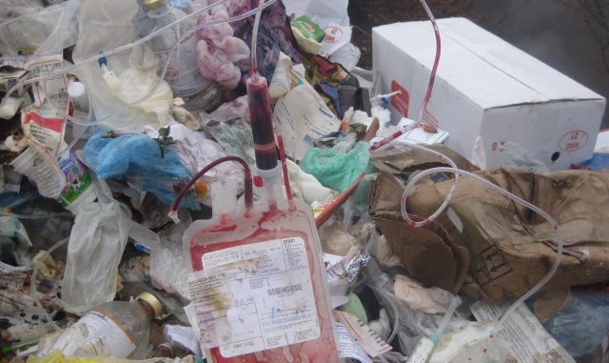
12= Medical or Clinical sources
Medical/clinical waste, normally refers to waste produced from health care facilities, such as hospitals, clinics, surgical theaters, veterinary hospitals and labs.
They tend to be classified as hazard waste rather than general waste.
Items in this group include surgical items, pharmaceuticals, blood, body parts, wound dressing materials, needles and syringes

Slide 19
Impacts
of
Waste

Slide 20
Environmental Impacts of Waste
Some of the impacts of accumulation of wastes are described below:
Uncontrolled, open dumping in many of the region’s cities has resulting in the degradation of valuable land resources and the creation of long-term environmental and human health problems
Throughout the region, indiscriminate dumping has led to the contamination of surface and groundwater supplies.
Open burning of waste contributes significantly to urban air pollution.
At a global level, the uncontrolled release of methane, which is produced as a by-product of the decomposition of organic wastes, represents a significant proportion of the region’s contribution to the greenhouse effect

Slide 21
Environmental Impacts of Waste
The uncontrolled dumping of biomedical waste has the potential for transporting pathogens (disease producing organisms).
Indiscriminate disposal of oils, used batteries, discarded paints, spent chemicals and carcinogens, such as asbestos, can cause significant adverse impacts on human health and the environment.

Slide 22
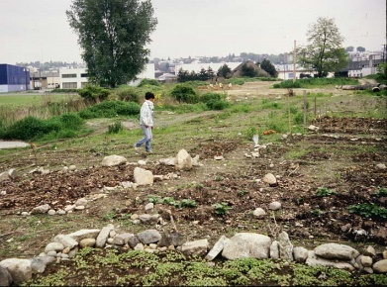
Spoilage of Landscape
It is a common practice to dump plastic bags, containers, vegetables, fruit peels, cans etc.
In the open area without thinking about its consequences.
We need to be fully aware that improper disposal of waste spoils the beauty of the landscape.

Slide 23
Pollution
Dumping of wastes in a haphazard and unscientific manner has serious environmental impact.
Health hazards due to air pollution
Hazardous air pollutants present in the atmosphere affect human health both directly and indirectly. It may be a short-term or long-term effect.
The following are the adverse effects on human health:
Toxic gas carbon monoxide reduces the blood oxygen and formation of hemoglobin, causing injury to heart and central nervous system.
2. Sulphur dioxide and sulphuric acid both cause irritation in the respiratory tracts of humans and high concentrations of sulphur dioxide leads to severe heart and lung diseases like bronchitis, asthma, etc.

Slide 24
3. Nitrogen oxide at higher concentration affects respiratory organs, liver and kidneys.
4. Ozone can seriously affect the pulmonary functions.
5. Lead can cause injury in blood-formation organs and nervous system, especially impairing of brain functions of new-born babies.
6. Pesticides and radiations are other toxic air pollutants which are very dangerous for human health.
7. Metal, dusts, asbestos and hydrocarbons shorten the life span and cause deterioration of nervous system and there is additional risk of cancer.
8. In mining operation, silica and dust cause pneumoconiosis (common disease in mine workers).
9. Petroleum components can affect the blood forming organs, brain, teeth bones etc.
10. Mercury and cadmium are known to damage the kidneys and brain.

Slide 25
The impact of waste accumulation in soil/land has following major health effects:
1.The impact of land pollution on human health is indirect. The pollutants added in the soil enter the human body through water or air through the food chain.
2. Several agrochemicals like DDT, fluorine, arsenic, lead compounds and organ phosphorus compounds are super toxic and cause symptoms like nausea, vomiting, diarrhea, sweating, salivation and muscular tremors.
3. Some rodenticides as strychnine, sodium fluoro-acetate etc.. are blood coagulants.
4. Ethylene dichloride, ethylene dibromide and methyl dibromide accumulate in liver, kidney, heart, spleen and cause degenerative lesions.

Slide 26
Impact of Waste Accumulation on Terrestrial Life:
Hazardous wastes may pollute soil, air, surface water and underground water. The oil pollutants may affect man, plants and animals. These toxic substances are transferred to different organisms through the food chain and cause a number of complications in living organisms.
Some of these are as follows:
1. Many toxic chemicals, pesticides, other agricultural wastes released into the environment that are taken up by the plants from air, water and soil. Plants growing under such conditions are severely affected by these toxic chemicals.
2. Exposure to high concentration of pollutants may cause acute injuries like chlorosis, discolouration and even the death of plants.
3. Crops show reduced productivity and yield. The quality of plant nutrients is also decreased.
4. Sulphur dioxide is a most toxic pollutant which damage the crops.
5. In recent years, the losses to agriculture and animal life due to fluoride content have greatly increased.

Slide 27
Impact of Waste Accumulation on Fresh Water:
Large amount of wastes of human society are disposed of in the rivers, lakes, ponds and other aquatic bodies making the water polluted which is not fit for drinking and other domestic purposes.
The impacts of waste dumping on aquatic life are as follows:
1. The toxic wastes reaching the water bodies badly disturb the aquatic life.
2. The sewage of cities is often drained into the rivers, which is dangerous to flora, fauna and human life.
3. Due to heavy accumulation of wastes into the canals, lakes and rivers, oxygen concentration is reduced considerably thus affecting the life of fishes and other aquatic populations. In extreme deficiency of oxygen most of the fishes die.
4. Biodiversity decreases in highly polluted aquatic habitats.

Slide 28
The impacts of waste dumping on marine life are as follows:
1. The growth of marine algae is affected.
2. Massive oil spills not only spoil innumerable beaches and estuaries but also cause widespread damage to marine life.
3. Herbicides and pesticides (especially the organ chlorides) reach the oceans via the wind and rivers and contaminate marine water.
4. It is a matter of great concern that mangrove forests are being damaged at an alarming rate due to disposal of wastes along sea shores.
5. Thermal and radioactive pollution have disturbed the life of fishes in estuaries and coastal ecosystems. Their breeding is also affected adversely.

Slide 29
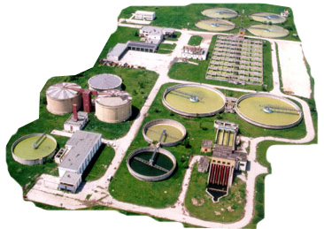
SOLID WASTE TREATMENT CONCEPT
The final disposal of the solid waste is usually on land or seldom at sea.

Slide 30
Ways to minimize waste
Reduce
Reuse is to use an item more than once
Reuse
Reducing the amount of waste produced by a person or a society.
Recycle
Recycling involves processing used materials into new products to prevent waste of potentially useful materials

Slide 31
Thank You

