Slide 1
Body temperature and regulation
DR MUNTAHA YASIR

Slide 2
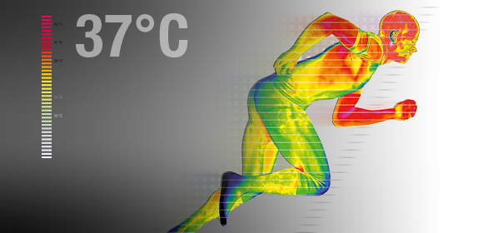

Slide 3
TYPES OF TEMPERATURE
CORE TEMPERATURE
97-99F
SKIN TEMPERATURE
55-103F

Slide 4
BALANCE
HEAT PRODUCTION
BMR
MUSCLE ACTIVITY
HARMOES
SYMPETHETIC SYSTEM
HEAT LOSS
ORGANS TO SKIN
SKIN TO SURROUNDINGS

Slide 5
INSULATORY SYSTEM
SKIN
FAT
SUBCUTANEOUS TISSUE

Slide 6
CONDUCTION SYSTEM
ARTERIOVENOUS PLEXUS
30% OF CO
VASOCONSTRICTION SNS

Slide 7
HOW HEAT IS LOST
RADITION 60%
CONDUCTION 3%
CONVECTION 15%
EVAPORATION16-19 CAL/HR
CLOTHING
SWWEATING
PANTING

Slide 8
SWEATING
Anterior hpothalamus preoptic area
Spinal cord
Sns
skin

Slide 9
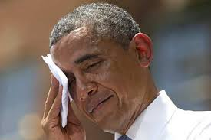

Slide 10
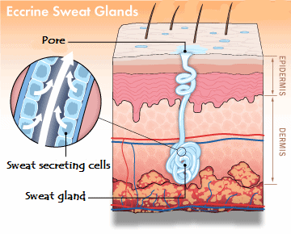
MECHANISM
Tubular structure
Subdermal portion
Tubular part
Primary secretion
Concentrated form

Slide 11
ACLIMATIZATION
TO GET ADAPTED TO ENVIRONMENT
Within 4 to 6 weesks
More quantity of sweat
Less concentrated
Sweat 2 to 3l/hr (1l)
Salt loss is 3 to 5g/day (15 to 30)

Slide 12
panting
Evaporation of water from respirator mucosa by rapid shallow breathing
Blood gases not changed
Occur due to presence of furr and absence of sweat gland in animals

