Slide 1
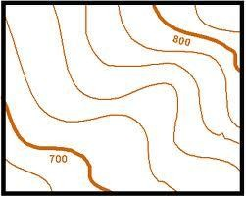
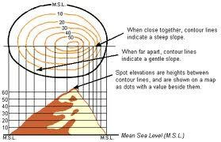
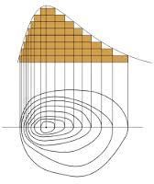
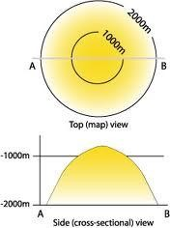

Slide 2
Contour An imaginary line on the ground surface joining the points of equal elevation is known as contour.
In other words, contour is a line in which the ground surface is intersected by a level surface obtained by joining points of equal elevation. This line on the map represents a contour and is called contour line.
CONTOURING
2
2

Slide 3
Contour Map
A map showing contour lines is known as Contour map.
A contour map gives an idea of the altitudes of the surface features as well as their relative positions in plan serves the purpose of both, a plan and a section.
CONTOURING
3

Slide 4
Contouring
The process of tracing contour lines on the surface of the earth is called Contouring.
CONTOURING
4
3

Slide 5
PURPOSE OF CONTOURING
Contour survey is carried out at the starting of any engineering project such as a road, a railway, a canal, a dam, a building etc.
For preparing contour maps in order to select the most economical or suitable site.
To locate the alignment of a canal so that it should follow a ridge line.
To mark the alignment of roads and railways so that the quantity of earthwork both in cutting and filling should be minimum.
CONTOURING
5
3

Slide 6
PURPOSE OF CONTOURING (contd.)
For getting information about the ground whether it is flat, undulating or mountainous.
To find the capacity of a reservoir and volume of earthwork especially in a mountainous region.
To trace out the given grade of a particular route.
To locate the physical features of the ground such as a pond depression, hill, steep or small slopes.
CONTOURING
6

Slide 7
CONTOUR INTERVAL
The constant vertical distance between two consecutive contours is called the contour interval.
HORIZONTAL EQUIVALENT
The horizontal distance between any two adjacent contours is called as horizontal equivalent.
The contour interval is constant between the consecutive contours while the horizontal equivalent is variable and depends upon the slope of the ground.
CONTOURING
7

Slide 8
FACTORS ON WHICH CONTOUR - INTERVAL DEPENDS
The contour interval depends upon the following factors:-
i) The Nature of the
Ground country,
In flat and the
uniformly sloping interval is small ,
contour
but in broken and
mountainous region the contour interval should be large otherwise the contours will come too close to each other.
CONTOURING
8

Slide 9
FACTORS ON WHICH CONTOUR - INTERVAL DEPENDS
ii) The Purpose and extent of the survey. Contour interval is small if the area to be surveyed is small and the maps are required to be used for the design work or for determining the quantities of earth work etc. while wider interval shall have to be kept for large areas and comparatively less important works.
CONTOURING
9

Slide 10
FACTORS ON WHICH CONTOUR - INTERVAL DEPENDS
The Scale of the Map. The contour interval should be in the inverse ratio to the scale of the map i.e. the smaller the scale, the greater is the contour interval.
Time and Expense of Field and Office work. The smaller the interval, the greater is the amount of field-work and plotting work.
CONTOURING
10

Slide 11
COMMON VALUES OF THE CONTOUR - INTERVAL
The following are the common values of the contour interval adopted for various purposes:-
i) For large scale maps of flat country, for building sites, for detailed design work and for calculation of quantities of earth work;
0.2 to 0.5 m.
CONTOURING
11

Slide 12
COMMON VALUES OF THE CONTOUR - INTERVAL
ii) For reservoirs and town planning schemes;
0.5 to 2m.
For location surveys. 2 to 3m.
For small scale maps of broken country and general topographic work; 3m,5m,10m,or 25m.
CONTOURING
12

Slide 13
CHARACTERISTICS OF CONTOURS
All points in a contour line have the same elevation.
Flat ground is indicated where the contours are widely separated and steep- slope where they run close together.
A uniform slope is indicated when the contour lines are uniformly spaced and
A plane surface when they are straight, parallel and equally spaced.
CONTOURING
13

Slide 14
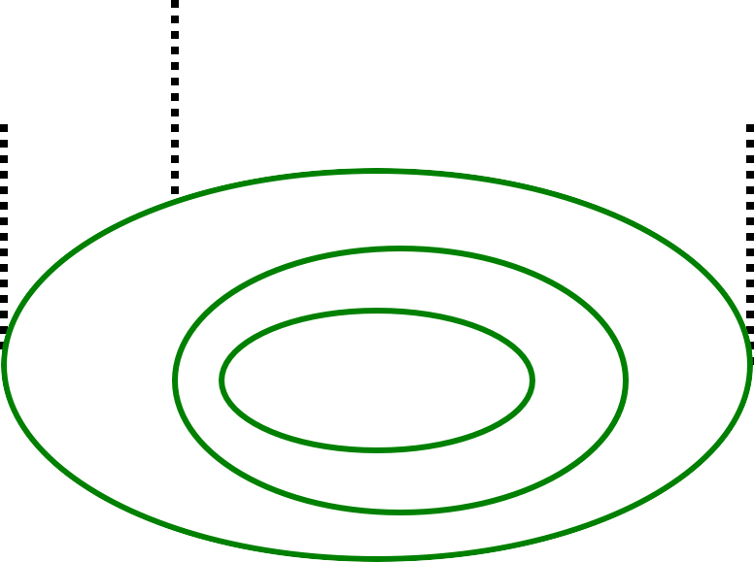
CHARACTERISTICS OF CONTOURS
v) A series of
80
closed contour
75
70
lines on the map
represent
65
60
a hill , if the
HILL
higher values
60
65
70
75
80
are inside
A HILL
CONTOURING
14

Slide 15
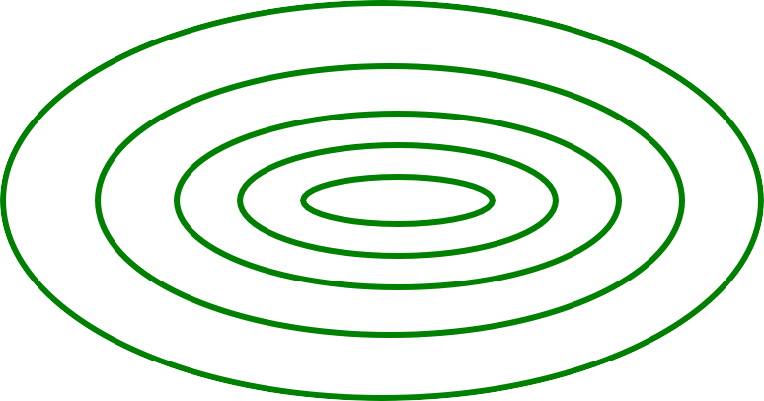
CHARACTERISTICS OF CONTOURS
80
vi) A series of
75
closed contour
DEPRESSION
70
lines on the
65
map indicate a
60
depression if
the values outside
higher
are
70
60
65
70
75
80
A DEPRESSION
CONTOURING
15

Slide 16
CHARACTERISTICS OF CONTOURS
vii)
Contour line cross ridge or valley line at right angles.
100
If the higher
90
values are inside the bend or loop in the contour, it
80
70
60
50
indicates a Ridge.
RIDGE LINE
CONTOURING
16

Slide 17
CHARACTERISTICS OF CONTOURS
vii)
Contour line cross ridge or valley line at right angles.
If the higher
values are outside the bend, it
100
90
80
represents a Valley
70
60
50
VALLEY LINE
CONTOURING
17

Slide 18
CHARACTERISTICS OF CONTOURS
viii) Contours cannot end anywhere but close on themselves either within or outside the limits of the map.
CONTOURING

Slide 19
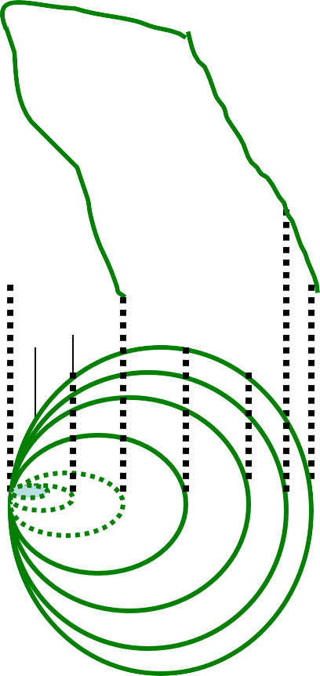
CHARACTERISTICS OF CONTOURS
ix).
Contour lines cannot
40
merge or cross one another on map
30
except in the case of an overhanging cliff.
20
10
40 30 20 10
OVERHANGING CLIFF
CONTOURING

Slide 20
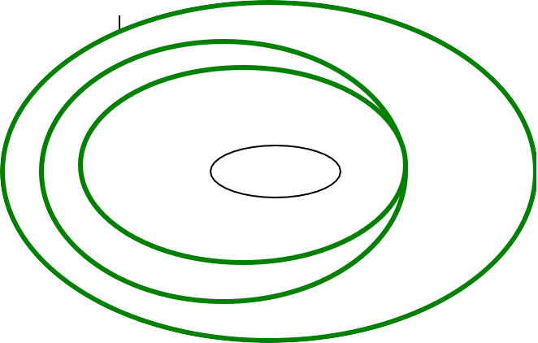
CHARACTERISTICS OF CONTOURS
x) Contour lines
never run into one
50
another except in
a In
40
the case of
30
VERTIC CLIFF
vertical cliff.
20
10
this case
,several coincide
contours
and the horizontal equivalent becomes zero.
10 20 30 40
50
50
OVERHANGING CLIFF
CONTOURING
20

Slide 21
CHARACTERISTICS OF CONTOURS
X Depressions between summits is called a saddle. It is represented by four
sets of contours
_{as} 70
SADDLE
70
80
90
80
shown. It represents 90
a dip in a ridge or
90
100
the junction of two
110
ridges. And in the
case of a mountain Line
passing through the
range ,it takes
_{the} saddles and summits gives water shed line.
form of a pass .
CONTOURING

Slide 22
METHODS OF CONTOURING
There are mainly two methods of locating contours:- (1)Direct Method and (2) Indirect Method.
Direct Method:
In this method, the contours to be
located are directly traced out in the field by locating and marking
50
48
46
B.M
a number of points on each
contour. These points are then surveyed and plotted on plan and
the contours drawn through
DIRECT METHOD OF
CONTOURING
them.
CONTOURING

Slide 23
METHODS OF CONTOURING
Direct Method:
This method is most accurate but very slow and tedious as a lot of time is wasted in searching points of the same elevation for a contour.
This is suitable for small area and where great accuracy is required
CONTOURING

Slide 24
Procedure: To start with, a temporary B.M is established near the area to be surveyed with reference to a permanent B.M by fly leveling. The level is then set up in such a position so that the maximum number of points can be commanded from the instrument station. The height of instrument is determined by taking a back sight on the B.M. and adding it to the R.L. of bench mark. The staff reading required to fix points on the various contours is determined by subtracting the R.L. of each of the contours from the height of instrument.
CONTOURING
24

Slide 25
2. Indirect Method:
In this method the points located and surveyed are not necessarily on the contour lines but the spot levels are taken along the series of lines laid out over the area .The spot levels of the several representative points representing hills, depressions, ridge and valley lines and the changes in the slope all over the area to be contoured are also observed. Their positions are then plotted on the plan and the contours drawn by interpolation. This method of contouring is also known as contouring by spot levels.
CONTOURING

Slide 26
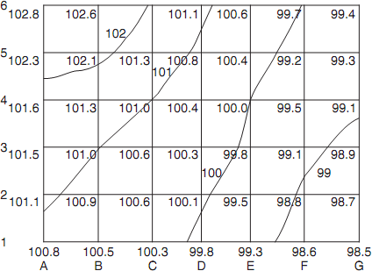
SQUARE METHOD
CONTOURING
31

Slide 27
INTERPOLATION OF CONTOURS
The process of spacing the contours proportionally between the plotted ground – points is termed as interpolation
of contours .
This becomes necessary in the case of indirect contouring as only the spot levels are taken in this method.
While interpolation of contours the ground between any two points is assumed to be uniformly sloping.

Slide 28
INTERPOLATION OF CONTOURS
There are three main methods of interpolation:
By Estimation: The position of the contour points between ground - points are estimated roughly and the contours are then drawn through these points. This is a rough method and is suitable for small scale maps.
By arithmetical calculation: This is very tedious but accurate method and is used for small areas where accurate results are necessary. The contours are interpolated as under:

Slide 29
INTERPOLATION OF CONTOURS
ii) By arithmetical calculation:
Suppose A and B are two points at a distance of 30 m and the reduced level of A and B are 25.45m and 27.54m respectively .Taking the contour interval as 1m, 26 and 27 m contours may be interpolated in between A and B. The difference of level between A and B is 2.09m.the difference of level between A and 26m,and A and 27m is 0.55mand 1.55 m respectively.
Therefore the horizontal distance between A and 26 m contour =0.55/2.09 x 30m and
Between A and 27 m contour =1.55/2.09 x 30m. These distances are then plotted to scale on the map.

Slide 30
INTERPOLATION OF CONTOURS
Graphical method of
(iii) By Graphical method:
interpolation is
65
simpler as compared
to arithmetical
B
62.5m
method and also the results obtained are
2
60
60m
accurate. several methods,
Out of
graphical
55
1
the most
55m
common is as given below:
A 51.5m
50
CONTOURING
42

Slide 31
Graphical method:
As shown in the fig. suppose the contour interval is 5m, then on a piece of tracing cloth, a number of parallel lines spaced at 0.5 m (usually 1/10th of the contour interval) are drawn. Every tenth line being made thick.
Suppose it is required to interpolate contours between two points A and B of elevation 51.5m and 62.5m respectively.
CONTOURING
43

Slide 32
INTERPOLATION OF CONTOURS
(iii) By Graphical method:
If the bottom line represents an
elevation of 50m. Then the successive thick lines will represent 55m, 60m and 65m, etc. Place the tracing cloth so that the point A is on the third line from the bottom, now move the tracing cloth until B is on the fifth line above the 60m thick line. The intersection of the thick lines 1 and 2 representing elevations of 55m and 60 m and the line AB give the position of the points on the 55m and 60m contours respectively and are pricked through on the plan with a pin.
CONTOURING
44

Slide 33
DRAWING THE CONTOUR LINES
Contour lines are drawn as fine and smooth free hand curved lines. Sometimes they are represented by broken lines .They are inked in either in black or brown colour. A drawing pen gives a better line than a writing pen and French curves should be used as much as possible .Every fifth contour is made thicker than the rest.
The elevation of contours must be written in a uniform manner, either on the higher side or in a gap left in the line .When the contour lines are very long, their elevations are written at two or three places along the contour .In the case of small scale maps, it is sufficient to figure every fifth contour.
45

Slide 34
USES OF CONTOUR MAP
A contour map furnishes information regarding the features of the ground , whether it is flat, undulating or mountainous.
From a contour map , sections may be easily drawn in any direction
Intervisibility between two ground points plotted on map can be ascertained
It enables an engineer to approximately select the most economical or suitable site for an engineering project such as a road, a railway, a canal or a pipe line etc.
A route of a given grade can be traced on the map.
Catchment area and capacity of a reservoir may be determined from the contour map.
Contour map may be used to determine the quantities of earth work.
45

Slide 35
HOME ASSIGNMENT
Q.No.1. (a) Define contour.
(b) What is a contour interval and on what factors does it depend?.
Q.No.2.(a) What is difference between a contour interval and horizontal equivalent?.
(b) Suggest contour intervals for following :-
(i) A hill Survey (ii) A city Survey (iii) survey of a dam site. Q.No.3. Describe with neat sketches the characteristics of contours.
Q.No.4. Show contours to represent the following :-
(i) A Hill (ii) A Depression (iii) A valley (iv) A vertical cliff (v) A saddle. Q.No.5. Describe various methods of interpolation of contours.
46

