Slide 1
Database systems
LECTURE # 7 Weak and Strong Entities

Slide 2
Weak and strong entity types
Strong entity type:
Strong entity type is a type of entity which has an Identifying attribute which is a unique.
Identifying attribute is a attribute which can uniquely identify a row or a record in a table.
Or, we can say that that unique attribute could be Primary Key
For example if we have entity named STUDENT , since it is a STRONG entity because it has StudentID(PK) attribute which uniquely identifies a student. Those entities which consist of a Primary key is known as a Strong Entity.

Slide 3
Weak entity type: It is a type of entity which has no unique attribute (Primary Key)to identify a record.
It is dependent on a strong entity , a key from strong identity is referenced into this weak entity to identify this weak entity record.
For example: We have an strong entity named EMPLOYEE which has fields (EmployeeID,EmployeeName,EmployeeDes) and there is another table which consist of data about EMPLOYEE Dependents , name another table as DEPENDENT which has fields (name,age,relationship).
Now there is a problem which is that how to identify a record of a Weak entity ?? Because it has no unique key in it.
To overcome above problem a Primary key from Strong entity table is referenced into the Weak Entity table. Then this referenced key into Weak table is known as a foreign key.

Slide 4
Weak entity type
• In an employees database Child entities exist only if their corresponding Parent employee entity exists.
• ISA relationship type An Employee is a special case of Person and therefore the existence of an Employee entity implies the existence of a
corresponding Person entity.

Slide 5
Diagram of Weak Entity type
Employee Dependent
Employeeid
EmployeeName
EmployeeDes
Name
Age
Relationship

Slide 6
Diagram of Weak Entity type
Employee Dependent
Employeeid
EmployeeName
EmployeeDes
Employeeid
Name
Age
Relationship

Slide 7
Relationships
A Relationship describes relations between entities. Relationship is represented using diamonds. Below is a types of relationships.
One to One Relationship: This type of relationship is rarely seen in real world.
The above example describes that one student can enroll only for one course and a course will also have only one Student. This is not what you will usually see in relationship.

Slide 8
One to Many : It reflects business rule that one entity is associated with many number of same entity. The example for this relation might sound a little weird, but this means that one student can enroll to many courses, but one course will have one Student.
The arrows in the diagram describes that one student can enroll for only one course.

Slide 9
Many to One : It reflects business rule that many entities can be associated with just one entity. For example, Student enrolls for only one Course but a Course can have many Students.
Many to Many :
The above diagram represents that many students can enroll for more than one courses.

Slide 10
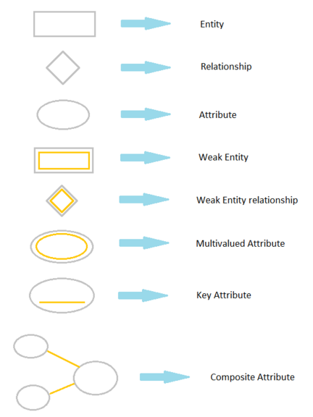
Symbols and Notations

Slide 11
Entity Relationship Diagram
Rectangles represent entity sets
• Diamonds represent relationship sets
• Lines link attributes to entity sets and entity sets to relationship sets
• Ellipses represent attributes
– Double ellipses represent multivalued attributes
– Dashed ellipses denote derived attributes
• Underline indicates primary key attributes

Slide 12
Steps to draw e-r d
The process has following steps:
1. Identify Entities
Identify the roles, events, locations, tangible things or concepts about which the end-users want to store data.
2. Find Relationships
Find the natural associations between pairs of entities using a relationship matrix.
3. Draw Rough ERD
Put entities in rectangles and relationships on line segments connecting the
entities.
7. Identify Attributes
Name the information details (fields) which are essential to the system under development.
5. Define Primary Keys
Identify the data attribute(s) that uniquely identify one and only one occurrence of each entity.

Slide 13
8. Map Attributes
For each attribute, match it with exactly one entity that it describes.
9. Draw fully attributed ERD
10. Check Results
Does the final Entity Relationship Diagram accurately depict the system data?
After we have drawn full E-R D we will try to implement it in lab.

Slide 14
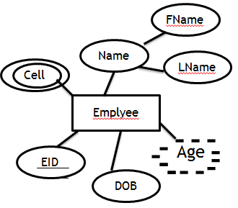
Learn by example
DID
DName
Works In
Department
Above drawn ER-D is describing that Many Employees work in Department.
And Department can have many employees.

Slide 15
Learn by example
DID
DName
Works In
Department
Above drawn ER-D is describing 1-1 Repaltionship
Which means that 1 Employee work in Department.
And Department can have 1 employee.

Slide 16
Learn by example
DID
EID
DID
DName
Works In
Department
Above drawn ER-D is describing M:N Relationship
Which mean that 1 employee can work in many departments
and 1 department can have many employees.

Slide 17
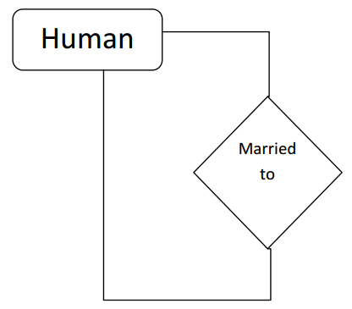
Degree of Relationship
Number of entity classes that participate in a relationship is known as degree of relationship
(no. of rectangles attached to one diamond)
Unary Relationship :
A relationship in which only one entity class participates in known as unary relationship (a single rectangle attached to a diamond)

Slide 18
Binary Relation / Degree two relationship :
A relationship in which two entity classes participate is known as binary relationship or
degree two relationship.
CLASS

Slide 19
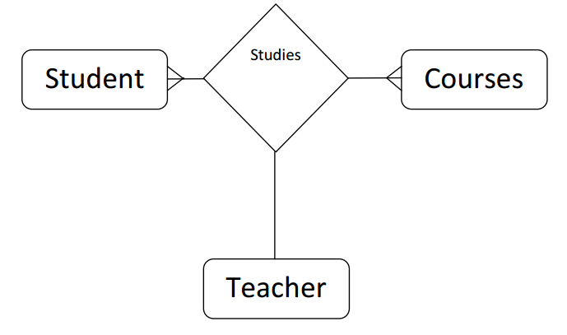
Ternary Relationship / Degree three relationship
A relationship in which three entity classes participate simultaneously is known as
binary relationship or degree two relationship.

