Slide 1
Capturing some action
Andleeb Rana

Slide 2
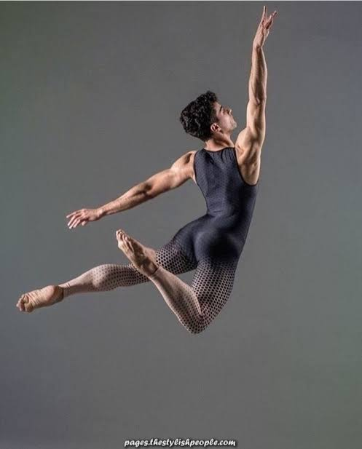

Slide 3
Action could be of figure or group

Slide 5
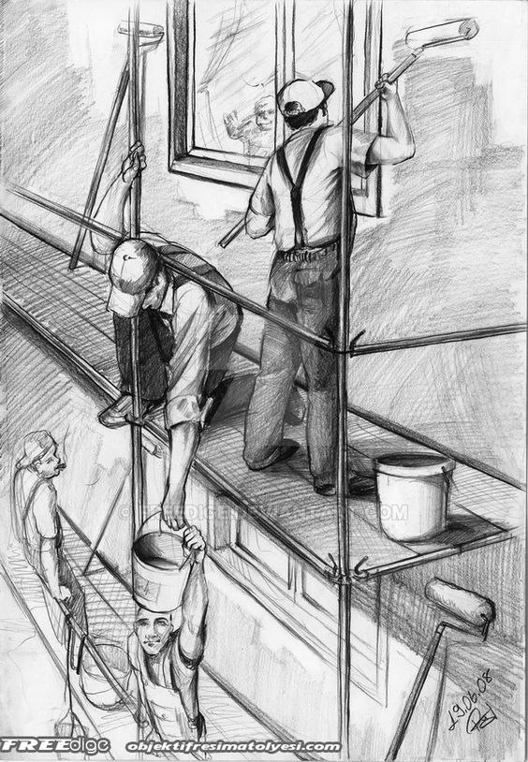

Slide 6
Compose your action figure in an environment

Slide 7
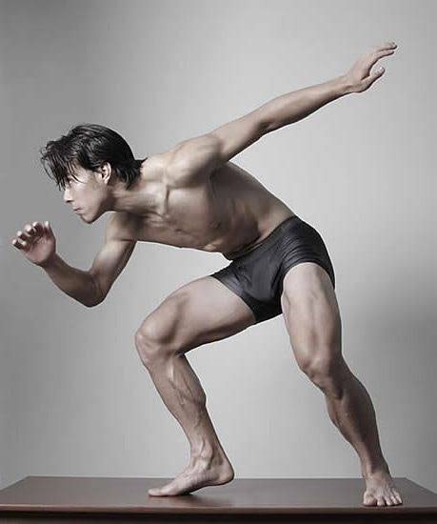

Slide 8
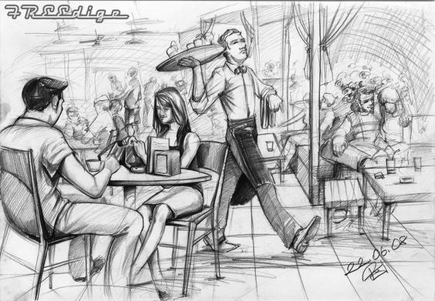

Slide 9
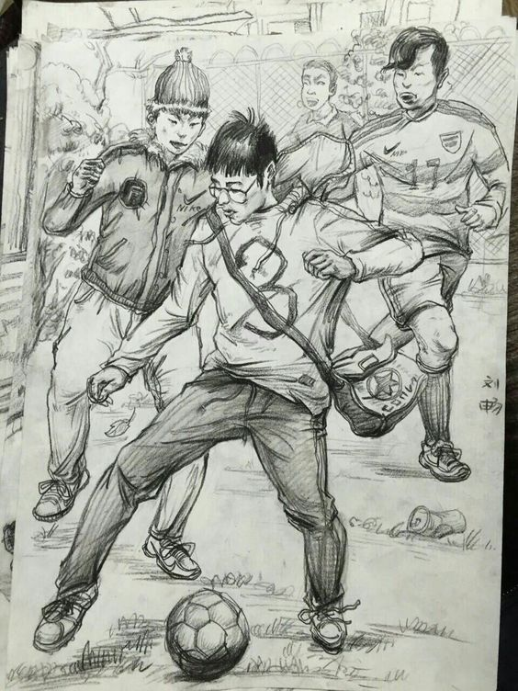

Slide 10
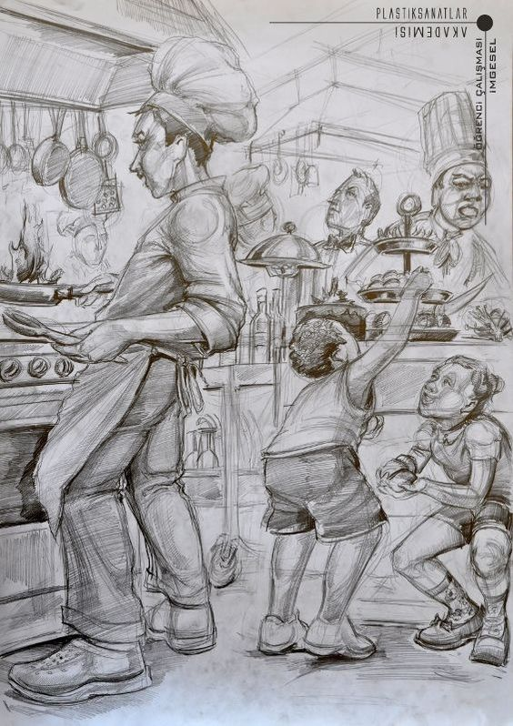

Slide 11
Try yours

Slide 12
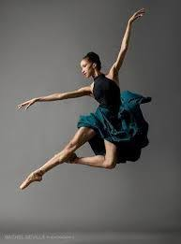
Thank you

