Slide 1
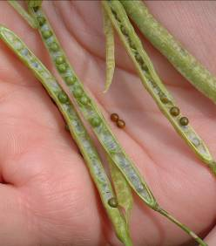
Canola Small seed with big potential
Dr. Saeed Rauf

Slide 2
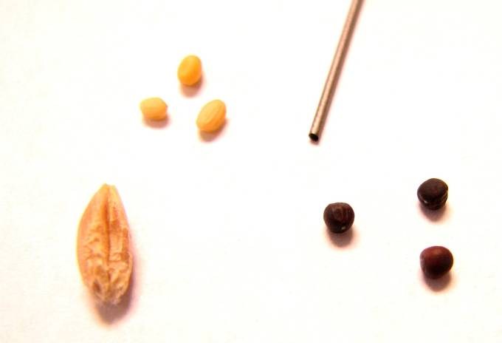
Small Seed with Big Potential
Mustard
Canola
Wheat

Slide 3
Why Winter Canola, Why Now?
Highly valuable oil in food market, but also a premium oil for biodiesel
Low weed pressure
Transgenic Roundup Ready winter canola available
Subsidy by govt. of punjab

Slide 4
Canola vs. Rapeseed
Rapeseed is the traditional, historical crop
Canola was developed from rapeseed through the use of traditional plant breeding techniques.
CANOLA is Canadian Oil Low Acid, which has eurucic acid levels (unpalatable for food) of less than 2% and 30 micromoles per gram of glucosinolates (Canola Council of Canada Canada’s Canola, 2-3).
Oilseed rape is contracted in parts of the Pakistan
canola oil may not contain more than two
percent erucic acid, and the solid fraction of the seed may not contain more than

Slide 5
Burton Craig, one of the scientists involved
in the early research, summed up their task:
“The only trouble with the crop was that the
oil was no good, and the meal was no good!”

Slide 6
Craig and Youngs explored methods of analysis to determine the fatty acid composition of rapeseed oil,
recognizing that a refined method of analysis would have to be found before a rapeseed breeding program could be successful (National Research Council, 21-22).

Slide 7
Fathers of canola
Keith Downey of the
Canada Agriculture Research Station in Saskatoon, and
Baldur Stefansson of the University of Manitoba.

Slide 8
Half seed Technique
Erucic acid in rapeseed was controlled by the genotype of the
developing embryo in the seed, rather than by the maternal plant.
Downey and Harvey worked out a “half-seed” method by which the oil of a seed could be analyzed, while at the same time preserving the seed for planting if it showed promise with low eruci acid content.

Slide 9
Low erucic acid rape seed
Stefansson came upon a seed from the European forage rape Liho with only about 10% erucic acid.
Stefansson shared some of the seed with Downey.
Downey who was first able to successfully transfer the low erucic acid characteristic to the B. napus variety (Kneen, 41). ORO,

Slide 10
Downey screened B. campestris germplasm from around the world.
One of the seeds was found to contain no erucic acid,
half-seed technique was employed to grow a plant - albeit a weak and sickly specimen. Span, the first low erucic acid B. campestris variety,was released in 1971 (National Research Council, 48).

Slide 11
Double Low
Bronowski, a B. napus variety with very low levels of glucosinolates.
Stefansson’s Tower variety registerd in 1974 Agriculture Canada registered
Tower as the world’s first zero-erucic acid, low-glucosinolate B. napus.
Downey developed the world’s first zero-erucic, low glucosinolate B. campestris variety Candle, which was released in 1977 (National Research Council, 65-72).

Slide 12
Canola Seed Composition
Others
(Sugar,
Starch,
Structural
Material)
(36 %)
Oil
(43 %)
Protein
(21 %)

Slide 13
Multiple Stresses
Drought
Control
82 ºF
95 ºF
64 ºF

Slide 14
Planting and Population

Slide 15
Canola Issues & Questions
Where is there a market?
Rotation issues with other crops?
Shattering losses and how to harvest?
Can canola be grazed?
Roundup Ready varieties now have yield potential that approaches conventional
How does canola compare with wheat?

Slide 16
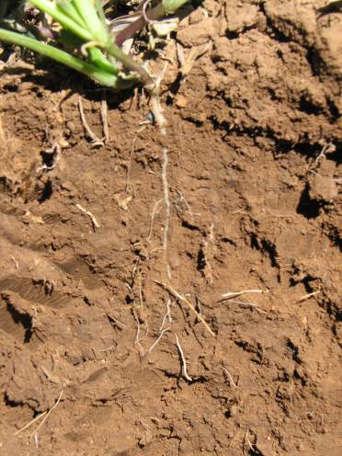
Canola Planting
Seed bed must be firm
Seeding depth—0.5-1.0”
Seed rate—2-10 lbs./A, but 5 is usu. OK
We recommend seed insecticide treatments
Date of planting

Slide 17
Date of Planting
Oklahoma State/Kansas State canola production guide suggests 9/12-10/6 for Panhandle & 9/15-10/10 for South Plains
Guide—6 weeks before killing freeze @ 25 F
That’s TOO LATE!! AgriLife Extension suggests last planting date of 9/15 in Panhandle, 9/20 in S. Plains
October, 2007 in Hale Co.—10/5, mediocre stand; 10/18, did not survive

Slide 18
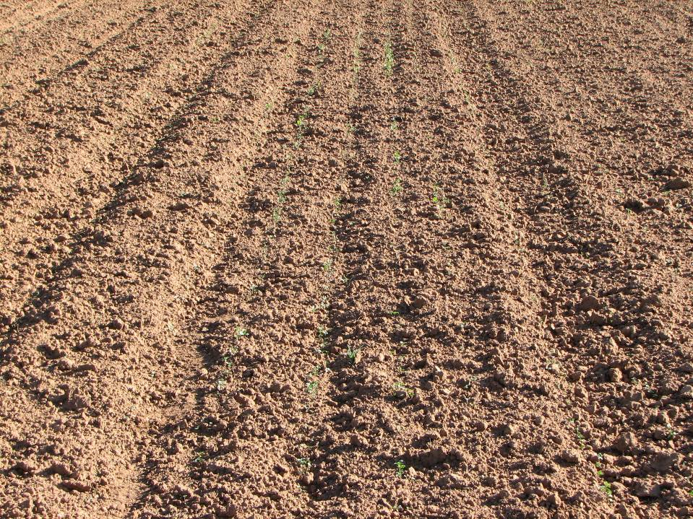
Seeding Depth
Seeding date: Sep 28, 07
Picture taken: Oct 12, 07
Location: Clovis

Slide 19
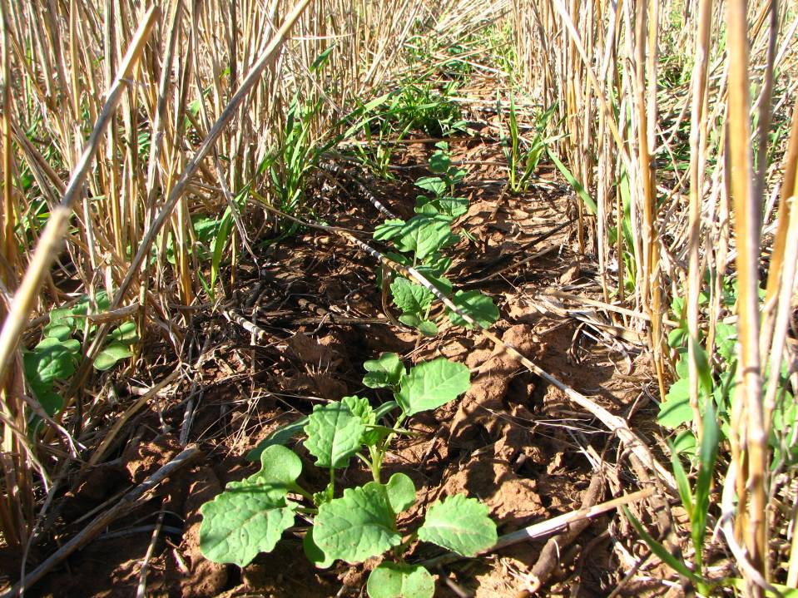
Seeding Depth
Seeding date: Sep 28, 07
Picture taken: Oct 12, 07
Location: Clovis

Slide 20
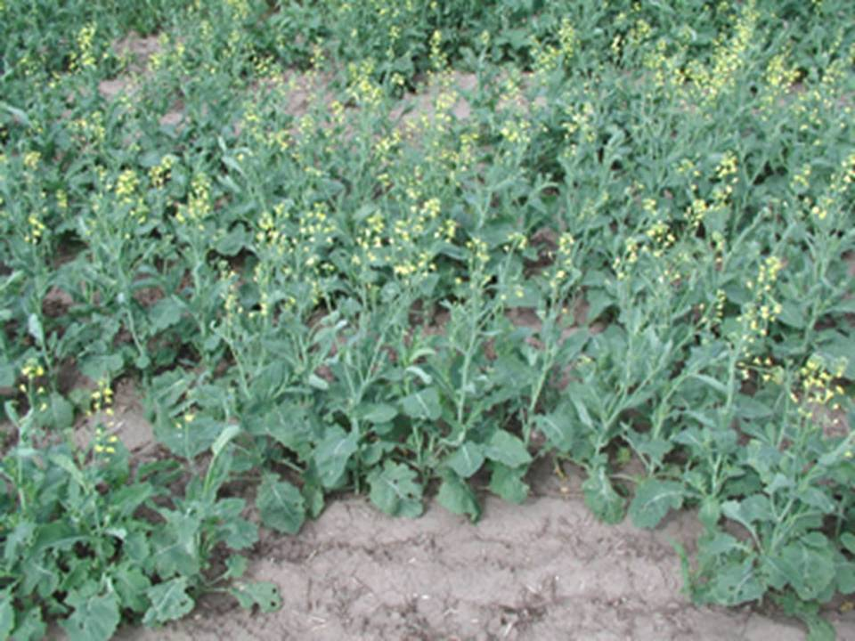
1 m
Uneven Population

Slide 21
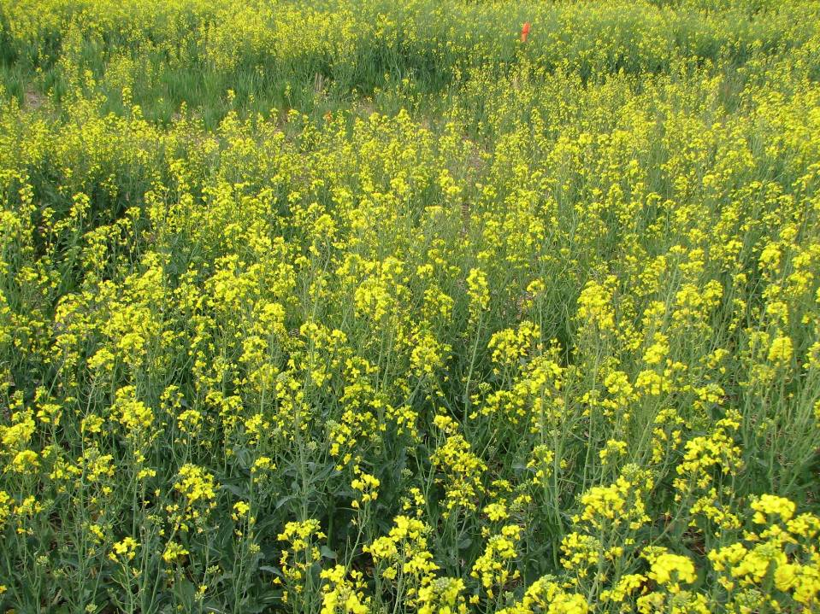
Fertility Management

Slide 22
Fertility Management
Nitrogen Requirement
Canola absorbs N early in the season
From Oklahoma State Extension:
N Rate lbs./A = 0.05 X yield goal (lbs./A) – soil test N (ppm)
At least 1/3rd in the fall
Sulfur Requirement
Canola needs sulfur (S)
Rate: 5% of N requirement

Slide 23
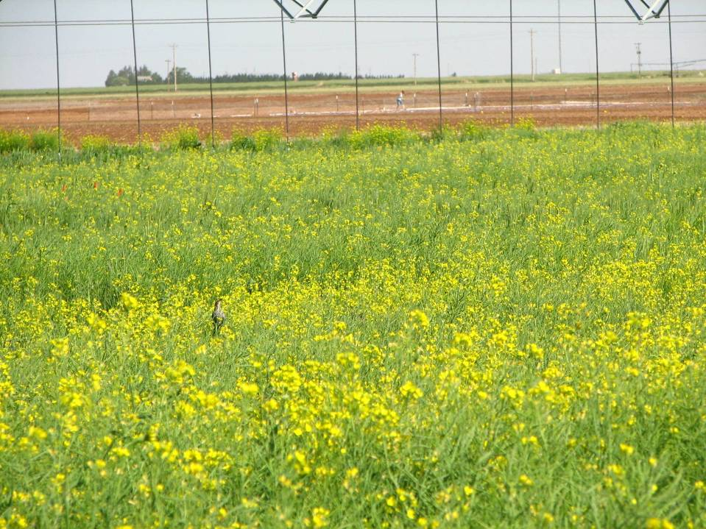
Water Management

Slide 24
Water Management
Winter canola needs fall irrigation or rainfall for good establishment
Flowering is the most critical stage for water stress
High temperatures increase the severity of water stress
Canola can recover by continuing flowering after stress is relieved
Late watering can delay maturity and uneven ripening of pods

Slide 25
Spring Canola Water Management
Treatments | Irrigation | Yield
 | (inches) | (lb/ac)
1-0-0-0-0† | 3.5 | 545
1-1-1-1-1 | 4.3 | 880
2-4-3-2-1 | 6.1 | 1123
2-2-2-1-1 | 6.1 | 1276
1-1-2-2-2 | 7.8 | 1130
1-1-3-4-3 | 8.9 | 1335
F-F-F-F-F | 9.6 | 1313
† Irrigation at five different stages |  | (Clovis 2007)

Slide 26
Early “Guesses” at Yield Potential
High Plains dryland—800-1,000 lbs./A
Irrigated, range of 8-10”, ~2,000 lbs./A
This depends greatly on established canola that has been fertilized
Biodiesel plant in Clovis, NM with maximum capacity of 15 million gallons/year: 50/50 irrigated dryland/irrigated → 200,000 acres needed, or 5% of High Plains wheat acres
~80% of wheat on bu/A basis

Slide 27
Harvest Management of Winter Canola

Slide 28
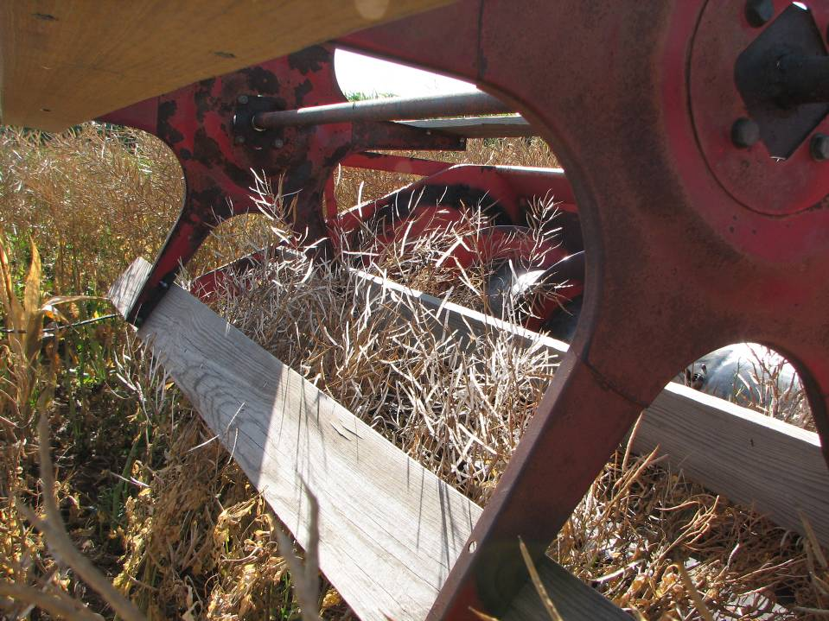
Direct Combining Canola

Slide 29
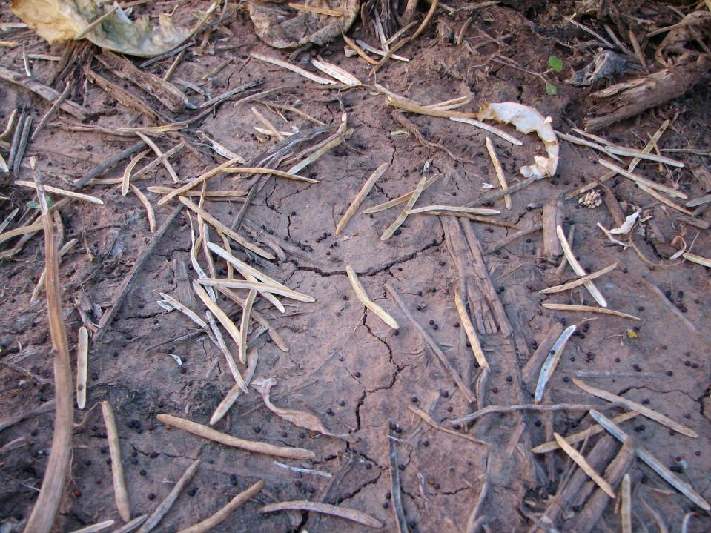
Canola Shatter Loss

Slide 30
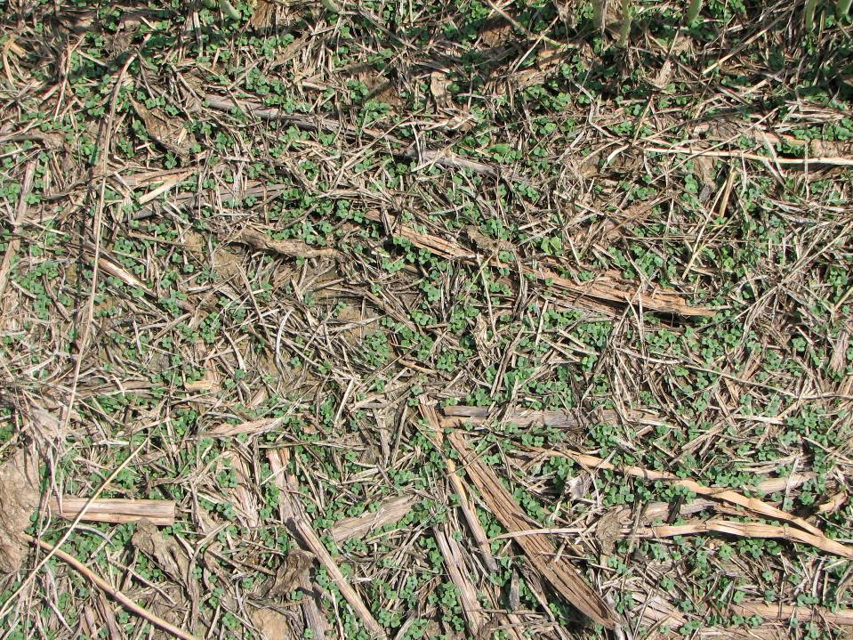
Volunteer Canola

Slide 31
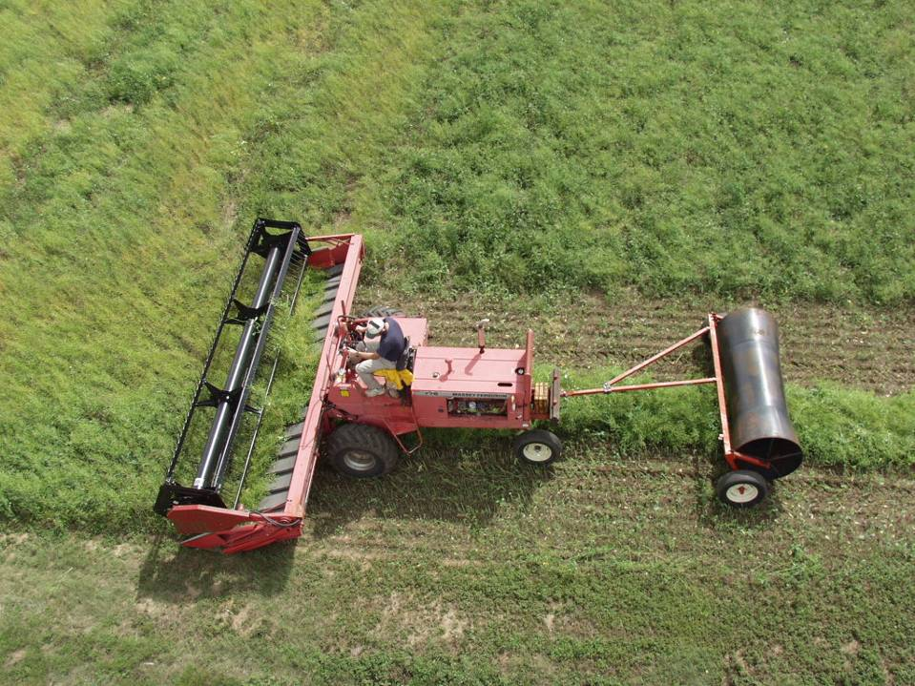
Swathing Canola

Slide 32
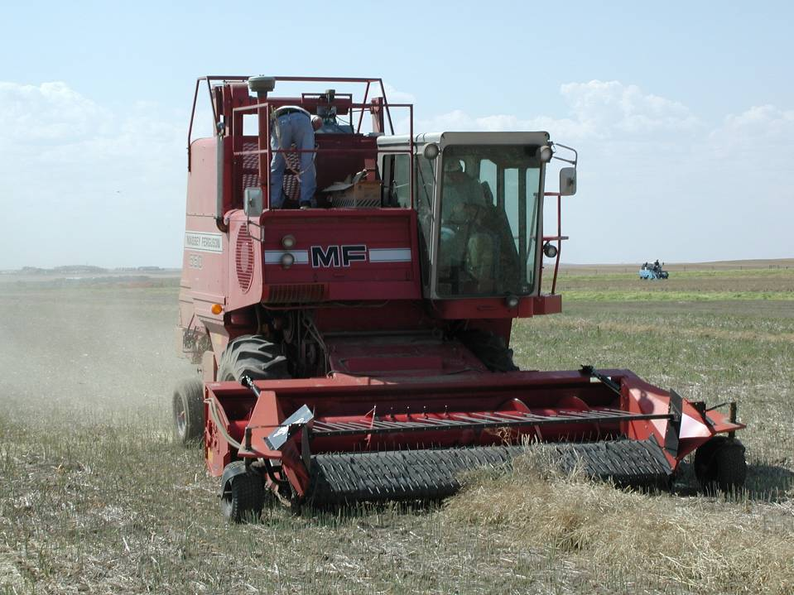
Harvesting Canola Swath

Slide 33
Harvest Management
Direct combine
Shattering losses
Narrow window
Cooler and humid part of the day
Non-uniform seed filling and green seeds
Swathing
An “art” to deciding when to swath--% of black seed
Less shattering, protect from storms better in windrow
Wider harvest window
Uniform seed filling
Wind problem
Need extra equipment

Slide 34
OSU/KSU Farmer Forum, 2008
Five farmers on the platform—see full summary of comments in your notebook
“Planting into residue is a problem; clean ground is best.”
“Need Roundup Ready canola to attack grass/weed issues.”
“I will never plant another acre of canola without a seed treatment (insects).”
Most prefer swathing

Slide 35
OSU/KSU Farmer Forum, 2008
Significant rotation advantage to subsequent wheat, at least 20%.
More fertilizer than wheat, always apply S
If too dry, plant wheat
Anticipate spraying for insects at least once
Not much luck with Select, Assure on grass control (hence RR canola)
Harvest timing is critical unlike wheat, don’t delay

Slide 36
Funding provided by
This event also made possible, in part, by generous support from the City of Plainview Convention & Visitors Bureau.

