Slide 1
The business analyst
Chapter 4

Slide 7
The business analyst
“A business analyst works as a association among stakeholders in order to elicit, analyze, communicate, and validate requirements for changes to business processes, policies, and information systems.”
OR
The business analyst is the individual who has the primary responsibility to elicit, analyze, document, and validate the needs of the project stakeholders.

Slide 8
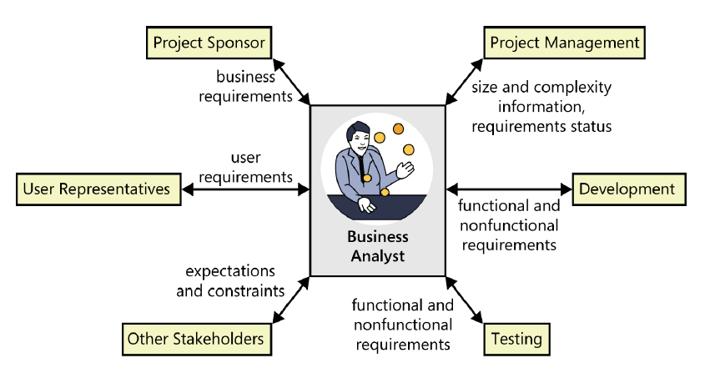
Cont.

Slide 9
The business analyst’s tasks
Define business requirements
Plan the requirements approach
Identify project stakeholders and user classes
Elicit requirements
Analyze requirements
Document requirements
Communicate requirements
Lead requirements validation
Manage requirements

Slide 10
Essential analyst skills
Listening skills
Interviewing and questioning skills
Thinking on your feet
Analytical skills
Systems thinking skills
Learning skills
Facilitation skills
Leadership skills
Observational skills
Communication skills
Organizational skills

Slide 11
A Well Rounded BA

