Slide 1
PHYSICAL THERAPIST AS CONSULTANT

Slide 2
Consultation is the rendering of professional or expert opinion or advice
Notes:
Render = Give something useful

Slide 3
Physiotherapist as Consultant
“ Consultation is the rendering of professional or expert opinion or advice by a physical therapist.
The consulting physical therapist applies highly specialized knowledge and skills to identify problems , recommend solutions, or produce a specified outcome or product in a given amount of time on behalf of a patient/client.”

Slide 4
PHYSICAL THERAPY CONSULTATION
Consultation is the practice of providing advice for a fee. This is a two-way interaction, a process in which a person or an organization seeks help, which the consultant provides.
The person or organization seeking help is the client, who may also be known as the customer, patient, or advisee.
Regardless of the label applied to the interaction (advising, coaching, counseling, consulting),this helping process is a key function of all professionals, including physical therapists.

Slide 5
Process of Consultation
Does The patient/client management role of the PT is a form of consultation ???
Patient care is a process of giving and receiving help
Developing and implementing plans of care, How to establish helping relationships with patients and ways to offer advice.

Slide 6
Therapist & patient relationship
Effect on consultation
Interactive model…..
According to Fuller Responsibilities of PT as following
Specialized services
Administrative skills
Problem solving
Investigative studies
Assessments
Advice
Notes:
Consultantant

Slide 7
Excelling in Consultation
By the time focusing on consultation as major income source & quitting (disengaging ) previous/other positions….
Consultants rather simple PT
Individuals typically are considered professional consultants when consultation is their only source of income

Slide 8
As the full-time consulting business grows, the level of consultation often changes.
PT consultant’s client base may broaden to include other health care professionals or different types of health care and community organizations.
Some PT consultants develop skills in organizational process, team building, or other consulting skills that do not require physical therapy expertise.

Slide 9
Consultant:
Generalist physical therapy consultants address a broad range of problems in physical therapy
Consultants must develop skills in identifying potential clients, marketing their services, determining their effectiveness, and attending to the ethical aspects of consultation

Slide 10
Fees Issues

Slide 11
Building a consulting Business
Consulting Fees: Value is determined by advisee/Patients.
Pt’s side
Type of business or industry,
its size and location,
The demand for consultants by such businesses
Client’s history of consultant use.

Slide 12
On the consultant’s side, factors include
the individual’s level of expertise,
degree of experience
professional standing.
This supply-and-demand situation creates a wide price range for consultation.

Slide 13
how to determine how much clients should be charged??
Determination with income goal
Amount needed to cover living and business expenses for 1 year,
determines the number of billable days in a year
using this information to arrive at a daily fees or per-hour fee.

Slide 14
Matching the fees charged by other physical therapy consultants…
Difficult to obtain this information…competition..
Reluctance in sharing fees schedule

Slide 15
WHAT you say about this….
If someone wants to open a clinic and is thinking over fees issue.
What should be the fees.
Either he should fix low fees or standard one…
Which is easy maneuver….starting with low fees and upgrading after some time or starting with high fees

Slide 16
If clients think that the consultant’s offer meets their needs, they most likely will pay the fee without questioning it.
Starting high, therefore, is easier than increasing fees at a later time.
Fixed price …..Project related

Slide 17
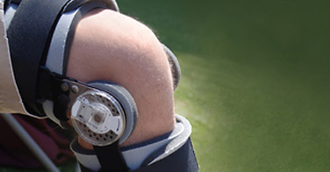
Regardless of the method used, the consultant must determine a consistent pricing structure that applies to all clients for the same work. Prices may vary if some aspect of the work is different (e.g., on-site versus home-based consultation) or
if the client is a nonprofit organization and the consultant chooses to give a discount.
If the fee structure changes, the consultant,, must be clear about the reason for the change

Slide 18
CONSULTING PROCESSES
SKILLS of a good consultant
Notes:
A skill is the learned capacity or ability to carry out pre-determined results often with the minimum outlay of time, energy, or both

Slide 19
CONSULTING PROCESS
Identify problems,
Consider alternatives,
Select and implement the best solution
Evaluate the solution’s effectiveness

Slide 20
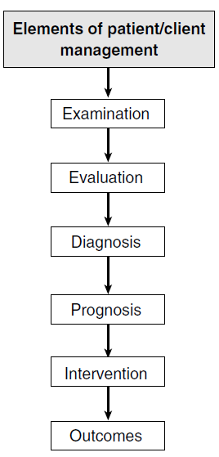
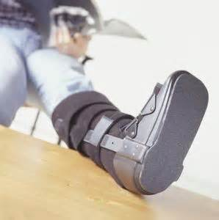

Slide 21
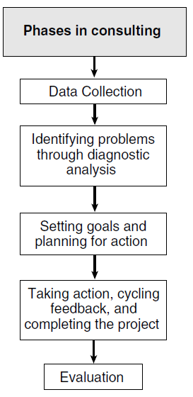

Slide 22
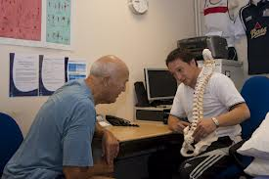
Skills of a good consultant
good advice,
technical capabilities
ability to diagnose problems and find
solutions,
ability to communicate,
ability to work under pressure.
behavior
Adventurous…take risk….
Solutions.
Strength & weakness
Trusting relationship with patient

Slide 23
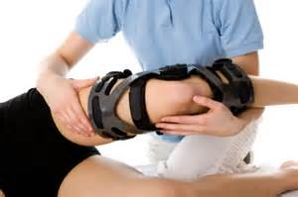
Trust in consultant client relationship
Consultant should be able to give
objective and independent advice to clients(that is unaffected by client’s personal biases , fears and concerns).
But consultant must be able to guard against their own biases, fears, and self-interests.

Slide 24
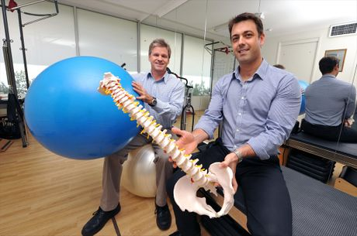
Feeling of patient about consultant
Respect…
Profit from weakness of others

Slide 25
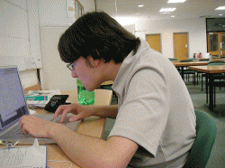
Consultant Need??
The presence of a consultant may suggest that the client has weaknesses and is unprepared to deal independently with the issues at hand.

Slide 26
Establishing trust is
critical…..
A consultant who puts the client’s interests first and is sensitive and careful in interactions with the client and others affected greatly improve the chances of success.
Trust is earned through direct experience in a highly emotional, and dynamic two-way relationship.

Slide 27
Client must feel free to accept or reject the consultant’s advice,
the consultant is responsible for organizing and directing the consultation process
toward the desired end of solving a problem

Slide 28
A consultant must be sensitive to the position of clients.
Clients’ reputations are at stake, because they will be evaluated on the results of the consultation.
Clients need to feel confident that the consultant will do a thorough, professional job.

Slide 29
consulting is primarily a relationship business. Without that relationship , the consultant’s specialized knowledge and experience are of no value.
Consultant’s success depends heavily on the quality of the relationship that develops as the process moves toward the desired goal.

Slide 30
Ethical and legal issues in consultation
The consultant is an independent contractor
more than an employee.
In an independent contractor agreement, a client hires an expert to perform a certain task, relinquishes control over the way the task is accomplished, and is relieved of certain legal responsibilities of employers.

Slide 31
Employment status is likely to be that of consultant If answer to 6 Q is YES …
1. Are you generally free to seek out many business opportunities and to work for more than one client at a time?
2. Are you paid a flat, negotiated fee for your work?
3. Do you provide your own resources to get the job done?
Notes:
Component of consulting aggrement

Slide 32
4. Are you at risk for suffering a loss if your estimated expenses are exceeded?
5. Is there no expectation that the work will continue indefinitely?
6. Is the work you are doing not considered a routine part of the organization?

Slide 33
Guide for professional conduct GPC
“A physical therapist shall seek consultation whenever the welfare of the patient will be safeguarded or advanced by consulting those who have special skills, knowledge, and experience” (GPC 11.1).

Slide 34
Clients of PT consultants should expect the consultant to be trustworthy, to maintain confidentiality, and to “make professional judgments that are in the patient’s/client’s best interests” (GPC 4.1A)

Slide 35
GPC 5.1
“A physical therapist shall practice within the scope of his/her competence and commensurate* with his/her level of education , training, and experience.”
* Corresponding in size, degree or extent

