Slide 1
Deflection and Slope of Simply supported beam
Lecture # 12

Slide 2
Introduction
The simply supported beam is one of the most simple structures.
It features only two supports, one at each end. A pinned support and a roller support.
With this configuration, the beam is allowed to rotate at its two ends but any vertical movement there is inhibited.
Due to the roller support it is also allowed to expand or contract axially, although free horizontal movement is prevented by the other support. This is a determinant (also called critical) structure, which means that if any of the supports is removed or an internal hinge is inserted, the beam is unable to carry loads anymore and it becomes a mechanism (a structure that moves freely under loading).

Slide 3
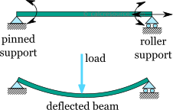
Introduction

Slide 4
Reference table: maximum deflection of simply supported beams
For reference purposes, the following table presents formulas for the ultimate deflection ẟu of a simply supported beam, under some common load cases.
In all cases, E is the material modulus of elasticity and I the cross section moment of inertia around the elastic neutral axis.
Also, take in mind that a positive sign of the maximum deflection means a downward direction.

Slide 6
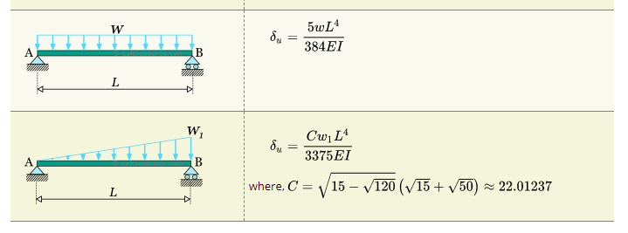

Slide 7
Classical beam theory
Trying to estimate the deformations of a beam under transverse loading several beam theories are available.
The most widely adopted is the Euler-Bernoulli beam theory, also called classical beam theory. The two basic assumptions of the theory are:
The deformations remain small
the cross sections of the beam under deformation, remain normal to the deflected axis (aka elastic curve).

Slide 8
Classical beam theory
The second assumption is practically valid for beams with homogeneous and isotropic material, with symmetrical cross-section, and with length significantly larger than their cross section dimensions (10 times or more is a common rule of thumb).
Effectively, if the beam deforms significantly in any other form except symmetric bending then the assumption of normal and plane cross sections is not satisfied.
Examples of such cases include short beams, beams with sandwich type cross-sections, or slender cross-sections or open unsymmetrical cross-sections.

Slide 9
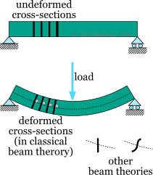
Classical beam theory

Slide 10
Classical beam theory
Also the following assumptions are typically associated with the classical beam theory:
the material is linear elastic
the beam is prismatic, which means that the cross-section remains constant throughout its length
Under these assumptions, the classical beam theory results to the following relationship between the deflection y, as a function of and the bending moment M:

Slide 11
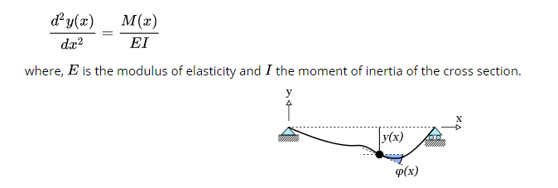
Classical beam theory

Slide 12
Finding deflections and slopes
Depending on the material, a beam may develop large deflections without breaking, even remaining elastic.
So it can be safe from failure, but there other reasons to consider excessive deflections undesirable.
Therefore, finding the deflections is an important step in the static analysis of a structure.
Provided, the bending moment diagram has been determined at a previous stage of the static analysis, and that the classical beam theory is adopted, the differential equation can be used as a means to find the deflections and the slopes across the beam.
If we integrate once, we find the first derivative of the deflection, which represents the beam slope:

Slide 13
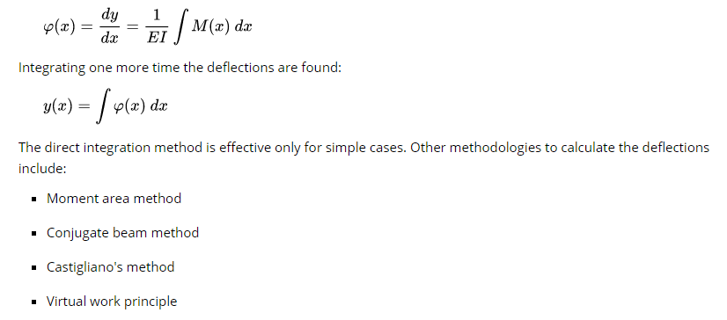
Finding deflections and slopes

Slide 15
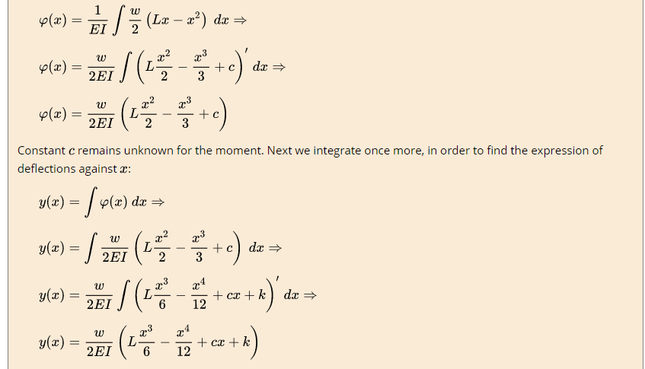

Slide 16
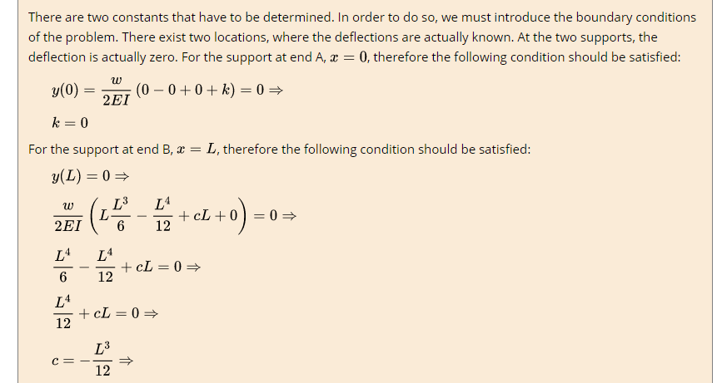

Slide 22
Thanks

