Slide 1
Chapter 7 (Remaining part)
Multimedia System and Design

Slide 2
What You Need: The Intangibles
Hardware
Software
Good ideas to make multimedia
talent and skill
Time and money
Team Effort
Artwork is performed by graphic artists
Video shoots by video producers
Sound editing by audio producers
Programming by programmers

Slide 3
Creativity
The better you know your medium, the better able you are to express your creativity.
In the case of multimedia, this means you need to know your hardware and software first.
Once you’re proficient with the hardware and software tools, you might ask yourself, “What can I build that will look great, sound great, and knock the socks off the viewer?”

Slide 4
Organization
It’s essential that you develop an organized outline and a plan that rationally details the skills, time, budget, tools, and resources you will need for a project.
These files—called assets—should continue to be monitored throughout the project’s execution.

Slide 5
Communication
Communication among workgroup members (instructional designers, writers, graphic artists, programmers, and musicians, etc. ) and with the client is essential to the efficient and accurate completion of your project.

Slide 6
What You Need: Hardware
--2 most significance platforms:
• Macintosh OS
• Intel-based IBM PC or PC Clone (MS Windows)
– Development environment
• Powerful workstation (Silicon Graphics, Sun Microsystems, or mainframe)
– Apple (Macintosh OS) more suitable for multimedia editing
– Cross platform format (both Mac & Windows)

Slide 7
Introduction to Making Multimedia
• Networking
– A collection of computers and other hardware components interconnected by communication channels that allow sharing of resources and information.
– LAN and WAN
– Cable and Wireless
• Ethernet, Fiber Optics, WIFI, Bluetooth n etc
– Internet Service Provider

Slide 8
Introduction to Making Multimedia
• The various connection methodologies include:
– Small Computer System Interface (SCSI)…. (for attaching printers, disk drives, scanners and other peripherals to computers.)
– Integrated Drive Electronics (IDE)…. (is a standard interface for connecting a motherboard to storage devices such as hard drives and CD-ROM/DVD drives.)
– Universal Serial Bus (USB).
– FireWire (is a method of transferring information between digital devices, especially audio and video equipment.)
– SATA ( is a computer bus interface that connects host bus adapters to mass storage devices such as hard disk drives)
– IDE (An integrated development environment (IDE) is a software application that provides comprehensive facilities to computer programmers for software development.)
– Fiber Channel
– Serial and Parallel Port
– Types of connections and transfer rate (refer to table 7-2 page 203

Slide 9
Small Computer System Interface (SCSI)
• SCSI can connect internal and external peripheral equipments and devices that conform to the SCSI standard.
• SCSI cards can be installed on Macintosh and PC platforms.
• SCSI is preferred for real-time video editing, network servers, and situations that require mirroring.

Slide 10
Integrated Drive Electronics (IDE)
• IDE connections are also known as Advanced Technology Attachment (ATA).
• They connect only internal peripherals.
• They can connect four peripherals mounted inside the PC.
• The circuitry for IDE is less expensive than SCSI.
• IDE utilizes processor chip time.

Slide 11
Universal Serial Bus (USB)
• It is a standard for connecting devices to the computer using the plug-and-play system.
• USB uses a single cable to connect 127 USB peripherals to a single PC.
• It can be attached to one computer at a time

Slide 12
FireWire
• FireWire was introduced by Apple in the 1980s.
• It is the industry standard and provides support for high-bandwidth serial data transfer, particularly for digital video and mass storage.
• Can connect multiple computers and peripheral devices (peer-to-peer).
• It is the most common method for connecting and interconnecting professional digital video equipment.

Slide 13
Memory
• Sufficient memory must be allocated for storing and archiving files.
• Memory requirements of a multimedia project depend on the project's content and scope.
• The two types of memory are random access memory (RAM) and read only memory (ROM).
• Storage Device : Hard Disk, Flash Memory, CD- ROM, DVD and
Blue Ray Disc is a digital optical disc data storage format. It was designed to supersede the DVD format, and is capable of storing several hours of video in high-definition and ultra high-definition resolution.

Slide 14
Input Devices
• Allow user enter DATA and COMMANDS into memory.
• Example: keyboard, mouse, camera, microphone and etc.
• Four forms of input: – Data – Program – Commands – User responses
Keyboard - Is the most commonly used input device. The most common keyboard for PCs is the 101 style, which provides 101 keys.
• Mouse - Is the standard input device for a graphical user interface (GUI).

Slide 15
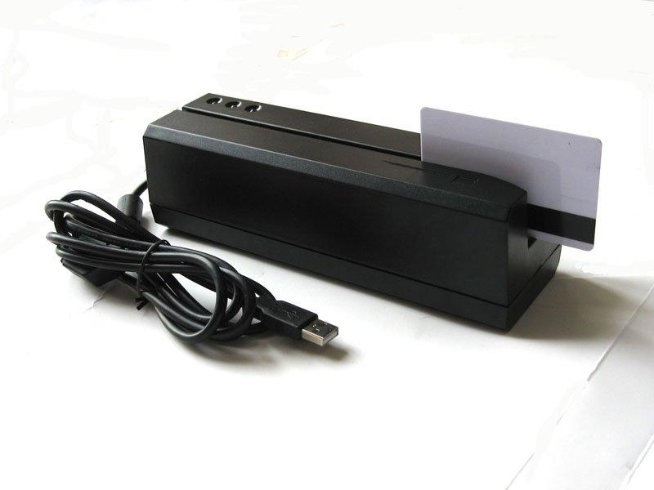
Input Devices
Trackball - It is suitable to small confined environments such as a portable laptop.
• Touch screen - They are monitors that usually have a textured coating across the glass face.
• Magnetic card encoder and reader - Is useful when an interface is needed for a database application or multimedia project that tracks users.
• Graphic tablet - Provides great control for editing finely detailed graphic elements.
• Scanner - Is the most useful device for producing multimedia. They are categorized as flat-bed, handheld, and drum.

Slide 16
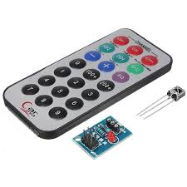
Input Devices
Optical Character Recognition (OCR) device - Is used to convert printed matter into ASCII text files.
Infrared remote - Is used to interact with the project when the user needs to move about.
Voice recognition system - Is used to facilitate hands-free interaction with the project.
Digital camera - Is used to capture still images of a specific resolution, and store them in camera’s memory. These images can then be uploaded to a computer.

Slide 17
Output Devices
• Convey information to one or more people.
• 4 forms of output: – Text – Graphics – Audio – Video
Audio devices:
– They include sound chips and microphones.
– Amplifiers are required when the project has to be presented to a large audience or in a noisy setting.
– Speakers can be internal or external.
Video devices:
– Video creates the maximum visual impact.
– Video devices include videodisc players and video cards.
– Videodisc players provide precise control over the image being viewed.
– Video cards enable the user to place an image in a window on the computer monitor.

Slide 18
Output Devices Projectors
– Projectors are used when you have a larger audience that can be accommodated around a computer monitor.
– The different types of projectors include
• Cathode-Ray Tube (CRT)
• Liquid-Crystal Display (LCD) panels
• Stand-Alone LCD projectors
• Light-Valve projectors.
– CRT projectors are compatible with the output of most computers as well as televisions.
– LCD panels are portable devices that are popular for on-the-road presentations.
– Light-valve projectors use liquid crystal technology. The images generated are very bright and color saturated and can be projected onto wide screens.

Slide 19
Output Devices Printers:
– The 2 types of printers:-
– Laser printers offer higher print quality, lower operating costs, but a higher initial cost.
– Inkjet printers are comparatively cheaper, but require higher maintenance.
– Color printers have become an important part of multimedia development.

Slide 20
Software
– Multimedia software tells the hardware what to do – Text, images, sounds, and video.
• Capturing images, translating between file formats, and editing your resources
• Photoshop, Premiere, GIF Animator, etc.
– Multimedia authoring
• Macromedia Director or flash
– Everybody can make multimedia project!!

Slide 21
Types of Software
• Text-based editing tools.
• Graphical tools.
• Sound editing tools.
• Animation, video, and digital movie tools.
• Video formats.
• Utilities useful for multimedia.
• Software, also called a program, is a series of instructions that tells the computer what to do and how to do it.
• Users interact with the program through its GRAPHICAL USER INTERFACE (GUI) which contains an object called ICON (can be as text, graphics or visual images). ICONs

Slide 22
Software
• Two categories of software:
– System Software
– Application Software
System Software – Consists of the programs that control or maintain the operations of the computers and its devices.
– 2 types of system software
• Operating System – Windows XP
• Utility Programs – Disk defragmenter, Anti virus, Scan Disk
2. Application Software
• Consists of programs that perform specific task for user. Application software is used for a variety of reasons:
– As business tool
– To assist with graphics and multimedia projects
– To support home, personal and educational activities
– To facilitate communications

Slide 23
Software
• Business Software
– Accounting
– Stock
• Graphic and Multimedia Software
– Photo Editing
– Authoring tools
– Movie Players
• Home, Personal and Education Software
– Courseware
• Communication Software
– Yahoo Messenger MSN Messenger
• Web Application

Slide 24
Text-based Editing Tools Word processors: –
Are powerful applications that include spell checkers, table formatters, thesaurus, and pre- built templates for commonly used documents.
– Are used for creating project letters, invoices, and storyboards.
– Allow embedded multimedia elements.
Microsoft Word and WordPerfect are Word processors. – Often come bundled in an "Office Suite."

Slide 25
Text-based Editing Tools Optical Character Recognition (OCR) software: –
Converts bitmapped characters into electronically recognizable ASCII text.
– Makes use of probability and expert system algorithms.
– Is very accurate and saves time and effort.

Slide 26
Graphical Tools
• Painting and drawing tools.
• 3-D modeling tools.
• Image editing tools.
Painting and Drawing Tools
• Most graphic programs use bitmapped images since they provide the greatest choice.
• Include the Eyedropper tool, Autotrace tool, and anti- aliasing, airbrushing, blending, and masking functionalities.
• Photoshop, Fireworks, and Painter are painting software.
• CorelDraw, FreeHand, and Illustrator are drawing software.

Slide 27
Painting and Drawing Tools Features include:
–graphical user interface.
– Scalable dimensions.
– Multiple undo capability.
– Scalable text font support.
– Support plug-ins.
– Layering capability.

Slide 28
3-D Modeling Tools Features
– Good color and palette management.
– Multiple dimension windows and unlimited cameras.
– Lathe and extrude features.
– Ability to drag and drop primitive shapes,
– Color and texture mapping.

Slide 29
Image-Editing Tools
• Are specialized and powerful tools for enhancing and retouching existing bitmapped images.
• Features include conversion of image-data types and file formats, masking features, employment of virtual memory scheme, etc.
• Support plug-ins.

Slide 30
Sound Editing Tools
• Enables the user to see music as well as hear sound.
• This is done by drawing a representation of sound in fine increments.
• Enable the user to create custom system beeps.
• System beeps are pre-packaged sounds that indicate an error, warning or special user activity.

