Slide 1
Extension Methods by Nature of Contact
GROUP CONTACT METHODS
Group Meetings
Group Discussions
Demonstrations (Result & Method Demonstration)
Training/ Workshop/ Seminar
Symposium
Brainstorming
Buzz Group

Slide 2
ADVANTAGES OF GROUP CONTACT METHODS
Low cost per participant as compared to individual methods
Reach large audience in less time
Experimental learning, group learning
Use of demonstrations as effective tools
Motivation is effective due to group influence

Slide 3
DISADVANTAGES OF GROUP CONTACT METHODS
Diversity in the interest of group members
Holding the meeting may be regarded as an objective in itself
Different interests groups, caste groups & village fractions may hinder free interaction
Decision making influenced by group members

Slide 4
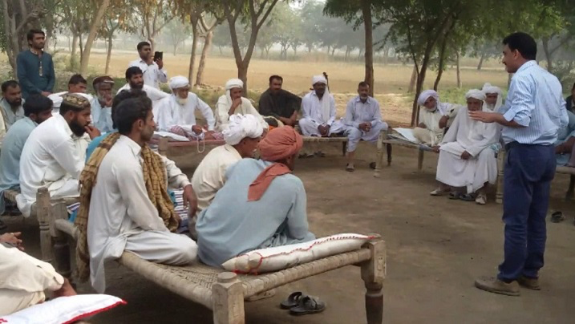
GROUP MEETINGS
In Group Meetings extension worker communicates to group of farmers at farmer’s home or field
Meeting are used to collect farmers’ inputs different needs, challenges & proposed solutions.
To train farmers on new technologies, methods or practices
To get feedback related to discussed issue or technology.
Group meetings promote learning

Slide 5
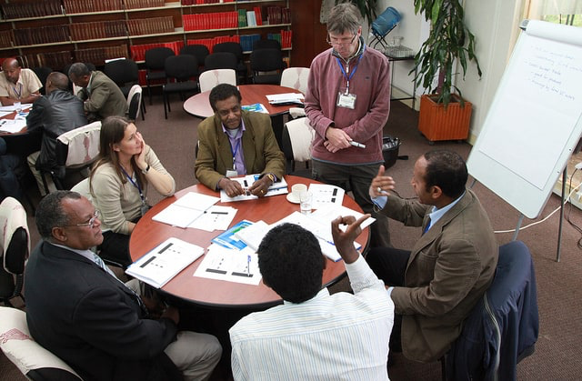
GROUP DISCUSSIONS
It is that form which occurs when group of farmers, recognizing a common problem exchange and evaluate information and ideas, in an effort to solve that problem.
Their effort may be directed towards a better understanding of the problem
Toward the development of a program of action relative to the problem.
Discussion usually occurs in a face-to-face or co- acting situation, with the exchange being spoken.

Slide 6
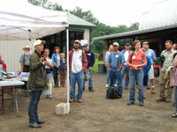
DEMONSTRATIONS
METHOD DEMONSTRATION:
It is a relatively short-time demonstration given before a group to show how to carry out an entirely new practice or an old practice in a better way.
It is not concerned with providing the worth of a practice but with how to do something
it is definitely not an experiment or trail but a teaching effort.
The method demonstration is given by the extension worker himself or a trained leader for the purpose of teaching a skill to a group.

Slide 7
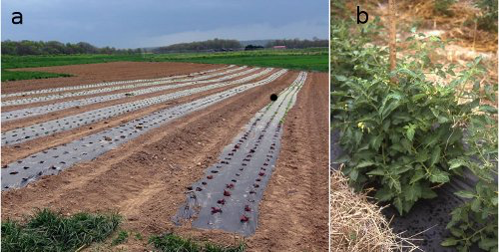
RESULT DEMONSTRATIONS
A result demonstration is designed to show by example the practical application of an established fact, or group of related facts.
In other words, it is a way of showing people the value or worth or an improved practice whose success has already been established on the research station.
In this method the new practice is compared with the old one so that the learners may see and judge the results for themselves

Slide 8
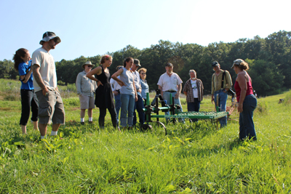
TRAINING/ WORKSHOP/ SEMINAR
Training is the action of teaching a person a particular skill/s
Workshop is a type of interactive learning where participants carry out practical activities
In seminars different experts discuss solutions to various issues in related field

Slide 9
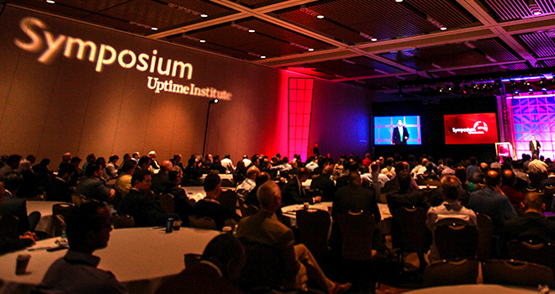
SYMPOSIUM
Symposium is an academic activity highlighting any problem.
All the experts discuss their findings related to issue.
Participants ask their issues related to topics
Symposium is similar activity like conference

Slide 10
BRAINSTORMING
Group based creative activity in which efforts are made to reach conclusion for any specific problem.
List of ideas is generated contributed by all participants.
Total participants are up to 12 including expert
At the end final conclusion is made by expert based on different inputs of participants

Slide 11
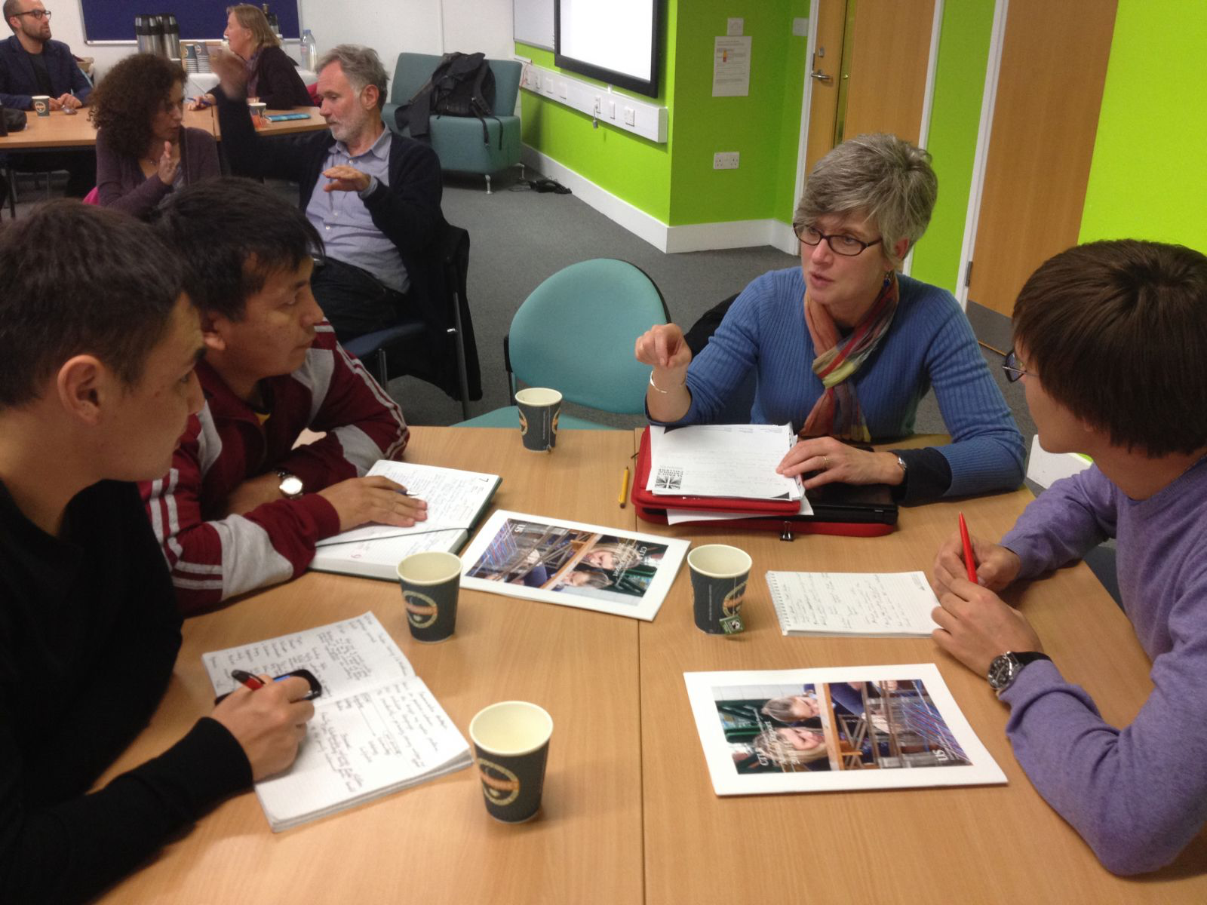
BUZZ GROUP
Method in which small groups of 3-4 participants discuss a specific issue, to gather different ideas by participating groups.
some times it is used as “ice breaker” in training/s
Small groups are given 5-15 minutes to complete their tasks
Participating groups have one member as leader
At the end all inputs are gathered to generate overall conclusion

