Slide 1
VASCULITIS

Slide 2
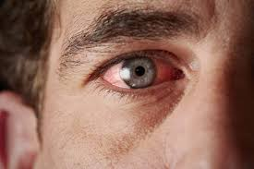
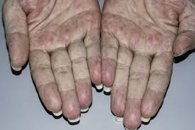
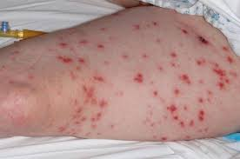
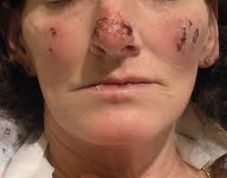
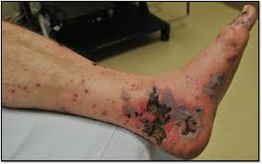
DEFINITION OF VASCULITIS :
This is a heterogeneous group of diseases characterised
by inflammation and necrosis of blood vessel walls, with
associated damage to skin, kidney, lung, heart, brain
and gastrointestinal tract.
There is a wide spectrum of
involvement and disease severity, ranging from mild and
transient disease affecting the skin, to life-threatening ful-
minant disease with multiple organ failure.

Slide 3
ETIOLOGY :
Vasculitis may occur secondary to a variety of inflammatory and infectious diseases, including SLE, Sjögren’s syndrome, RA, endocarditis and hepatitis B or C, when it is thought to be due to deposition of immune complexes in small vessels.
Primary vasculitis occurs in the absence of a known cause. It is uncommon.
Vasculitis is usually classified on the basis of the size of vessel involved.

Slide 4
Pathogenesis
vasculitis result from a combination of local tissue ischaemia (due to vessel inflammation and narrowing) and the systemic effects of widespread inflammation.

Slide 5
Clinical features:
Systemic vasculitis should be considered in any patient with fever, weight loss, fatigue, evidence of multisystem involvement, rashes, raised inflammatory markers and abnormal urinalysis.
Other conditions that may mimic vasculitis include sepsis (particularly infective endocarditis and meningococcaemia), malignancy, cholesterol emboli, atrial myxoma and the antiphospholipid syndrome.
This may lead to diagnostic delay, but early diagnosis and management are essential to prevent irreversible organ damage.

Slide 6
GIANT CELL ARTERITIS

Slide 7
GIANT CELL ARTERITIS

Slide 8
GIANT CELL ARTERITIS

Slide 9
GIANT CELL ARTERITIS

Slide 10
GIANT CELL ARTERITIS

Slide 11
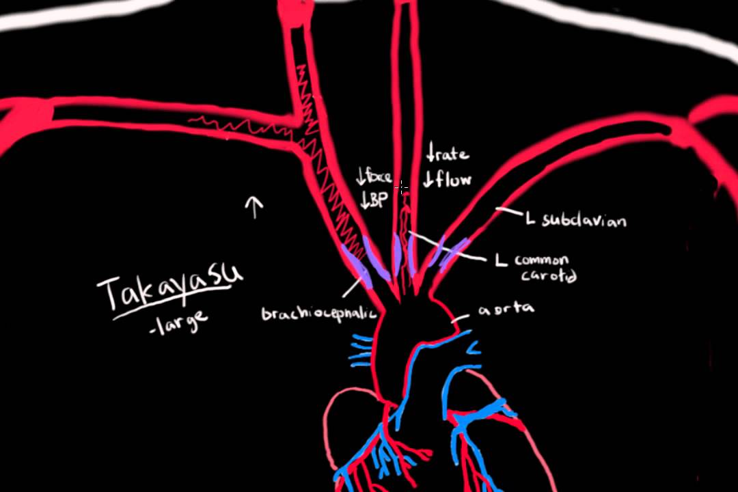
TAKAYASU ARTERITIS :
Takayasu’s disease predominantly affects the aorta, its major branches and occasionally the pulmonary arteries.
The typical age at onset is between 25 and 30 years, with an 8:1 female preponderance.
It has a world-wide distribution but is most common in Asia.
In contrast to other vasculitides, Takayasu’s is characterised by granulomatous inflammation of the vessel wall leading to vessel occlusion or weakening of the vessel wall.
It presents with claudication, fever, arthralgia and weight loss.
The vessels most commonly affected are the aorta, carotid, ulnar, brachial, radial and axillary arteries.

Slide 12
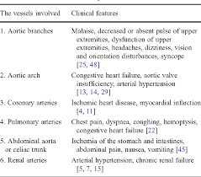
CLINICAL FEATURES OF TAKAYASU ARTERITIS :-
Clinical examination may reveal loss of pulses, bruits, hypertension and aortic incompetence.

Slide 13
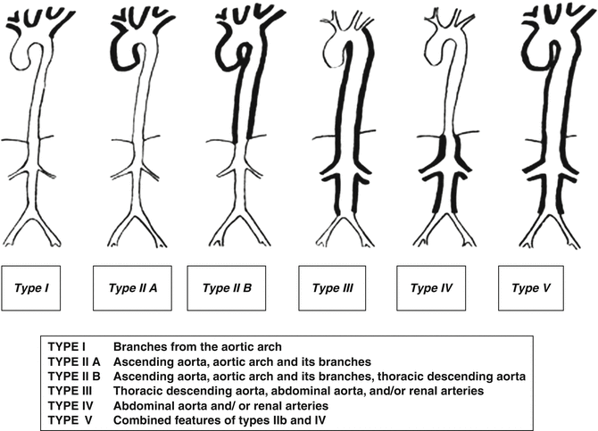
TYPES OF TAKAYASU ARTERITIS:-
The distribution of involvement is classified into four types:
• type 1: localised to the aorta and its branches
• type 2: localised to the descending thoracic and
abdominal aorta
• type 3: combines features of 1 and 2
• type 4: involves the pulmonary artery.

Slide 14
TAKAYASU ARTERITIS
Angiography(gold standard) and tissue biopsy are the pivotal investigations
CBC ,ESR,CRP: Investigation shows an increased APR and normocytic, normochromic anaemia, but the diagnosis is based on angiographic findings of coarctation, occlusion and aneurysmal dilatation

Slide 16
Treatment

Slide 17
Prognosis
With appropriate treatment, the 5-year survival is 83%.

Slide 18
POLYARTeritis nodosa:-
PAN can affect any age group but the peak incidence is between 40 and 50, with a male preponderance of 2:1.
Hepatitis B is an important risk factor.
Pathological changes comprise necrotising inflammation and vessel occlusion, and in 70% of patients arteritis of the vasa nervorum leads to neuropathy which is typically symmetrical and affects both sensory and motor function.

Slide 19
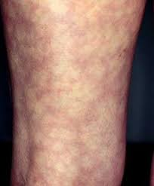
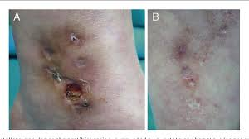
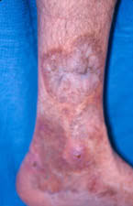
POLYARTeritis nodosa:-
Presentation is with fever, myalgia, arthralgia and weight loss, in combination with manifestations of multisystem disease.
The most common skin lesions are palpable purpura, and
livedo reticularis
ulceration, infarction

Slide 20
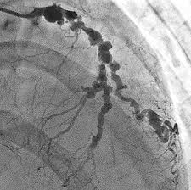
PAN continued…
Severe hypertension and/or renal impairment may occur due to multiple renal infarctions but glomerulonephritis is rare (in contrast to microscopic polyangiitis).
The diagnosis is confirmed by angiographic demonstration of multiple aneurysms and smooth narrowing of mesenteric, hepatic or renal systems, or by histology (muscle or sural nerve biopsy).
Mortality is less than 20% with treatment but relapse occurs in up to 50% of patients.
Notes:
These findings on coronary angiography are most consistent with severe generalized coronary arteritis. This 25-year-old woman had been given a diagnosis of polyarteritis nodosa 3 years earlier and was receiving prednisolone maintenance therapy when she presented with cardiac arrest. Although severe cardiac involvement in polyarteritis nodosa is unusual, it can result in myocardial infarction and confers a poorer prognosis. Despite treatment, the patient died a few months later.

Slide 21
Diagnostic Criteria PAN

Slide 22
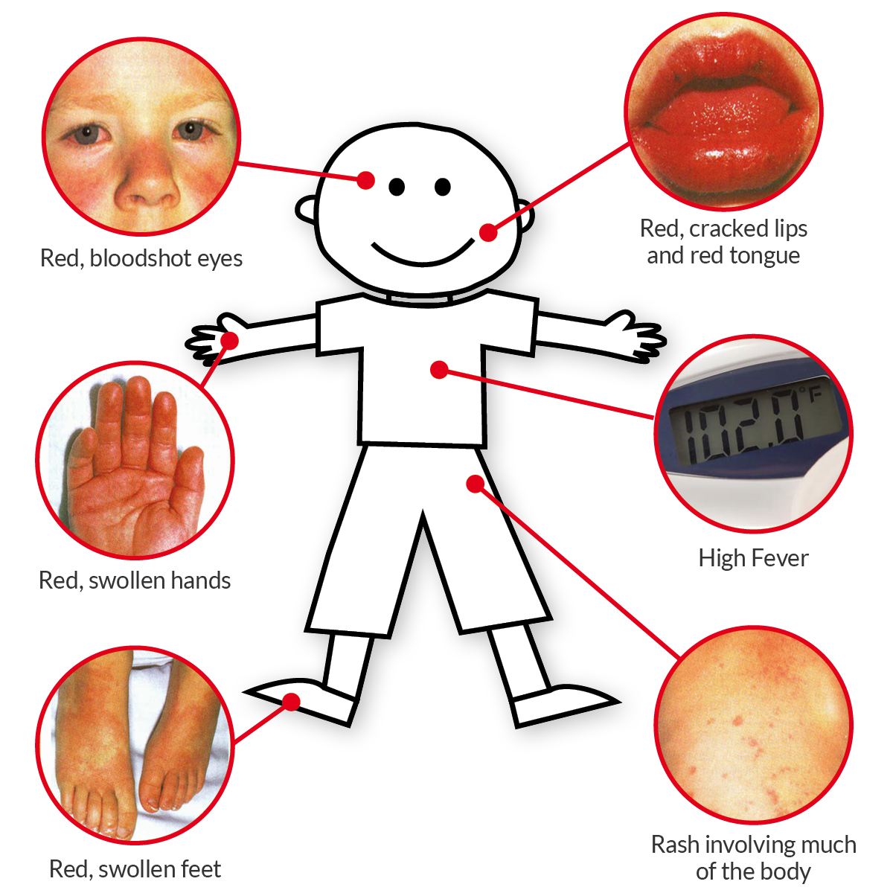
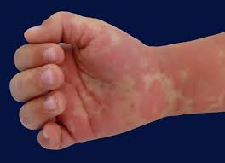
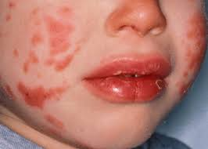
KAWASAKI DISEASE :-
Kawasaki disease is an acute systemic disorder of childhood that predominantly occurs in Japan.
Presentation is with fever, generalised rash including the palms and soles, inflamed oral mucosa and conjunctival injection resembling a viral exanthem or Stevens–Johnson syndrome.

Slide 23
KAWASAKI DISEASE :-
Although the causative trigger is unknown, it has been associated with Mycoplasma and HIV infection.
Cardiovascular complications include transient coronary dilatation, myocarditis, pericarditis, myocardial infarction, peripheral vascular insufficiency and gangrene.
Treatment is with aspirin (5mg/kg daily for 14 days) and intravenous gammaglobulin (400mg/kg daily for 4 days).

Slide 24
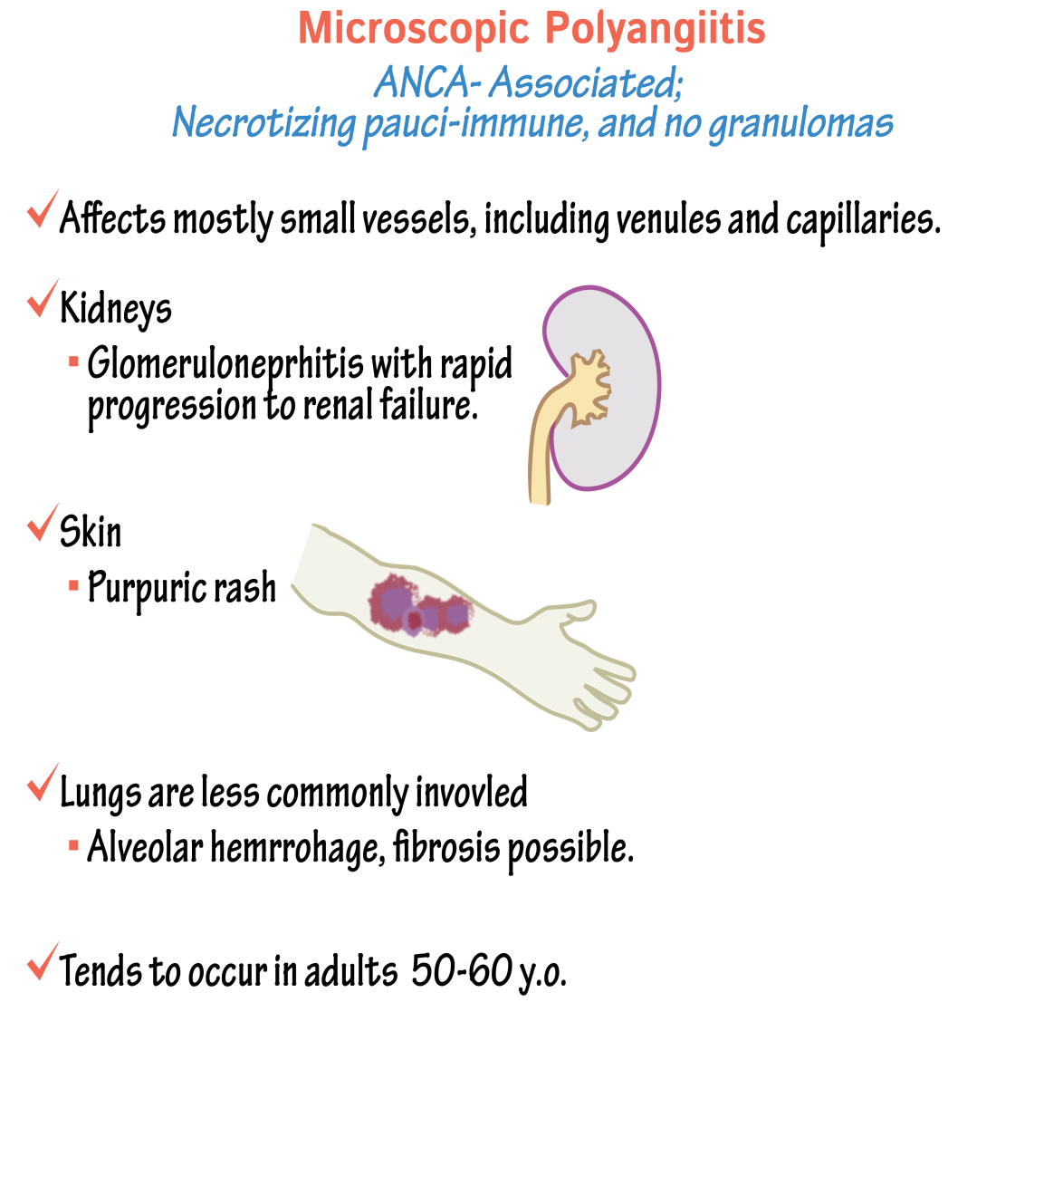
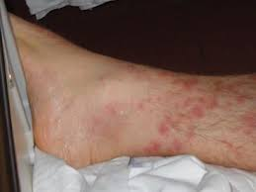
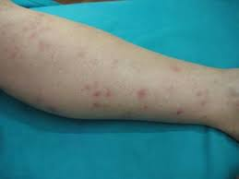
MICROSCOPIC POLYANGIITIS:-
This has an annual incidence of about 8/1 000 000 and is characterised by necrotising vasculitis affecting small vessels.
Typical presentation is with rapidly progressive glomerulonephritis, often associated with alveolar haemorrhage. (renal-pulmonary syndrome)
Cutaneous and gastrointestinal involvement is common and other features include neuropathy (15%) and pleural effusions (15%).
Patients are usually p-ANCA (myeloperoxidase)-positive.

Slide 25
WEGENER GRANULOMATOSIS:-
WG has an incidence of 5–10/1 000 000 and is characterised by granulomatous inflammation and necrotising vasculitis affecting the nasal passages, airways and kidney. (renal pulmonary syndrome)

Slide 26
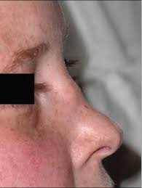
WEGENER GRANULOMATOSIS
The most common presentation is with upper airway involvement (typically epistaxis, nasal crusting and sinusitis), The bridge of the nose can collapse resulting in a “saddle–nose deformity”.haemoptysis, mucosal ulceration and deafness due to serous otitis media.
Untreated nasal disease ultimately leads to destruction of bone and cartilage.
A minority of patients present with glomerulonephritis.
Patients are usually c-ANCA-positive.

Slide 27
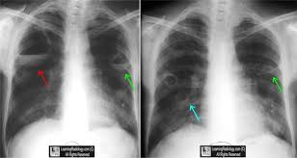
WEGENER GRANULOMATOSIS
granulomatous inflammation
and necrotising vasculitis
Migratory pulmonary infiltrates and nodules occur in 50% of patients.

Slide 28
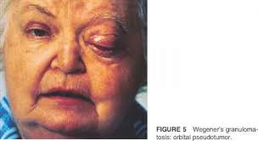
WEGENER GRANULOMATOSIS
Proptosis (abnormal protrusion or displacement of an eye or other body part.)may occur due to inflammation of the retro-orbital tissue, causing diplopia due to entrapment of the extra-ocular muscles, or loss of vision due to optic nerve compression. Disturbance of colour vision is an early feature of optic nerve compression.

Slide 29
WEGENER GRANULOMATOSIS

Slide 30
Treatment

Slide 31
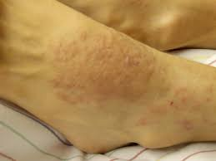
CHURG STRAUSS SYNDROME:-
CSS has an incidence of 1–3/1 000 000.
Pathologically, it is similar to WG but eosinophilic infiltration of the vessel wall also occurs.
Most patients have a prodromal period for many years characterised by allergic rhinitis, nasal polyposis and late-onset asthma that is often difficult to control.
The typical acute presentation is with a triad of skin lesions (purpura or nodules), asymmetric mononeuritis multiplex,renal impairment and eosinophilia on a background of resistant asthma.
Pulmonary infiltrates and pleural or pericardial effusions due to serositis may be present.
Up to 50% of patients have abdominal symptoms due to mesenteric vasculitis. Either c-ANCA or p-ANCA is present in around 40% of cases.
R-Rash A-asthma P-petechiae ( RAP)
F-fever A-arthralgia N-neuropathy (FAN)
E-Eosinophilia AR-arthralgia S-sinusitis (EARS)

Slide 32
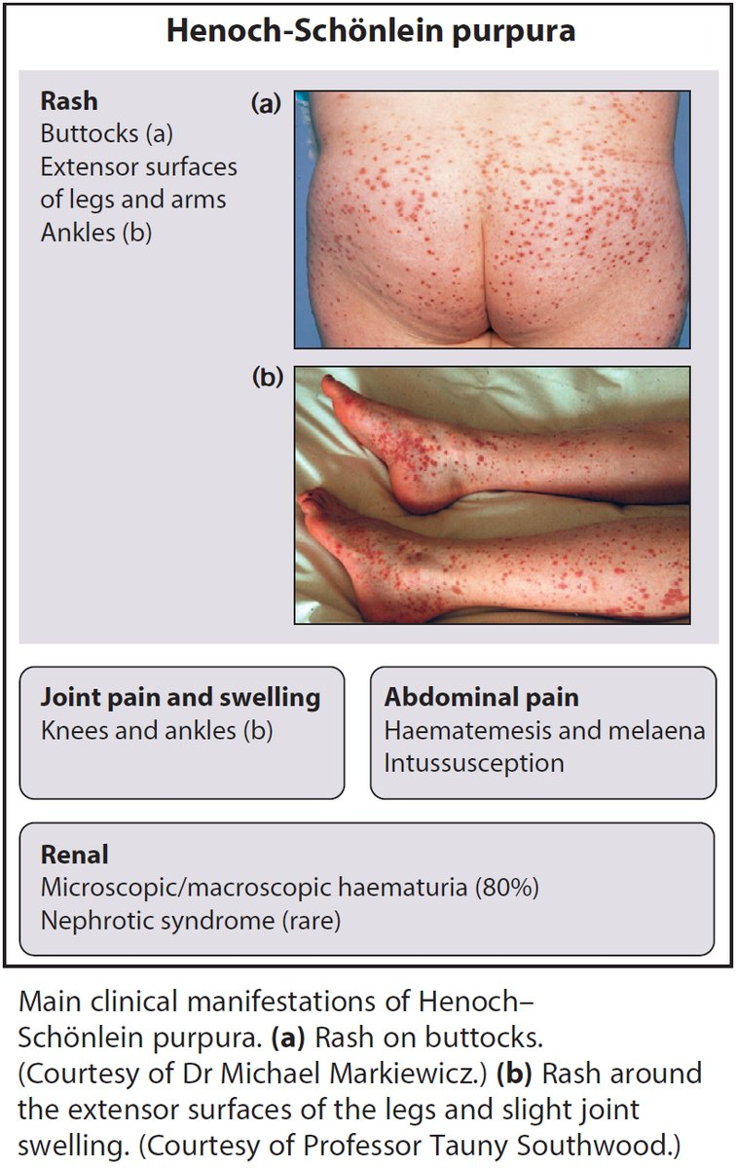
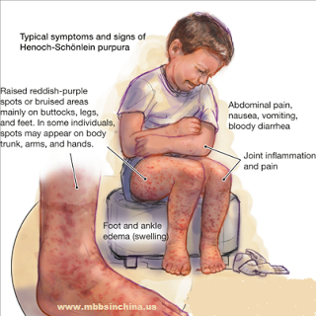
HENOSCH SCHONLEIN PURPURA :-
HSP usually occurs in children and young adults and generally has a good prognosis.
It is characterised by immune complex deposition in small vessels with associated vasculitis.
The typical presentation is with
purpura over the buttocks and lower legs,
abdominal symptoms (pain and bleeding)
arthritis(knee or ankle) following
an upper respiratory tract infection.

Slide 33
HENOSCH SCHONLEIN PURPURA :-
The diagnosis can be confirmed by tissue biopsy, which demonstrates IgA deposition within and around blood vessel walls.

Slide 34
HENOSCH SCHONLEIN PURPURA :-
The PROGNOSIS is determined by the severity of renal involvement.
Adverse prognostic features at presentation in adults include
hypertension,
abnormal renal function and
proteinuria > 1.5g/day(but only 1% of patients develop end-stage renal failure).

Slide 35
Treatment
Steroids
Immunosuppressive therapy

Slide 36
BEHCET DISEASE :-
This is a vasculitis of unknown aetiology that charac-
teristically targets venules.
There is a wide range of clinical features, with unpredictable exacerbations.
Oral ulcers are universal. Unlike aphthous ulcers, they are usually deep and multiple, and last for 10–30 days. Genital ulcers are less common (60–80%).
The usual skin lesions are erythema nodosum or acneiform lesions but migratory thrombophlebitis and vasculitis also occur. The pathergy reaction is hyper-reactivity at the site of minor trauma.

Slide 37
BEHCET DISEASE :-

Slide 38
BEHCET DISEASE :-

Slide 39
BEHCET DISEASE :-

Slide 40
BEHCET DISEASE :-

Slide 41
INVESTIGATIONS:
CBC(normocytic normochromic anemia) with ESR
CRP
LFT’s(elevated)
TEMPORAL ARTERY BIOPSY

Slide 42
INVESTIGATIONS IN SYSTEMIC VASCULITIS :-
Angiography and tissue biopsy are the pivotal investigations.
Biopsies can be taken from the nasal septal tissue or from areas of ulceration in patients suspected of having WG, from muscle or nerve in PAN or CSS, from kidney in patients with renal involvement, or from skin in HSP and cryoglobulinaemic vasculitis.
Angiography is useful in PAN and Takayasu’s disease.
Complement levels are useful; C3 and C4 are typically reduced in active disease, reflecting complement consumption, and can be used as an index of disease activity.

Slide 43
INVESTIGATIONS
Screening for ANCA is important, although they are not specific for the diagnosis of vasculitis and can occur in other diseases.
The presence of c-ANCA is particularly associated with WG and CSS, whereas p-ANCA is associated with MPA.
Urinalysis for protein and blood should always be performed with subsequent microscopy, since the prognosis of vasculitis is often determined by the degree of renal involvement.
Routine biochemistry should be performed to identify renal impairment. CRP and ESR are elevated in active disease and are useful in monitoring disease activity.

Slide 44
MANAGEMENT OF VASCULITIS:-
Treatment is with high-dose corticosteroids and immunosuppressives, as described for life-threatening involvement in SLE. If cyclophosphamide fails to induce a remission, the diagnosis should be reconsidered.
ANCA-positive patients with acute renal failure have a better outcome when also treated with adjunctive plasma exchange.

Slide 45
TREATMENT:-
Patients with PAN who have evidence of hepatitis B infection should also be treated with antiviral therapy.
In Takayasu’s arteritis, reconstructive vascular surgery may benefit selected patients, especially those with hypertension secondary to aortic or renal lesions.

Slide 46
Thank you

