Slide 1
History of Computer

Slide 2
Computers in Our World
Before going to discuss lets take a glance
Computers are everywhere
We can find them in pretty unlikely places
Family car
Home appliances
Pharmaceutical Manufacturing companies etc.

Slide 3
Computer Definition
An Electronic device that converts data into information which is useful to people
Is Black Box
Is a Problem Solver
Processing
Input
Output
Memory

Slide 4
Anatomy of a Computer
Every computer has four basic parts, or units:
an input unit such as the keyboard, that feeds information into the computer
a central processing unit (CPU) that performs the various tasks of the computer
an output unit , such as a monitor , that displays the results;
a memory that stores information and instructions.

Slide 5
Computer vs. Human
Input - Five senses
CPU - Brain
Output - Body Parts
Memory - Human memory
Hardware - Human body
Software - Aliveness
Programs for operations and problem solving

Slide 6
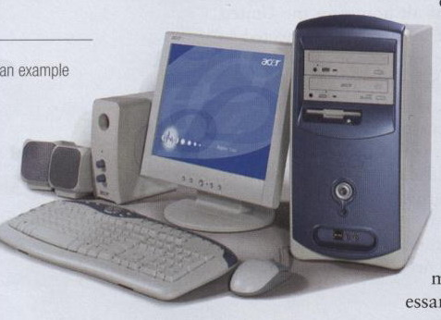
Modern Computers
Modern computers are digital
Digit mean “numbers” 0 to 9
Break all types of information into tiny units
Use numbers to represent information
Two digits combine to make data (0, 1)
2 10
2 5- 0
2 2- 1
1- 0
Binary no
10= 1010
Decimal no

Slide 7
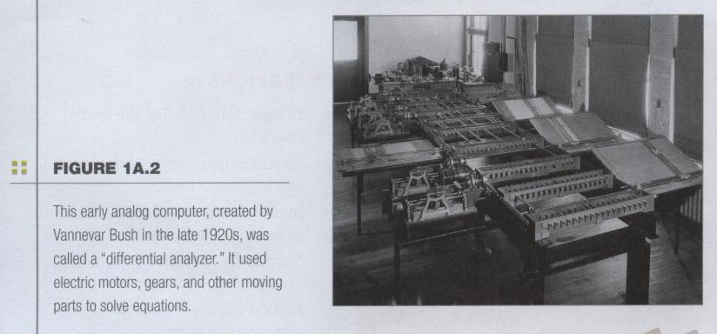
History of Computers
Older computers were analog
Early Computer was created by Vannevar Bush in 1920.
This computer was used electric motors for moving parts to solve equation
Represent data as variable points along a continuous spectrum of values.
Notes:
Use mechanical devices, weighs several tons and using motors and gears to perform calculations

Slide 8
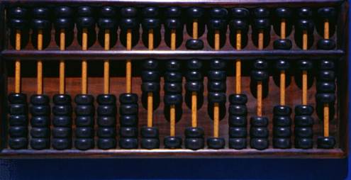
ABACUS
More information on
http://en.wikipedia.org/wiki/Abacus

Slide 9
1- ABACUS
5000 BC: The first calculating device ABACUS was invented by Egypt.
The abacus is still in use in some countries especially China, Japan etc.
Operations
Addition, subtraction, division and multiplication
Extract square root and cube root
User has to memorize certain rules

Slide 10
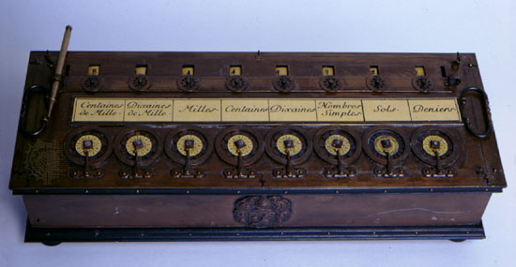
2- Pascaline
1642: A Frenchman Blaise Pascal introduced the first mechanical
calculating device.
Series of wheels with teeth which could be turned using hands
Used to handle 999,999.99
Perform both addition and subtraction.

Slide 11
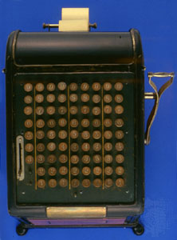
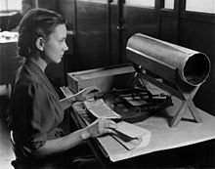
3- Punched Cards

Slide 12
4- Punched Card
1890: Herman Hollerith
American Inventor
This devices can read information which had been punched into cards automatically

Slide 13
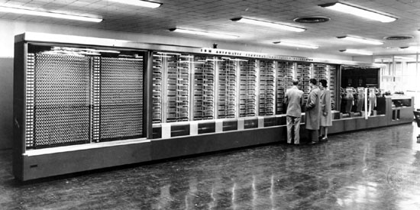
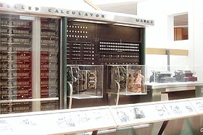
5- Harvard Mark I

Slide 14
Harvard Mark I…
1944: Howard Aikens and Grace Hooper developed an electromechanical machine at IBM
Capable of reading numbers, characters, and special symbols only

Slide 15
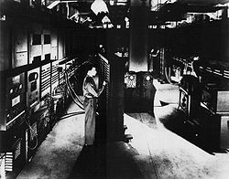
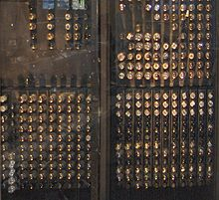
6- ENIAC

Slide 16
ENIAC…
1946 First general purpose electronic computer
Electronic Numerical Integrator And Computer (ENIAC)
Technology used
Vacuum tubes 17,468
Crystal Diodes 7,200
Relays 1,500
Transistors 70,000
Capacitors 10,000
Hand soldered joints 1 million

Slide 17
ENIAC…
Weight 27 tons
01 ton = 1016 KG
Volume 100ft (L) X 8 ft ( H) X 3 ft (D)
Covers 1800 sq. feet
Power consumption 150 kW
Uses punch cards
Averages 5,000 operations

Slide 18
Generation of Computers

Slide 19
Generation of Computers
Generation | Dates | Characteristic
1st | 1942-55 | Use Valves (Vacuum tubes)
2nd | 1955-64 | Use transistors
3rd | 1964-75 | ICs (Integrated Circuits)
4th | 1975-1989 | Ultra Large Scale Integrated Circuits (ULSI)
5th | 1989-to date | “Artificial Intelligence” based computers

Slide 20
End Note
Good judgment comes from experience,
and
Experience comes from bad judgment.

Slide 21
For any query:
Like & Subscribe the channel

