Slide 1
Topic :Introduction of ecology

Slide 2
Key concepts include:
Ecology and its branches
Level of organizations.
Terms of ecology.
Interaction within and among populations
Types of ecology
Nutrient cycling with energy flow through ecosystems
Scope of ecology
Application of ecology.

Slide 3
What is ecology ?
The scientific study of interactions between organisms and their environments, focusing on energy transfer
It is a science of relationships.
The word ecology is derived from a Greek word “Okios” means home life or place of living and “logos” means science of study.
Plant ecology is concerned with the study of relationship between plants and their environment.

Slide 4
Branches of ecology
Autecology:
It involves the study of individual organisms , their life histories and their relationship to the environment.
Synecology:
It is concerned with the study of communities, their composition behavior, development and relationship to the environment.

Slide 5
Branches of ecology
Ecosystem ecology:
It is the study of interaction between living and non-living organisms in a particular climatic region.

Slide 6
Specialized branches of ecology
Habit ecology:
It deals with the study of different habits (places) on earth where life is present.
Community ecology:
It deals with the study of different groups according to the environment

Slide 7
Branches of ecology
Evolutionary ecology:
It deals with problems of segregation and formation of new species.
Population ecology:
It deals with the growth, structure of population according to environment.

Slide 8
Branches of ecology
Human ecology:
It deals with the relation of man to the environment.
Ecosystem ecology:
It deals with interaction between living and non living organisms

Slide 9
Branches of ecology
Physiological ecology:
It deals with the survival of species according to their function related to their environment.
Chemical ecology:
It deals with the adaptation of living organisms due to certain chemicals.

Slide 10
Branches of ecology
Genecology (ecological genetics):
It deals with the study of variations of species based upon their genes.
Ethology :
It is the study of the behavior of living organisms.

Slide 11
Level of organizations.
BIOSPHERE
ECOSYSTEM
COMMUNITY
POPULATION
ORGANISM

Slide 12
ORGANISM
Any unicellular or multicellular form exhibiting all the characteristics of life, an individual.
The lowest level of organization.

Slide 13
Population
A group of organisms of one species living in the same place at the same time that interbreed and compete with each other for resources.
For example food ,shelter.

Slide 14
Community
A community is a group of similar r dissimilar species living together under more or less similar environmental condition.
A forest with various trees, shrubs, herbs, animals, insects, birds, and micro organisms is considered as community.

Slide 15
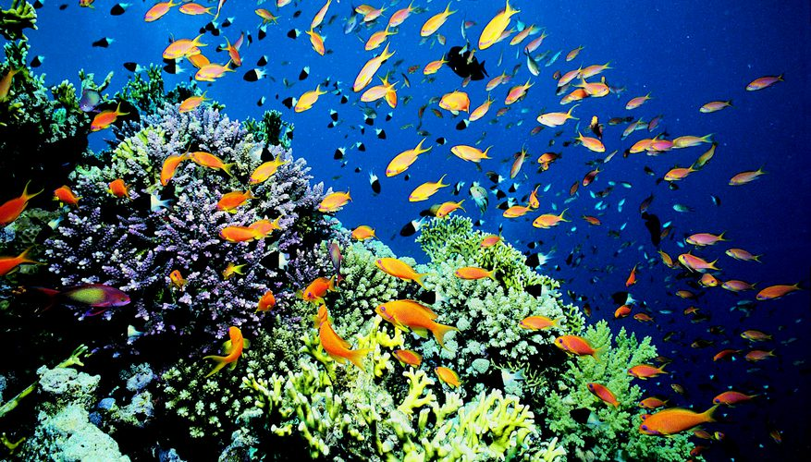
Ecosystem
The ecosystem is the basic functional unit in ecology consisting of both living (biotic ) and non living (abiotic) environment.
For example:
marine ecosystem
terrestrial ecosystem

Slide 16
Biosphere
Life supporting portions of Earth composed of air, land, fresh water, and salt water.
The highest level of organization.

Slide 17
Terms of ecology
What do you mean by environment ? Environment is made up of two factors:
Biotic factors:
all the living organisms inhabiting the earth
Abiotic factors:
nonliving parts of the environment i.e. temperature , soil , light , moisture , air currents.

Slide 18
Habitat vs. Niche
Habitat
Niche
The place in which an organism lives out its life.
It may be said that the habitat is the organism’s address
The role a species plays in a community
It may be said that the niche is the organism’s job

Slide 20
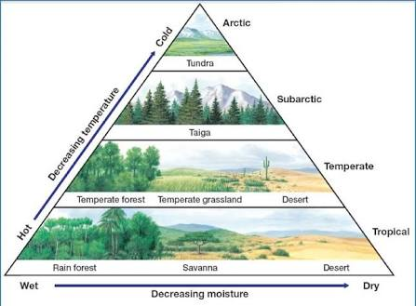
Terms of ecology
Biomes:
the place of earth which has particular climate and particular ecosystem. There are different biological regions in the earth due to different climate, these have their own climate , the biome is identified by its dominant species. Such as rain forest , grass land etc.

Slide 21
Feeding relationships
There are 3 main types of feeding relationships:
1.Producer –consumer
2.Predator –prey
3.Parasite –host

Slide 22
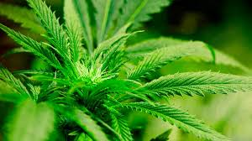
Feeding relationships
Producer:
Green plants or autotrophs (plants) are producers, they trap energy from the sun and prepare food.
The are at the bottom of the food chain.

Slide 23
Feeding relationships
Consumer-All heterotrophs:
This is the group of animals which cannot use their own food material
Herbivores
Carnivores
Omnivores
Decomposers

Slide 24
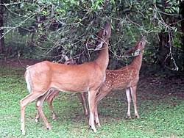
Feeding relationships
Herbivores – consumer
These are the animals which completely depend upon plants for their food.
For example: rabbit, goat , sheep etc.
They are also known as primary consumers.

Slide 25
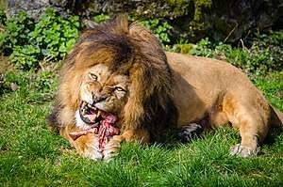
Feeding relationships
Consumer –carnivores
They eat meat.
They are also called as carnivores
For example : cat , dog ,fox , eagle.

Slide 26
Feeding relationship
Consumer –omnivores
They eat both plants and animals.
For example crow , bear men etc

Slide 27
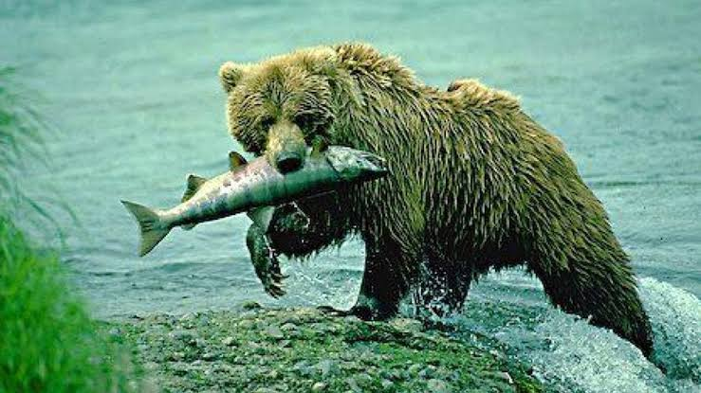
Feeding relationship
Consumer – predators
They are the large animals which attack on herbivore and carnivore animals and obtain their food by preying upon them. In this way they eat primary and secondary consumers
For example: tiger , lion , hawk etc.

Slide 28
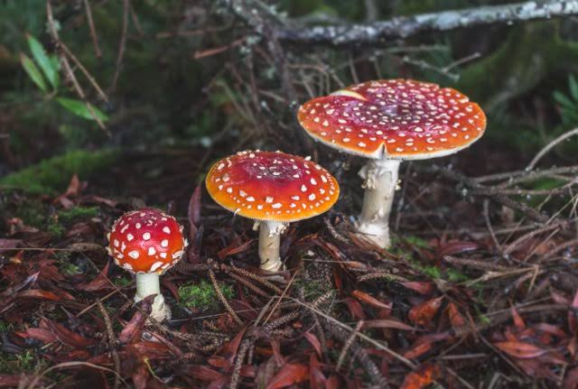
Feeding relationship
Consumer –decomposers
breakdown the complex compounds of dead and decaying plants and animals into simpler molecules that can be absorbed.
They are also called as saprophytes.
They are fungi and bacteria.

Slide 29
Symbiotic relationships
Symbiosis –two species live together
Three types of symbiosis:
1.Commensalism
2.Parasitism
3.Mutualism

Slide 30
Symbiotic relationships
Commensalism-
one species benefits and the other is neither harmed nor helped
Example: orchids on a tree.
Epiphytes:
A plant such as a tropical orchid that grows on another plant.

Slide 31
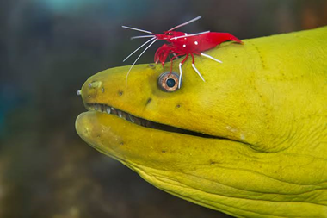
Symbiotic relationships
Commensalism-
One specie benefits and the other is neither harmed nor helped.
Example polar bears and cyanobacteria.

Slide 32
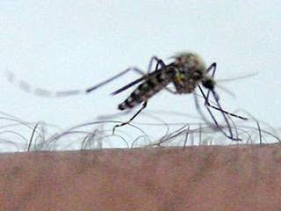
Symbiotic relationships.
Parasitism-
One specie benefits (parasite) and the other is harmed(host).

Slide 33
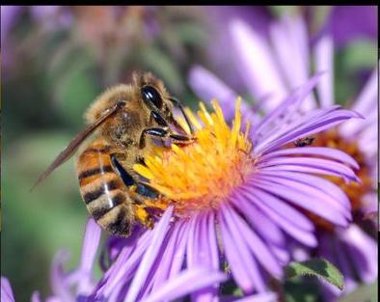
Symbiotic relationship
Mutualism –
It is a symbiotic relationship in which both species get benefits

Slide 34
pic

Slide 35
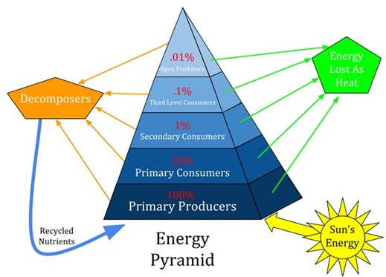
Trophic levels in ecosystem
“The step wise process through which food energy moves, with repeated stages of eating and being eaten is known as food chain “
Food chain represents various levels of nourishment. these levels are called trophic levels.

Slide 36
Trophic levels
Green plants occupy first tropic level .
Its is the primary producer level.
The herbivores form the second level or primary consumer level.
And the carnivores that eat the herbivores form the third level or secondary consumer level.
Food chain form a kind of pyramid.

Slide 37
Trophic level

Slide 38
Food chain
Producers Herbivores
Carnivores decomposers

Slide 39
Food chain
Pic

Slide 40
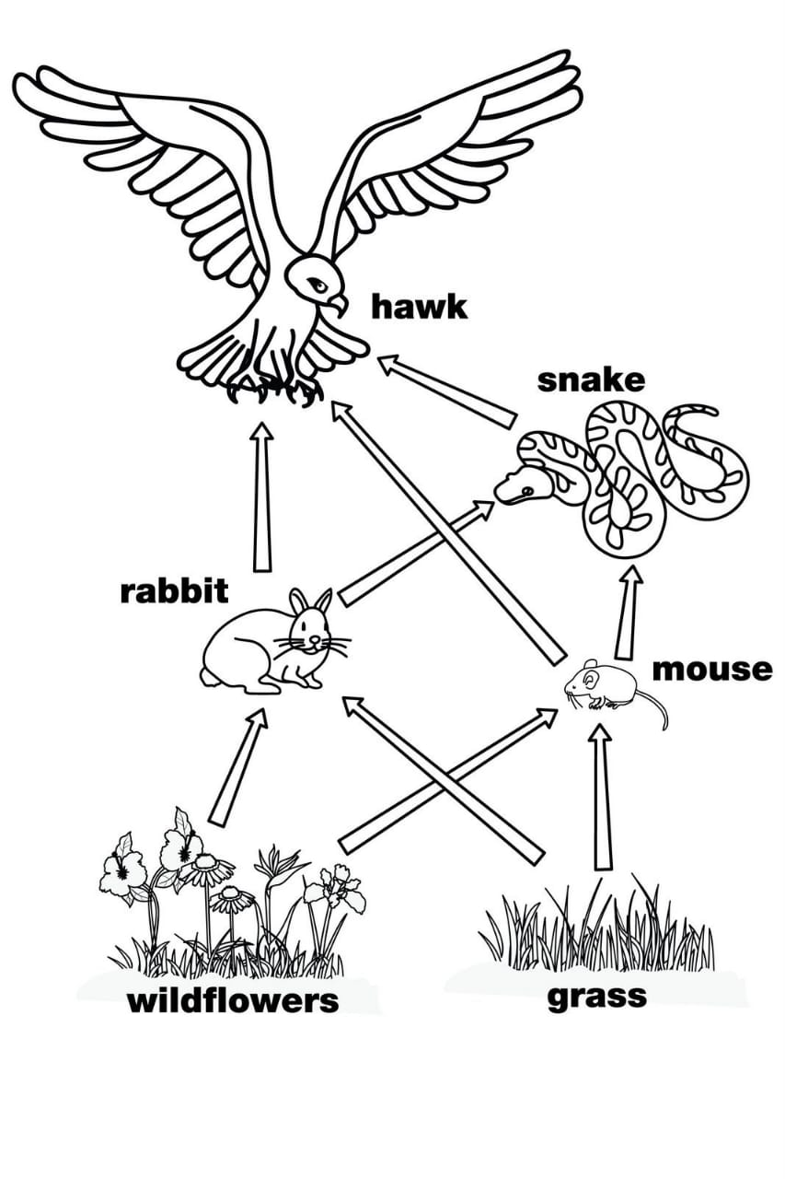
Food web
Network of interconnected food chains.

Slide 41
Biogeochemical cycles in an ecosystem
The cycle in which nitrogen, carbon, and other inorganic elements of the soil , atmosphere etc. of a region are converted into the organic substances of animals and plants and released back into the environment.
Cycling maintain homeostasis (balance) in environment.
1.water cycle.
2. carbon cycle.
3.nitrogen cycle.

Slide 42
Water cycle
The circulation of water and moisture between living organisms , atmosphere and earth is called hydrological cycle or water cycle.
It is an alternation of evaporation , transpiration , condensation.

Slide 43
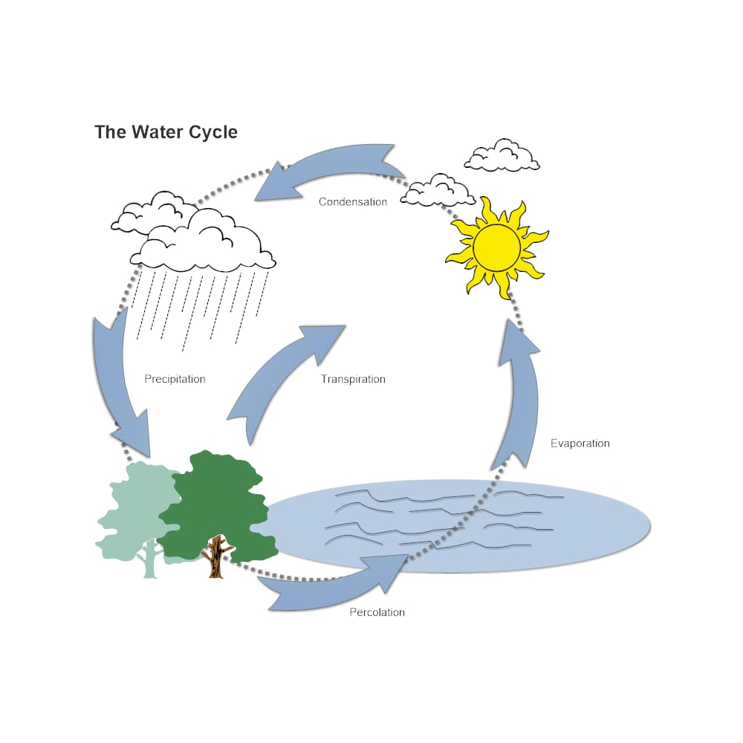
Water cycle
Pic

Slide 44
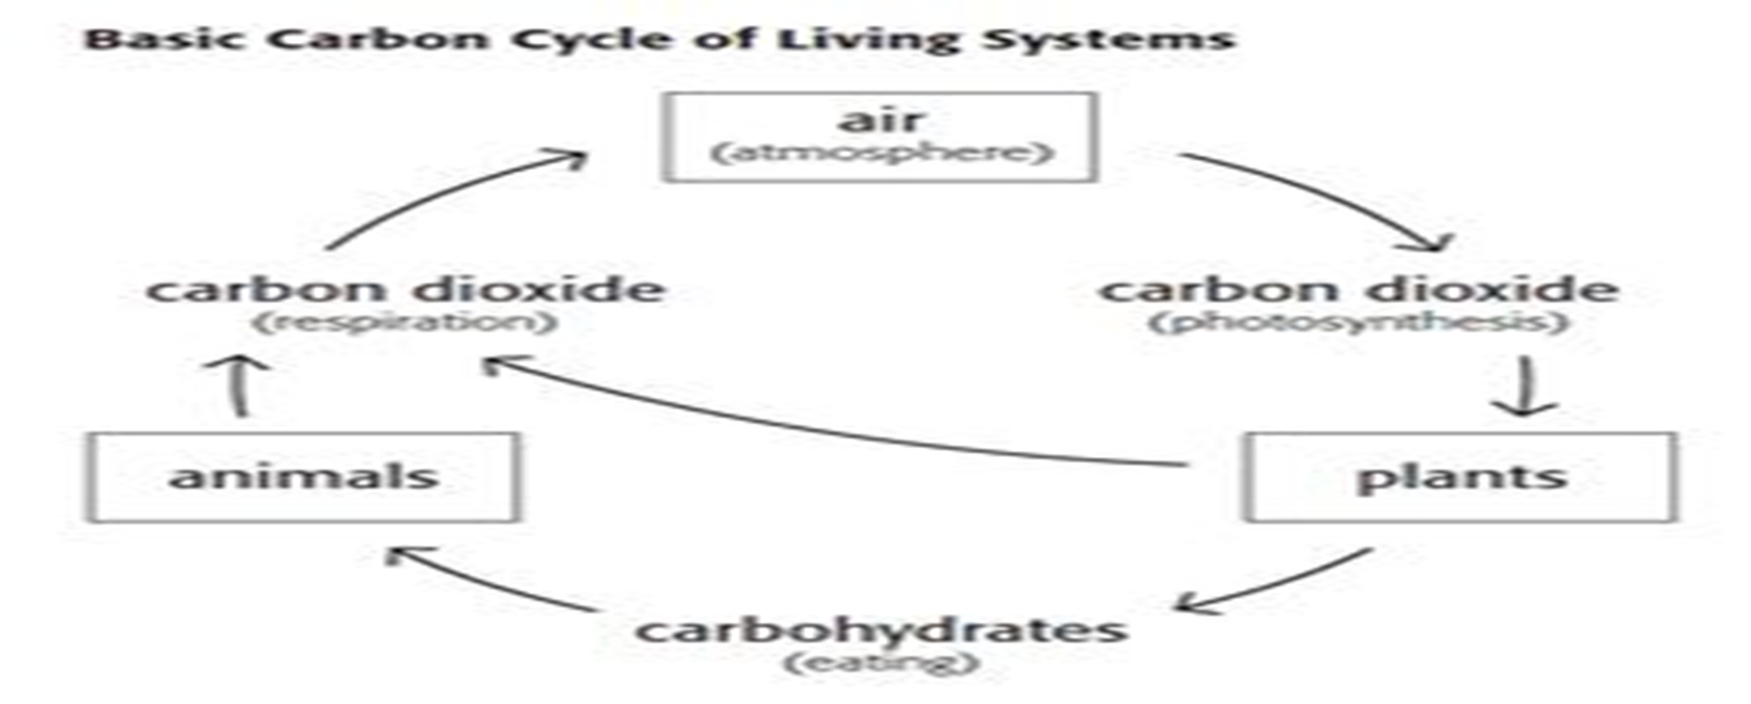
Carbon cycle
carbon cycle involves carbon fixation.

Slide 45
Nitrogen cycle
Atmospheric nitrogen ($N_{2})$ makes 78%- 80% of air.
Organisms can not use it in that form.
Lightening and bacteria convert nitrogen into useable forms.
Certain bacteria fix nitrogen such as nitrobacter and nitrosomonas which convert nitrogen into nitrates and nitrites.
In nitrogen fixation atmospheric nitrogen is converted into ammonium which is used to make organic compounds like amino acids.

Slide 46
Nitrogen cycle
Pic

Slide 47
Scope of ecology
Ecology is considered as environmental sciences. The relationship of organism with their environment can be studied at various levels.in this field effect of environment like light, water on living organisms is studied.
There is a great scope of ecology in pedology (soil sciences ) the nature of soil can change the type of vegetation.

Slide 48
Scope of ecology
Ecology is a very vast field. It has scope in different field, such as agricultural, forestry, fishery, wild life, pest control environmental pollution.

Slide 49
Application of ecology
Balance between living organisms and environment:
It attempts to maintain the balance between plants and their environment.
Food production :
It can be applied in food production. The food production can be increased by using new varieties, weed control, crop rotation practice.

Slide 50
Application of ecology
Pollution control:
atmospheric pollution causes many disturbances in human life and responsible for various diseases of heart, lung, skin etc. pollution can be reduced or controlled by different methods.

Slide 51
Any question
Thank you

