Slide 2
Photodormancy

Slide 5
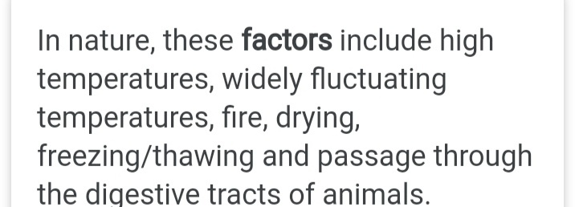

Slide 11
