Slide 1
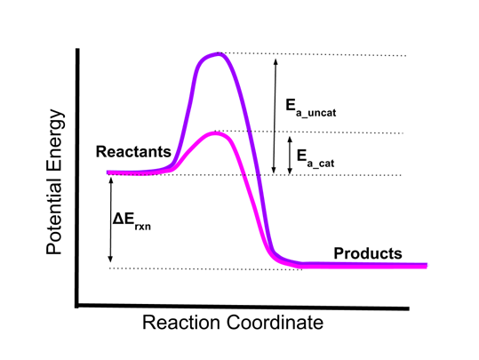
Catalysis
Catalysis is the process of increasing the rate of a chemical reaction by adding a substance known as a catalyst, which is not consumed in the catalyzed reaction and can continue to act repeatedly. Because of this, only very small amounts of catalyst are required to alter the reaction rate in most cases
Homogeneous catalysis
Heterogeneous catalysis

Slide 2
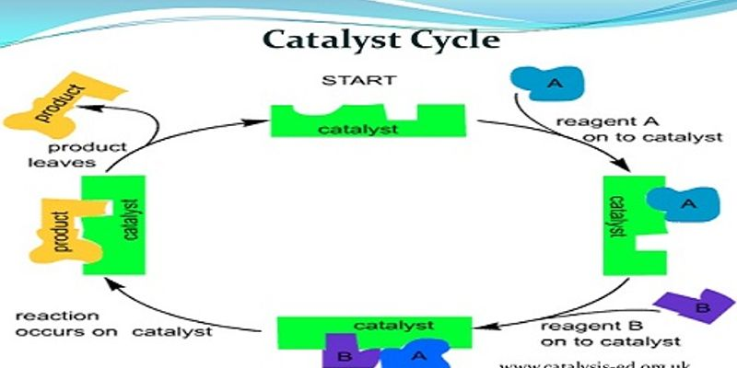

Slide 3
Homogeneous catalysis
Heterogeneous catalysis

Slide 4
Comparison of Homogenous and Heterogeneous catalyst

Slide 8
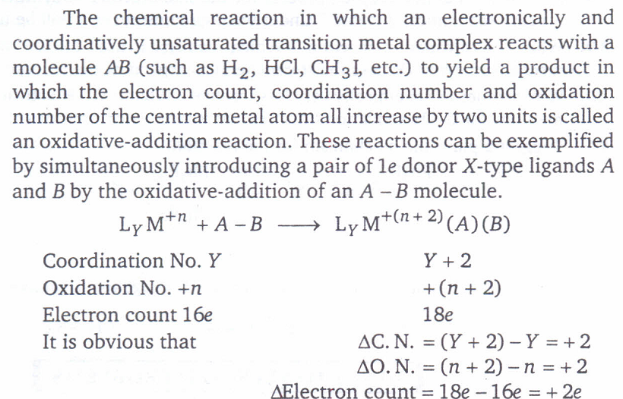

Slide 9
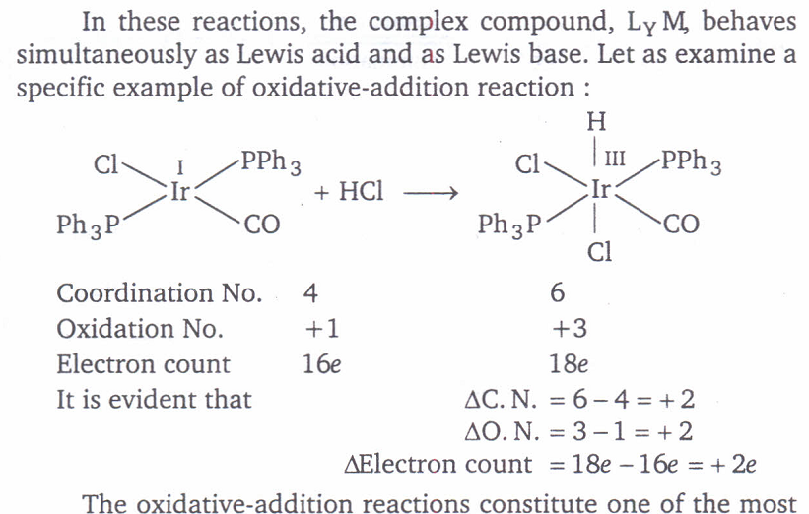

Slide 10
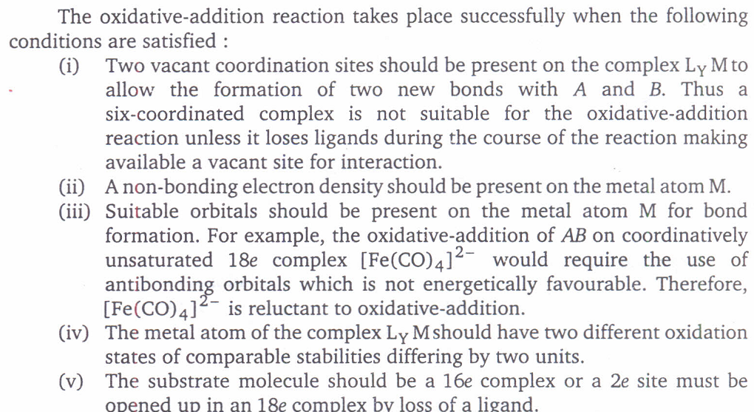

Slide 11
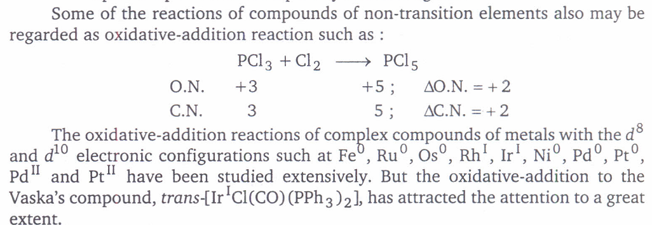

Slide 12
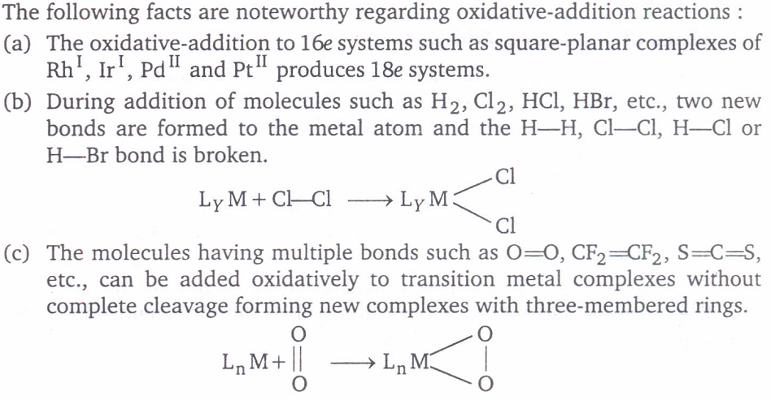

Slide 13
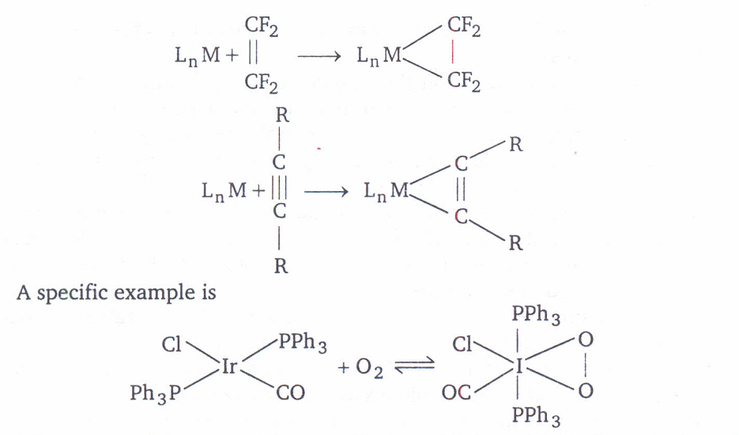

Slide 14
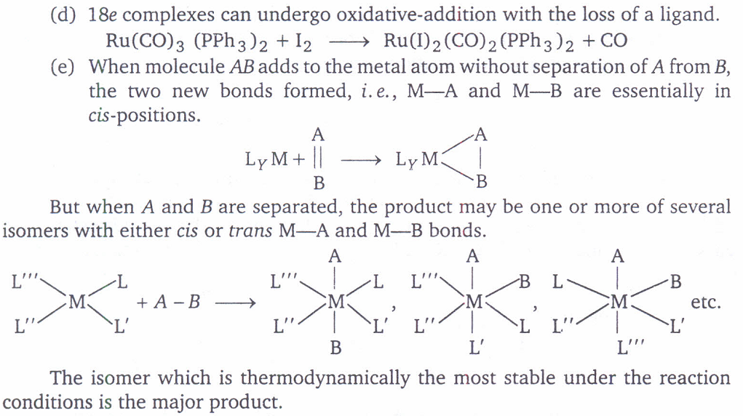

Slide 16
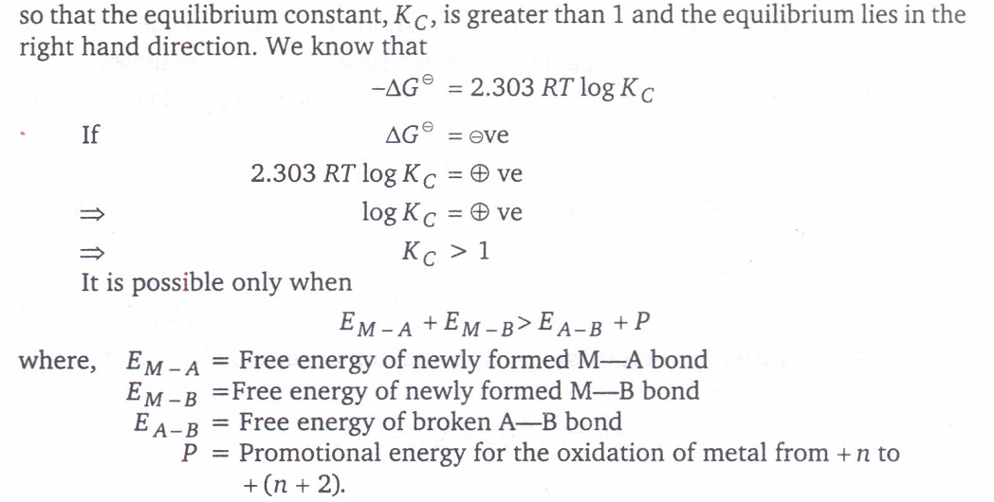

Slide 19
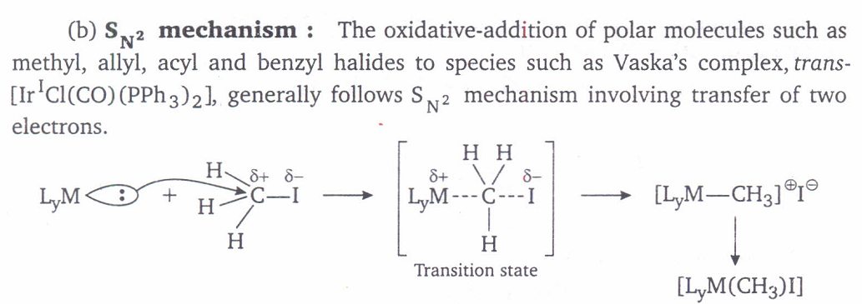
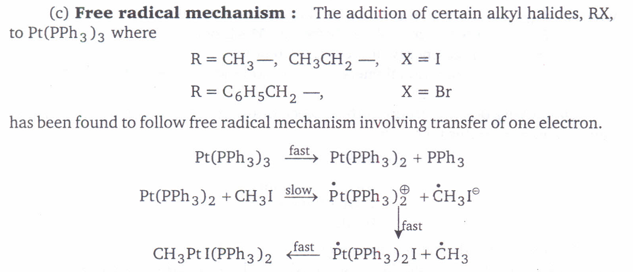

Slide 21
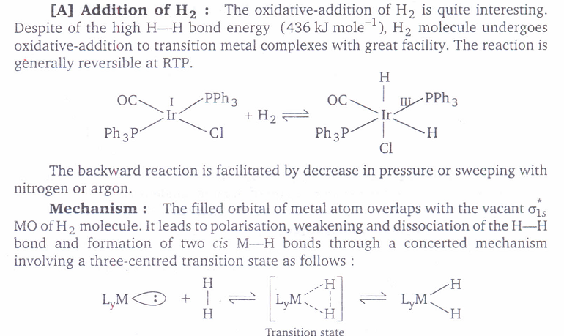

Slide 24
