Slide 1
Respiration
• Respiration: Respiration is an oxidation reduction reaction in which organic foods are oxidized to CO2, and O2 absorbed in this process is reduced to form water
. Redox process E = 2870 kJ/mol, 685 kcal/mol (1 cal = 4.19 J)
• Oxidation: Addition of O2 or Removal of electrons or Removal of protons (hydrogen)
• Reduction: Removal of O2 or Addition of electrons or Addition of protons (hydrogen)
• Heat energy + ATP (Metabolic energy)

Slide 2
Respiration
Respiratory substrates
These are the compounds that completely breakdown to give rise carbon dioxide and water as a
result of this, energy is released.
• Respiratory intermediates
• These are the compounds which are completely broken down to give rise CO2 and H2O .
• In addition to respiratory substrates, some other compounds are produced during the
breakdown of respiratory substrates which are known as respiratory intermediates.
• Glucose CO2 + H2O
• All compounds produced as a result of 50 reactions are known as intermediates.

Slide 3
Respiratiion
• Types of respiratory substrates
• Following are the four different types of respiratory substrates
1. Carbohydrates
2. Lipids or Fats
3. Organic acids
4. Proteins
• These are all organic compounds and are utilized in respiratory phenomenon
• Carbohydrates: Monosaccharide, Disaccharides, Oligosaccharides, Polysaccharides
•
• i) Monosaccharide: Trioses, Tetroses, Pentoses, Hexoses
•
• ii) Disaccharides: Two units of monosaccharide are attached e.g.
• Maltose = Glucose + Glucose
• Sucrose = Glucose + Fructose

Slide 4
Respiration
Trisaccharides e.g Raffinose suger=Galactose ,glactose and fructose
Tetrasaccharide e.g. Stachyose sugar = Gal + Gal + G + F
• Pentasaccharides e.g. Verbascose sugar = Gal + Gal + Gal + G + F
• Hexasaccharides e.g. Ajugose sugar = Gal + Gal + Gal + Gal + G + F
•
• iii) Oligosaccharides: Dextrins - almost ten glucose molecules
• Inulin - polymer of fructose (30-40 fructose units)
•
• iv) Polysaccharides: Starch: It is a storage carbohydrate in plants and consists of
two types of subunits
• a) Amylose α-1, 4-linkage
• b) Amylopectin α-1, 6-linkage

Slide 5
Respiration
2. Lipids or Fats: Generally in plants fat is present in low amount and its distribution is large and its
occurrence is maximum in oil-seed crops. Fat is converted into glycerol and fatty acids by the action of
lipase enzyme and then both glycerol and fatty acids give rise to sucrose and other sugars in the process
generally known as gluconeogenesis (when glucose or sugars are formed from organic substances other
than sugars).
3. Organic acids:-
1. Malate (CAM plants)
2. Glycolate
3. Citrate
4. Proteins:-
• If these are stored and sugar is not available then proteins are converted into sugars.

Slide 6
Respiration
The Respiratory Quotient:
• If carbohydrates such as sucrose, fructose or starch are respiratory substrates and if they are
completely oxidized, the volume of O2 taken up exactly balances the volume of CO2 released
from the cell. This ratio of CO2/O2 called respiration quotient or RQ.
• RQ obtained from leaves of many different species averaged about 1.05. Germinating seeds of
cereal grains and many legumes such as peas and beans, which contain starch as main reserve
food, also show the value of RQ approximately 1.0. Seeds from many other species, however
contain much fat or oil. RQ value for these species is often as low as 0.7. Consider the oxidation
of common fatty acid, oleic acid
• C18H34 + 25O2 18 CO2 + 17H2O
• RQ for this reaction is 18/25.5 = 0.71
• By measuring RQ for any plant part, information can be obtained about the type of compound

Slide 7
Breakdown of Starch
• It is a polymer of glucose and is a main storage product in plants. In cereals, the amount of
starch varies from 65-75%. In mature potato 80% starch is present.
• Breakdown enzymes of starch are of four types
1. α-amylase
2. β-amylase
3. Phosphorylase
4. De-branching enzyme
5. α-amylase:-
6. By the action of α-amylase a mixture of linear and branched chains is obtained such as glucose
,
fructose, maltose and in case of amylopectin dextrins are formed.

Slide 8
7. β-amylase:-
8. β-amylase produces maltose from the starch. It removes maltose unit from long chain of starch.
9. Phosphorylase:-
10. It gives rise glucose-1-phosphate when the level of inorganic phosphate is high (greater than
1mM).
11. De-branching enzymes:-
12. These enzymes attack on 1,6-linkages of amylopectins
13. Isoamylase
14. Pullulanase
15. Breakdown of Sucrose:
16. Two enzymes are involved in the breakdown of sucrose.
17. Sucrose synthase:
18. Sucrose synthase is present in cytosole
19. Reaction is reversible
20. Invertase:
21. Sucrose Glucose + Fructose

Slide 9
21. Sucrose Glucose + Fructose
22. Invertases are present in three forms
23. Acidic invertase: Present in cell wall and vacuole (apoplast)
24. Alkaline invertase: Present in cytosol
25. Neutral invertase: Mostly present in apoplast
26. The cell wall invertase hydrolyses incoming sucrose into glucose and fructose that are then absorbed by sink cells.

Slide 10
Mechanism of Respiration
Respiration is of two types
1. Aerobic respiration i.e. in the presence of O2
2. Anaerobic respiration i.e. in the absence of O2
1. Aerobic respiration: Aerobic respiration can be divided into four major steps
i) Glycolysis = Hexose 2 trioses [Pyruvate (PA)
ii) Oxidative decarboxylation = PA Acetyl Co. A
iii) Krebs cycle = Acetyl Co. A CO2
iv) Electron transport chain/system

Slide 11
2. Anaerobic respiration: Anaerobic respiration can be divided into two steps
i) Glycolysis
ii) Fermentation
Various conditions on the basis of O2 availability
i) Hypoxic condition: Low amount of O2
ii) Anoxic condition: Zero oxygen
• Soil is porous, O2 of atmosphere can move through these pores or gases form a phase around
soil particles. When water logging occurs, diffusion of O2 decreased so plants observe hypoxic
condition. Anaerobiosis (anaerobic condition) may be due to water logging or some other
factors e.g. pressed soil also has no O2 so condition is anaerobiosis.

Slide 12
History of glycolysis
History
The pathway of glycolysis as it is known today took almost 100 years to fully discover.
The combined results of many smaller experiments were required in order to understand the pathway as a whole.
The first steps in understanding glycolysis began in the nineteenth century with the wine industry. For economic
reasons, the French wine industry sought to investigate why wine sometimes turned distasteful, instead of fermenting into alcohol.
French scientist Louis Pasteur researched this issue during the 1850s, and the results of his experiments began the
long road to elucidating the pathway of glycolysis.
His experiments showed that fermentation occurs by the action of living microorganisms; and that yeast's glucose
consumption decreased under aerobic conditions of fermentation, in comparison to anaerobic conditions .

Slide 13
In a series of experiments (1905-1911), scientists Arthur Harden and William Young discovered more pieces of glycolysis.
They discovered the regulatory effects of ATP on glucose consumption during alcohol fermentation. They also shed light on the role of one compound as a glycolysis intermediate: fructose 1,6-bisphosphate.
The elucidation of fructose 1,6-bisphosphate was accomplished by measuring CO2 levels when yeast juice was incubated with glucose
. CO2 production increased rapidly then slowed down. Harden and Young noted that this process would restart if an inorganic phosphate (Pi)
was added to the mixture. Harden and Young deduced that this process produced organic phosphate esters, and further experiments allowed
them to extract fructose diphosphate (F-1,6-DP).

Slide 14
Arthur Harden and William Young along with Nick Sheppard determined, in a second experiment, that a heat-sensitive high-molecular-weight subcellular fraction (the enzymes) and a heat-insensitive low-molecular-weight cytoplasm fraction (ADP, ATP and NAD+ and other cofactors) are required together for fermentation to proceed.
This experiment begun by observing that dialyzed (purified) yeast juice could not ferment or even create a sugar phosphate.
This mixture was rescued with the addition of undialyzed yeast extract that had been boiled
. Boiling the yeast extract renders all proteins inactive .. The ability of boiled extract plus dialyzed juice to complete
fermentation suggests that the cofactors were non-protein in character.

Slide 15
With all of these pieces available by the 1930s, Gustav Embden proposed a detailed, step-by-step outline of that pathway we now know as glycolysis.
The biggest difficulties in determining the intricacies of the pathway were due to the very short lifetime and low steady-state concentrations of the intermediates of the fast glycolytic reactions.
By the 1940s, Meyerhof, Embden and many other biochemists had finally completed the puzzle of glycolysis.
The understanding of the isolated pathway has been expanded in the subsequent decades, to include further details of its
regulation and integration with other metabolic pathways.

Slide 16
Glycolysis
Embden - Meyerhof and Parnass (EMP pathway)
Hexose bisphosphate pathway
• Glycos = Sweet or sugar and lysis = breakdown
• Glycolysis is lysis or breakdown of sugars
• Glycolysis occurs in all types of organisms in prokaryotes and eukaryotes and it can take place in
the presence as well as in the absence of O2.
In animals glycolysis starts from glycogen which is a
reserve carbohydrate in liver and muscles whereas in plants since the major reserve or storage
carbohydrate is sucrose, so first of all breakdown of sucrose takes place and later on hexoses
which are resulted from this breakdown are utilized in glycolysis.
In animals and plants glycolysis
takes place in cytosol but in plants glycolysis also occurs in chloroplast. Only one reaction of
glycolysis in plants also takes place in vacuole i.e. conversion of phosphoenol pyruvate in the
presence of enzyme phosphatase which is present in vacuole.

Slide 17
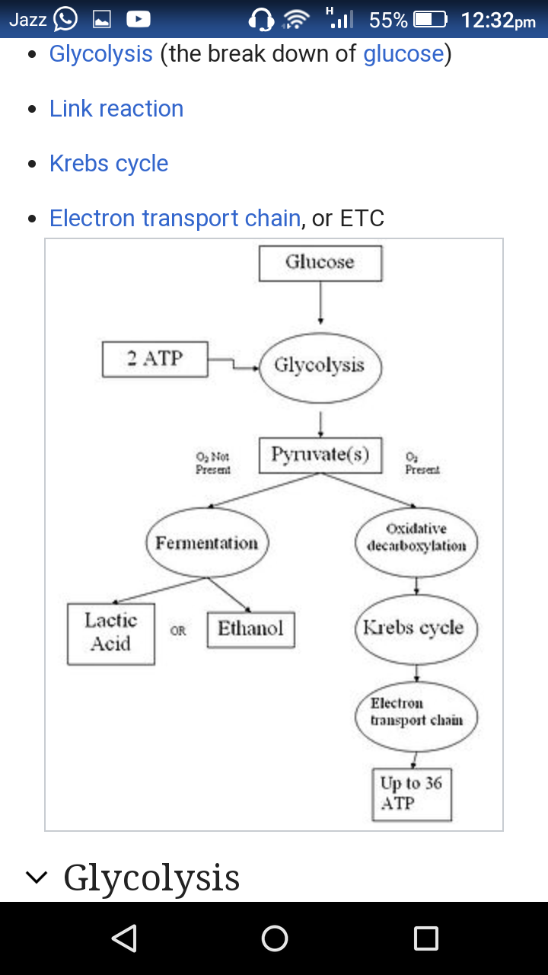

Slide 19
The first five steps of Glycolysis are regarded as the preparatory (or investment) phase.
, since they consume energy to convert the glucose into two three-carbon sugar phosphates.

Slide 20
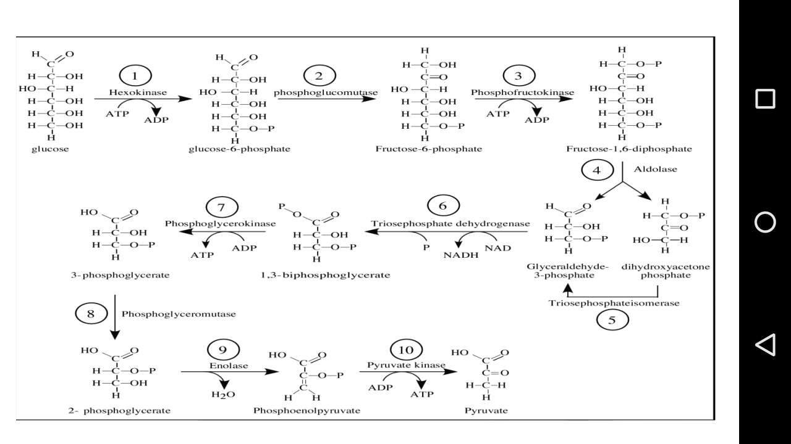

Slide 22
• In Plants:
• In plants net balance is 6 ATPs when the route is through ATP-PFK. When PPi-PFK is operative at
1st step of glycolysis then there will be saving of energy equivalent to 1 ATP, so net balance of
metabolic energy in glycolysis will be equal to 7 ATPs.
• In animals:
• In animals the situation is different. In animals NADH is either equal to 2 ATP or 3 ATP,
so depending upon the utilization of NADH in ETC in animals energy balance of glycolysis will be
either 6 ATP or 8 ATP.

Slide 23
Enzymes used in Glucolysis
Hexokinase
Phosphoglucose isomerase
Phosphofructokinase
Aldolase
Triosephosphate isomerase
Glyceraldehyde 3 phosphate dehydrogenase

Slide 24
Phosphoglycerate kinase
Phosphoglycerate mutase
Enolase
Pyruvate kinase

