Slide 1
Importance of Vegetables in our Daily life:

Slide 2
Subject: Bioremediation

Slide 3
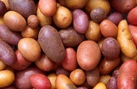
1. Solanum tuberosum (Potatoes):
A raw potato is 79% water, 17% carbohydrates (88% starch), 2% protein, and contains negligible fat
Potatoes are rich in vitamins, minerals and antioxidants
Potatoes are good source of fibre, which can help to lose weight
Fibre can help to prevent heart diseases by keeping cholesterol and blood sugar level in check
Potatoes are full of antioxidants that work to prevent diseases and vitamins that help our body function properly
Raw potato is rarely eaten because raw potato starch is poorly digested by humans

Slide 4
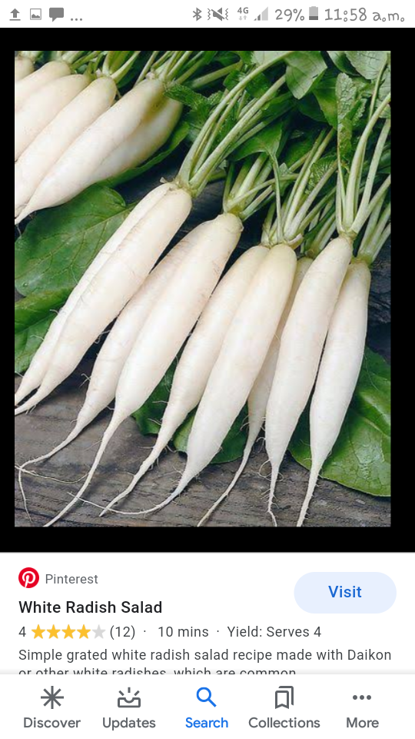
3. Radish
Radishes are rich in antioxidants & minerals like calcium and potassium
Together these nutrients help lower blood pressure and reduce risk of heart diseases
The radish is also a good source of natural nitrates that improve blood flow
Helps treat jaundice &Release osteoarthritis
Treats urinary disorders
Helps fight cancer
Treats respiratory disorders
Lowers blood sugar levels
Boosts the immune system

Slide 5
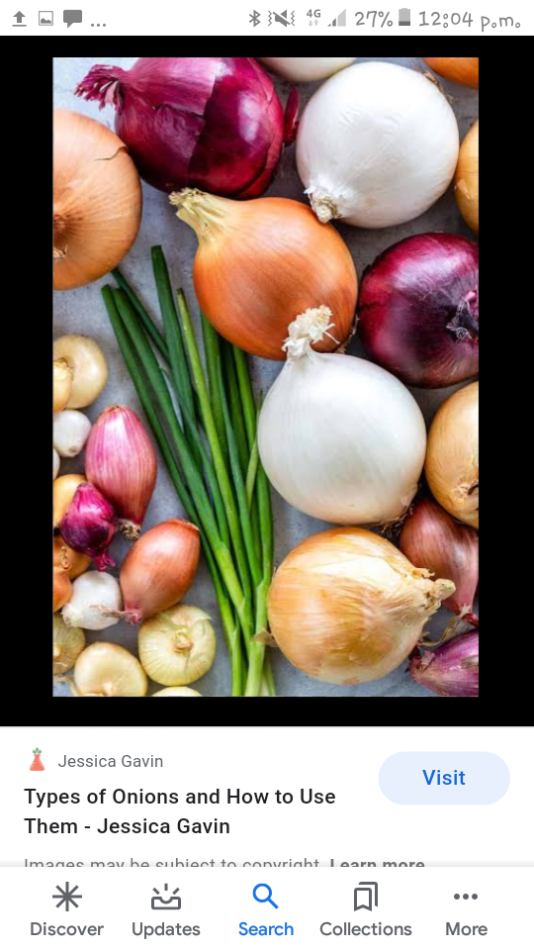
4.Onion:
Green Onions: Vitamin A & C, Phytochemicals & Immunity
Brown Onions: Anti inflammatory, Anti-bacterial & treats bug stings
Red Onions: healthy heart, Blood pressure & anti-cancer
White Onions : High sulphur, Anti-cancer & High fibre
Leek Onions: vitamin B6, Anti-oxidant rich & Anti-cancer

Slide 6
Health Benefits of Onion:
Onions have antibiotic, antiseptic, antimicrobial and carminative properties to help to stay away from infections
It is an immediate cure for fever, common cold, cough, sore throat, allergies,etc.
A mixture of onion juice and honey can cure these problems easily
A small piece of onion can work against side effects of fever if it is kept on the forehead
A small piece of onion, when inhaled, can stop or slow down the bleeding through the nose

Slide 7
Ginger :
Ginger is loaded with antioxidants, compounds that prevent stress and damage to your body’s DNA
They help our body fight off chronic diseases like high blood pressure, heart disease, and diseases of the lungs, & promote healthy aging
Contains gingerol, which has powerful medicinal properties
Can treat many forms of nausea, especially morning sickness
Drastically lower blood sugars & improve heart disease risk factors
Can also treat chronic indigestion

Slide 8
Garlic
Garlic is extremely low in calories
But really pack a punch with regards to nutrition
Just one ounce of garlic contains a gram of fibre, plenty of copper, calcium, and potassium as well as 6% of selenium
Garlic fights inflammation
Two sulphur containing constituents in garlic, diallyl sulphide (DAS) & thiacremonone, have anti-arthritic properties
Apart from anti-viral & anti-bacterial properties, garlic fights off fungal infection

Slide 9
Tomato:
1 medium tomato contains 20 calories and 1.5g of dietary fibre
Tomatoes are also good sources of Vitamin A, B9 & C as well as minerals like potassium
Tomatoes contain an antioxidant known as lycopene which can lower high cholesterol levels
Lycopene in tomatoes prevents prostate cancer
The vitamin C in tomatoes helps prevent premature aging
The amount of lycopene in tomato is increased by cooking with olive oil

Slide 10
cucumber
Nutrients: Carbohydrate & Protein 1%
Dietary Fibre 2%
Minerals: Potassium & Manganese 4%
Magnesium 3%
Calcium 2%
Vitamins: Vitamin K. 21%
Vitamin C 5%
Pantothenic Acid 3%
Folate 2%

Slide 11
Conti….
Reduces risk of kidney stones
Helps lower blood pressure
Helps prevents constipation
Rehydrate & Remineralizes the body
Aids in managing diabetes
Aids in weight loss
Keeps body healthy & functioning
High silica content for silky hair
Prevents headache

Slide 12
2. Carrots:
Carrot is a root vegetable
It is crunchy, tasty, and highly nutritious
The fibre in carrots can help keep blood sugar levels under control
They are loaded with vitamin A & beta-carotene, which can lower diabetes risk
They are a weight-loss friendly food and linked to lower cholesterol levels & improved eye health
They can strengthen our bones
Carrots have calcium and vitamin K, both of which are important for bone health

Slide 13
Conti….
Improves skin
Improves digestion
Improves liver function
Maintains a healthy heart
Anti-cancer
Healthy teeth
Anti-aging

Slide 14
Peas
Peas are good source of vitamin C & E, zinc, and other antioxidants that strengthen our immune system
Other nutrients, such as vitamins A & B and coumestrol,, help reduce inflammation
Lower the risk of chronic conditions, including diabetes, heart diseases, and arthritis
Peas are really little powerhouses of nutrition that are a bone of our health and the whole planet
Defend against stomach cancer
Can inhibit tumour growth

Slide 15
Lady’s Finger (Bhindi)
It is packed with folate, niacin, Vitamin C, Vitamin E & Vitamin K
Other than these, it is also rich in calcium, copper, iron, magnesium, manganese, phosphorous & zinc
It contains no cholesterol of its own
In fact it contains a component called pectin which helps in lowering blood cholesterol
Helps in production of RBC’s
It is also rich in polyphenols, which fight harmful inflammation & protect your heart
The mucilage of lady finger may also help to remove toxins from the body

Slide 16
Bitter gourd (Karela)
It is an excellent source of vitamins B1, B2, & B3, C, magnesium, folate, zinc, phosphorus, manganese, & has high dietary fibre
It is rich in iron & contains twice the beta-carotene of broccoli, twice the calcium of spinach, and twice the potassium of a banana
Acts as a blood purifier
Improves blood circulation
Helps to cure issues like rashes, acne, psoriasis, blood boils
It hinders the growth of cancerous cells in the body
It is extremely rich source of vitamin C, which helps boost immunity

Slide 17
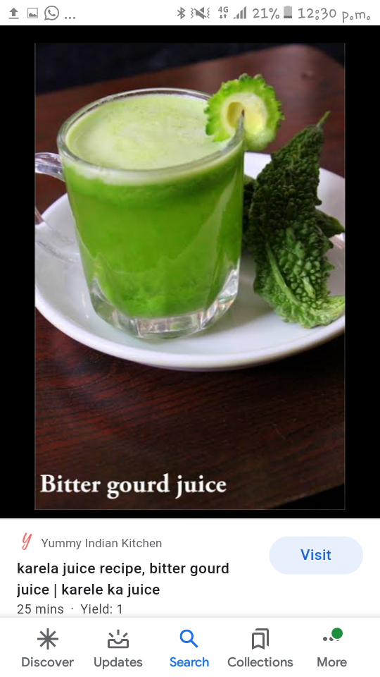
Bitter gourd juice
It have insulin like protein called polypeptide P that mimics the action of insulin & lowers blood sugars level in diabetic patients
Eating or drinking the juice of karela stimulates the liver to secrete bile acids that are essential for metabolising fat in the body

Slide 18
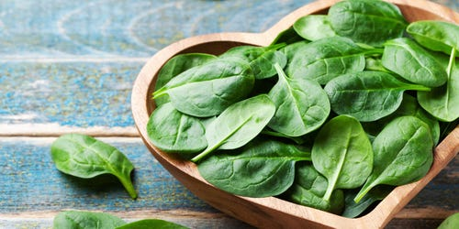
spinach
Spinach is a super food
It is loaded with tons of nutrients in a low-calorie package
Dark , leafy greens like spinach are important for skin, hair and bone health
Spinach is one of the best sources of dietary magnesium, which is necessary for energy metabolism, maintaining muscle, nerve function, regular heart rhythm, a healthy immune system and maintaining blood pressure
Magnesium also plays a part in hundreds more biochemical reactions that occur in the body

Slide 19
Conti…
Spinach contains an antioxidant known as alpha-lipoic acid which lower glucose levels, increase insulin sensitivity, and prevent oxidative, stress-induced changes in patients with diabetes

Slide 20
Brinjal ( Egg plant)
Nutrients: Carbohydrate & Protein 2%
Dietary Fibre 14%
Minerals: Potassium 7%
Manganese 13%
Magnesium 3%
Copper 4%
Vitamins: Vitamin K. 4%
Vitamin C 4%
Vitamin B6 4%
Folate 5%

Slide 21
Health Benefits
Provides flawless skin & Imparts instant glow
High fibre content
Protects brain
Protects heart & Arteries
Promotes anti-aging
Cures Actinic Keratosis
Promotes hair growth & Improves hair texture
Low in calories

Slide 22
Bottle Gourd( long melon)
It is rich in fibre so helps in curing
Constipation
Refreshes during summer because of its high water content
Regulates blood pressure and prevent the risk of heart ailments
It improves weight/fat loss
Bottle gourd juice Helps in weight loss if drank empty stomach, helps digestion, treats constipation, sleeping disorder, urinary problem

Slide 23
Cabbage :
Cabbage has 1 gram of fibre for every 10 calories
That helps fill you up, so you eat less
It also keeps you regular, and it could help lower your “bad” (LDL) cholesterol & control your blood sugar
Cabbage also has nutrients that keep the living of your stomach & intestine strong
Red cabbage is one of those with a great dose of vitamin C, making it an antioxidant-rich, immune booster
In comparison to green cabbage, red cabbage contains 10x more vitamins, cancer-fighting flavonoids, & a winning amount of antioxidants which improve eye, teeth, bone, & immune health

Slide 24
Cauliflower:
Cauliflower is nutrient dense
Cauliflower is a cruciferous vegetable that is naturally high in fibre & B-vitamins
It provides antioxidants and phytonutrients that can protect against cancer
It also contains fibre to enhance weight loss and digestion, choline that is essential for learning and memory

Slide 25
Coriander(dhania)
Coriander is a fragrant, antioxidant-rich herb that has many culinary uses and health benefits
Coriander is also a good source of Vitamin A, Vitamin C, Vitamin K
It may lower our blood sugar fight infections, and promote heart, brain, skin, and digestive health
We can easily add coriander seeds or leaves—sometimes known as cilantro– to our diet

Slide 26
Tinda Gourd:
Also known as round gourd
Tinda gourd is a rich source of water & dietary fibers to aid in digestion
It also has significant amounts of vitamin C & E & antioxidants, which improve skin and hair health
It removes harmful free radicals from injuring the healthy cells in the body
Accelerates weight loss
Detoxifies the kidneys

Slide 27
Turnip:
Turnips are loaded with fiber and vitamins K, A, C, E, B1, B3, B5, B6, B2 and folate( one of the B vitamins)
Minerals like manganese, potassium, magnesium, iron, calcium and copper
They are also a good source of phosphorous, omega-3 fatty acids & protein
It is low in calories
Fiber content in turnip may prevent constipation and promote regularity for a healthy digestive tract
It also plays role in sebum production & sebum keeps the hair moisturized
Turnips are kidney friendly and make an excellent replacement for vegetables that are higher in potassium like potatoes & winter squash

