Slide 1
3.LUNGS CANCER

Slide 2
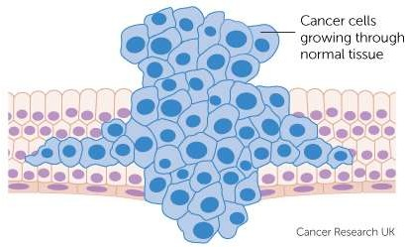
DEFINITION:-
Lung carcinoma, is a malignant lung tumor characterized by uncontrolled cell growth in tissues of the lung. If left untreated, this growth can spread beyond the lung by the process of metastasis into nearby tissue or other parts of the body

Slide 3
PALLIATIVE PROCEDURES FOR LUNG CANCER
Palliative, or supportive care, is aimed at
relieving symptoms and improving a person’s quality of life.
ISSUES ARE ADDRESSED IN PALLIATIVE
CARE:-
Physical.
Emotional and coping.
Spiritual.

Slide 4
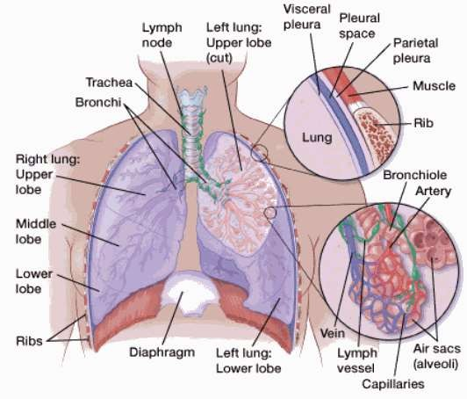
REVIEW:

Slide 5
INCIDENCE OF LUNG CANCER:-
Lung cancer mainly occurs in older people. About 2 out of 3 people diagnosed with lung cancer are 65 or older.
About 14% of all new cancers are lung cancers.
About 224,390 new cases of lung cancer (117,920 in men and 106,470 in women)

Slide 6
TYPES OF LUNG CANCER:-

Slide 7
Non-small cell lung cancer (NSCLC) :
Most common type
About 80-85% are NSCLC
Grows more slowly
It is further classified into the following:-
Epidermoid carcinoma or Squamous cell carcinoma:
30-35% of lung cancer
Arise from bronchial epithelium
Cavitation may also occur
Slow growth, metastasis not common

Slide 8
Adenocarcinoma:
25-30% of lung cancer
Arise from bronchiole mucus gland
Slow growth,
Rarely cavity
Strongly linked to cigarette smoking
Large cell caracinoma:
10-20% of lung cancer
Cavitation common
Slow, metastasis may occur to kidney, liver and adrenals
May be located centrally, mid lung or peripherally

Slide 9
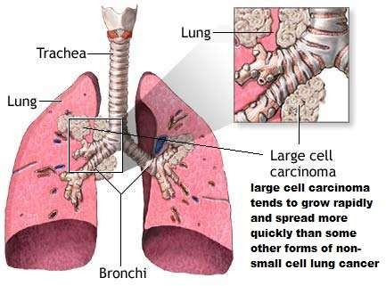
Small cell carcinoma :
It generally starts in one of the larger breathing tubes, grows fairly rapidly, and is likely to be large by the time of diagnosis.
Spreads more quickly and aggressively
Accounts for 15% of cases
Found mostly in heavy smokers

Slide 10
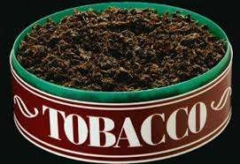
ETIOLOGY:-
Tobacco smoke:-
▫ Smoking is by far the leading risk factor for lung cancer. About 80% of lung cancer deaths are thought to result from smoking.
Exposure to other cancer-causing agents in the workplace :
▫ Radioactive such as uranium
▫ Inhaled chemicals such as beryllium, silica , coal products, mustard gas.

Slide 11
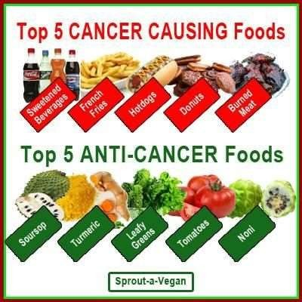
Certain dietary supplements :-
▫ 2 large studies found that smokers who took beta carotene supplements actually had an increased risk of lung cancer.
Exposure to asbestos:-
▫ People who work with asbestos (such as in mines, mills, textile plants, places.
Talc and talcum powder:
▫ Talc is a mineral that in its natural form may contain asbestos.

Slide 12
PATHOPHYSIOLOGY:-
DUE TO ETIOLOGICAL FACTORS
DAMAGE TO THE CELL CARCINIGEN BIND TO DAMAGED CELL DNA
CELLULAR CHANGES PASSED TO THE DAUGHTER CELL EVENTUALLY MALIGNANT CELL
MALIGNANT TRANSFORM FROM NORMAL EPITHELIUM CARCINOMA

Slide 13
SIGN AND SYMPTOMS:
A cough that gets worse
sputum (spit or phlegm)
Chest pain that is often worse with deep breathing, coughing, or laughing
Coughing up blood
Hoarseness
Weight loss and loss of appetite
Shortness of breath
Feeling tired or weak
Infections such as bronchitis and pneumonia

Slide 14
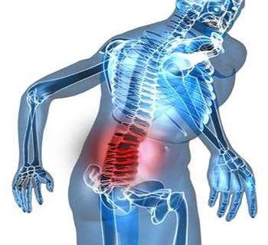
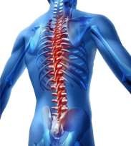
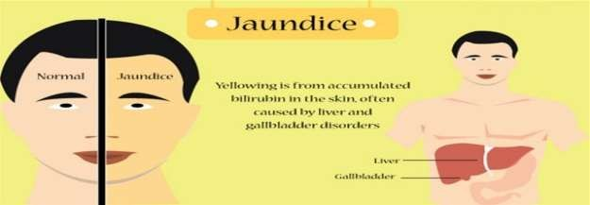
Bone pain (like pain in the back or hips)
▫ Nervous system changes (such as headache, weakness, dizziness, balance problems, or seizures), from cancer spread to the brain or spinal cord.
Yellowing of the skin and eyes (jaundice), from cancer spread to the liver.

Slide 15
HORNER SYNDROME
HORNER SYNDROME Cancers of the top part of the lungs (sometimes called Pancoast tumors) sometimes can affect certain nerves to the eye and part of the face, causing a group of symptoms called Horner syndrome:
▫ Drooping or weakness of one eyelid
▫ Reduced or absent sweating on the same side of the face sometimes cause severe shoulder pain.

Slide 16
SUPERIOR VENA CAVA SYNDROME
▫ Tumors in this area can press on the SVC, which can cause the blood to back up in the veins. This can lead to swelling in the face, neck, arms, and upper chest.
PARANEOPLASTIC SYNDROMES:-
▫ Some lung cancers can make hormone-like substances that enter the bloodstream and cause problems with distant tissues and organs, even though the cancer has not spread to those tissues or organs. These problems are called paraneoplastic syndromes.
Excess growth/thickening of certain bones, especially those in the finger tips
Excess breast growth in men (gynecomastia)

Slide 17
STAGES OF CANCER
American Joint Committee on Cancer (AJCC) TNM system, which is based on:
Sr. No | STAGE | FEACTURES
The size of the main (primary) tumor (T) | T0: | There is no evidence of a primary tumor.
 | T1: | The tumor is no larger than 3 centimeters, not reached PLEURA
 | T2: | The tumor has 1 or more, larger than 3 cm across but not larger than 7 cm. BROCHUS
 | T3: | The tumor has 1 or more of the following features, It is larger than 7 cm across CHEST WALL
 | T4: | The cancer has 1 or more, A tumor of any size has grown into the space between the lungs

Slide 18
Sr. No
STAGE
FEACTURES
N0:
There is no spread to nearby lymph nodes.
Whether the cancer has spread to nearby (regiona
l) lymph nodes (N).
N1:
The cancer has spread to lymph nodes within the lung , bronchus enters the lung
N2:
The cancer has spread to lymph nodes
around the carina , mediastinum
N3:
The cancer has spread to lymph nodes near the collarbone on either side

Slide 19
Sr. No
STAGE
FEACTURES
M
categ- ories for lung cance r
No spread to distant organs or areas. This includes the other lung, lymph nodes
M0:
away than those mentioned in the N stages above, and other organs
M1a:
The cancer has spread to the other lung.
Cancer cells are found in the fluid around the lung
M1b
The cancer has spread to distant lymph nodes or to other organs

Slide 20
DIGNOSTIC EVALUATION:-
Medical history and physical exam:-
Blood tests:-
▫ A complete blood count (CBC) looks at whether patient blood has normal numbers of different types of blood cells.
▫ Blood chemistry tests can help spot abnormalities in some of patient organs, such as the liver or kidneys. For example,
e.g. high level of lactate dehydrogenase (LDH).

Slide 21
IMAGING TESTS:-
Chest x-ray
▫ This is often the first test will do to look for any abnormal areas in the lungs.
Computed tomography (CT) scan:-
A CT scan uses to make detailed cross-sectional images of patient body.
can show the size, shape, and position of any lung tumors and can help find enlarged lymph nodes
CT-guided needle biopsy:
If a suspected area of cancer is deep within patient body, a CT scan can be used to guide a biopsy needle into the suspected area.

Slide 22
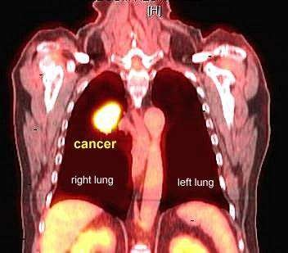
Positron emission tomography (PET) scan:-
▫ For this test, a form of radioactive sugar (known as FDG) is injected into the blood.
▫ This radioactivity can be seen with a special camera. PET/CT scan.
•

Slide 23
Needle biopsy:- can often use a hollow needle to get a small sample from a suspicious area (mass).
▫ fine needle aspiration (FNA) biopsy,
▫ core biopsy.
Bronchoscopy:-
▫ Bronchoscopy can help the find some tumors or blockages in the lungs.
Thoracoscopy:-
▫ spread to the spaces between the lungs and the chest wall, or to the linings

Slide 24
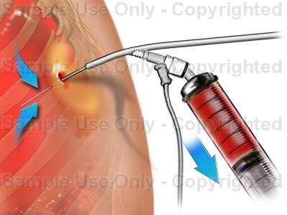
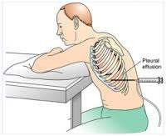
MANAGEMENT:-
MEDICAL MANAGEMENT:-
PHOTODYNAMIC THERAPY (PDT):-
▫ This type of treatment can be used to treat very early-stage lung cancers that are only in the outer layers of the lung airways,
THORACENTESIS:-
▫ This is done to drain the fluid.

Slide 25
LASER THERAPY:-
▫ used to treat very small tumors in the linings of airways.
▫ open up airways blocked by larger tumors to help people breathe better.
PHARMACOLOGICAL MANAGEMEN:-
CHEMOTHERAPY
for lung cancer Chemotherapy (chemo) is treatment with anti-cancer drugs injected into a vein or taken by mouth. These drugs enter the bloodstream and go throughout the body, making this treatment useful for cancer anywhere in the body

Slide 26
SR.NO
NAME OF DRUGS
DOSE
SIDE EFFECT
Hair loss
1
Cisplatin
75-100 mg/m² IV, 4Weeks
Mouth sores
Loss of appetite
Nausea and vomiting
•Diarrhea/ constipatio Easy bruising or bleeding (from having too few blood platelets)
Fatigue
2
Carboplatin
200 mg/m2 IV on day 1
Paclitaxel (Taxol)
135 mg/m2, IV over 24 hours, every 3 weeks
3
Albumin-b
25 g (5% or 25% solution) IV infusion
4
Docetaxel (Taxotere)
75 mg/m² IV over 1 hour 3Weeks
5
25 mg/sq.meter IV Week with IV cisplatin 100 mg/sq.meter 4Weeks
7
Vinorelbine (Navelbine)
9
Vinblastine
4 mg/sq. meter, 2week

Slide 27
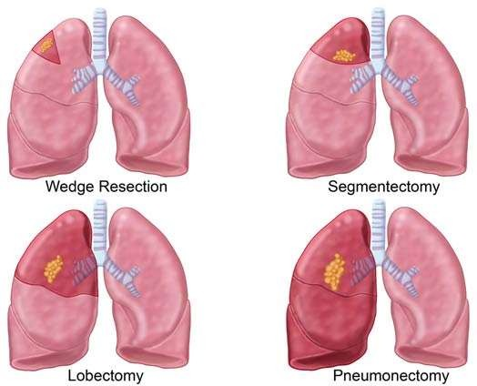
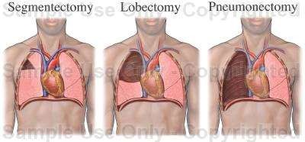
SURGICAL MANAGEMENT:-
• Lobectomy:
▫ In this surgery, the entire lobe containing the tumor is removed.
• Segmentectomy or wedge resection:
▫ In these surgeries, only part of a lobe is removed. This approach might be used, for example, if a person doesn’t have enough lung function to withstand removing the whole lobe.
Pneumonectomy:
▫ This surgery removes an entire lung. This might be needed if the tumor is close to the center of the chest.

Slide 28
VIDEO-ASSISTED THORACIC SURGERY (VATS)
Increasingly, treat early-stage lung cancers in the outer parts of the lung with a procedure called video-assisted thoracic surgery (VATS), which requires smaller incisions than a thoracotomy.
During this operation, a thin, rigid tube with a tiny video camera on the end is placed through a small cut in the side of the chest to help the surgeon see inside the chest on a TV monitor.
One of the incisions is enlarged if a lobectomy or pneumonectomy is done to allow the specimen to be removed. Because only small incisions are needed, there is usually less pain after the surgery and a shorter hospital stay – typically 4 to 5 days.

Slide 29
RADIOFREQUENCY ABLATION (RFA)
RFA uses high-energy radio waves to heat the tumor. A thin, needle-like probe is put through the skin and moved in until the tip is in the tumor. Placement of the probe is guided by CT scans. Once the tip is in place, an electric current is passed through the probe, which heats the tumor and destroys the cancer cells.
might have some pain where the needle was inserted for a few days after the procedure. Major complications are uncommon, but they can include the partial collapse of a lung or bleeding into the lung.

