Slide 2
CONTENTS
Meat ageing
Meat tenderization
Meat preservation at low temperature
Meat canning
Meat drying
Egg processing

Slide 3
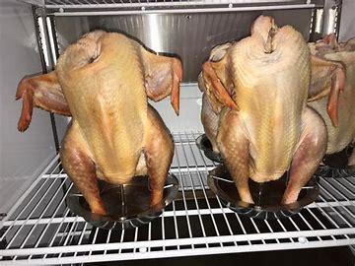
MEAT AGING
Ageing is storing or holding the meat at a refrigeration temperature for 2-4 hours to improve the tenderness of meat. It also improves flavor also known as meat conditioning
1.DRY AGING
In this case, whole carcass is hanged in a refrigerated room having temperature of 34-36F and Relative humidity of 85-90%
The enzymes present in the meat breakdown the muscles and connective tissues

Slide 4
MEAT AGING
2.WET AGING
In this case, meat is vacuum packed in the plastic packaging material and held for few hours at refrigeration temperature
Then meat is sent for distribution and sale and ageing continues until meat is unpacked
This method is more convenient and cheap as compared with dry ageing

Slide 5
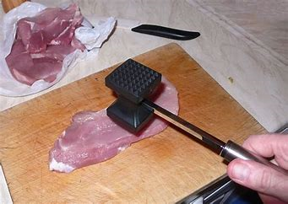
MEAT TENDERIZATION
A process of breaking down the collagen protein to make meat softer
There are three methods
1.MECHANICAL TENDERIZATION
In this, any tool like meat mallet is used to breakdown the fiber of meat

Slide 6
MEAT TENDERIZATION
2.TENDERIZATION BY COOKING
There are two types of cooking
Moist heat cooking
Braising is cooking with fat and water in closed pot
Boiling is cooking with boiling water
Stewing is cooking with water at low heat

Slide 7
MEAT TENDERIZATION
b) Dry heat method
Barbequing is cooking on open wire
Grilling is cooking over a grill
Roasting is cooking in an oven
Frying is cooking in oil
3. TENDERIZATION BY ENZYMES
Proteolytic enzymes are used that breaks the peptide bond present in proteins. Examples include papain, ficin, bromelain

Slide 8
MEAT PRESERVATION AT LOW TEMPERATURE
There are two methods
1.Refrigration
Keeping the meat at a temperature above it’s freezing point
2.Freezing
Keeping the meat at a temperature below it’s freezing point
Shelf life extension
Shelf life of meat at a refrigeration temperature is 72 hours while after properly vacuum packed and stored at freezing temperature, its shelf life can be extended to 1 year

Slide 9
MEAT PRESERVATION AT LOW TEMPERATURE: Freezing
Recommended temperature is -18C
There are following steps in freezing
Wrap food tightly in order to prevent the exposure of air
By adopting quick freezing methods like air blast freezing and cryogenic freezing, meat quality is restored
By avoiding fluctuations in temperature
By properly thawing the meat before use

Slide 10
MEAT PRESERVATION WITH CHEMICALS: Curing
Meat curing is the preservation technique in which salts and nitrates are added to extend the shelf life of meat and to improve the flavor and color of meat
Normally 1-2% salt is added to improve the flavor
Sugar is also added to reduce the harshness of salt
Sodium ascorbates are also added to speed up the process
Sodium nitrate is added that acts as antimicrobial and antioxidant in the curing process. Only 3.5g is added

Slide 11
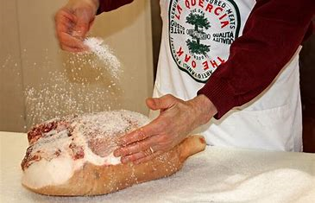
MEAT PRESERVATION WITH CHEMICALS: Curing

Slide 12
MEAT CANNING
Canning is the method of food preservation in which food contained in hermetically sealed container is subjected to an elevated temperature for a definite period of time and then cooled
It keeps as mush as original chemical, physical and sensory properties of meat
Allow the storage and transportation at normal temperature

Slide 13
MEAT CANNING
Preparation of Canning of Meat
Use only good clean, sound, fresh meat for canning.
All meat should be thoroughly bled and cooled.
Wash meat, if necessary, but never allow it to soak in water.
Cut meat into convenient, uniform pieces for packing in jars. Trim off excess fat. Small bones may be left in. They seem to improve the flavor and aid in heat penetration.
Meat should be precooked. When glass jars are used, meats should be precooked in the oven or in water before being packed in the container

Slide 14
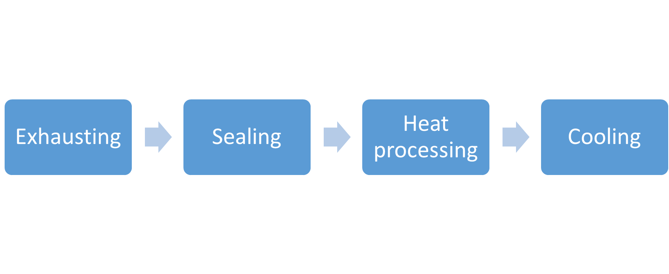
Preparation
Brining
Liding/clinching

Slide 15
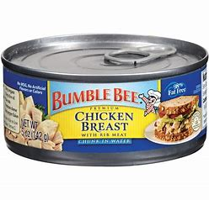
MEAT CANNING

Slide 16
MEAT DRYING
The process of removing moisture from the product so that microbial growth is retarded
Some common methods are
1.SUN DRYING
This is removal of water under normal conditions
2.DEHYDRATION
Removal of moisture under controlled conditions of temperature and RH
3.FREEZE DRYING
Removal of water by sublimation of frozen meat

Slide 17
MEAT DRYING
Advantages
Better nutrition
Better rehydration property
Little changes to the texture
Disadvantages
When moisture is allowed to loose quickly from the surfaces, it causes the hardening of the surfaces
Only 1% of total meat production is dried

Slide 18
MEAT IRRADIATION
Irradiation is a process of exposing foods to very high-energy electrons, which are similar to light waves or microwaves. This process is sometimes referred to as ionizing radiation or Irradiation
Ionizing radiation will reduce, or even eliminate, pathogenic microorganisms such as Salmonella, E. coli O157:H7, Clostridium perfringens, Staphylococcus aureus;, Listeria monocytogenes, Campylobacter jejuni
Food and Drug Administration has approved irradiation of meat and poultry

Slide 19
MEAT IRRADIATION
Three types of energy can be used for food irradiation
X-rays
Electron beams (Penetrates 1 to 2 inches deep)
Gamma rays (High penetration power)
Parasites have large amounts of DNA, are rapidly killed by an extremely low dose of irradiation.
Bacteria have less DNA, so it takes more irradiation for killing
Viruses are the smallest pathogens that have nucleic acid, and they are, in general, resistant to irradiation at doses approved for foods

Slide 20
MEAT IRRADIATION
Irradiated foods are wholesome and nutritious
Irradiation produces no heat within food
Losses of proteins, carbohydrates, and fats are still very small at very large doses
No trace minerals are lost. A small percentage of vitamins may be lost (colder the meat during the treatment, the lower the thiamin destruction)

Slide 21
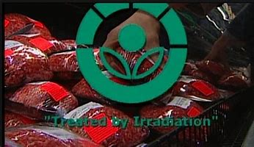
MEAT IRRADIATION
The symbol of the food that is preserved through irradiation is

