Slide 1
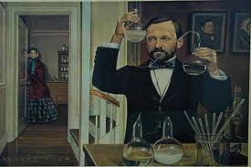
1. Development of Microbiology History of Microbiology
Siti Sarah Jumali
Room 3/14

Slide 2
Timeline
1677 Observed "little animals" (Antony Leeuwenhoek)
1796 First scientific Small pox vaccination (Edward Jenner)
1850 Advocated washing hands to stop the spread of disease (Ignaz Semmelweis)
1861 Disproved spontaneous generation (Louis Pasteur)
1862 Supported Germ Theory of Disease (Louis Pasteur)
1867 Practiced antiseptic surgery (Joseph Lister)
1876 First proof of Germ Theory of Disease with B. anthracis discovery (Robert Koch)
1881 Growth of Bacteria on solid media (Robert Koch)
1882 Outlined Kochs postulates (Robert Koch)
1882 Developed acid-fast Stain (Paul Ehrlich)
1884 Developed Gram Stain (Christian Gram)
1885 First Rabies vaccination (Louis Pasteur)
1887 Invented Petri Dish (R.J. Petri)
1892 Discovered viruses (Dmitri Iosifovich Ivanovski)
1899 Recognized viral dependence on cells for reproduction (Martinus Beijerinck)
1900 Proved mosquitoes carried the yellow fever agent (Walter Reed)
1910 Discovered cure for syphilis (Paul Ehrlich)
1928 Discovered Penicillin (Alexander Fleming)
1977 Developed a method to sequence DNA (W. Gilbert & F. Sanger)
1983 Polymerase Chain Reaction invented (Kary Mullis)
1995 First microbial genomic sequence published (H. influenzae) (TIGR)
____1600_______1700_______ 1800_________ 1900_______

Slide 3
What is microbiology?
Microbiology is the study of microorganisms, which are microscopic.
Examples:
Bacteria
Virus
Protozoa
Fungi
Algae

Slide 4
So…
Microbes: Germs that causes diseases
Biology: The study of life
Microorganisms: Bacteria, Virus, Protozoa, Fungi, some Algae
But..
Some can organisms studied by microbiologists can be visualized with naked eye such as bread molds and filamentous algae, bcuz of the technique similarities

Slide 5
Microbiologists and “their organisms”
Virologists- viruses
Bacteriologists- bacteria
Phycologists/ Algologists- Algae
Mycologists- fungi
Protozoalogists- protozoa
Others are like medical microbiologists/ immunologists, etc

Slide 6
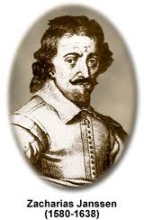
Invention of 1st compound microscope
Zacharias Jannsen (1580 -1638) was a Dutch spectacle-maker

Slide 7
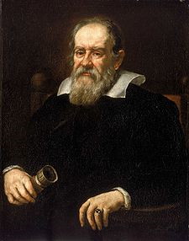
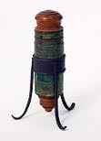
Galileo Galilei (1564 – 1642)
Improved microscope

Slide 8
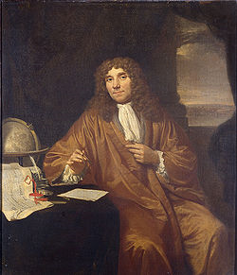
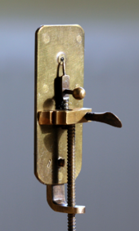
Antonie Philips van Leeuwenhoek
Improved microscope
1st to observe and describe single celled organisms, “animalcules”, we now refer to as microorganisms.
1st to record observations of muscle fibers, bacteria, spermatozoa and blood flow in capillaries (small blood vessels).

Slide 9
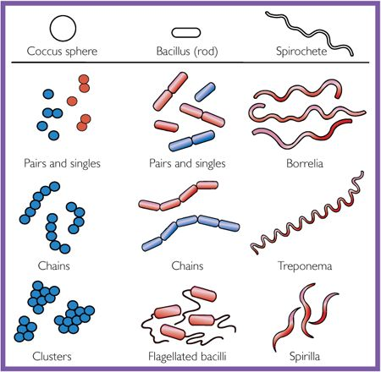
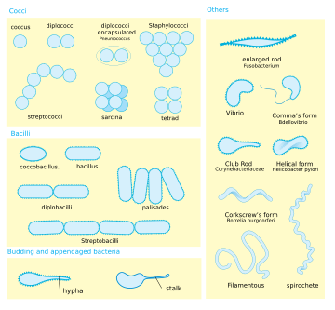
Basic shapes
Cocci | Rods/ Bacillus | Spirals/ Spirochete
Staphylococci
Streptococci

Slide 10
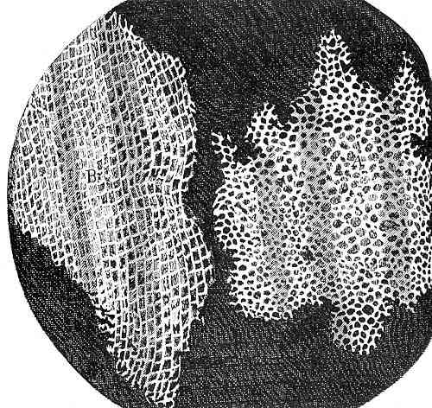
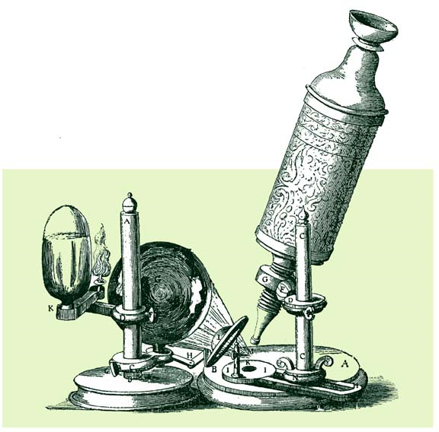
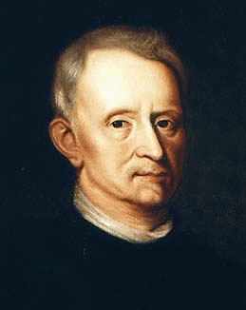
Robert Hooke (1635-1703)
Coined the term cells

Slide 11
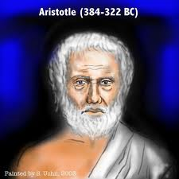
Spontaneous generation
Spontaneous generation or Equivocal generation- the origin of life from non-living matter,
By Aristotle, who compiled and expanded the work of prior natural philosophers; it held sway for two millennia.
Generally accepted until disproven in the 19th Century by the experiments of Louis Pasteur, supporting scientists (such as Francesco Redi who had performed similar experiments in the 17th century).
Ultimately, it was succeeded by germ theory and cell theory.

Slide 12
Assignment
Work in groups
Explain about
Spontaneous generation
Role of microorganisms in disease
How microorganisms affect their environment

