Slide 1
Visual Support for Written words in Scientific Writing

Slide 11
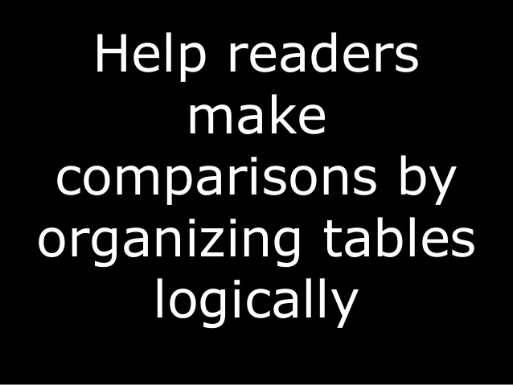

Slide 27
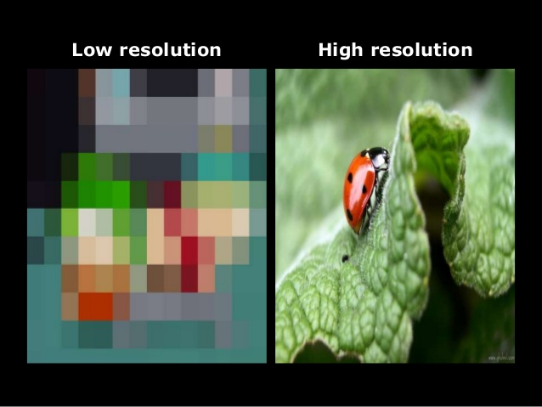

Slide 29
