Slide 1
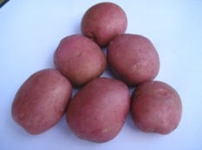
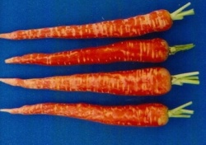
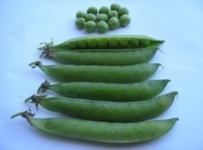
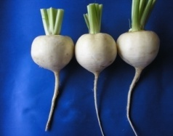
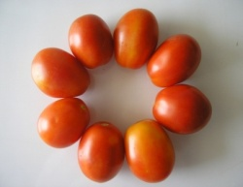
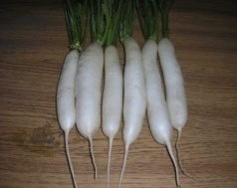
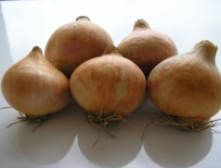
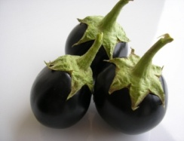
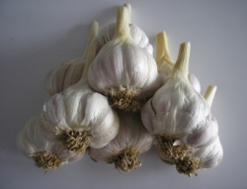
Horticulture?
HORT-201
University College of Agriculture,
University of Sargodha

Slide 2
Air
Air composition
different gases with
N₂ 78%
O₂ 21%
Argon 0.9%
CO₂ 0.03%
Vapors 1-3%
Traces of organic and inorganic compounds

Slide 3
Air effects
Nitrogen
an inert gas, essential element for plants
Available in form of nitrate and ammonia ions
Oxygen
basic requirement of life
Carbon dioxide
a very small friction is available
Critical to plants as only source of Carbon
low in thick populations/G.H due to high photosynthesis
CO₂ enrichment is performed in G.H

Slide 4
Air pollution
Principle source of pollution
High industrialization and urbanization caused degradation of air quality
auto mobilization
Industries using fossil fuels
Heating
fuel burning

Slide 5
Air pollutant
Ozone (O3)
Combustion engines release nitric oxide (NO-) oxidize in air to form nitrogen dioxide (NO2) than photochemical reactions, nitrogen dioxide converts to oxygen (O2) which than form combine with molecular oxygen (O) to form ozone(O3)
So Ozone is highly reactive compound
In the upper atmosphere, a deep layer of ozone is present which protects living organisms on the earth from UV radiation of the sun
Several plant disorder are known to be caused by ozone
Leaves may turn yellow, bronze or red, inhibiting their ability to perform photosynthesis.
Citrus and grape leaves may wither and drop off.
Conifers may show yellow-brown mottling and tip burn. White pines are often stunted and yellow.

Slide 6
Sulfur dioxide
Released from burning of fuels and mining operation
It is toxic to plant, animal and human
It enter in the leaves through the stomata and is absorbed on wet cell surfaces
At low concentration interferes with synthesis of protein
Large amount cause direct injury to the cell of plant

Slide 7
Fluoride
Are non-degradable hydrocarbons
They are produced in the aluminum, glass, ceramic and phosphate industries
Households paints and coolants in refrigerators and air conditioners contain significant quantities of fluorides
These compounds has been depleting the ozone (O3) layer
But fluorides enter into the plants through stomata
They cause mottling (blotches of different shades or colors) and necrosis (premature death of cells in living tissue) at the tips and margins of the leaves of broad leave plants

Slide 8
Other gases
Ammonia
Chlorine
Ethylene
Will also injure the plants if present in great quantities.

Slide 9
Dust
Dust or suspended particulates matter, can be injurious to plants
Dust in introduced into air by
soil erosion
Agricultural operation
Traffics
Winds
Industrial process
The most of vegetables (lettuce and cabbage), many fruit and ornamental plants can be badly damaged the foliage by airborne particles
Dust particles disturb the photosynthesis process by blocking the stomata of the leaves

Slide 10
Smog
Smog is made up from smoke + fog.
It contains
Dust
Oxide of nitrogen
Ozone
Sulfur dioxide
Hydrocarbons
And other emission products

Slide 11
These emission products from the automobiles react in the atmosphere
Under the influence of sunlight to produce toxic gases which are injurious to plants
End product of these reactions are peroxyacetyl nitrate (PAN)
PAN are toxic to plants at a concentration of 5 ppm for 10 minutes

Slide 12
These emission products from the automobiles react in the atmosphere
Under the influence of sunlight to produce toxic gases which are injurious to plants
End product of these reactions are peroxyacetyl nitrate (PAN)
PAN are toxic to plants at a concentration of 5 ppm for 10 minutes

Slide 13
Soils
All types are used for raising diff. hort. crops
Types
Sandy soils
Sandy loam soils
Silt loam
Clay loam
Silty soils

Slide 14
Sandy soils
Sandy soils
Coarse textured
Low fertility
Speedy decomposition of OM
Sand 80-95%
Clay and silt 5-20%
Well aerated
Well drained
Some part of Punjab and Deserts of Sindh

Slide 15
Vegetables may be grown for early maturity
Yield is low
Texture improvement
Frequent irrigation
Heavy manuring
Crops
Watermelon, muskmelon, groundnuts
Sweet potato
Repeated green manuring
May help raising Citrus

Slide 16
Sandy loam soils
Properties
Well aerated
Well drained
Most soils of Punjab and Sindh
Composition
Sand 50-80%
Silt and Clay 20-50%
Little OM
Silt and OM increases Water Holding Capacity.
Crops
Wide var.
Citrus, mango, date, cucurbits, root crops and ornamentals

Slide 17
Silt loam
Common around
the salt range
Potohar Plateau in Punjab
Wet mountains of the N. part of country
Dry western plateau of Baluchistan
Properties
Fine textured
Poorly drained
Fertile soils
Composition
Sand 20-30%
Silt/Clay 70-80%
High OM
Good soil preparation required for growing
Apples, pear and stone fruits
Melons and some vegetables

Slide 18
Clay loam
Clay soils generally have a greater strength when relatively dry,
but are also susceptible to waterlogging,
leading to restricted root and shoot growth.
poor aeration
Sand 20-40%
Silt and clay 60-80%
clay particles the smallest
Crops potato, tomato, Spinch citrus

Slide 19
Organic soils
Organic soils are formed from plant material deposits in and around shallow bodies of water and contain over 20% organic matter. They are of two types:
muck and peat soils.
Muck soils contain 20-70% organic matter and are fine-textured. Plant residue is in an advanced stage of decomposition. These are highly valuable soils, producing high yields of horticultural crops, particularly vegetables and ornamentals.
Peat soils are composed of coarse and fibrous organic matter. The percentage of organic matter in these soils also ranges from 20-70%. They are important in greenhouse production.These soils are not found anywhere in Pakistan. Our soils generally have less than 1% organic matter content (Kausar et al. 1979).

Slide 20
Sodic soils have high levels of alkalis, particularly sodium hydroxide, and are also sometimes called alkali soils. They are black in colour because of accumulated organic matter, and are considered most difficult to reclaim.
There is another class of soils known as saline soils. These soils contain harmful quantities of chlorides, sulphates, and carbonates of sodium,
Date palm and olives are highly tolerant to acidity as well as alkalinity of soils.

