Slide 1
Cell Adhesion:
Introduction: One of the areas of biomedical science that has advanced tremendously in past decade is that of understanding of signalling at the cell surface. It is becoming increasingly clear that the body's tissue rely, in the main, for their integrity, function and spatial organisation on interactions at the cell surface between cells and their soluble and insoluble molecular environment. The molecules that facilitate interactions between cells and between cells and tissue matrices are known as cell adhesion molecules.
Types of cell adhesion molecules:
There are six known cell adhesion molecule families into which most of these entities are grouped on the basis of chemical, structural or functional similarities. Four rely on interaction between and two on interactions between proteins and carbohydrates. The four protein-protein recognition molecules are;
The immunoglobin super family
The cadherins
The integrins
The receptor protein tyrosine phosphatases

Slide 2
The selectins and hyaluronate receptors mediate interactions between proteins and carbohydrates. All but the hyaluronate receptors are involved in cell-cell adhesion; integrins and hyaluronate receptors are involved in cell-matrix interactions. All of these molecules are transmembrane glycoproteins with extracellular binding domains and cytoplasmic functional domains.
On binding of ligands to the extracellular domain intracellular events are initiated through the cytoplasmic functional domain. In turn, these cause major behavioral and functional changes in the cells. Thus if cells are to interact with one another or with their matrix, two complementary molecules are required, the adhesion molecule and its ligand, one on each side of the adhesion site.
These may be:
Members of the same group of cell adhesion molecules(homophilic) for example, cadherin-cadherin binding.
Members of different groups of cell adhesion molecules for example, selectins binding to members of the immunoglobin super families.
A cell adhesion molecule and a molecule which does not belong to any of these groups for example, integrins binding to matrix molecules.

Slide 3
Functions and actions of cell adhesion molecules:
It is apparent that, at a cellular level, cell adhesion molecules are responsible for more than just adhesion of cells to one another and to their insoluble matrices. Additional functions include: The ordering of cell sorting, migration and differentiation; organization of cell motility via the cytoskeleton; regulation of inter and intracellular signaling; and control of gene transcription.
In recent years, there has been an explosion of interest in the function of these molecules in all of the areas.
Cell-cell adhesion:
Cell to cell adhesion is obviously one of the most important functions of cell adhesion molecules. Adhesion of one cell to another serves to major purposes. The first is to form distinct groups, lines or sheets of cells and the second to prevent or arrest movement.
One of the most striking electron microscopic features of epithelial and non-epithelial tissues alike in the presence between cells of junctional complexes specifically designed to lock cells to one another.

Slide 4
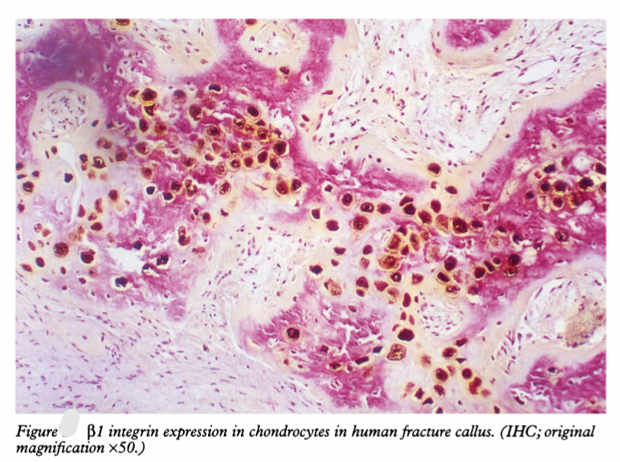

Slide 5
The most dramatic of these structures are the desmosomes. As started earlier, cadherins are important structural and functional components of desmosomes. Perhaps the most recent notable advance has been the determination of two high resolution structures on the extracellular cadherin domain implicated in cadherin-cadherin binding.
It has been suggested that the two molecules may form parallel dimers leading to a zip-like structure as the basis of adhesion. This analogy may give an important insight into the function of cell adhesion molecule during cell migration where the rapid attachment and release of cell processes from other cells and their matrices are implicted in directed cell movement.
Other theories suggest that the cadherins do not function in this way but form rod or cylindrical oligomers bridging the space between cells. It is recognized now that there are also weaker binding cadherins that allow looser clusters of cells to form.
Cell matrix adhesion:
Integrins are the predominant mediator of cell matrix adhesion. It is now cleared that these molecules are a key part of a very complex organizational hierarchy that controls cell function and movement over matrices.

Slide 6
In monolayer culture, integrins cluster within focal adhesion complexes on regions of closed contact between cell and its matrix. There is evidence that these clusters induce changes within the cell, leading to recruitment of a number of structural proteins to the developing adhesion complex and generating a physical link with the actin based cytoskeleton.
However, the factors that influence the cell profoundly are the chemical and physical nature of the matrix to which they are attached. These can affect cell shape and more importantly, cell proliferation and differentiation.
Cell migration, sorting and differentiation:
One of the major factor initiating the intense examination of cell adhesion molecules was study of cell sorting phenomenon thought to orchestrate morphogenesis. The organization of multicellular organisms requires the selective association of embryonic cells into specific tissues.
The pattern of expression of cell adhesion molecules, notably the members of the N-CAM and cadherin families, indicates that these molecules play a pivotal role in linking the primary processes of cell division, migration, differentiation, and cell death.

Slide 8
Their spatiotemporal expression suggests that these molecules are key candidates for controlling morphoregulation.
The Immunoglobulin Super Family:
Interference with N-CAM molecules and their expression together with gene knockout experiments have shown that CAMs are important regulators of tissue morphology. Genetic manipulation of mice leading to failure to express N-CAM causes distortion of central nervous system
Cadherins:
The segregation and remodelling of embryonic tissues is associated with sequential expression of different cadherin molecules. Cadherins are one of the first type adhesion molecules to be expressed during embryonic development and are necessary for early organization of developing embryo. For example, ectoderm surrounding the embryo initially expresses E-cadherins.
Yet, when the dorsal ectoderm is induced to form neural tissue by underlying mesoderm, E-cadherin expression disappears, coinciding with the onset of N-cadherin expression in the neural plate.

Slide 10
Blocking the maternal cadherins by the injection of antisense oligonucleotides results in decreased cell adhesion in the blastomere and disruption of the blastocoel. A recent study in which antisense oligonucleotides for β-catenin mRNA were injected into developing Xenopus embryos lead to the duplication of the dorsal body axis.
N- and R-cadherins are important in the sorting of functional nerve fibre tracks. Similarly, N- , E- , and T-cadherins delineate different regions in the developing spinal cord.
Regulation of Cell adhesion molecules:
As with many other molecules, the regulation of cell adhesion molecules, whether it be stimulatory or inhibitory, may be directed at the molecule itself or at its functional pathways. It is better to consider regulation of cell adhesion molecules as occurring in three different areas:
At the level of the cell adhesion molecule
Through the second messenger or cytoskeleton
At the level of the gene

Slide 11
REGULATION OF THE LEVEL OF THE CELL ADHESION MOLECULE:
The expression of cell adhesion molecules may be upregulated through a number of different mechanisms. The presence of other cell adhesion molecules will induce altered cell adhesion molecule expression or alterations in the distribution of these molecules on the plasma membrane. Such molecules may be other cells or in the matrix.
The endothelium becomes more adhesive for circulating inflammatory cells following altered, often sequential, expression of different families of cell adhesion molecules as the inflammatory process progress.
The presence of two cells in contact with one another can lead to upregulation of mutual cell adhesion molecules on both cells. Specifically, in leucocyte trafficking the β2 integrins on the leucocytes interact with members of the immunoglobin superfamily expressed by endothelial cells, resulting in stronger adhesion and leucocyte spreading.

Slide 12
Cell signaling pathway:
Because of the complexity of intracellular signaling and, in particular communication between the various signalling pathways, it has been difficult to pinpoint the influences of cell adhesion molecule mediated from non-cell adhesion molecule mediated events.
However, some have been analyzed and revealed potentially interesting interactions between cell adhesion molecule mediated processes and others. For instance, the integrin signalling pathways also converge with those through which growth factor effects are signalled.
When the α5β1 integrin binds to fibronectin, molecules of mitogenic pathway, such as ras, associate with the integrin signalling complex. There is every chance that the interplay between different regulatory proteins and the integrins permit a coordinated response to multiple environmental factors.
Adhesion molecules play an important role in the regulation of immune responses. Part of regulatory mechanism involve the upregulation of expression of cell surface adhesion molecules. An example is the E-selectins, which are important mediators of inflammatory reactions and are upregulated within hours by inflammatory mediators such as tumour necrosis factor(TNF) and certain interleukins.

Slide 13
Gene Control:
These molecules are either encoded, or regulated, by genes disturbed in cancer. Many are proto-oncogenes. E-cadherin expression is regulated by the ErbB2 proto-oncogene and RHAMM is regulated in H-ras transformed cells.
In addition, various components of intercellular junctions have molecular, structural similarities or close physical associations with the products of tumour supressor genes. Regulation at genetic level can be controlled by other ways.
For example, CD44 can display heterogeneity through alternative splicing of certain of its exons, resulting in different isoforms with differing binding capacities and hence physiological roles. These include lymphocyte homing, immune response regulation(through lymphocyte activation) and cell migration.

Slide 14
Summary:
The cell adhesion molecules are ubiquitous recognition molecules that allow cells to communicate with one another and their environment. Through these molecules, complex alterations in the cytoplasmic messenger pathways and the microfilamentous cytoskeleton can lead to profound alterations in cell division, differentiation, behavior and function. It is difficult to conceive of a group of molecules that could be more important to pathologists and their understanding of disease processes.

