Slide 2
DEPARTMENT OF BOTANY ECOLOGICAL SUCCESSION

Slide 4
ECOLOGICAL SUCCESSION
“An orderly and progressive replacement of one community by another till the development of a stable or climax community in a particular area is termed ECOLOGICAL SUCCESSION”.

Slide 5
ECOLOGICAL SUCCESSION
A biotic community normally undergoes continuous changes under the influence of various biotic and abiotic factors.
The communities at any place modify the environment due to their activities.
The modified environment becomes less suitable to the existing community which is replaced by some better suited more complex new community.
The process is repeated leading to serial succession of previously existing community by the new one.

Slide 6
ECOLOGICAL SUCCESSION
The entire series of communities is known as sere, and the individual transitional communities as seral communities or seral stages. The first community to inhabit an area is called pioneer community. It has low biomass and nutrient level.
The succeeding communities are called the transitional communities and the last stable community, the climax community
The climax community has maximum diversity and niche specialization.

Slide 7
EOCLOGICAL SUCCESSION
Fig.1 Types of successional stages, 1. Pioneer stages, 2. Intermediate or seral or transitional stages and 3. Climax community

Slide 8
TYPES OF ECOLOGICAL SUCCESSION
Based on the habitat, ecological succession can be of following four types:
1.
XEROSERE
2.
LITHOSERE
3.
PSAMMOSERE
4.
HYDROSERE

Slide 9
TYPES OF ECOLOGICAL SUCCESSION
Xerosere: The sequence of developmental stages of biotic succession on dry habitat like desert is termed as xerosere.
Lithosere: It is the sequence of successional stages on a bare rock.
Psammosere: It is the sequence of successional stages on coastal sand.
Hydrosere: It is the sequence in biotic succession taking place in a water body pond, pool or lake. Such a succession is known as hydrarch succession.

Slide 10
TYPES OF SUCCESSIONAL COMMUNITIES
There are three types of successional communities:
1. Pioneer Community
3. Climax Community
2. Seral or Transitional Communities

Slide 11
TYPES OF SUCCESSIONAL COMMUNITIES
Pioneer Community:
It is the first community developing over a bare area. This community has a little diversity and takes a lot of time in converting the bare area suitable for the second or seral community.
Members of pioneer community have a high rate of growth, a short lifespan, low biomass and low nutrient level. Therefore, they produce lots of organic matters.

Slide 12
TYPES OF SUCCESSIONAL COMMUNITIES
Seral or Transitional Communities:
These communities develop in the area after the pioneer community but before the climax communities make their appearance.
Seral or transitional communities have high biomass and high levels of organic nutrients.
They slowly build soil, increase in biodiversity, niche specialization and biogeochemical cycling. Successional species that develop latter are slow growing and long lived.

Slide 13
TYPES OF SUCCESSIONAL COMMUNITIES
Climax Community:
It is a stable, self-perpetuating biotic community which establishes itself after the seral community.
It shows a high niche specialization, complex food webs and stratification.
It is in perfect harmony with the climate of the region. In a climax community species diversity is the maximum.

Slide 14
KINDS OF SUCCESSION
There are two main types of succession:
1.Primary succession
2. Secondary succession

Slide 15
KINDS OF SUCCESSION
PRIMARY SUCCESSION
When succession begins on primarily bare area which has not been previously occupied by a community (e.g., a newly exposed rock area, sand dunes, new island, deltas, shore or recent lava flow), it is known as primary succession or prisere.
The first group of organisms (plants or animals) which become established in such an area is termed the pioneer community.

Slide 17
PRIMARY SUCCESSION

Slide 18
KINDS OF SUCCESSION
SECONDARY SUCCESSION
When community development occurs in a secondarily bare area from where community was removed and where nutrients and conditions for existence are already favourable, e.g., cutover forest, abandoned cropland and ploughed field, it is termed secondary succession.

Slide 19
SECONDARY SUCCESSION
The destruction of previous community can occur due to:
Forest cutting
Forest fire
Submergence due to floods
Severe drought for several successive years
Landslide or earthquake
Heavy overgrazing or harvested crop fields left uncultivated for several years
The secondary succession is usually more rapid because some seeds and underground parts of plants are already present which quickly give rise to a new community as soon as conditions become favourable. The previously occupied territory is more receptive to biotic community development

Slide 20
COMPARE AND CONTRAST PRIMARY AND SECONDARY SUCCESSION

Slide 22
SECONDARY SUCCESSION

Slide 23
SECONDARY SUCCESSION
Fig. The circle of life in secondary succession

Slide 24
Kinds of Ecological Succession
There are two types of ecological succession seen in plants. They are as follows:
Hydrarch succession
Xerarch succession

Slide 25
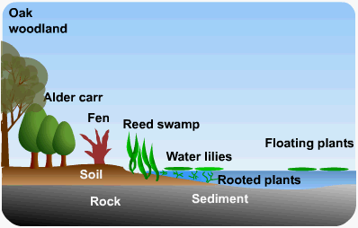
Kinds of Ecological Succession
Hydrarch succession
This kind of succession takes place in areas where the water content is very high as a result the plants grow in availability of too much of water.
Thus, the plants have a tendency to develop so as to minimize the water usage.
We can therefore say that the plants change from hydric conditions to mesic condition.
Hydrosere

Slide 26
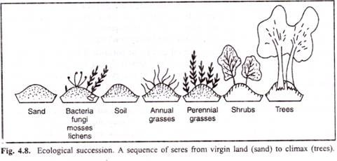
Kinds of Ecological Succession
Xerarch succession
This succession takes place in areas where there is scarcity of water, as a result, plants develop so as to conserve water. Thus, the plants change from xeric to mesic condition. Hence, the general conclusion is both the plant successions move towards attaining mesic conditions.
Xerarch succession

Slide 27
Hydrarch succession
Hydrosere or Hydrarch succession occurs in a pond and its community are converted into a land community. Stages Of Hydrach Succession
Phytoplankton stage
Submerged stage
Floating stage
Reed swamp stage
Sedge Marsh or Meadow stage
Woodland stage
Climax forest

Slide 28
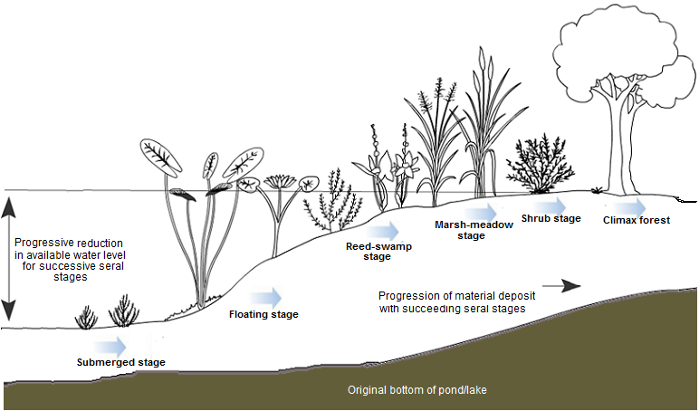
Kinds of Ecological Succession
Hydrarch succession

Slide 29
Hydrarch succession
Characteristics of Hydrosere:
In the initial stage, phytoplankton(cyanobacteria), green algae (Spirogyra, Oedogonium) are the pioneer colonizers.
They are consumed by zooplankton (protozoans as Amoeba, Euglena, Paramecium etc.) and fishes.
Gradually these organisms die and increase the content of dead organic matter in the pond.

Slide 30
Hydrarch succession
This is then utilized by bacteria and fungi, and minerals are released after decomposition.
Nutrient rich mud supports rooted hydrophytes growth as Elodea, Hydrilla, Ceratophyllum etc in the shallow water zone.
This submerged stage is also inhabited by animals such as may flies. Dragon flies etc and Crustaceans as Daphnia, Cypris, Cyclops etc.

Slide 31
Hydrarch succession
The hydrophytes die and decomposed by micro organisms and thus release nutrients.
Due to silting, water depth is reduced and at the margin of pond grow rooted floating vegetation.
Example- Nelumbo nucifera, Monochoria, Trapa etc.
In floating stage faunal living space is increased and diversified. Example- frogs, salamander, hydra, diving beetles etc inhabit such conditions. Some turtles and snake also invade the pond.

Slide 32
Hydrarch succession
Gradually, the water depth decreases due to water evaporation and organic matter decomposition.
Free floating plants as Lemna, Azolla, Pistia, Spirodella, Wolffia etc increase in number as availability of high nutrient is there.
When these die, they build up the pond ecosystem, resulting in further build up of the substratum.
Pond becomes a Swampy ecosystem.

Slide 33
Hydrarch succession
The reed swamp species, such as Scirpus, Typha or Phragmites and sedges as Juncus, Carex, Cyperus etc invade the pond and gradually replaced by mesic communities.
Gradually, land plants as shrubs (Salix and Cornus) and trees (Almus, Populus) invade ending in the climax community as deciduous forest.
The aquatic fauna also changes and ultimately gets replaced by land animals.

Slide 34
Xerarch Succession
Xerosere Xerosere or Xerarch succession begins on exposed parent rocks (lithosere) or dry sand (psammosere). A lithosere involves following stages
Crustose Lichen Stage (Pioneers)
Foliose Lichen Stage
Moss Stage
Herbs Stage
Shrub Stage
Forest Stage (Climax Stage)

Slide 35
Xerarch Succession
Fig. Xerarch succession begins on exposed parent rocks (lithosere) or dry sand (psammosere).

Slide 36
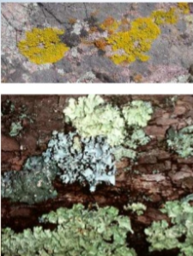
Crustose Lichen Stage (Pioneers)
Crustose are land lifeless structure.
The crustose may have an external protective layer surface on the rock.
Special types of lichens can grow on ,these rocks. The lichens are called crustose lichens.
Its most common species are Rhizocorpon, Rthodina
These lichens can live in extreme conditions. Sometime, their surface becomes wet due to rain and dew-drops. They absorb water during dry season. They cause weathering of the rock. They prepare the land for next stage.

Slide 37
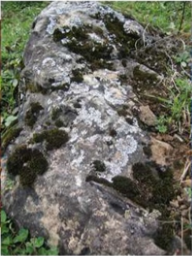
Foliose Lichens Stage:
Now habitat is suitable for foliage lichens. Foliage lichens are leaf like.
They are attached at one point, Their examples are Parmelia and Dermaticarpo.
They produce shade on the crustose lichens. As a result the growth of crustose lichen is reduced or decreased.
They make the soil acidic. Humus is added to it. It makes the rock rough.

Slide 38
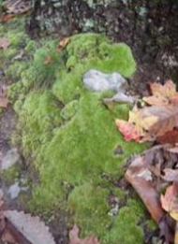
Moss stage
The soil becomes more porous. Litter of the lichens is collect in it. Thus at this stage moss plants added in the area.
The examples of mosses are Polyerichum and Tornda.
The mosses compete with lichens for water. They penetrate much deeper in the soil as compared to the lichens. The lichens become dead.
Thus more humus is added to the soil. Minerals combine with this humus. This environment is now suitable of herbaceous plants:

Slide 39
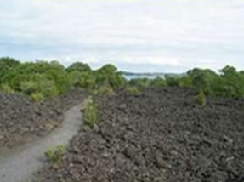
Herbaceous (plant) stage
The soil has a large amount of humus and litter. Thus its water holding capacity is increased.
Thus there is wire availability of moistures, humus and soil for anchorage.
The herbaceous plants are now established there. These plants increase the process of weathering. Evaporation or transpiration takes place. It reduces the temperature.
Now bacteria, fungi and other animals establish there. Some xerophytes grasses also establish there.

Slide 40
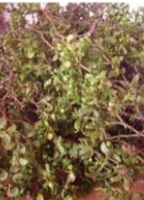
Shrub stage
Soil conditions are now becomes favourable for shrubs. Shrubby plants now start growing such as Rhus and Phytocarpus
They become dense. They cast shadow on herbs so the herbs die.
Thus the herbaceous plants add more humus to the soil. The roots of shrubs penetrate into soil.
They develop wide cracks in rock. The process of soil formation continues.

Slide 41
Climax stage
The soil is much improved now. So it now allows the growth and establishment of woody plants.
These plants are densely rooted. The shade of these plants inhibits the growth of most plants.
Woody plants dominate in this stage. This stage essentially remains the same if nothing changes in the environment to upset the balance.
It is a stable stage in succession. Thus the woody forest is the climax stage for this region.

Slide 42
OTHER KINDS OF SUCCESSION
These are other kinds of succession;
Allogenic Succession
Autogenic Succession
Progressive Succession
Retrogressive Succession
Autotrophic Succession
Microsuccession
Seasonal Succession

Slide 43
KINDS OF SUCCESSION
Allogenic
Change in Environmental conditions
e.g. Salt marsh to woodland.
The environmental changes the composition of the plant community
Autogenic
Where both plant community and environment change
Caused by the activities of plants over time
e.g. Eruption of volcanos

Slide 44
KINDS OF SUCCESSION
Progressive
Where community becomes more complex with time
Contains more species
Contains more biomass over time
Retrogressive
The community regresses.
Becomes more simplistic
Contains fewer species and less biomass
Some retrogressive successions are allogenic in nature
e.g. Introduction of grazing animals results in degradation of farmland.

Slide 45
KINDS OF SUCCESSION
Autotrophic Succession
Characterized by early and continued dominance of autotrophic organisms like green plants
Begins in a predominantly inorganic environment
The energy flow is maintained indefinitely
Micro Succession
This involves the succession of microorganisms
It begins in a predominantly organic environment
There is a progressive decline in the energy content

Slide 46
KINDS OF SUCCESSION
Seasonal Succession
Seasonal succession is another type of succession, but instead of being the result of a disastrous event, it is caused by cyclical changes in the environment or interactions between the species in a community.

Slide 47
CAUSES OF SUCCESSION
The main causes of succession are as follows:
(1) Climatic Causes
(2) Topographic Causes
(3) Biotic Causes

Slide 48
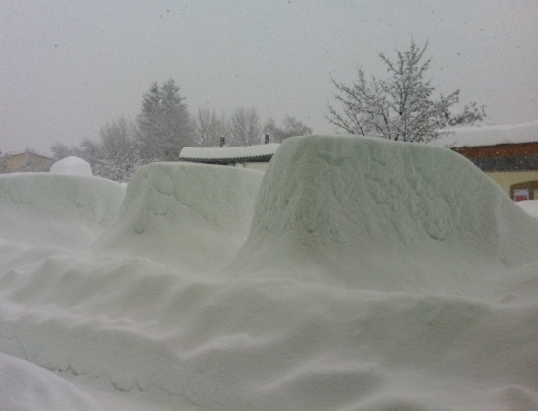
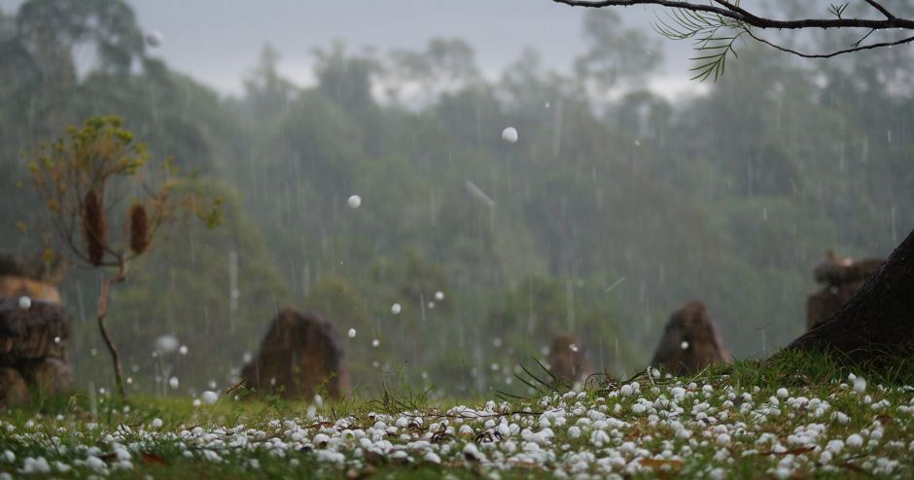
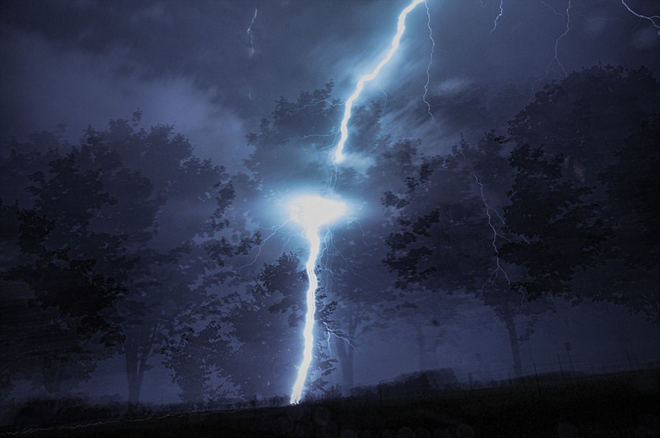
CAUSES OF SUCCESSION
Heavy snowfall
1. Climatic Causes:
Plants cannot adjust with the long range variations in the climate.
The fluctuating climate sometimes leads the vegetation towards total or partial destruction and, as a result, the bare area develops which becomes occupied by such plants as are better adapted for changed climatic conditions.
Drought, heavy snowfall, hails and lightning are some of the important factors for the destruction of vegetation. Sometimes new bare ground is formed by emersion of land from the bodies of water (ponds, rivers etc.).
Hails
Lightning

Slide 49
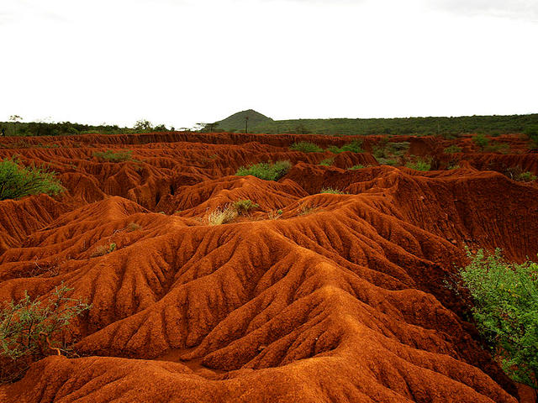
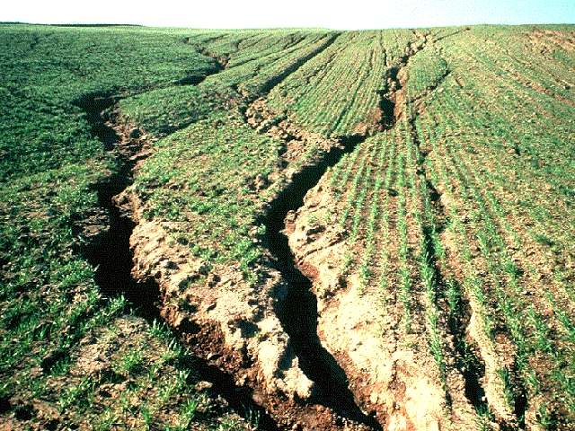
CAUSES OF SUCCESSION
Erosion of the soil
2. Topographic Causes:
These are concerned with the changes in the soil. The following are two important soil factors which bring about changes in the habitat:
(i) Erosion of the soil:
Sometimes surface soil is removed by a number of agents, such as wind, water currents, and rainfall. This process is known as soil erosion. In the process of erosion new and bare area is exposed in which new plant communities begin to appear one after another.

Slide 50
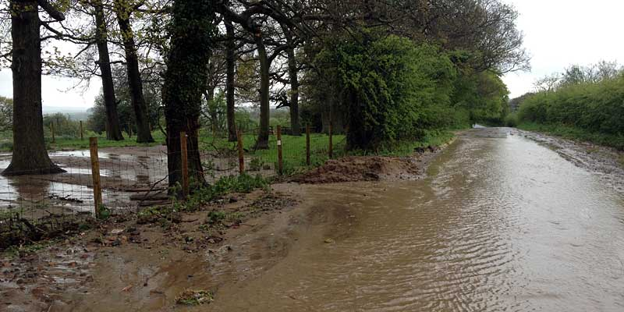
CAUSES OF SUCCESSION
(ii) Soil deposition:
It is one of the important causes that initiates succession. Soil deposition results owing to heavy storms, glaciers, snowfalls and landslides. If the deposition of soil takes place over an area already covered with vegetation, the plants occurring over there may be suppressed and destroyed. Deposition results in a new bare area on which succession of vegetation starts.
Soil deposition

Slide 51
CAUSES OF SUCCESSION
3. Biotic Causes:
Many biological or living agencies also affect the vegetation in many respects.
Grazing, cutting, clearing, cultivation, harvesting, and deforestation, all caused by living agencies, are directly responsible for vegetational change.
The parasitic plants and animals also affect the vegetation and destroy it.

Slide 52
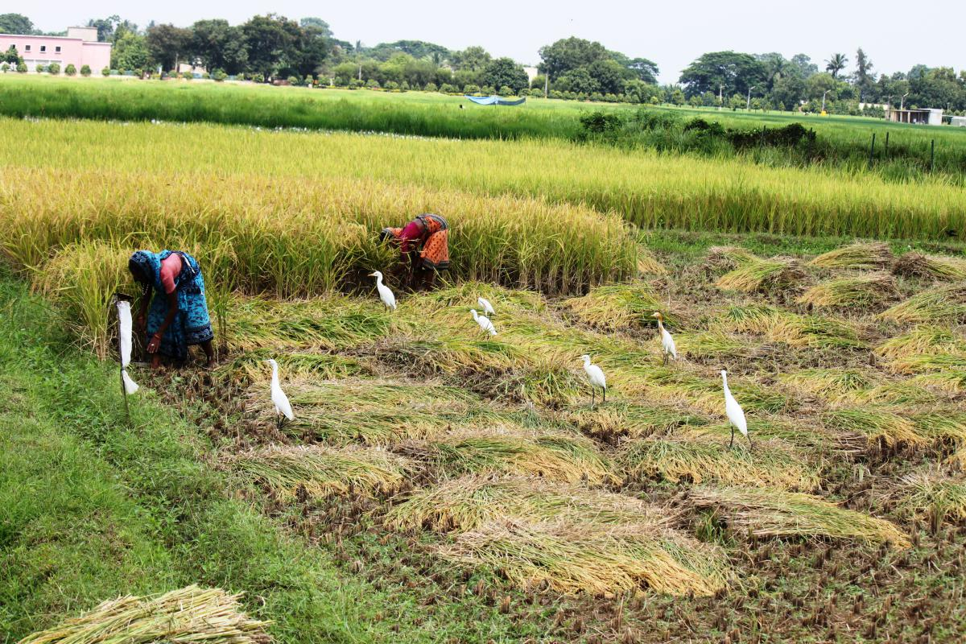
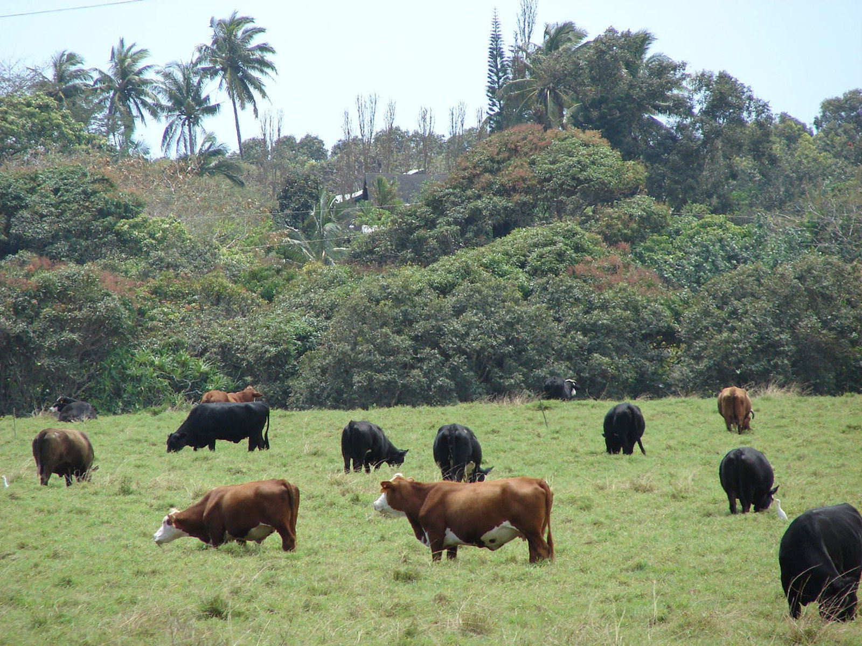
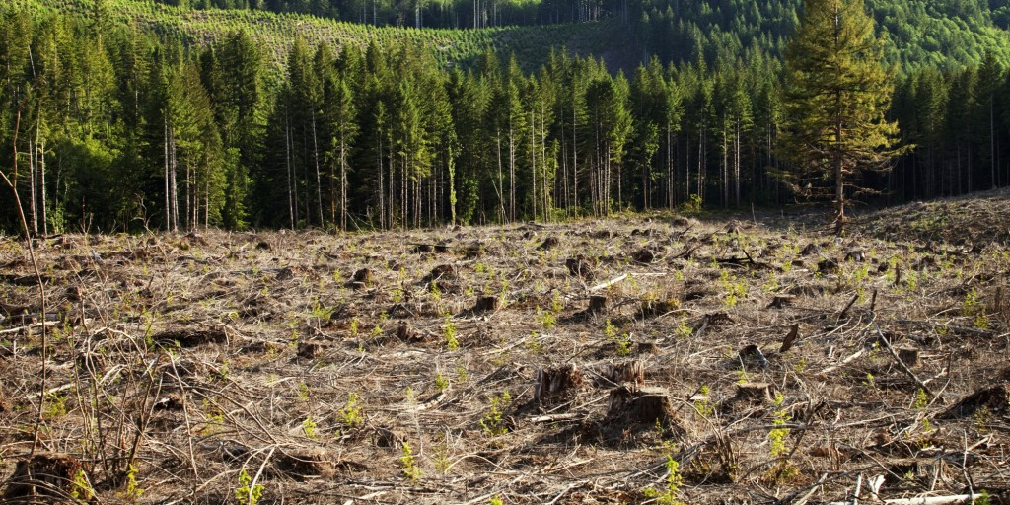
Biotic Causes Grazing, cutting, clearing, cultivation, harvesting, and deforestation etc

Slide 53
EVENTS IN THE PROCESS OF BIOTIC SUCCESSION
The process of succession always starts on a bare land and involves following sequential events:
MIGRATION
COMPETITION
INVASION
REACTION
STABILISATION
ECESIS
COLONIZATION AND AGGREGATION

Slide 54
EVENTS IN THE PROCESS OF BIOTIC SUCCESSION
Migration: It is transport of spores, seeds or other structures of propagation to the bare area.
Ecesis: It is successful germination of propagules into the bare area. The germination of seeds and spores produce new seedlings or new plants. As a result, some individuals of species are established in the bare area.
Colonization and Aggregation: In this stage, the plants that had established themselves multiply and form colonies or aggregate into small or large groups.

Slide 55
EVENTS IN THE PROCESS OF BIOTIC SUCCESSION
4. Competition: When number of these individuals increases many fold in a given area, they enter into intraspecific and interspecific struggle. This results in the elimination of unsuitable or weak plants and animals. They start showing various types of interactions.
5. Invasion: New varieties of plants and animals migrate into this area and establish themselves in spaces created due to elimination of weaker plants. This is called invasion.

Slide 56
EVENTS IN THE PROCESS OF BIOTIC SUCCESSION
6. Reaction: New migrants interact with the existing plants. This is called reaction. This leads to a changed environment. The changed environment becomes unsuitable for the existing community. Under environmental pressure, the community also changes or gets replaced by better adjusted species.
7. Stabilization: This is the final stage of biotic succession. The terminal community becomes more or less stabilized in the environment and remains in equilibrium with climatic and other environmental conditions of that area. The stabilized community is called climax community.

Slide 57
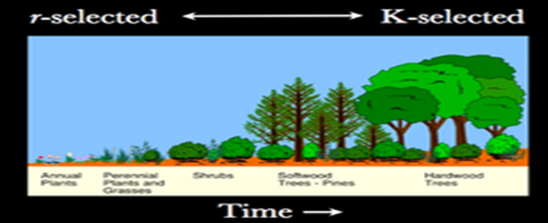
‘r-selected’ species and ‘k-selected’ species
Pioneer species are the ones that thrive the new habitat at the beginning of ecological succession. Pioneer species are ‘r-selected’ species that are fast growing and well-dispersed.
Early succession is therefore dominated by so called ‘r-selected’ species. As succession continues, more species enter the community and begin to alter the environment. These are called ‘k-selected’ species. They are more competitive and fight for resource and space.

Slide 58
IMPORTANCE OF SUCCESSION
It is one of the bases for classification of forests into forest types.
The species to be planted have to be selected keeping in view the stage of succession, otherwise it would result in failure.
Knowledge of succession shows that how the composition of the crop is changing and will change in future.
It also indicates the factors by which the succession can be altered to the best advantage of the people.

Slide 59
REFERENCES
http://www.forestrynepal.org/notes/silviculture/succession/1
http://cals.arizona.edu/classes/rnr555/lecnotes/27.html
http://biologyboom.com/theories-of-succession/
http://www.biologydiscussion.com/biotic-community/4-theories-of-the-climax-community-explained/4704
http://www.biologydiscussion.com/plants/plant-succession-causes-concepts-and-theories/6808
http://www.forestrynepal.org/notes/silviculture/succession/2
http://www.conserve-energy-future.com/types-and-stages-of-ecological-succession.php
study.com/.../what-is-ecological-succession-definition-types-stages.html
www.yourarticlelibrary.com/ecology/ecological-succession...types...ecol...
www.biotecharticles.com/.../Ecological-Succession-Causes-and-Types-74...
https://www.boundless.com › ... › Community Ecology

