Slide 1
Review of different youth organizations in Pakistan

Slide 2
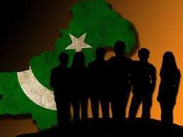
Pakistan
Agriculture country
75% Attached with agriculture
60-65% lives in rural areas
54% literacy rate of Pakistan
67% youth lives in rural areas
48% Rural & 67% Urban literacy rate

Slide 3
Youth
Youth is defined as a period during which a person prepares himself/herself to be an active and fully responsible member of the society .

Slide 4
Organization
The Planning of an activity or event.
Youth Organizations
Political or Religious or Social reform movement or agitation consisting chiefly of young people

Slide 5
Age
For Pakistan the population in the age group of 15-29 years is taken as the young population.

Slide 6
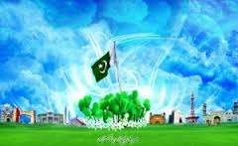
Different youth organizations in Pakistan

Slide 7
(1)
UNESCO
(United Nations Educational, Scientific & Cultural Organization)

Slide 8
Established
The UNESCO Office in Pakistan was established in Karachi in 1958 as the “UNESCO Regional Centre for Reading Materials in South Asia”

Slide 9
United Nations Educational Scientific and Cultural Organization
Emphasize community development through education
Education in:
Basic literacy, vocational training and income generating activities
Focuses on remote areas

Slide 12
(2)
UNICEF
(United Nations International Children's Emergency Fund)

Slide 13
Established
After World War II, European children face famine and disease. UNICEF is created in December 1946 by the United Nations to provide food, clothing and health care to them.

Slide 14
Established in Pakistan in 2010
Head office Islamabad

Slide 15
United Nations International Children’s Education Fund
Working against child labor
Encouraging children to go to schools

Slide 18
(3)
Oxfam
( Oxford Committee for Famine Relief )

Slide 19
Established
Oxfam has been working in Pakistan since 1973. We support local partners and work with government authorities

Slide 20
Youth employment
Youth training
Income generating ability
Food security in disaster conditions

Slide 22
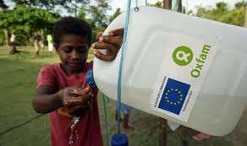
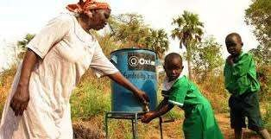

Slide 23
(4)
PLYC
(Pakistan lions youth council)

Slide 24
Established
Established in 1986
head office in Islamabad

Slide 25
socio-economic development
Health
Education
Gender
Youth
Human rights

Slide 28
(5)
PYO
(Pakistan youth organization)

Slide 29
Established
Pakistan Youth Organization (PYO) is a non-political welfare organization founded by Mr. Sana Ullah Rathore in 1990.
PYO is registered with the Social Welfare Department Government of the Punjab (Pakistan). PYO started its working in Gujranwala.

Slide 30
Health Care facilities
Drug abuse
Outreach services for Street Drug users
Mission:
Drugs and HIV/AIDS free Pakistan

Slide 33
(6)
YPP
(Youth parliament of Pakistan)

Slide 34
Established
Youth Parliament Pakistan is a project launched in 2007 in Islamabad

Slide 35
By famous singer Abrar-ul-Haq
To empower the youth of Pakistan with the ability to understand the importance of their role in community.
Leadership, citizenship and ability for governance in youth.

Slide 38
Generally viewed as passive recipients of support, rather than active agents capable of solving problems
Neglected in development planning
Youth proper political representation
Lack of social protection, Education & Health

Slide 39
Poverty
Involvement in decision-making
Ability often under-valued
Lack of employment opportunities
Education
Urban-migration
Lack of training opportunities
Gender Discrimination (for young females)
Access to information sources

Slide 40
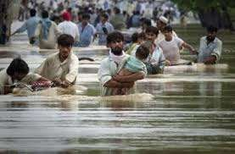
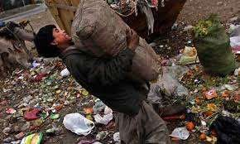

Slide 41
Many of these are at their last stage and are going to be demolished
CHANDTARA CLUB
BOY SCOUTING
GIRLS GUIDE MOVEMENT
FARM GUIDE MOVEMENT
FARM GIRLS GUIDE
YOUTH INVESTMENT PROMOTION SOCIETY
PAKISTAN YOUTH ORGANIZATION
YOUTH FRONT PAKISTAN

