Slide 1
ENTO-306
Agricultural pests and their management
Identification of important agricultural pests
Their mode of damages
Control measures
By: Dr. Muhammad Zeeshan Majeed

Slide 2
Major Insect Pests of Winter Vegetable Crops
in Pakistan

Slide 3
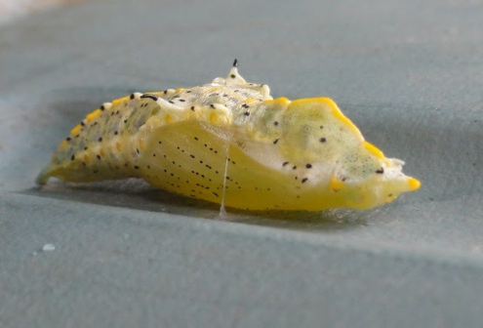
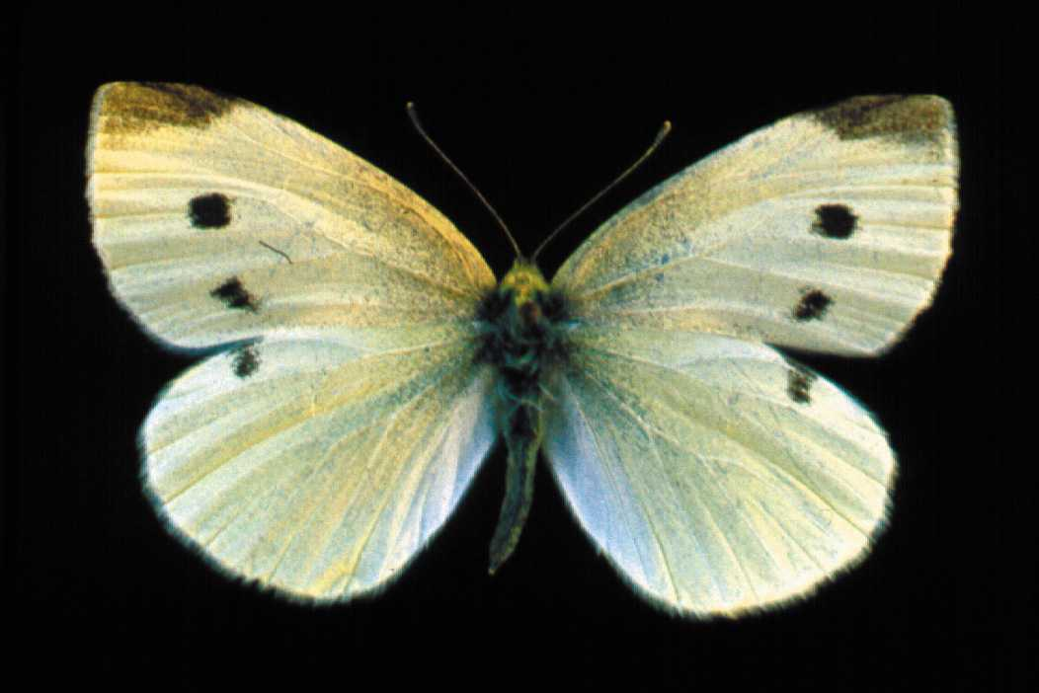
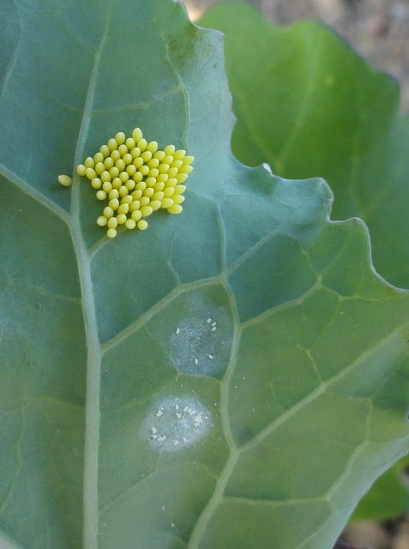
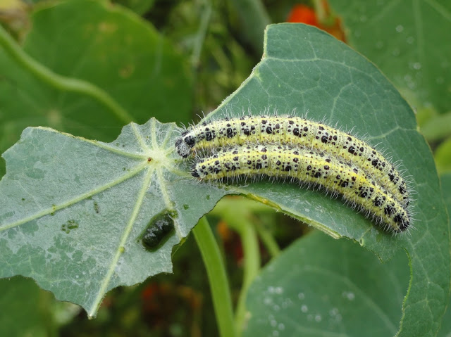
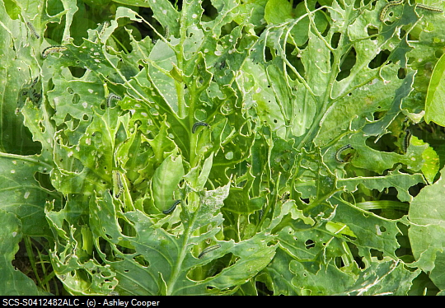
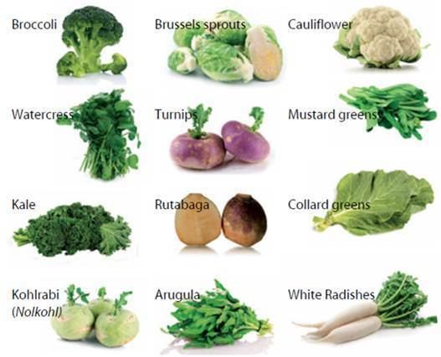
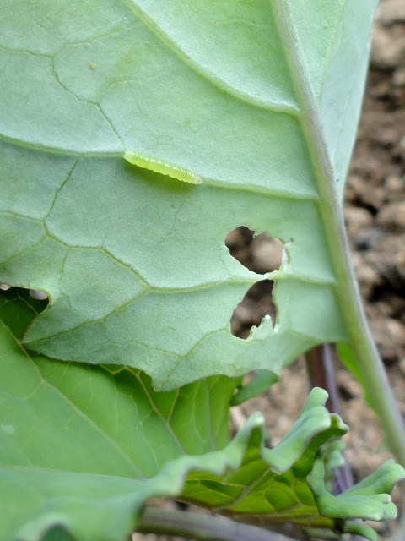
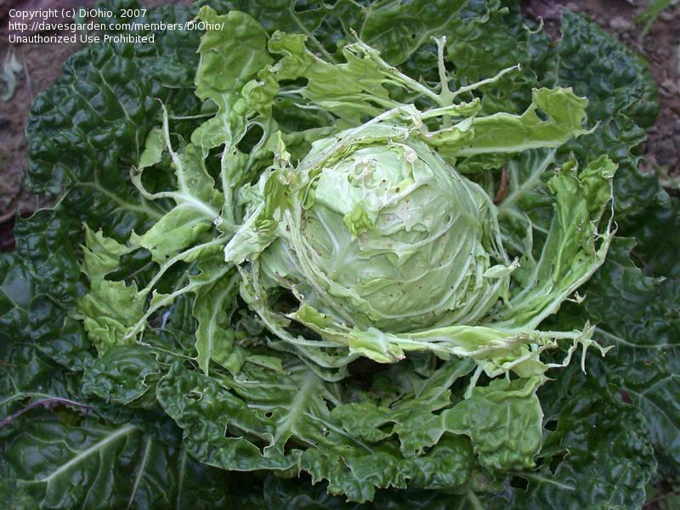
ENTO-306 Agricultural pests and their management 4(3-1)
Cabbage butterfly (Pieris brassicae: Pieridae: Lepidoptera)
Host plants: Major pest of cabbage and other cruciferous plants
Identification
Adult: Yellowish white (female with 2 black spots on up side of forewings, while in males these are absent or on lower side
of forewings.
Eggs: Pale white or yellowish in color 200-400 eggs laid singly or in batches) on leaf undersides.
Larva/grub: Creamy white or yellowish
With black spots and setae on body.
Pupa: Creamy white
Life history:
Life cycle: About 2 months
Adult: 1 week
Larvae: 3-4 weeks (5 instars)
No. of generations: 2-3
Damage:
Active period: November to April (in hilly areas May to Nov.)
Caterpillars feed gregariously on plant leaves and heads.
Attacked plant bears abnormal plant head and ultimately a lower market price.
Control:
Destruction of crop stubbles.
Cypermethrin/abamectin/Spinosad
Notes:
The first instar larvae (about 6 mm in length) on hatching were light yellow in colour with distinct shiny black heads. Last instar larva is about 40 mm in length.
The longitudinal lines on the body were similar to the fourth instar. Body was covered with black hairs on raised tubercles.
four larval moultings and five instars. The wingspan of adults is roughly 35–45 mm

Slide 4
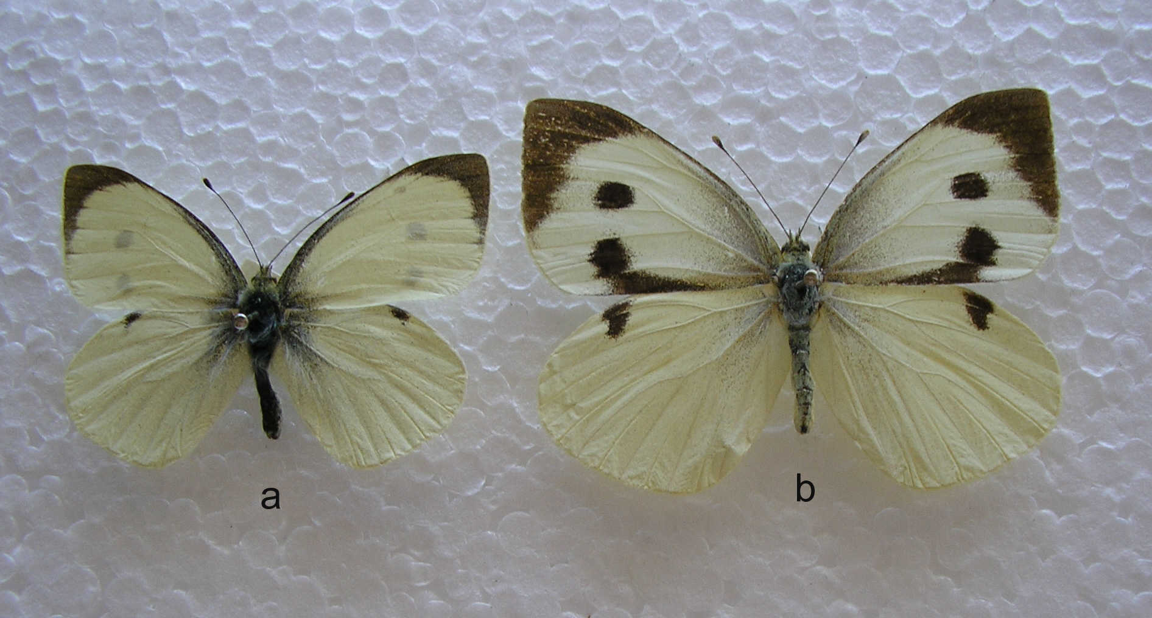

Slide 5
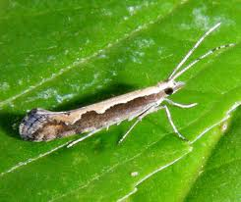
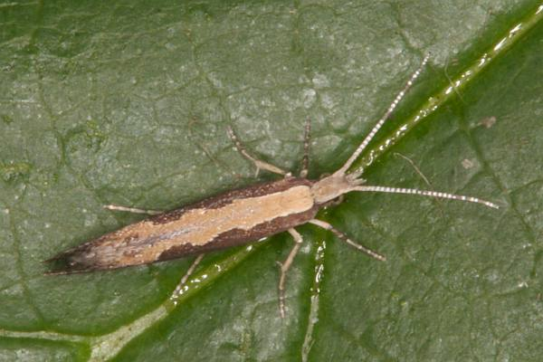
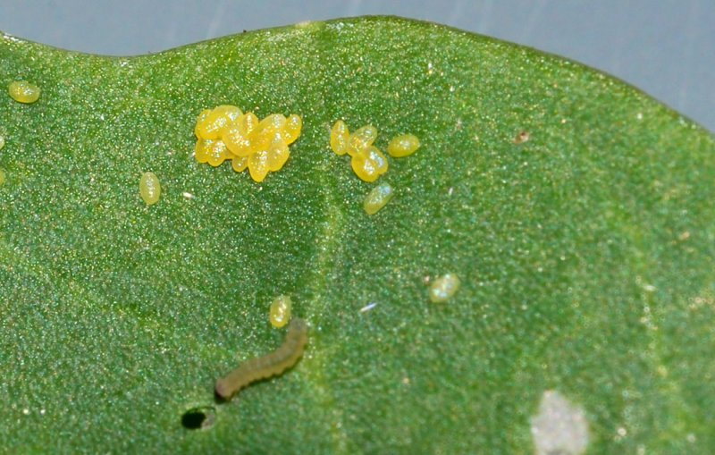
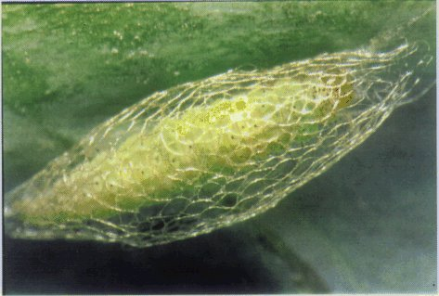
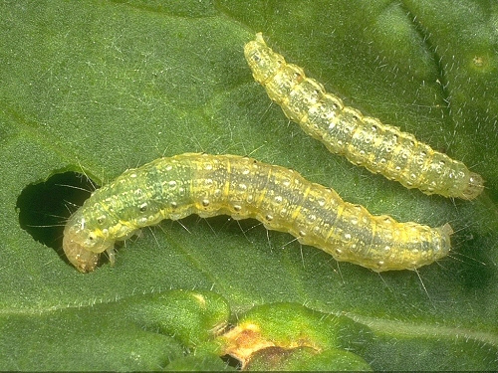
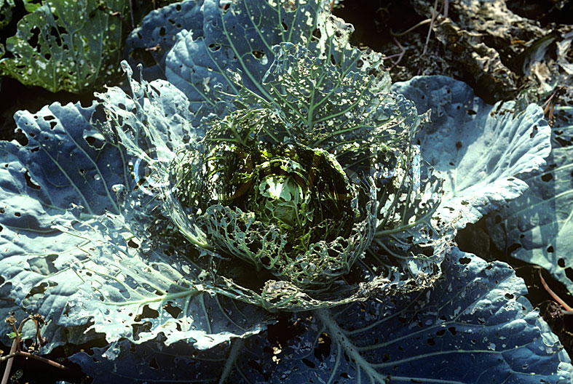
ENTO-306 Agricultural pests and their management 4(3-1)
Diamondback Moth or Cabbage moth (Plutella xylostella: Plutellidae: Lepidoptera)
Host plants: Major pest of cabbage and other cruciferous plants
Identification
Adult: Greyish brown forewings with golden strip on the dorsal side. 8 -12 mm
Eggs: Pale or yellowish white in color (av. 200) eggs laid singly or in batches of 2-8 eggs) on leaf undersides.
Larva: Pale or yellowish green (hang out by a silken thread when disturbed) 11 mm with fine setae over all body
Pupa: Yellowish green , found in silken cocoon
Life history:
Life cycle: About 1 to 1.5 months
Adult: 3 weeks
Larvae: 1-2 weeks (4 instars)
Pupa: 1 week
No. of generations: many overlapping generations per annum
Damage:
Active period: Nov. to April (maxi. Damage Dec. January)
Caterpillars feed gregariously on plant leaves and heads,
leaving leaf skeleton behind. Riddled look
Control:
Eradication of other crucifer hosts before
cabbage crop sowing and clean culture
Light trap (mass capturing of adult moths)
Different parasitoid and predatory insects
(Apenteles plutellae: A braconid wasp)
Cypermethrin/abamectin/ Spinosad
Bacillus thuringiensis products
Notes:
If disturbed, they often wriggle violently, move backward, and spin
Pupation occurs in a loose silk cocoon, usually formed on the lower or outer leaves. down from the plant on a strand of silk.

Slide 6
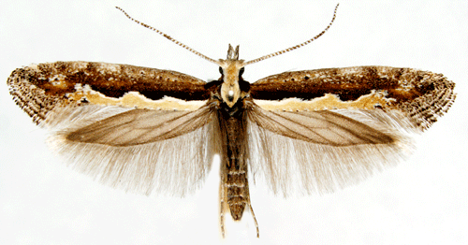
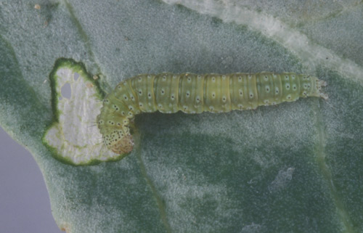
Notes:
Damage
Plant damage is caused by larval feeding. Although the larvae are very small, they can be quite numerous, resulting in complete removal of foliar tissue except for the leaf veins. This is particularly damaging to seedlings, and may disrupt head formation in cabbage, broccoli, and cauliflower. The presence of larvae in florets can result in complete rejection of produce, even if the level of plant tissue removal is insignificant.

Slide 7
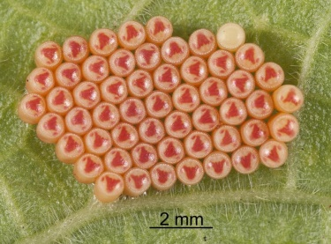
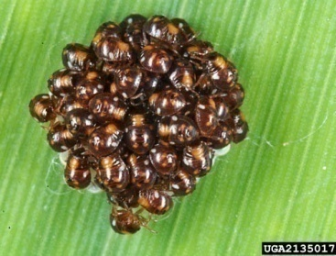
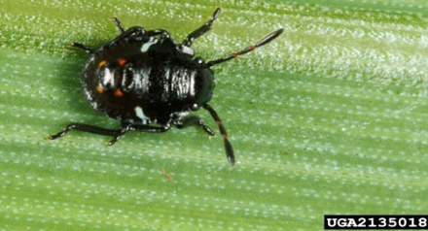
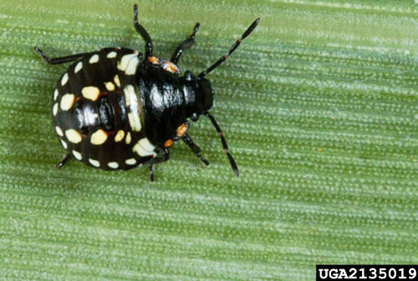
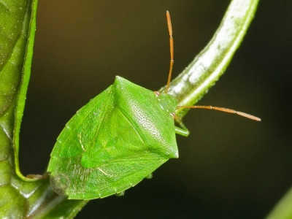
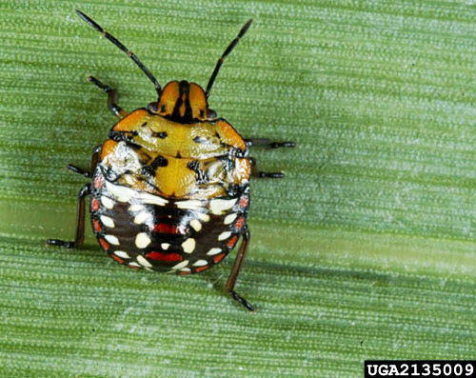
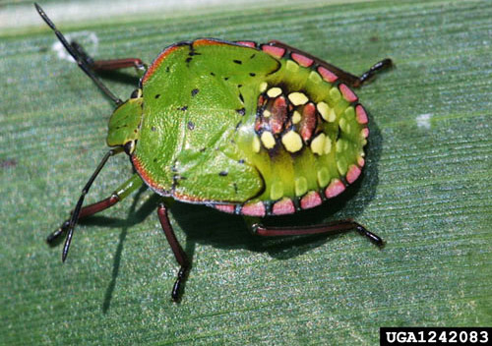
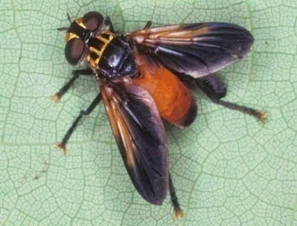
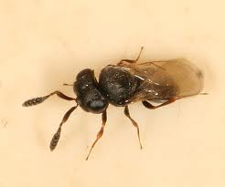
ENTO-306 Agricultural pests and their management 4(3-1)
Green Potato/Stink bug (Nezara viridula: Pentatomidae: Hemiptera
Host plants: Major pest of potato crop and other winter vegetables
Identification
Adult: shield-shaped green body (15 mm length / 8 mm width)
Eggs: Yellowish white eggs laid in batches of 30-100 underside of leaves or on tender shoots. 250 eggs in life span.
Nymph: 1st instar dark brown, 2nd instar black body with orange and yellow spots, 5th instar becomes green
Life history:
Life cycle: 2.5 to 3.5 months
Adult: 3 weeks
Nymph: 4 weeks
Pupation: 1 week
No. of generations: 3-4 overlapping generations per annum
Damage:
Active period: March to Nov. (maxi. Damage August/Sept.)
Adults and nymphs suck sap from plant tender
shoots/fruits, withering and dyeing of plants occur
Control:
Clean cultivation
Biological control by parasitic Tachinid flies (nymph/adult) and Trissolcus wasps (egg parasitoid)
Chemical control through systemic insecticides (Imidacloprid, Thiamethoxam etc.)
Notes:
https://nzacfactsheets.landcareresearch.co.nz/factsheet/InterestingInsects/Green-vegetable-bug---Nezara-viridula.html
Trissolcus japonicus (Scelionidae)

Slide 8
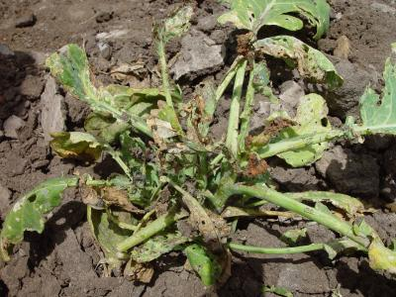
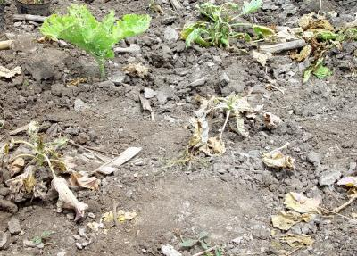
ENTO-306 Vegetable Insect Pests
Painted / Mooli / Stink bug (Bagrada hilaris : Pentatomidae, Hemiptera)
Host plants: Reddish, turnip, cabbage, cauliflower
Major pest of winter vegetables .
Identification
Adult: Blackish body with orange, red and yellowish-white spots on the dorsal side.
Eggs: Dirty white (averagely 90 eggs / female bug)
Nymph: 1st instar light reddish orange, then turns black with
red markings on the abdomen (5 nymphal instars)
Life history:
Life cycle: 1.5 – 2 months
Adult: 2-4 weeks
Egg hatching : about 1 week
Nymphs: 3-4 weeks
No. of generations: 5
Damage:
Active period: Through the year
(maxi. Damage March-April and September-October)
Adults and nymphs desap the plant causing
retarded plant growth and poor quality crop yield.
In case of early crop infestation, re-sowing of the
entire crop becomes necessary.
Control:
Biological control (green lacewings, assassin bugs etc.)
Chemical control (Imidacloprid, cypermethrin, thiamethoxam)

Slide 9
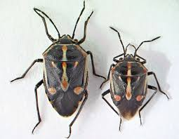
Bagrada hilaris
Nezara viridula

Slide 10
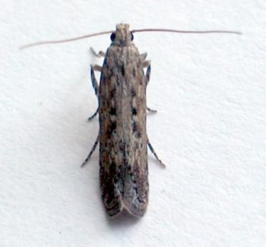
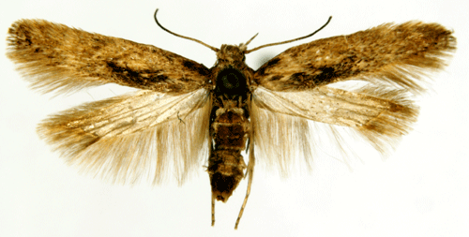
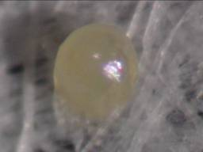
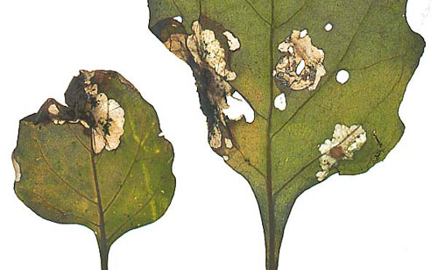
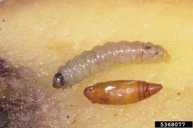
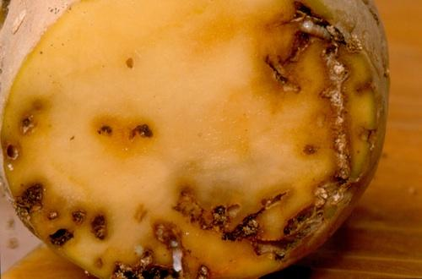
ENTO-306 Vegetable Insect Pests
Potato tuber moth (Phthorimaea operculella : Gelechiidae, Lepidoptera
Host plants: Major and global insect pest of potato
Widely distributed in potato growing areas of Pakistan
Identification
Adult: Grayish brown with dark markings on forewings
Hair fringes at outer wing margins (wingspan = 12 mm – 6mm long))
Eggs: Minute pearly white eggs (averagely 100-150 eggs / female)
Larva: 20mm, Yellowish green if feeds on foliage, pinkish white
if feeds on tubers , with a black head capsule
Life history:
Life cycle: 1 – 1.5 months
Adult: 2 weeks
Egg hatching : in 1 week (Laid singly on upper surface of young tender leaves or on tubers)
Larva: 2 weeks
Pupa: 2 weeks
No. of generations: 5 – 6 per annum
Damage:
Active period: Through the year
Winter passage as larvae in tubers either in field or stores
Larvae mines in the young foliage and later on tunnels in the stems and tubers while accumulating excreta near entrance holes on tubers
Control:
Removal and destruction of crop stubbles
Sowing of varieties resistant to PTM infestation
Maintain 2 inch soil layer on tubers in the field to avoid moth attack
PTM pheromone lures
Chemical control (Acetamiprid, Abamectin, Cypermethrin etc.)
Notes:
lta sticky traps baited with P. operculella synthetic pheromone, IT053 ISCA lure, were used to monitor adult male moth populations.
The PTM pheromone (male-attracting stimulant) can be used to bait pan-water traps for attracting and monitoring adult male PTM presence.
Prevention and Control of PTM:
The infestation of this pest in growing plant can be minimized by regular earthing-up of the crop (maintain at least 2 inch soil layer on potato seeds).
2. The infested leaves should be cut and burned before harvesting the crop.
3. The potatoes after harvesting should not be left in the field overnight as there is chance of moths laying eggs during dusk inside the tubers.
4. Potatoes should be stored in dry and well ventilated store houses. The potatoes should be covered with two to three centimeters thick layer of sand.
5. The potato crop in field should be periodically sprayed with suitable synthetic insecticide such as cypermethrin, acetamiprid etc.
6. The tubers stored for seed purpose should be dusted with or sprayed with suitable recommended synthetic insecticide.
7. The tubers stored for food purposes should be fumigated with methyl bromide @ 4 kg/ 100 cubic meter for three hours. Carbon disulphide can also be used as fumigant.
8. At early stage of crop, synthetic pheromone lures such as IT053 ISCA lure (in the form of sticky or water-pan type baits) can be used to monitor and/or mass-capturing of male PTMs.

Slide 11
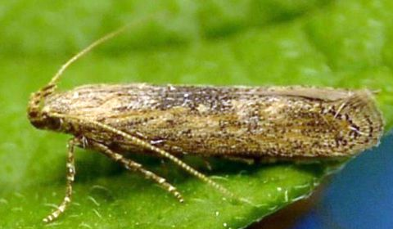
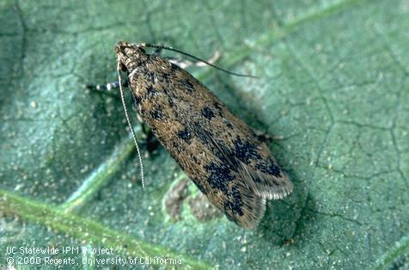
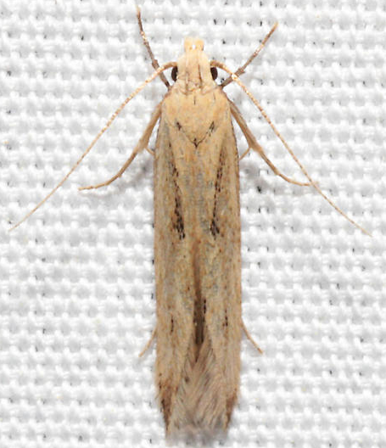
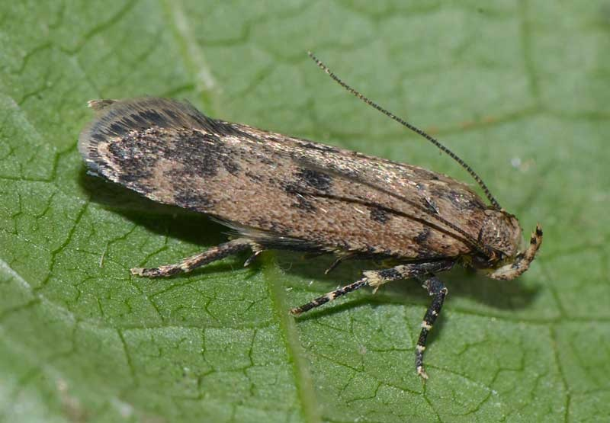
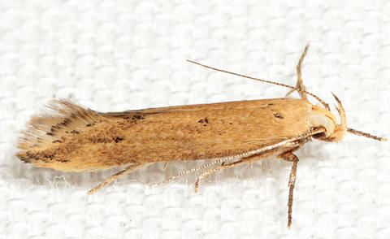
Gelechiidae, Lepidoptera
Notes:
Angoumois grain moth (Sitotroga cerealella)

