Slide 2
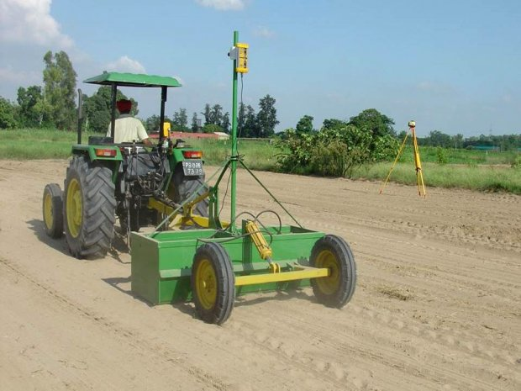
Leveling
Definition:
Smoothing and shaping the field surface.
Depths and discharge variations over the field are
relatively uniform.

Slide 3
Problems of uneven soil surface
Impact on germination
Yield reduced
Delays tillage
Increased weed burden
Un uniform distribution of water and nutrients
Soil erosion

Slide 4
Importance of leveling
Improve crop establishment.
Increase Yield
Increase Grain Quality
Reduce the amount of effort required to manage the crop
Easy to irrigate

Slide 5
Techniques
By draft animals (e.g. Buffalo, oxen).
By using harrows and leveling boards.
By using rear mounted tractor blades or drag buckets.
By a laser-controlled bucket.

Slide 6
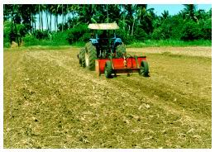
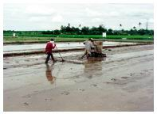
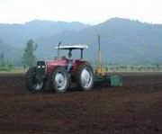

Slide 7
Leveling tractor blade

Slide 8
Laser Leveling

Slide 9
Laser leveling
A laser transmitter transmits a laser beam, which is intercepted by the laser receiver mounted on the leveling bucket.
The control panel mounted on the tractor interprets the signal from the receiver and raises or lowers the bucket.

Slide 10
Laser leveling

Slide 11
Laser leveling
This way the soil gets shifted to the right places to make the entire field level.

Slide 12
Laser Leveling used due to
More accurate than others techniques
Easy to operate
Easy to install
Negligible errors

Slide 13
Benefits of Leveling
More level and smooth soil surface
More uniform germination and growth of crops
More uniform distribution of water in the field
More uniform moisture environment for crops

Slide 14
Benefits of Leveling
Reduction in time and water required to irrigate the field
[Laser-leveling in rice fields reduced irrigation time by 47-69 hours per hectare per season compared with traditionally leveled fields.]

Slide 15
Benefits of Leveling
Reduced run-off and water-logging.
Maximum yield is obtained.
[Improved yield by laser leveling approximately 7% per hectare per seasion in rice.]

Slide 16
Benefits of Leveling
Control soil erosion
Better weed control
Large farming area

Slide 17
Benefits of Leveling
In low rainfall areas, land leveling
Produces a smooth uniform land surface,
Reduces runoff and induces infiltration of rainfall
Assures even moisture distribution.

Slide 18
Disadvantages of leveling
High cost of equipment
Less efficient in irregular and small sized fields
Cause hardness
We cannot use these instruments in extremely foggy conditions

