Slide 1
CARBOHYDRATES
Carbohydrates are the most abundant class of
organic compounds found in living organisms.
They originate as products of photosynthesis,
an endothermic reductive condensation of
carbon dioxide requiring light energy and the
pigment chlorophyll.

Slide 2
General Information:
n H2O + Energy CnH2nOn + n O2
• The formulas of many carbohydrates can be written as carbon hydrates, Cn(H2O)n, hence their name.
• The carbohydrates are a major source of metabolic energy, both for plants and for animals that depend on plants for food.
•Aside from the sugars and starches that meet this vital nutritional role, carbohydrates also serve as a structural material (cellulose), a component of the energy transport
compound ATP.

Slide 3
Terminology
In scientific literature, the term "carbohydrate" has many synonyms, like "sugar" (in the broad sense), "saccharide", "ose", "glucide","hydrate of carbon" or "polyhydroxy compounds with aldehyde or ketone".
In food science and in many informal contexts, the term "carbohydrate" often means any food that is particularly rich in the complex carbohydrate starch

Slide 4
• Carbohydrates are called saccharides or, if they are relatively small, sugars.
A- Simple Sugars
• Contain the elements carbon, hydrogen, and oxygen.
• The name carbohydrate literally means water compounds of carbon.
• The general formula for simple sugars is Cn(H2O)n
• This class of compounds is better described as Polyhydroxy aldehydes and ketones.

Slide 5
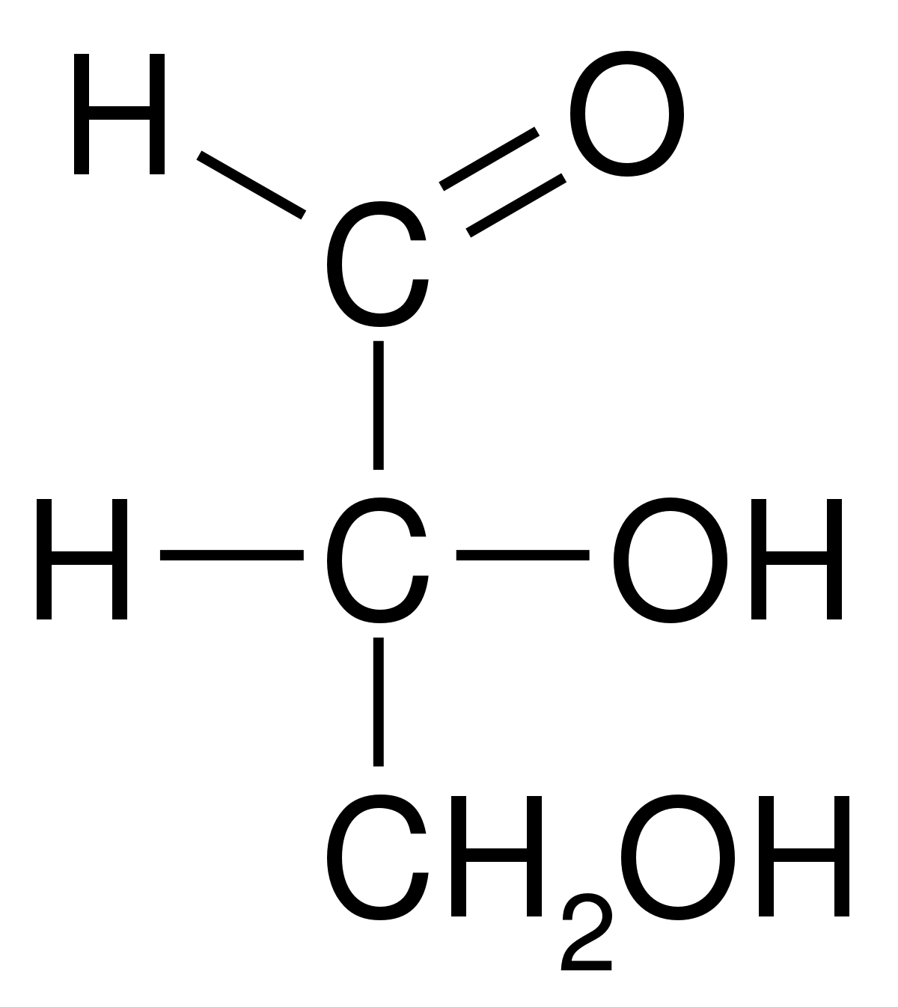
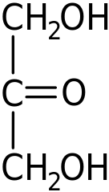
• The simplest carbohydrates are glyceraldehyde and dihydroxyacetone

Slide 6
Biochemical role of Carbohydrates
Instant source of energy
Storage Form
Formation of Conjugated Molecules
Formation of GAGs
Sperm Nourishment
Diseases
Normal blood glucose level

Slide 7
Instant source of energy
Carbohydrate are the first food components which get digested in body giving out energy.
A single molecule of glucose produces 38 molecules of ATPs.
One gram of carbohydrates provide about 4 calories of energy which is equal to 16.736 Joules.
They have the advantage of being converted into energy faster than fats and protein.

Slide 8
Storage Form
Carbohydrates are stored in animals body in the form of glycogen.
Glycogen is a multi branched polysaccharide of glucose that serves as a form of energy storage in animals.
It is also known as animal starch
Glycogen primarily stored in the cells of the liver and muscles.
During starvation, glycogen act as primary source of energy by providing ATPs.

Slide 9
Formation of Conjugated Molecules
Conjugated molecules are those molecules which are made by combination of two different groups. E.g. Carbohydrates with proteins forms glycoproteins and proteoglycans, while with lipids they form glycolipids
Glycoproteins helps in formation of Structural molecule, Lubricant and protective agent, Cell attachment-recognition site and Hormone.
The glycolipids and glycoproteins are located on the exterior of the cell membrane. They allow for communication with their neighboring cells so each cell would know which process they should be carrying out in order for the whole organism to be able to function properly.

Slide 10
Formation of GAGs
GAGs (Glycosaminoglycan's or mucopolysaccharides)
are long unbranched polysaccharides consisting of a repeating disaccharide unit.
They are useful to the body as a lubricant or as a shock absorber.

Slide 11
They have role in release of hormones, cell migration in embryonic tissues and as anticoagulant in body.
Heparin (a GAG) acts in the body to increase the activity of the some enzymes.
Sperm Nourishment
Sperms (Male gametes) are nourished and protected by fructose.
Fructose fulfill energy requirements of sperm cells till fertilization.

Slide 12
Diseases
Long term elimination of carbohydrates can cause serious health issues. An adult should consume 45% to 65% of their calories from carbohydrates.
Excessive intake of carbohydrates in blood can cause diabetes mellitus.
Glycogen storage diseaseis the result of defects in the processing of glycogen synthesis or breakdown within muscles, liver, and other cell types which stores glycogen.

Slide 13
Deficiency of carbohydrates cause serious problems in body. E.g. Hypoglycemia Ketosis
Normal blood glucose level
A normal fasting (no food for eight hours) blood sugar level is between 70 and 99 mg/dL.
A normal blood sugar level two hours after eating is less than 140 mg/dL

Slide 14
CARBOHYDRATE METABOLISM
Glycolysis
the oxidation metabolism of glucose molecules to obtain ATP and pyruvate. Pyruvate from glycolysis enters the Krebs cycle, in aerobic organisms after moving through pyruvate dehydrogenase complex.
The pentose phosphate pathway which acts in the conversion of hexoses into pentoses and in NADPH regeneration. NADPH is an essential antioxidant in cells which preventoxidative damage and acts as precursor for production of many biomolecules.

Slide 15
Glycogenesis
the conversion of excess glucose into glycogen as a cellular storage mechanism; this prevents excessive osmotic pressure build up inside the cell
Glycogenolysis
the breakdown of glycogen into glucose, which provides a glucose supply for glucose dependent tissues.

Slide 16
Gluconeogenesis
new synthesis of glucose molecules from simple organic compounds. An example in humans is the conversion of a few amino acids in cellular protein to glucose.

Slide 17
HARMS OF EXCESS CARBOHYDRATES
Excess consumption of carbohydrates causes pancreas to continue secreting insulin & body is constantly in fat storage mode. This leads to many health problems.
Obesity
– excess fat storage.
Insulin Resistance
(Hyperinsulinemia)
– precursor to Type II Diabetes.
High Blood Pressure
- Excess insulin forces kidneys to retain Na ions, hence fluid retention increases. Blood retains more fluid hence Blood Pressure rises.

Slide 18
High cholesterol –
Excess insulin causes LDL levels to rise.
Heart disease
– When LDL particles migrate into the walls of coronary artery.
Prostrate and Breast Cancer.

