Slide 1
Paired sign test

Slide 2
Paired sample sign test
Used to test the difference between two population medians when the populations are not normally distributed

Slide 3
Assumptions:
For the paired-sample sign test to be used, the following must be true.
A sample must be randomly selected from each population.
The samples must be dependent (paired).
The difference between corresponding data entries is found and the sign of the difference is recorded.
The measurement scale is at least ordinal.
The variable understudy is continuous.

Slide 4
General Procedure
Hypothesis :
1) H₀ :M₀ = 0
H₁ : M₀ ≠ 0
2) H₀ = M₀ ≥ 0
H₁ = M₀ < 0 (left tailed)
3) H₀ = M₀ ≤ 0
H₁ = M₀ >0 (right tailed)

Slide 5
2. Specify the level of significance =α
3. Test Statistic:
$X_{i}−Y_{i}$
Determine the sample size n by finding the difference for each data pair. Assign a + sign for a positive difference and a – sign for a negative difference and a 0 for no difference. Less occurring sign number will be test statistic.
4. Critical value:
1.(K < k/n,0.50) ≤$\frac{\text{α}}{2}$ (two tailed)
2. (K < k/n,0.50) ≤ $\text{α}$ (right tailed)
3. (K < k/n,0.50) ≤ $\text{α}$ (left tailed)
The null hypothesis will be rejected if the test statistic is less than or equal to the critical value.
Decision:
Make a decision to reject or fail to reject the null hypothesis. Interpret the decision in the context of the original claim.

Slide 6
Question no.1
A psychologist claims that the number of repeat offenders will decrease if first-time offenders complete a particular rehabilitation course. You randomly select 10 prisons and record the number of repeat offenders during a two-year period. Then, after first-time offenders complete the course, you record the number of repeat offenders at each prison for another two-year period. At α = 0.05, can you support the psychologist’s claim?

Slide 7
Prison | Before | After
1 | 21 | 19
2 | 34 | 22
3 | 9 | 16
4 | 45 | 31
5 | 30 | 21
6 | 54 | 30
7 | 37 | 22
8 | 36 | 18
9 | 33 | 17
10 | 40 | 21

Slide 8
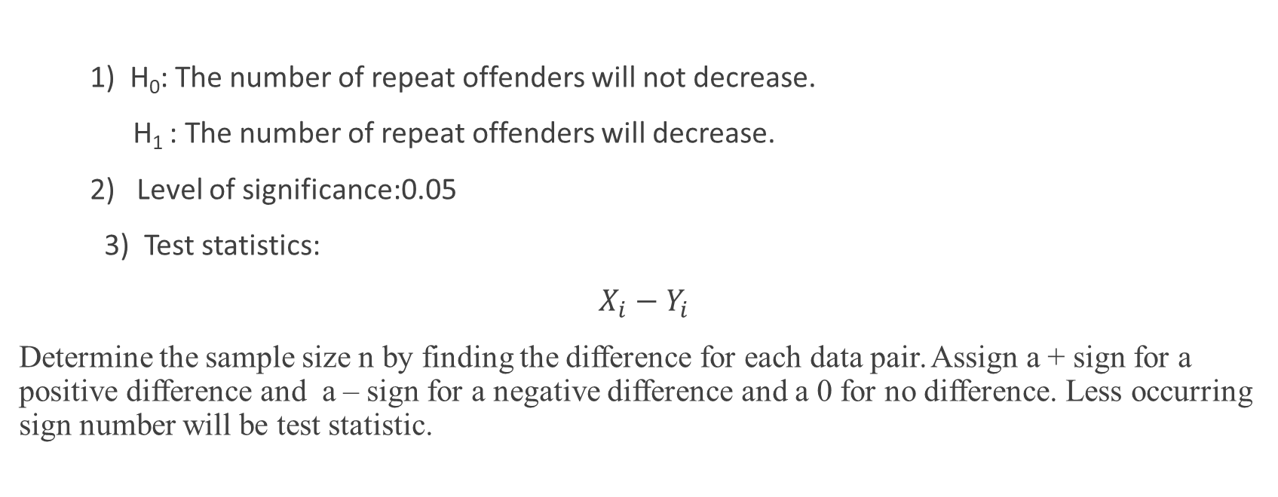
Solution
1) H₀: The number of repeat offenders will not decrease.
H₁ : The number of repeat offenders will decrease.
2) Level of significance:0.05
3) Test statistics:
$X_{i}−Y_{i}$
Determine the sample size n by finding the difference for each data pair. Assign a + sign for a positive difference and a – sign for a negative difference and a 0 for no difference. Less occurring sign number will be test statistic.

Slide 9
Prison | Before | After | Sign
1 | 21 | 19 | +
2 | 34 | 22 | +
3 | 9 | 16 | -
4 | 45 | 31 | +
5 | 30 | 21 | +
6 | 54 | 30 | +
7 | 37 | 22 | +
8 | 36 | 18 | +
9 | 33 | 17 | +
10 | 40 | 21 | +

Slide 10
4) Test Statistic:
k=1 (number of –signs)
5) Critical value:
(K < 1/10,0.50) =0.0108
(K < k/n,0.50) ≤ 0.05 (if fulfill then reject )
0.0108 < 0.05.
6) Conclusion:
So we reject the null hypothesis and support the psychologist’s claim that the number of repeat offenders will decrease.

Slide 11
Home assignment
Before | After
2.7 | 4.5
4.2 | 2.6
3.3 | 1.4
5.3 | 2.5
4.2 | 2.5
3.5 | 2.3
6.5 | 3
4.8 | 2.6
3.7 | 1.9
7.1 | 0.4

