Slide 1
Inorganic Chemistry
Complexometric Titration

Slide 2
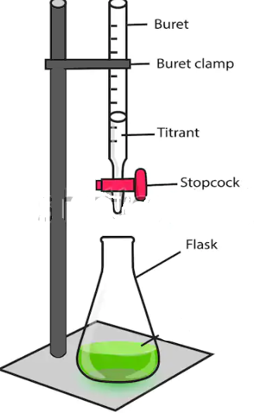
Titration
Practical process of determination of concentration of unknown solution by allowing it to react with solution of known concentration.
The reaction completion is identified by the color change of the indicator.
Standard Solution ,Titrator or Reagent
Solution of known Concentration .
Taken in Burette
Types of Titration
Neutralization titrations
Complex formation titrations
Precipitation titrations
Oxidation-Reduction Titrations
Titrand Or Titrates:
Solution of unknown Concentration
Taken in Flask

Slide 3
Complexometric Titration
It is a type of volumetric analysis in which certain organic compounds form stable complexes with metal ions in solution
Formation of a colored complex is used to indicate the end point of a titration.
Complexometric titrations are particularly useful for the determination of a mixture of different metal ions in a solution.
Sample (Metal)+Complexing Agent +Indicator→ M-Complexing Agent + Indicator
Complex

Slide 4
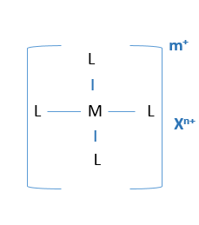
Complex Formation
Generally complex have following parts
Central Metal atom
Ligand
Counter Ion (may or may not)
Central Metal atom
Generally a metal ion having tendency after interaction between type d orbitals with s, p orbitals of ligands.
Ligand
Ions having atleast one lone pair to form a bond
OR
Ions or molecule binds to central atom to form coordination complex.
Counter Ion
Ion necessary for electroneutrality if complex is charged
Dative Bond
Bond formed b/w central metal ion and ligand

Slide 5
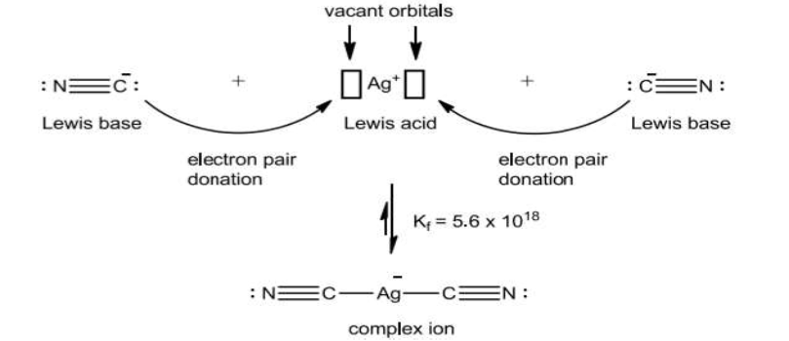
Complexation Titrations are essentially Lewis acid-base reactions, in which an electron pair is donated from one chemical to another.
Formation Constant K_{f}
The equilibrium constant for the reaction between a metal ion (M^{+n}) and a ligand (L^{-P}) is known as a formation constant or stability constant.
K_{f}=[Product]/[Reactant]
Metal: Electron pair acceptor
Ligand: Electron pair donor

Slide 6
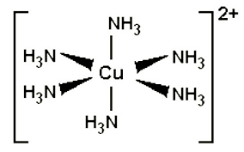
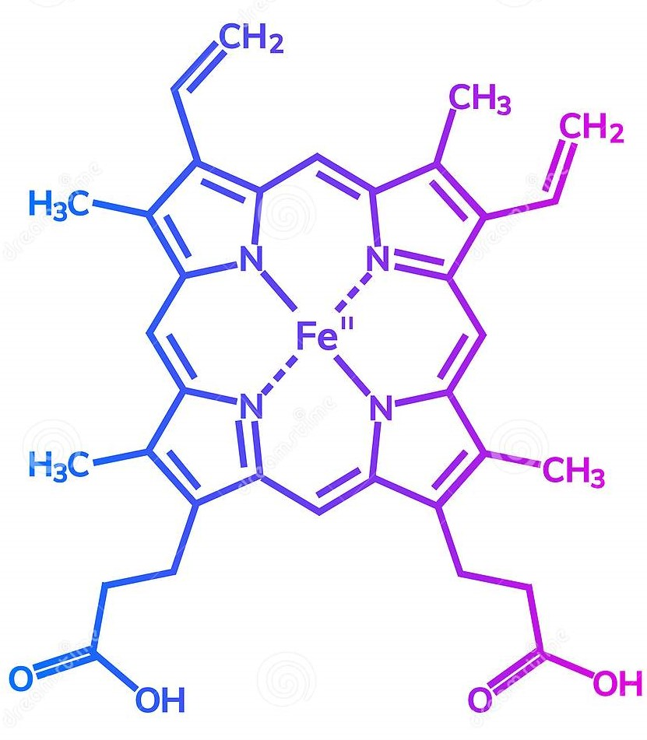
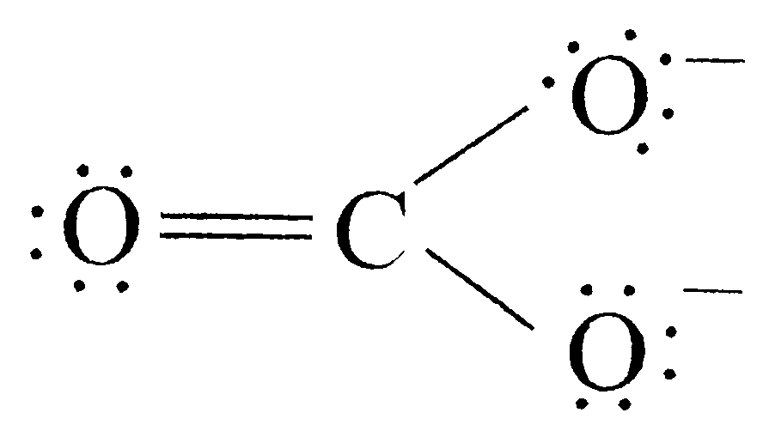
Types of Ligands
Unidentate Ligands:
Ligands that are attached to metal ion only at one place are called unidentate ligands (one toothed).
Bidentate and Multidentate Ligands:
These ligands contain more than one group, capable of
binding with metal ions.
Bidentate ligands
Tridentate ligands
Quadridentate ligands, etc.

Slide 7
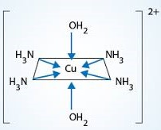
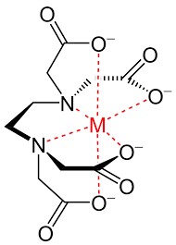
Chelate Compound
Complex containing a ligand (Multidentate) bonded to central metal atom at two or more points
More stable than Coordination compounds
Chelating Agent
Multidentate or ligand having more than one electron donor groups

Slide 8
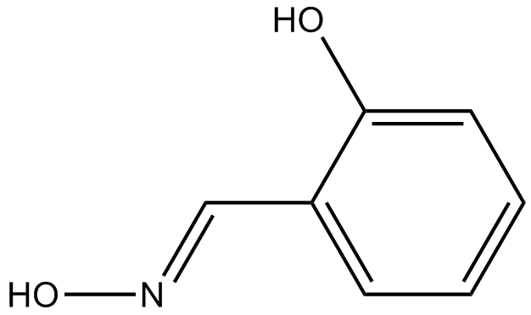
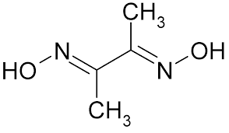
Solubility of Metal Chelates
Sequestering agent
chelating agents that form water-soluble complexes with bi- or poly-valent metal ions.

