Slide 1
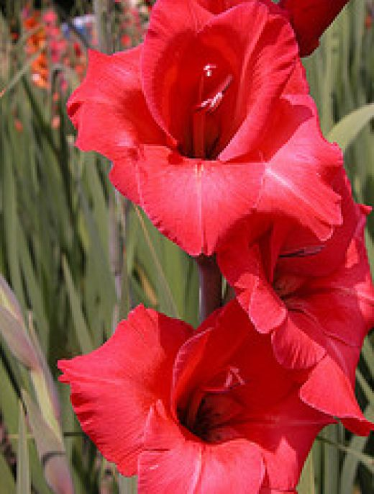
Gladiolus

Slide 2
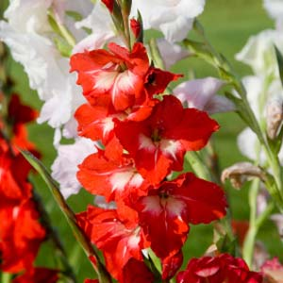
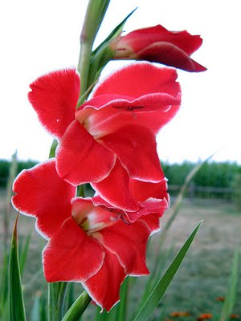
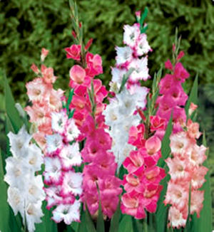
Gladiolus
Second most important cut flower grown from storage organ
The genus Gladiolus contains about 200 species
Commercial are hybrid Gladiolus x grandiflorus

Slide 3
Gladiolus
Gladiolus from Latin, the diminutive of gladius, a sword, sometimes called the sword lily, is a genus of flowering plants.

Slide 4
Gladiolus
Family: Iridaceae
Having edible and medicinal (headache) value
Grown mostly as cut flower due to great diversity of flower color and shape.

Slide 5
Glads grow 2–6 feet high, topped by a flower spike bearing a double row of trumpet-shaped florets.
The flowers range from 1–8 inches in diameter.
The sword-shaped leaves inspired its name, which comes from the Latin word gladius, meaning sword.

Slide 6
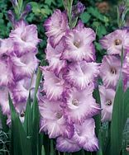
Colors range from white and yellow to purple, red and even green shades.
In general, glads are not fragrant.
Gladioli have been extensively hybridized and a wide range of ornamental flower colours are available from the many varieties.

Slide 7
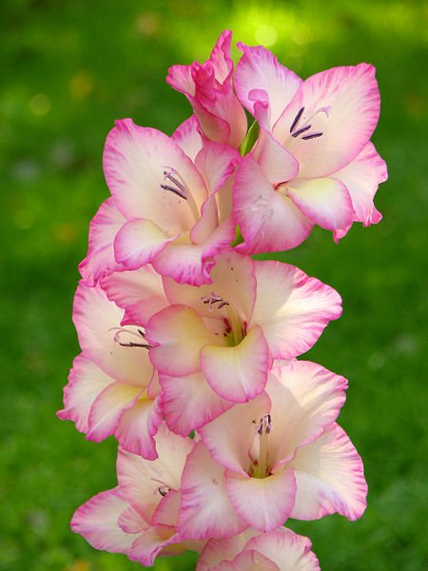
Origin:
Gladiolus
South Africa.

Slide 8
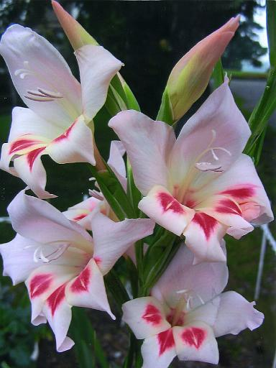
Planting season
In Plains
September - October
In Hills
March-April

Slide 9
Dormancy
Some remain full year dormant
Storage at 5⁰C for 8 weeks following storage at 20⁰C stimulates rapid regrowth
Corms formed above soil at temp. of 15⁰C are more dormant than maturing at low temperatures.

Slide 10
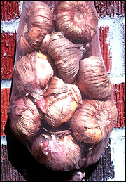
Storing
Airy containers such as loose-weave baskets, mesh bags or old nylon stockings make good containers that may be hung out of the.
Dust corms before storage with fungicide to ensure against insect and disease damage while in storage.

Slide 11
How to Grow:
They can be grown in rows.
On Ridges Plant – Plant 6”
Ridge- Ridge 1’
They will tolerate a little crowding, but will grow bigger if spaced out.
They prefer a rich, soft soil, and plenty of water.
Gladiolus grows well in full sun.

Slide 12
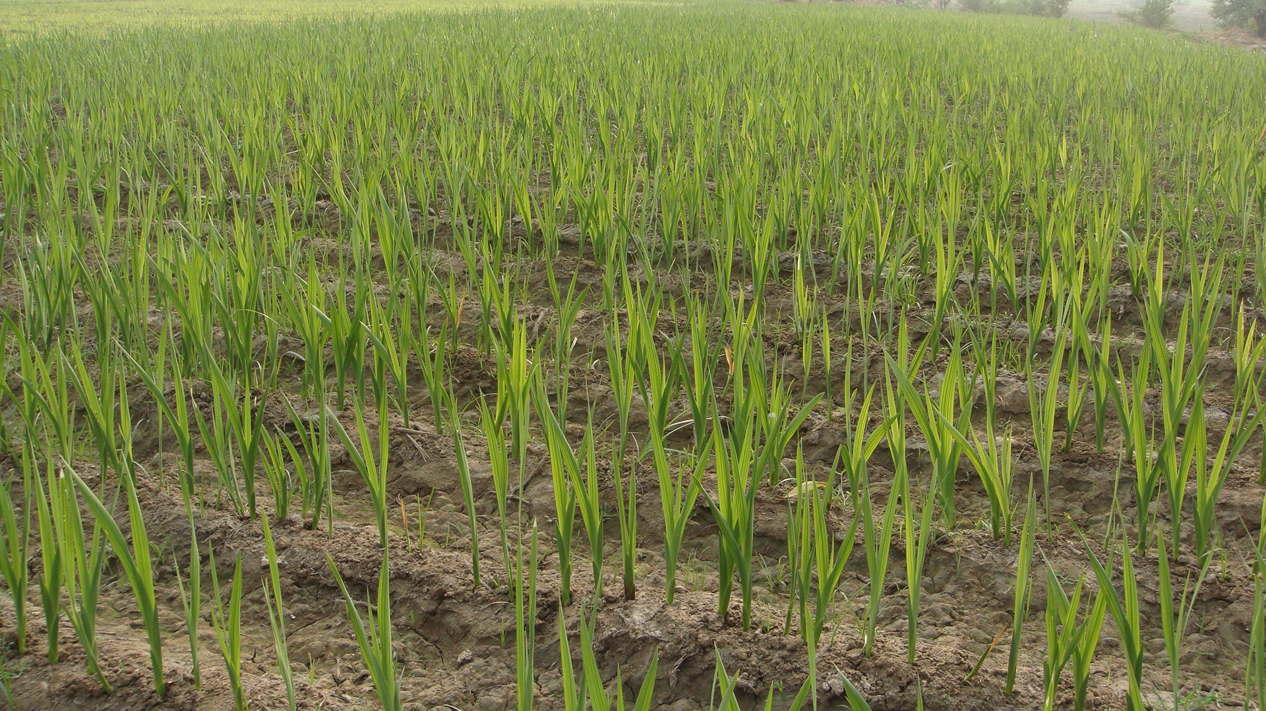

Slide 13
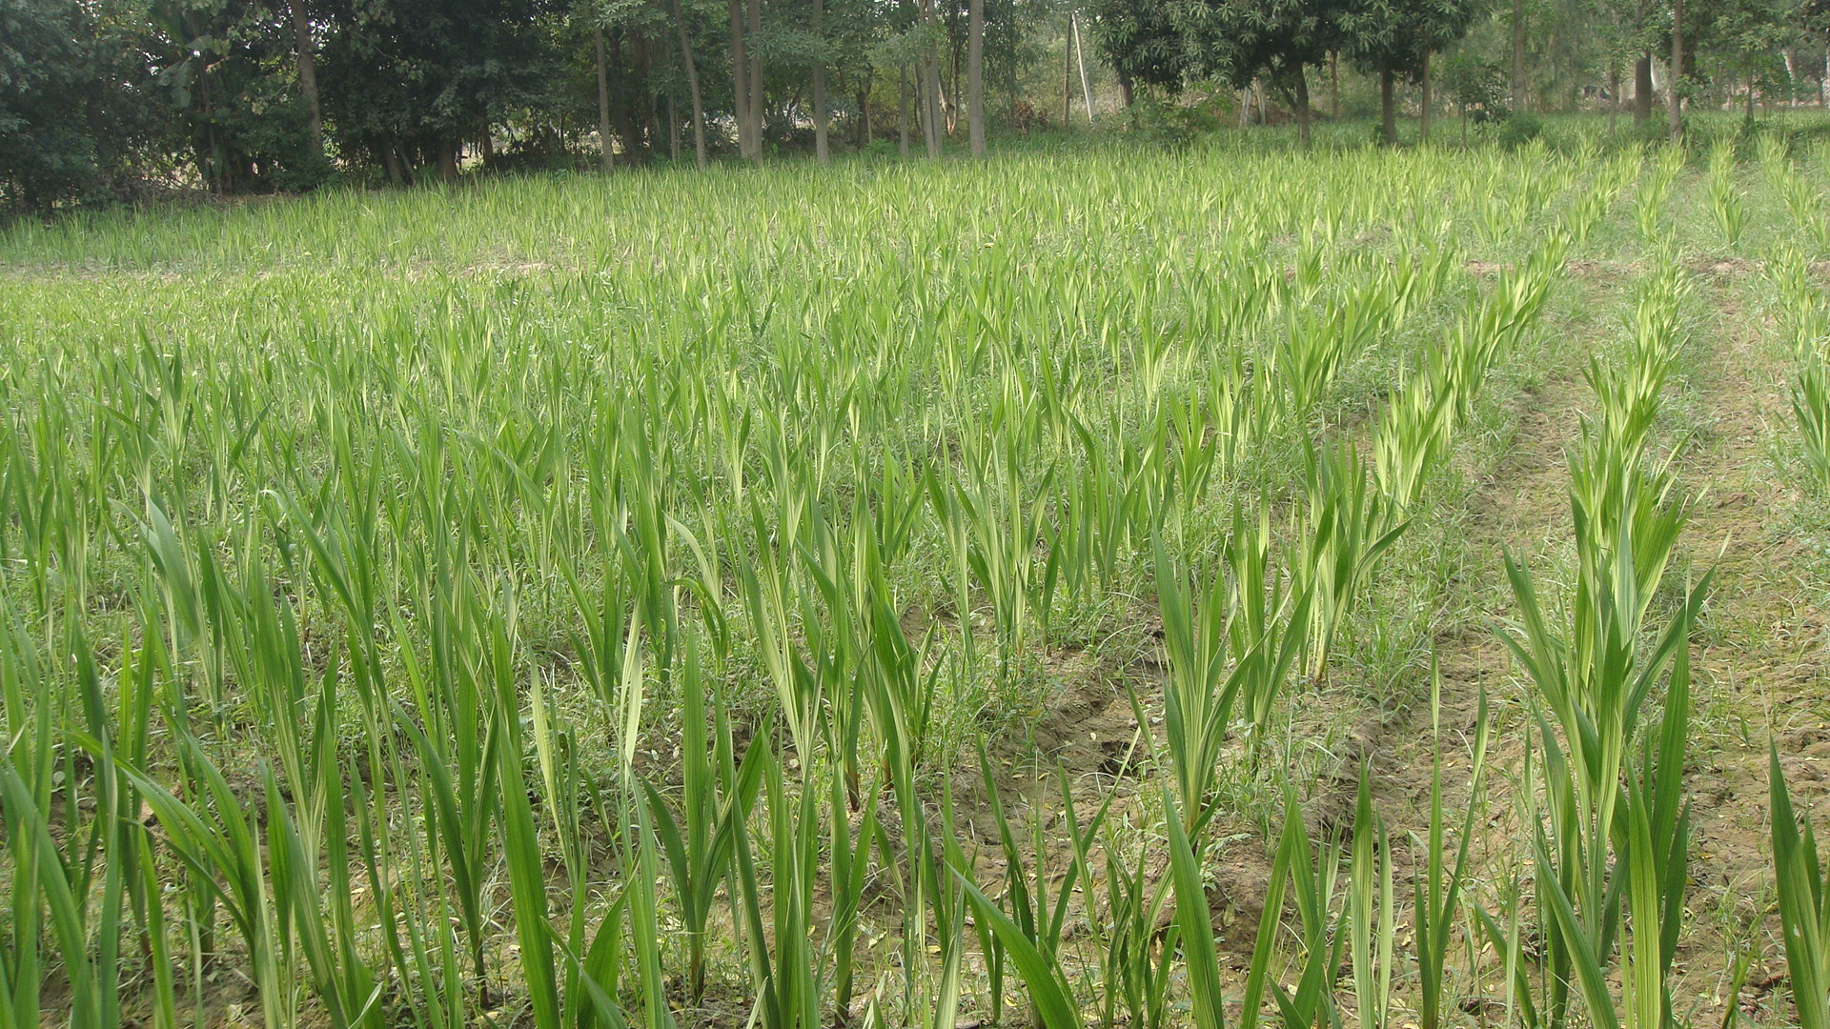

Slide 14
Soil:
Glads grow best in Sandy loam.
The key in soil selection is proper drainage; glads do not grow well in soil that is too wet (puddles remain 24 hours after the soil is saturated).
Soggy, compacted soil hampers root growth.
Diverts moisture and locks up plant food.
It also contributes to root rot.

Slide 15
To improve drainage, add organic matter such as leaves, spoiled hay, straw, manure or compost in late fall to ground that will be planted with glads the following spring.
Raising the beds 3–6 inches will also improve drainage.
The soil should have a pH of 6.0–6.5.
Till the soil about 2 weeks before planting.

Slide 16
Cultural Requirements/practices: Watering
Overhead watering is not recommended.
It may damage the flowers,
cause spotting on the petals,
splash Soil onto the foliage and
promote the spread of disease.
Drip irrigation is recommended because it places the water on the ground where it is needed, not on the flowers or foliage.
Glads need plenty of water.

Slide 17
Lack of water inhibits
spike growth,
flower development
corm growth.
Watering at planting will help develop a good root system.
Critical period of Water application are:
flower spikes formation
florets begin to open.

Slide 18
Propagation
Gladiolus is actually a food-storage structure known as a corm
Commercially propagated by corm

Slide 21
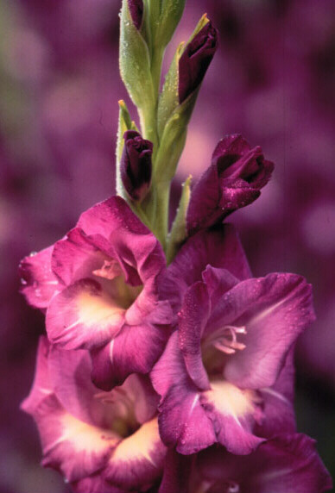

Slide 22
New corm
Old corm
Cormel

Slide 23
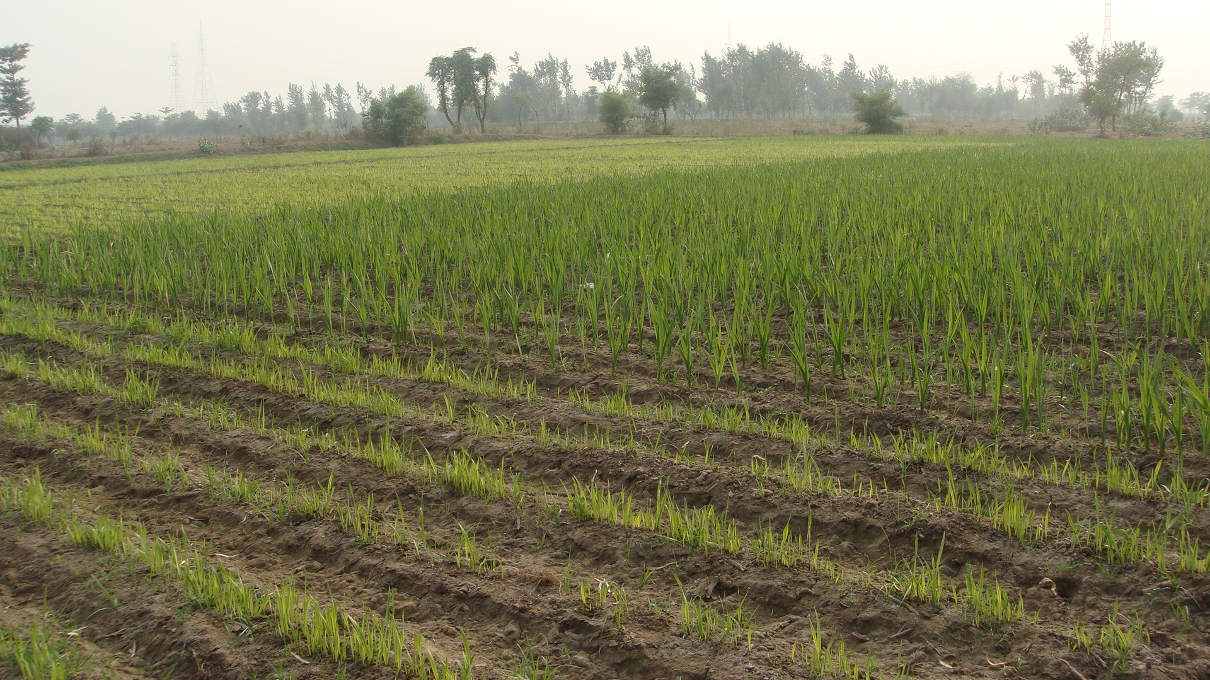
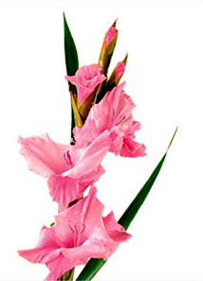

Slide 24
GLADIOLUS DISEASE PROBLEMS
Diseases often reduce the quantity and quality of gladiolus flowers, and in some cases, cause significant plant mortality. Diseases such as
Botrytis blight,
Root rots, and
Storage rots

Slide 25
Botrytis blight
Symptoms of this disease can appear on leaves, flowers, stems, and corms.
Flowers turn a papery brown and become covered with gray, fuzzy masses.
Senescing flowers are particularly susceptible.
Tan to brown spots with a target-like appearance can also develop on the leaves.
These patches are often associated with flowers which have dropped onto the leaf surface.
This disease is particularly troublesome during periods of extended cloudy, humid, wet weather.

Slide 26
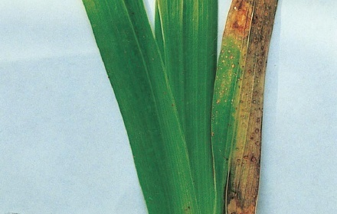
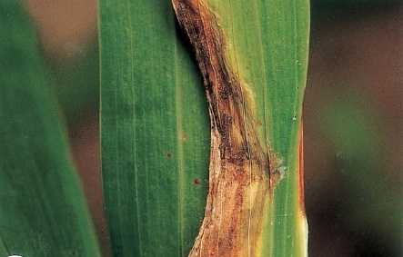
Lesions on leaves of gladiolus

Slide 27
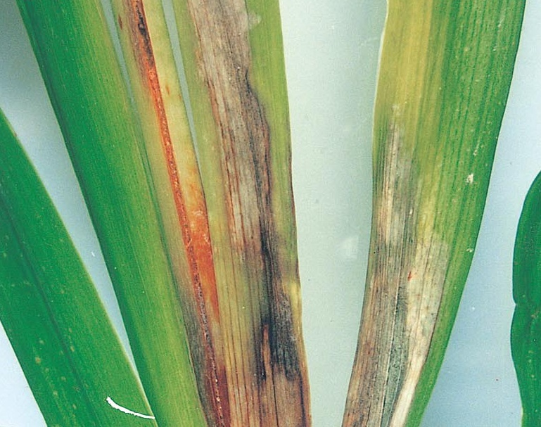
Botrytis blight

Slide 28
Control
Good sanitation practices,
grooming the plants
removing spent or senescing flowers
Avoid wetting the flowers when watering, and crowding plants.
Adequate spacing between the plants can promote good air circulation.
Any corms with symptoms of infection should be rogued and destroyed.
It is also important to dig the corms during dry weather and to cure them properly.

Slide 29
Botrytis rot will progress at lower temperatures than other storage rots and is particularly likely to affect improperly cured corms.
Artificial heat for curing is advisable if the presence of Botrytis is suspected.
Fungicide sprays during the growing season. e.g.
Chlorothalonil
Mancozeb
Thiophanate-methyl

Slide 30
Aphids, leafhoppers and thrips may transmit viruses.
Keep fields as weed-free as possible to control insects and viruses.
Rotate planting beds in the field each year to avoid buildup of soil borne fungal pathogens and nematodes.
Routine fungicide applications may be necessary to control Botrytis blight on susceptible varieties of gladiolus during wet years.

Slide 31
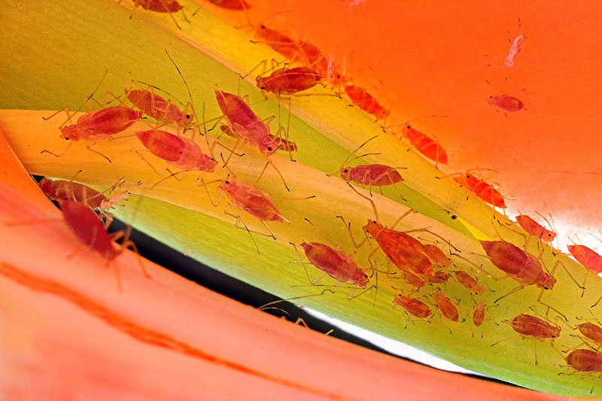
Aphids on Gladiolus

Slide 32
Harvest Practices:
Gladiolus spikes exhibit negative geotropism.
This means that if the floral spikes are laid flat in storage or transport, the tips will curve upward.

Slide 33
Keep spikes upright in the field through use of stakes or supports to prevent the spikes from bending.
Use tall containers that hold the stems upright during harvest, handling, packing, storage and transit.

Slide 34
Regional, national and international wholesale markets require harvest when the basal (lowest) florets on the spike begin showing color.
Local wholesale markets want spikes with more florets showing color and the basal florets partly opened.
Local retail markets need the basal florets fully open to display their beauty to the consumer.

Slide 35
Post Harvest Handling:
The maturity of the spike at harvest will determine its storage time and vase life.
Less mature spikes store longer than more mature spikes.
Glads harvested with closed florets can be stored upright and dry-wrapped in moisture-proof materials for one week at 36–40°F.
Spikes with closed florets can also be stored upright in preservative for 1–2 weeks.

Slide 36
Post Harvest Requirements:
Grade by stem length, flower size and cultivar.
Bunch by buyer’s specifications, usually in bunches
of 10 spikes.
Re-cut stems under water to a uniform length.
Store graded and bunched stems in clean, disinfected containers in commercial floral preservative.
Store stems upright and dry-wrapped in moisture proof materials.
Store at 36–40°F and 85–90 percent relative humidity.
Keep the stems vertical.

