Slide 1
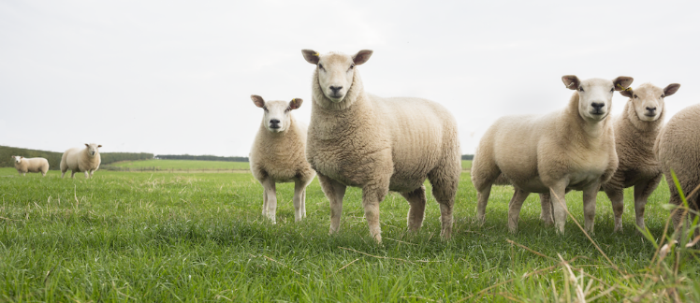
dentition of Small Ruminants

Slide 2
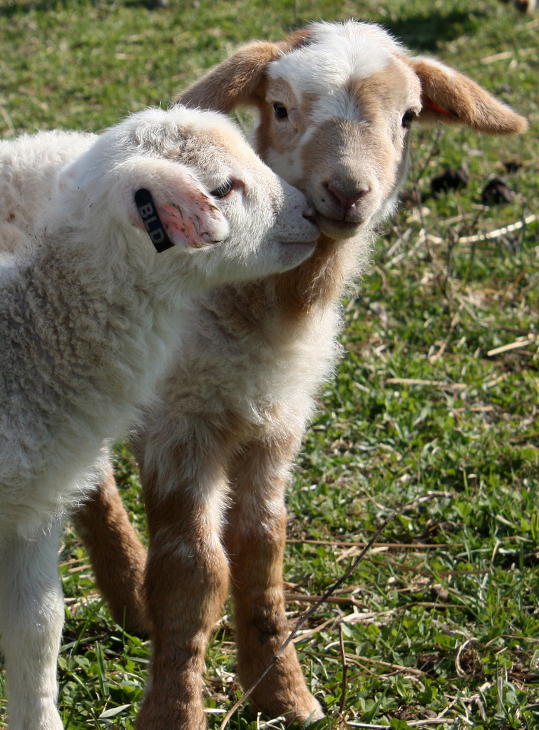
Teeth
Mouthing sheep and goats to estimate age
Mouthing sheep and goats to determine soundness

Slide 3
Mature sheep and goats have 32 teeth Lambs and kids have 20 temporary teeth
Dental pad no teeth
Molars Back teeth
Incisors (front teeth)

Slide 4
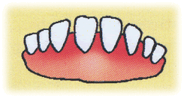
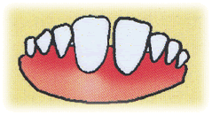
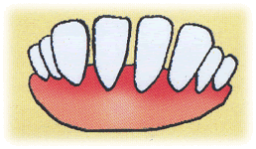
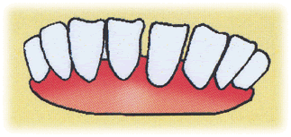
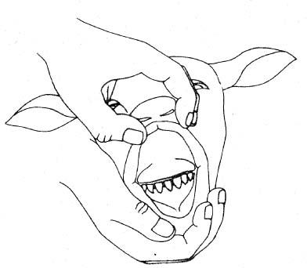
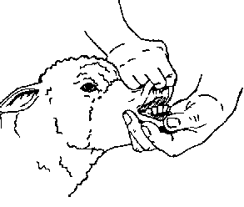
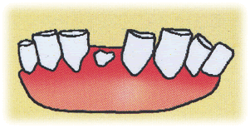
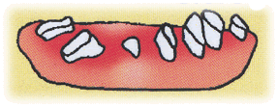
Mouthing sheep and goats to estimate age
You can estimate the approximate age of sheep and goats by determining the age at which the milk teeth are replaced by permanent incisors.
Age varies by individual animal, breed, environment, and nutrition.
< 1
1-2
2-3
3-4
> 4
Old

Slide 5
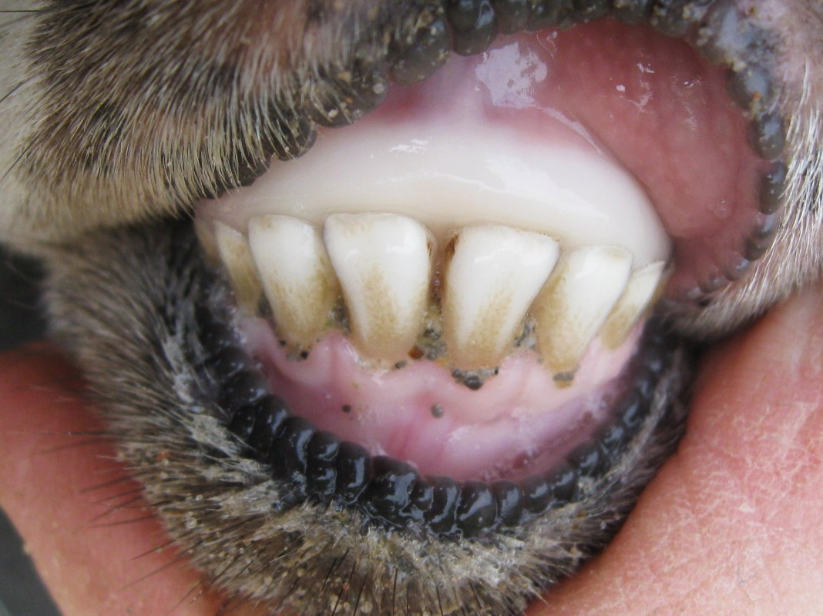
Lamb – less than 1 year of age
Baby teeth
Milk teeth
All temporary

Slide 6
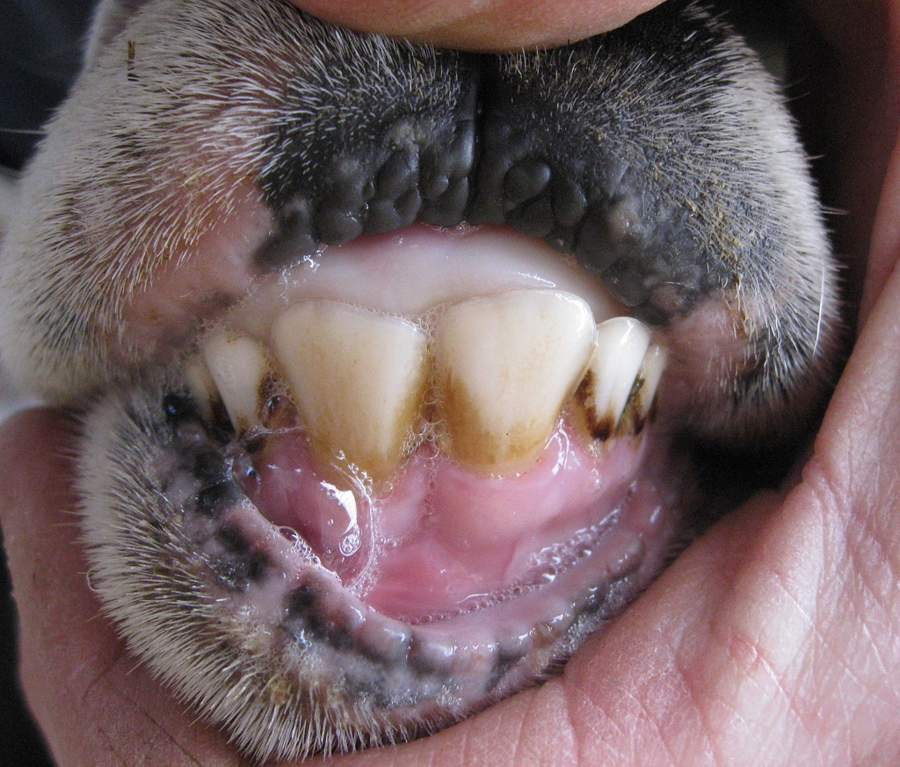
Yearling (1-2 years)
1 pair

Slide 7
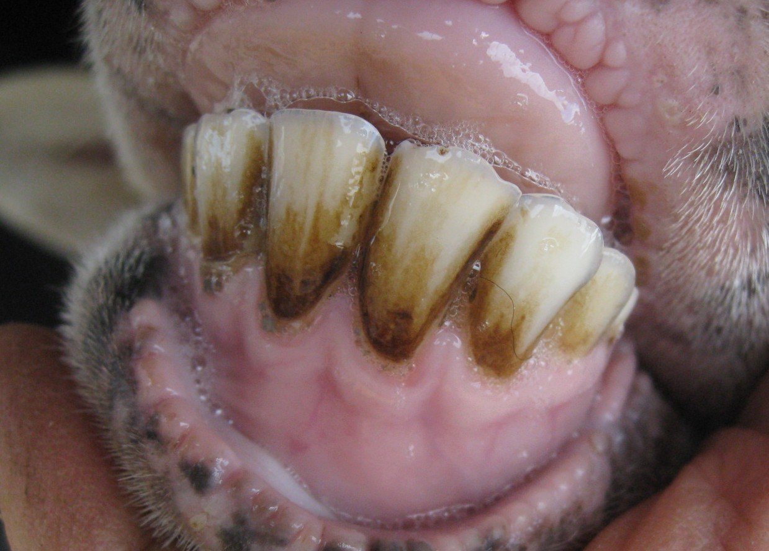
2 to 3 year old
2 pairs

Slide 8
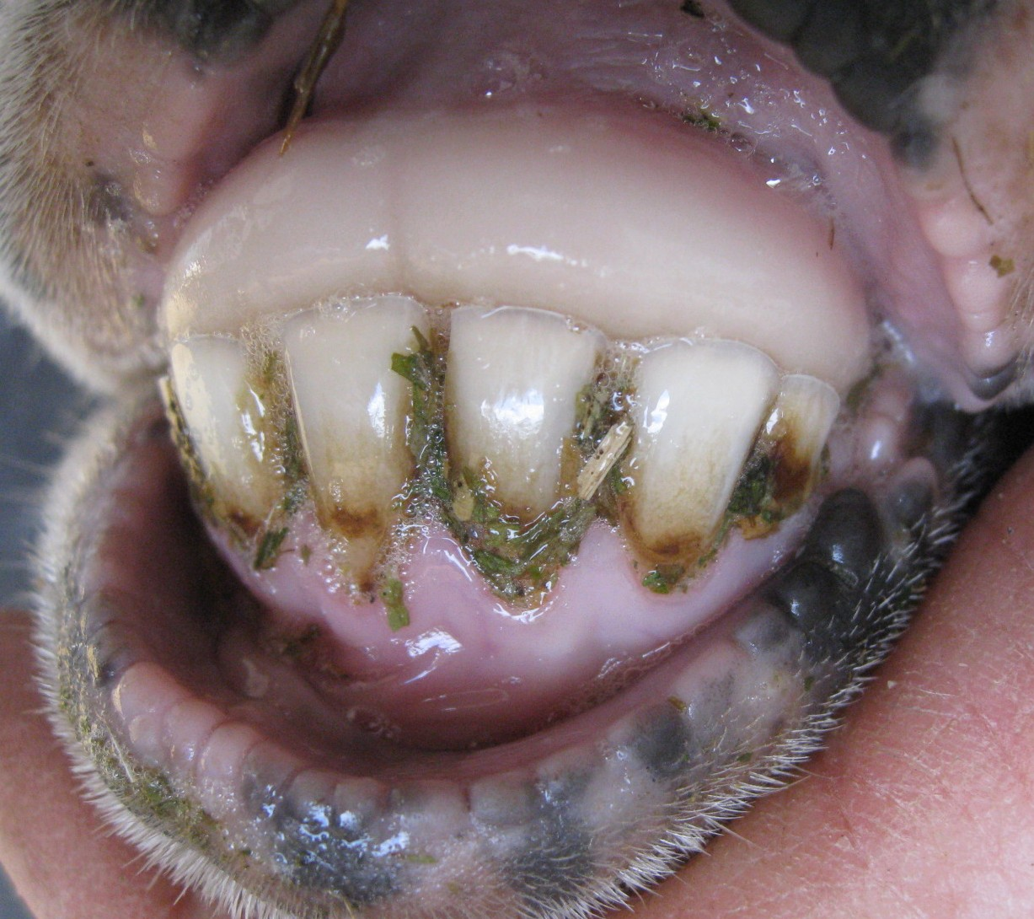
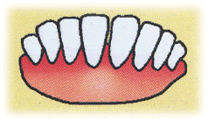
3 to 4 year old
3 pairs

Slide 9
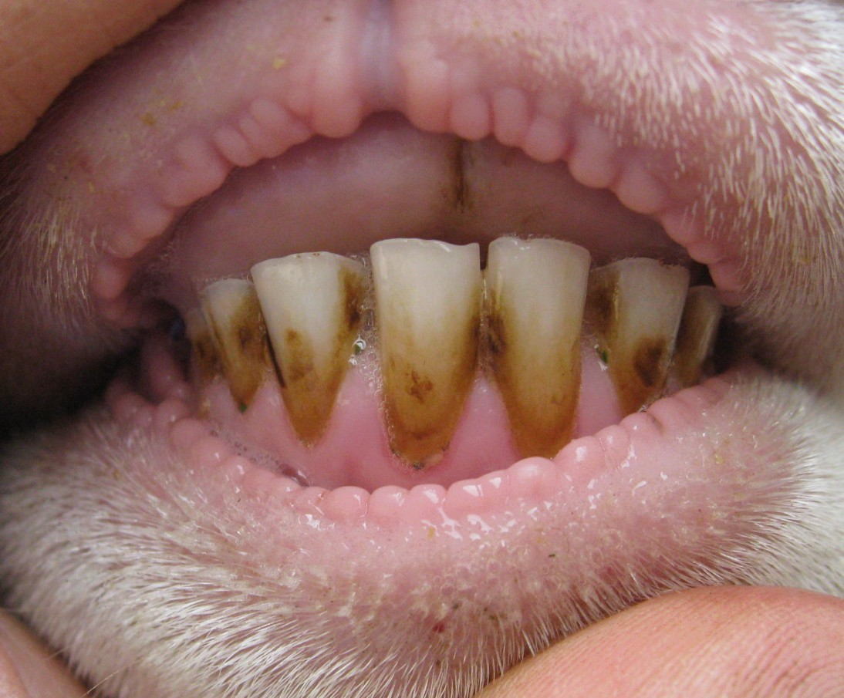
4-5 years old – solid mouth
4 pairs

Slide 10
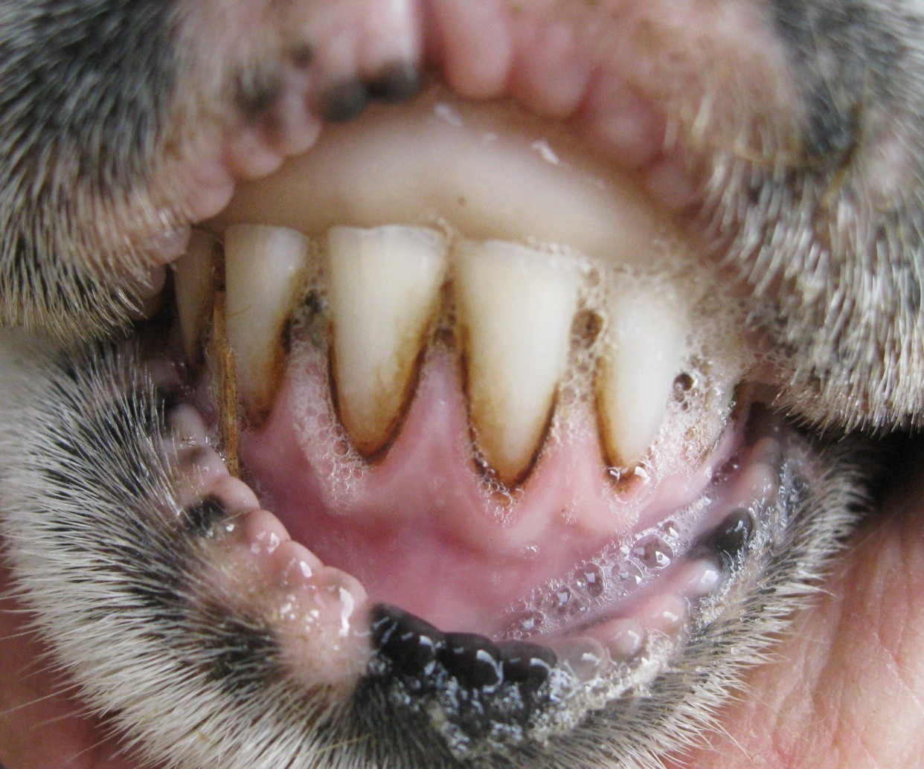
7-8 year old – Solid mouth
< 4 pairs

Slide 11
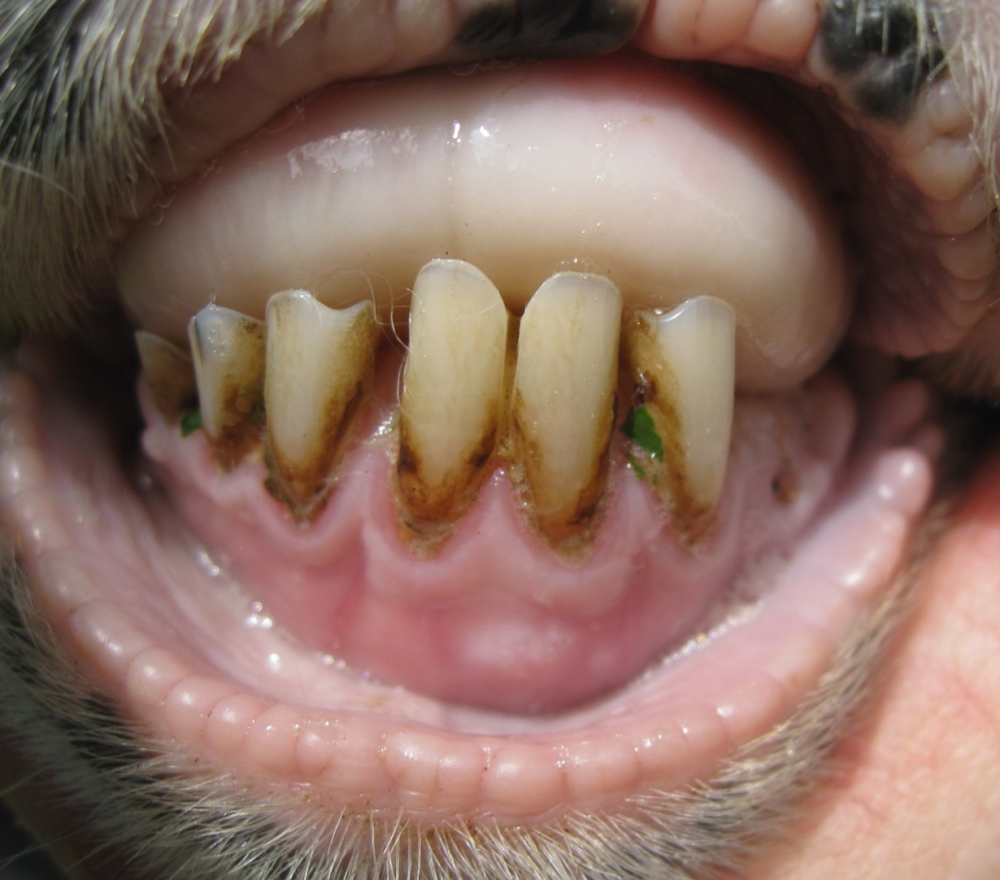
10-11 year old broken mouth

Slide 12
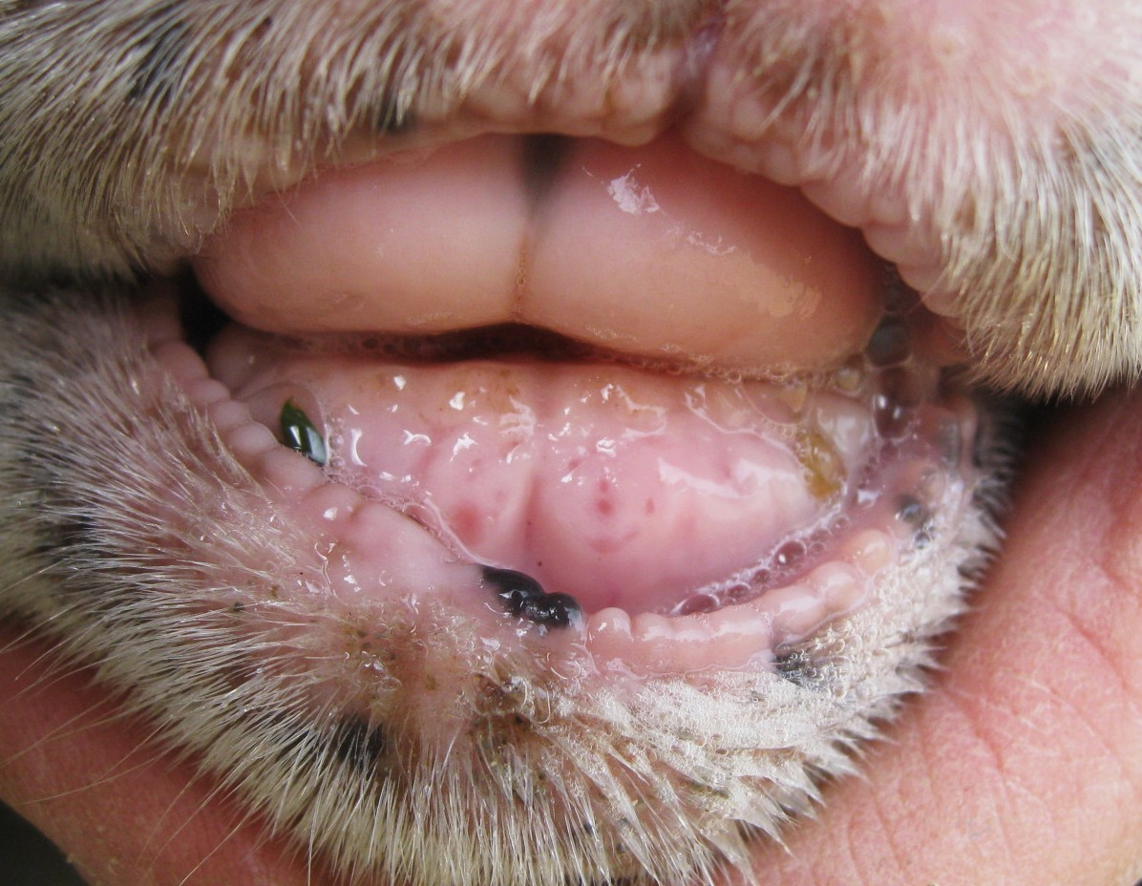
11+ years old “Gummer”
old

Slide 13
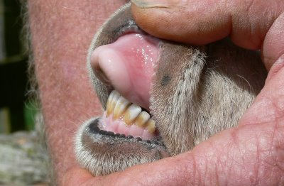
Jaw abnormalities
Overshot
‘’monkey-mouth”
Undershot
“pasrrot-mouth”

Slide 14
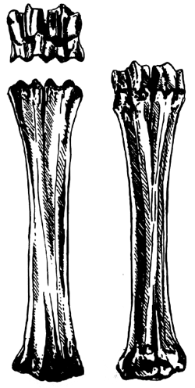
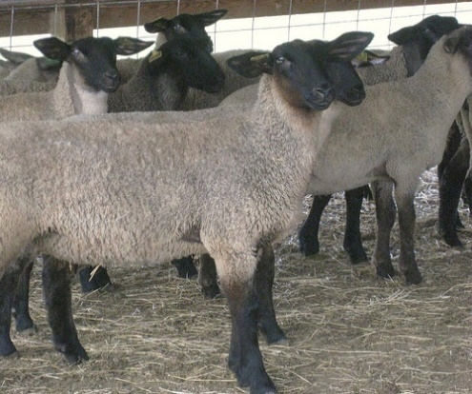
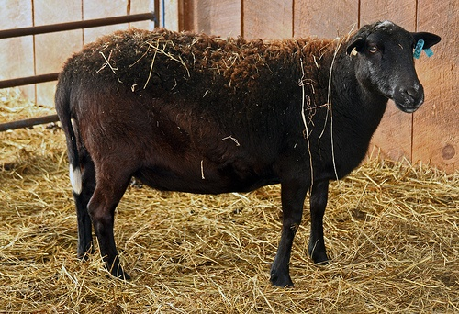
Another way to tell how old a sheep is
Lamb, > 12 months
2 break joints
Yearling, 13-24 months spool and/or break joints
Mature sheep, > 2 years
2 spool joints

