Slide 1
Plant Growing Media

Slide 2
INTRODUCTION
Various natural or manufactured root-zone media supply
Water
oxygen
mineral nutrients
support for plants .
liquid culture provides potentially better control of water and mineral supply
but solid media are most often used
because they demand significantly less maintenance and better fulfill experimental criteria.

Slide 3
Soil media
A solid media is a body of solid particles in which plant roots grow and from which they absorb water, oxygen and minerals.
This includes a wide range of natural (soil, sand, peat, etc.)
They may be manufactured eg. vermiculite

Slide 4
Types

Slide 5
Soil
Natural soil or mixtures containing natural soil are not generally recommended for growth chamber
If it is used, it should be modified or used in sufficiently deep containers to ensure adequate aeration.
Natural soil has many disadvantages for growth chamber use.
It is neither physically nor chemically uniform
results may not be same from experiment to experiment.
often infested with seeds and pathogens.
heavier than manufactured media

Slide 6
Peat
Peat is commonly used because it is
light and has high water-holding capacity,
The exchange capacity high when expressed in the traditional mass basis but not when expressed on a volume basis.
most commonly used peat originates from
sphagnum and is strongly acidic.
Physical properties of peat can vary significantly from lot to lot or bag to bag.
When different lots of peat are required for an experiment, they should be blended into a single batch to ensure uniform media among containers.

Slide 7
Vermiculite
This material is a mica, which has been expanded by heating to a very high temperature (therefore it is sterile after processing).
Micas are potassium aluminum silicates with a variety of other cations.
it has high exchange capacity and good water holding capacity,
vermiculite alone will not sustain good plant growth.
This may be due to an excess of unusual cations on the exchange sites.
It is also strongly basic and, therefore, commonly mixed with peat to provide a reasonable pH.
Very fine or mixtures of coarse- and fine textured vermiculite should be avoided because they tend to be poorly aerated.
Vermiculite sold for insulation is unsuitable for plant culture because it often contains materials highly toxic to plants.

Slide 8
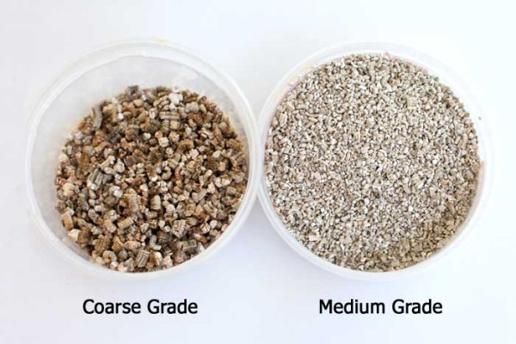

Slide 9
Sand
Silica sand provides an inert, incompressible medium with little exchange capacity
low water-holding capacity.
It is the heaviest material used for growth media.
Sand is not generally recommended for growth chamber research except as a mixture component or when automatic irrigation with nutrient solution is used at very frequent intervals.
Best results are obtained with sieved and washed sands.

