Slide 1
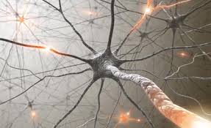
POLYNEUROPATHIES (PERIPHERAL)
FAIZA AMJAD

Slide 2
The 3 questions of clinical neurology…
#1. Where is the lesion?
#2. What is the etiology?
#3. What is the treatment?
Notes:
Peripheral neuropathy no different from any of the other syndromes of neurology…
Localization and determination of etiology (questions 1 and 3) key, as treatment of peripheral neuropathy is the treatment of the underlying condition. This will be the focus of the lecture therefore.
Roots, plexus, nerves. Peripheral nerves can be diseased singly or multiply. The distinction important as the pathophysiology and etiologies different – focal, multifocal or diffuse. This is a determination that can be made at the bedside… Know your anatomy and mononeuropathies and plexopathies straightforward.
Which leaves the polyneuropathies…

Slide 3
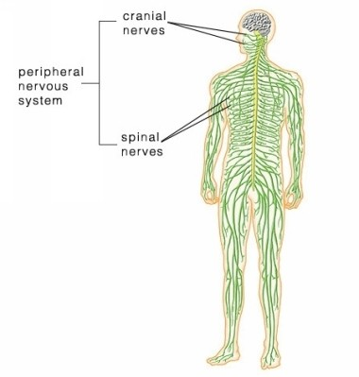
Introduction
Peripheral neuropathy is the term for damage to nerves of the peripheral nervous system, which may be caused either by diseases of the nerve or from the side-effects of systemic illness.

Slide 4
Introduction
Peripheral neuropathy affects ~2–8% of adults; the incidence increases with age.
Peripheral nervous system is composed of 12 pairs of cranial nerves and 31 pairs of spinal nerves.

Slide 5
Peripheral nervous system
The peripheral nervous system is made up of three main types of nerves, each with its own specific function:
- Automatic nerves help regulate the automatic functions of the body, such as blood pressure, bladder function and sweat levels.
- Motor nerves control the muscles of the body.
- Sensory nerves pass sensations, such as cold, heat or pain, from the affected area of the body to the brain.

Slide 6
Classification
Peripheral neuropathy may be classified in a varieties of ways-
according to the
1.number of nerves affected
Mononeuropathy
Mononeuritis multiplex
Polyneuropathy

Slide 7
Classification
2.the type of nerve cell affected
motor
sensory
autonomic

Slide 8
Classification
3. the process affecting the nerves Demyelinating
Axonal
Neuronal

Slide 9
Definitions
Neuropathy simply means a pathological process
affecting a peripheral nerve or nerves.
Mononeuropathy means a process affecting a single nerve.
(common nerve compression and entrapments)

Slide 10
Definitions
Mononeuritis multiplex (multiple mononeuropathy and/or multifocal neuropathy) affects several or multiple nerves.(like diabetic neuropathy)
Polyneuropathy describes diffuse, symmetrical disease, usually commencing peripherally. (guillain-barré syndrome)

Slide 11
Peripheral neuropathy like polyneuropathy
Polyneuropathy- The term "peripheral neuropathy" is sometimes used loosely to refer to polyneuropathy. Most cases of peripheral neuropathy affect the sensory and motor nerves..
Longest fibres are affected first so symptoms usually first develop in the extremities of your body, such as your feet, legs and hands and arms. This type of neuropathy is called generalised sensorimotor polyneuropathy

Slide 12
Facial paralysis
Facial paralysis is a condition in which the facial muscles become paralyzed. Basically, the muscles in the face become paralyzed due to the facial nerve being injured or experiencing some kind of trauma

Slide 13
Etiology
Facial paralysis can also occur due to infection, tumors, and other diseases

Slide 14
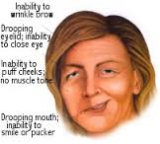
characteristics
A person with facial paralysis will be unable to move some or all of the muscles on the affected side of their face. Facial paralysis not only presents the sufferer with a disproportionate face, but can also cause other disabilities that make swallowing, speaking, and chewing quite difficult.

Slide 15
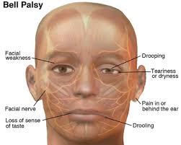
Bell’s Palsy
Bell’s Palsy is the most common form of facial paralysis, and is caused by inflammation of the facial nerve

Slide 16
cause
most likely related to reactivation of a virus known to cause cold sores (Herpes Simplex Virus). This swelling prevents the nerve from sending correct signals to the brain and facial muscles, resulting in paralysis. Bell’s Palsy can occur very quickly, with symptoms and paralysis setting in as quickly as 48 hours.

Slide 17
prognosis
People suffering from Bell’s Palsy have a relatively good prognosis, with approximately 90% of patients completely recovering

Slide 18
THE DIFFERENCE BETWEEN FACIAL PARALYSIS & BELL’S PALSY
The main difference between facial paralysis and Bell’s Palsy is that when a patient is diagnosed with facial paralysis, a cause for the paralysis can be identified, be it a tumor, infection, or nerve damage. In cases of Bell’s Palsy, the disorder appears without any reason, which can be quite troublesome for the afflicted patients.
Facial paralysis, in most cases, also appears more permanent than Bell’s Palsy, with cases lasting for years to life if a patient doesn’t seek treatment. A patient suffering from Bell’s Palsy may regain facial function at any time without surgical treatment, and patients usually recover without any permanent damage. However, if after 3 months a patient is still afflicted with Bell's Palsy, they should seek treatment from a facial paralysis expert.

Slide 19
UMNL-Facial nerve
In an UMN lesion, called central seven, only the lower part of the face on the contralateral side will be affected, due to the bilateral control to the upper facial muscles (frontalis and orbicularis oculi).

Slide 20
LMNL
Lower motor neuron lesions can result in a 7th cranial nerve palsy (Bell's palsy is the term used to describe the idiopathic form of facial nerve palsy), manifested as both upper and lower facial weakness on the same side of the lesion.

Slide 21
Testing the facial nerve
Voluntary facial movements, such as wrinkling the brow, showing teeth, frowning, closing the eyes tightly (inability to do so is called lagophthalmos) , pursing the lips and puffing out the cheeks, all test the facial nerve. There should be no noticeable asymmetry.
Taste can be tested on the anterior 2/3 of the tongue. This can be tested with a swab dipped in a flavoured solution, or with electronic stimulation (similar to putting your tongue on a battery).
Corneal reflex. The afferent arc is mediated by the General Sensory afferents of the Trigeminal Nerve. The efferent arc occurs via the Facial Nerve. The reflex involves consensual blinking of both eyes in response to stimulation of one eye. This is due to the Facial Nerve's innervation of the muscles of facial expression, namely Orbicularis Oculi, responsible for blinking. Thus, the corneal reflex effectively tests the proper functioning of both Cranial Nerves V and VII.

Slide 22
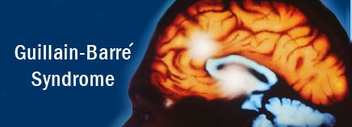

Slide 23
GBS
GBS disease or Guillain-Barre Syndrome is really a disease of the central nervous system due to damage to the myelin sheath around nerves. The myelin sheath acts being an insulator the same as rubber or plastic around electrical wires.

Slide 24
CAUSE
The disease is generally triggered by a severe infection. In many cases the result is shortly after a virus infection. It's also rarely associated with immunizations, surgery, and childbirth

Slide 25
characteristics
Ascending paralysis, weakness starting in the feet and hands and migrating for the trunk, is the most typical symptom. It may cause life-threatening complications, particularly if the breathing muscles may take a hit or if there is dysfunction from the autonomic nervous system.

