Slide 1
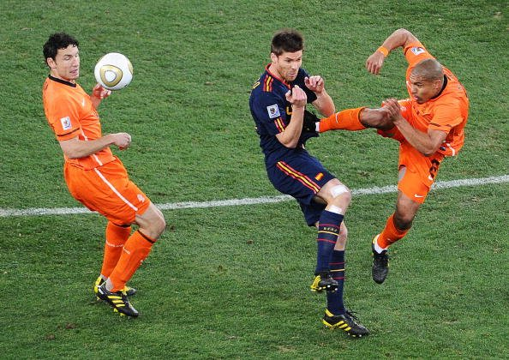

Slide 2
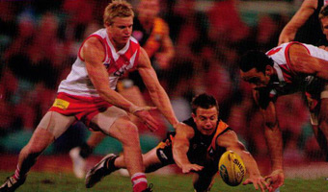

Slide 3
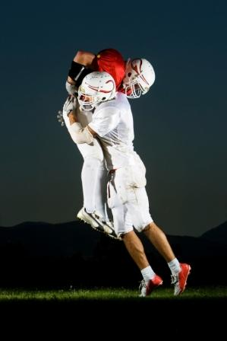
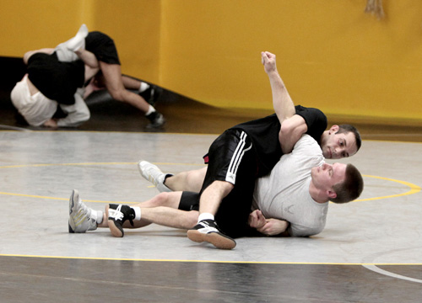

Slide 4
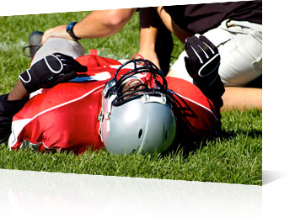

Slide 5
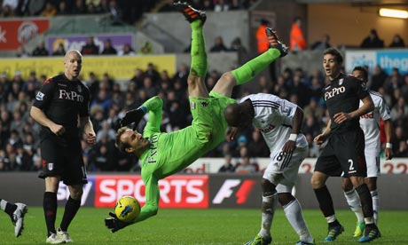

Slide 6
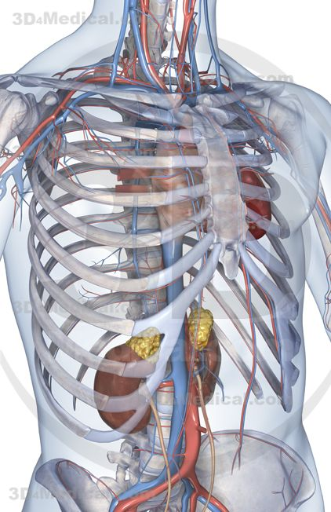
Heart , Lungs ,major vessels
Protected by Rib cage
High energy F to cause # /
Injury to mentioned structures

Slide 7
Early detection of Injury is important

Slide 8
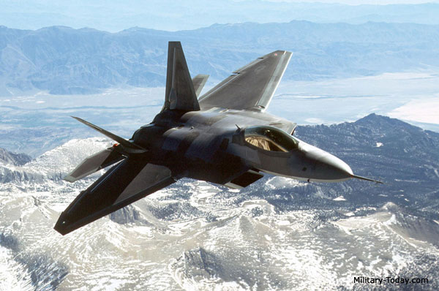
1st sign of hypoxia

Slide 9
Assessment
Mechanism of Injury
Level of Consciousness
ABCs
Thorough history
Dyspnea
Onset of symptoms
Appearance , anxiety
Difficulty in speaking / inability to complete full sentence **(needs immediate hospital referral)

Slide 10
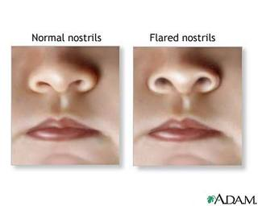
Vital signs
blood pressure
Pulse oximetry
pulse rate
skin color and temperature
Quality and frequency of respirations
Flared nostril
Tracheal tugging

Slide 12
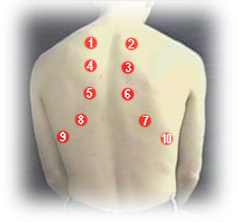
Wheeze , Rhonchi , Crackles

Slide 13
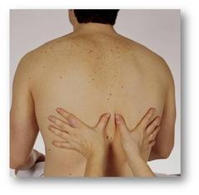
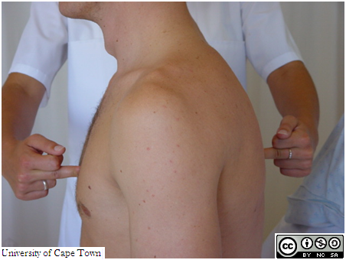
b/l Equality in motion,rate , rhythm

Slide 14
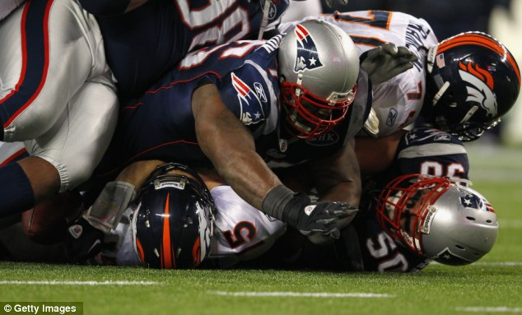
578 pounds on the chest of Tim tebow

Slide 18
Normal , Hyper resonant, Dull

Slide 19
Injuries
A direct force can result in a fracture or other injury at the site of force application.
Indirect forces act to cause an injury at a site away from where the force is applied; for example, an athlete may suffer an anterior rib fracture as a result of a blow to the back.
Significant force is required to fracture a rib; it also allowsfor the possibility of further internal injury. Fractures of ribs 10 through 12 may injure abdominal organs such as the liver or spleen, whereas upper rib fractures may injure the lungs.
Rib fractures present with localized pain that increases on
compression of the rib cage.

Slide 20
Respiratory effort is limited because of pain, which typically prevents the athlete from being able to take a full breath.
a single rib fracture with no internal
injury does not constitute an emergency and can be treated with rest, ice, and medication for pain. X-rays are required for a definitive diagnosis.

Slide 21
Fractures of the sternum require a significant amount of force and can be life threatening because the force may be transmitted to the heart, lungs, or great vessels of the chest.
Severe dyspnea, point tenderness, and sternal deformity all indicate an emergency situation and require immediate transport to the hospital

Slide 22
SC dislocation
Posterior dislocation of the sternoclavicular joint may cause respiratory distress from the clavicle, placing pressure on the trachea and surrounding structures. If the athlete is in respiratory
distress, immediately treat with basic airway maneuvers and supplemental oxygen. If improvement is not noted quickly, then reduction of the dislocation should be attempted.

Slide 23
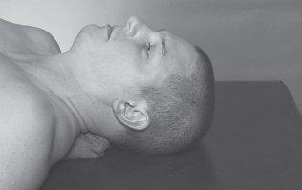

Slide 24
This may be accomplished by placing the athlete
in a supine position with a sand bag or towel roll between the scapulae in line with the spine . This technique allows the shoulders to be retracted, therefore pulling the head of the clavicle laterally and anteriorly. You may also be able to pull the clavicle laterally and anteriorly by grasping the clavicle with your fingertips

Slide 25
Symptoms of an acute pulmonary embolism include a sudden onset of chest pain, dyspnea, tachycardia, and bloody sputum. Lung sounds may reveal wheezing, although normal lung sounds are common. Treatment includes early recognition, oxygen administration, and rapid transport to the hospital.

Slide 26
High-flow supplemental oxygen by either
simple face mask or non-rebreather face
mask should be administered to any athlete complaining of difficulty breathing no matter what the underlying pathology

Slide 27
Fractures of ribs 10 through 12 may injure
abdominal organs such as the liver or spleen,
whereas upper rib fractures may injure the
lungs.
● Fractures of the sternum require a significant
amount of force and can be life threatening
because the force may be transmitted to the heart, lungs, or great vessels of the chest.

Slide 28
Fractures of two or more adjacent ribs in two
or more places can create a condition known
as flail chest and will cause the chest to
move in a paradoxical manner.
● Isolated flail chest injuries may be treated
by placing the athlete on the affected side
and transporting him or her to a trauma
center.

Slide 30
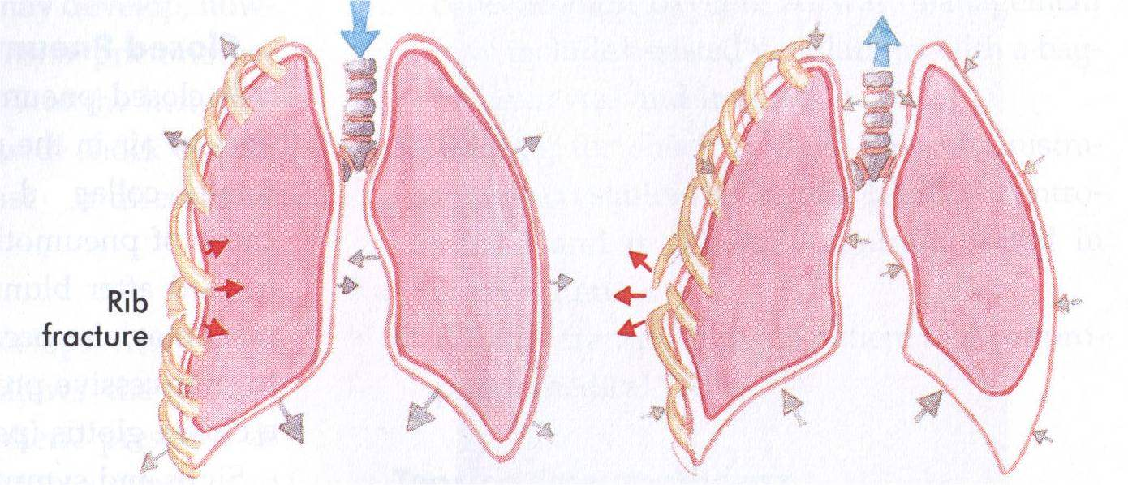

Slide 31
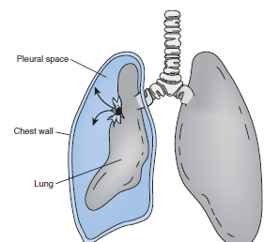
Pneumothorax

Slide 33
If breathing sounds are absent on the affected side and severe dyspnea and jugular vein distension are present, then a tension pneumothorax should be immediately suspected.
Tracheal deviation away from the affected side is a very late sign. Affected athletes will appear anxious and restless, hypotensive with a rapid and thready pulse, and on the verge of circulatory collapse

