Slide 1
Classification of bacteria

Slide 2
classification
Bacteria can be classified in many ways. The first classification scheme was published in 1773 and many have appeared since.
Science of microbiology has developed other kind of classification
The ultimate objective of biological classification is the characterization and orderly arrangement of organisms into groups
Classification is often confused with identification but it is a prerequisite for identification

Slide 3
History of classification of bacteria
The late 19th century was the beginning of bacterial taxonomy and Ferdinand Cohn in1872 was the first to classify six genera of bacteria (as members of plants) mainly based on morphology.
At the beginning of 20th century, physiological and biochemical data along with morphology were also used for classification and identification of microorganisms.
The first edition of “Bergey’s Manual of Determinative Bacteriology” classified bacteria in 1923 on the basis of phenotypic properties as “typically unicellular plants” called Schizomycetes. Even in the 7th edition of Bergey’s Manual, published in 1957, bacteria were still classified as members of plants (protophyta, primitive plants).
Based on partial sequences of 16s rRNA genes, Arhaea (Archaebacteria) were classified as a separate kingdom in 1977

Slide 4
Time span classification based on
Late 19th century
1900__1960
1960__1980
1980__today
Morphology, Growth Requirement, Pathogenic potential
Morphology, Physiology, Biochemistry
Chemotaxonomy, Numerical taxonomy, DNA-DNA Hybridization
Genotypic Analysis, Multi-locus sequence Analysis, Average Nucleotide Identity, Whole Genome Analysis.

Slide 5
Based on several major properties
Morphological
Anatomical
Staining
Based on pathogencity
Based on relationship of host and organism
Nutrition
Environmental factors

Slide 6
Morphological
1.True bacteria
Cocci
These are spherical or oval cells
On the basis of arrangement of individual organism they can be described as
Monococci (cocci in singles) __ Monococcus spp.
Diplococci (cocci in pairs) __Streptococcus pneumoniae
Staphylococci (cocci in grape-like cluster) __ staphylococcus aureus
Streptococci ( cocci in chains) __ Streptococcus pyogenes
Tetrad (cocci in group of four) __ Micrococcus spp.
Sarcina (cocci in group of eight) __ Sarcina ventriculi

Slide 7
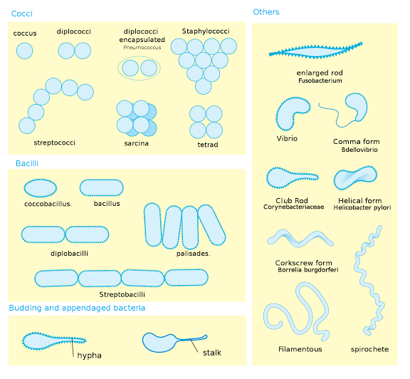
Bacilli:
These are rod shaped bacteria.
On the basis of arrangement of organisms they can be described as
Diplobacilli
Streptobacilli
Palisades
Chinese-letter form
Coccobacilli
Coma shaped

Slide 8
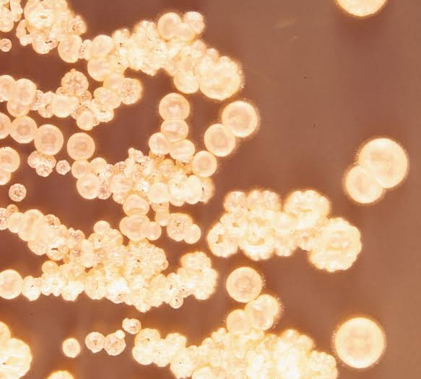
2.actinomyetes
Actin-ray, mykes-fungus
These are rigid organisms like true bacteria but they resemble fungi in that they exhibit branching and tend to form filaments.
They are termed as actinomycetes because of their resemblance to sun rays when seen in tissue sections.
Actinomyces bovis

Slide 9
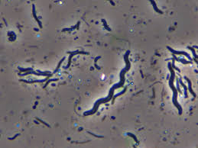
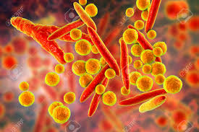
3.spirochaetes
They are relatively longer, slander, non branched microorganisms of spiral shape having several coils
( Treponema pallidum )
4. Mycoplasmas
These bacteria lack rigid cell wall and are highly pleomorphic and of indefinite shape
They occur in round or oval bodies in interlacking filaments

Slide 10
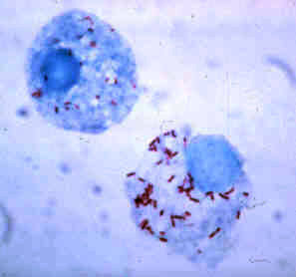
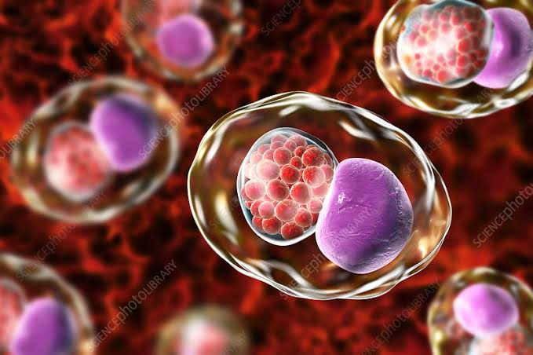
5. Rickettsiae and chlamydiae
They are very small, obligate parasites and at one time were considered as closely related to the viruses. Now, they are regarded as bacteria

Slide 11
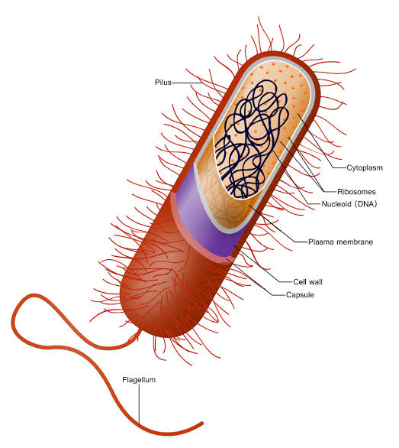
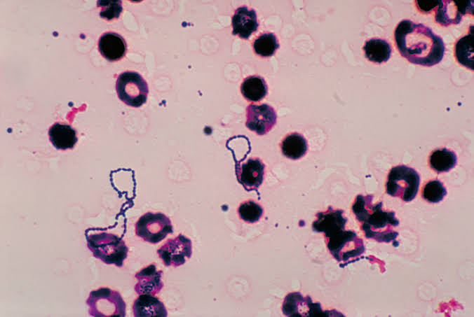
Based on anatomical features
1.Capsule
Capsulate-streptococcus pneumoniae
Non capsulate-viridans streptococci

Slide 12
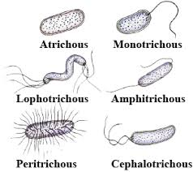
2.flagella
Flagellate
Monotrichous
Lophotrichous
Amphitrichous
Peritrichous
A-flagellate
Shigella spp.
3.Spore
Spore forming-Bacillus spp.
Non sporing-Escherichia coli

Slide 13
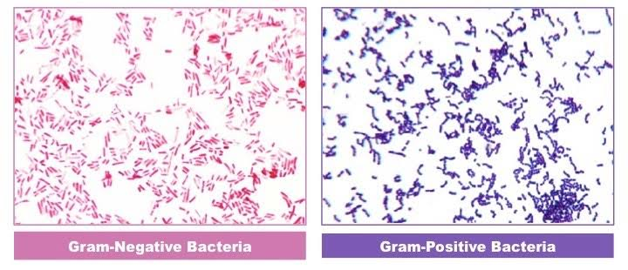
Based on staining reaction
1. Gram stain
Gram positive: After the gram stain organism which occur voilet in colour
Gram positive cocci: Staphylococcus aureus
Rods: Clostridium spp.
Gram negative: which appear pink or red
Gram negative cocci: Neisseria gonorrhoeae
Rod: E. coli

Slide 14
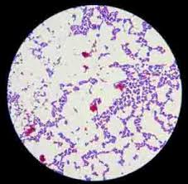
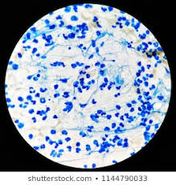
2. Acid fast stain
Acid fast organism: after ziehl-neelsen stain it will show pink in colour
Acid fast bacilli: Mycobacterium tuberculosis, Actinomycetes
Non acid organisms: after this stain organism will appear blue in colour
Non acid fast bacilli: Staphylococcus aureus

Slide 15
Based on pathogenicity
Pathogens
Organism which is able to spread disease and can cause disease ( Salmonella )
Non pathogens
Which does not cause disease ( Lactobacilli )
Commensals
Normally non pathogenic but sometime they show diseases when immunity impaired
( Bifidobacteria )

Slide 16
Based on relationship of host and organism
Saprophytes
Free living microbes on dead animals or decaying things that can be found in the soil and water and play important role in degradation of organic matter
Parasites
That establish themselves and multiply in host
( Salmonella )
Commensals
Microbes that live in complete live in complete life with harmony but they can produce disease when host resistance is lower ( p. acnes )

Slide 17
Based on nutrition
Autotrophic
Bacteria which grow by using inorganic carbon into organic compounds
( Cyanobacteria, Nitrifying bacteria)
Chemoautotrophic
Photoautotrophic
Heterotrophic
Bacteria that are unable to manufacture their own food and use the food that been reduced by the autotrophs
( Staphylococcus, E.coli )
Parasitic
Saprophytic
Symbiotic

Slide 18
Based on environmental factors
Temperature
PH
Oxygen dependence
Salt concentration
Atmospheric pressure

Slide 19
temperature
Psychrophiles
(15-20˚C) pseudomonas fluorescens
Mesophhiles
(20-40˚C) E. coli, Salmonella enterica, Staphylococcus aureus
Thermophiles
(50-60˚C) Bacillus stearothermophilus
Extremely thermophiles
(as high as 250˚C) Mathranii

Slide 20
Oxygen dependence
Aerobe
Grow in ambient temperature which contains 21% oxygen and small amount of carbon dioxide 0.03%
( Bacillus sp. )
Obligate Aerobe
Strictly require oxygen for their growth
(pseudomonas aeruginosa)
Micro Aerophilic
Grow under reduced oxygen 5-10% and increased carbon dioxide 8-10%
( Campylobacter jejuni, Helicobacter pylori )

Slide 21
Facultative
Capable of growing either in presence or absence of oxygen (E. coli)
Obligate anaerobe
Grow in the absence of oxygen
(Clostridium spp.)
Capnophilic
Require increased concentration of carbon dioxide 5-10% and 15% oxygen
H. influenzae
N.gonorrhoeae

Slide 22
ph
Acidophiles
Which grow at acidic pH
(Lactobacillus acidophiles)
Alkaliphiles
which grow at alkaline pH
(vibrio, V.cholerae)
Neutralophiles
which grow at neutral pH (pH6__8)
(pathogenic bacteria)
Majority of medically important bacteria grow best at neutral or slightly alkaline reaction (pH7.2__7.6)

Slide 23
Other ways of classification
Motile
Salmonella
Vibrio cholerae
Pseudomonas
Non motile
Staphylococcus
Shigella
Sensitive / resistant
(to particular antibiotic or chemicals)

Slide 24
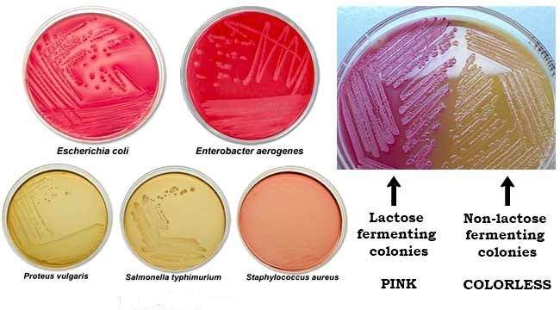
Lactose fermenter
Escherichia coli
E. klebsiella
Late lactose fermenter
Citrobacter
Serratia
Non lactose fermenter
Salmonella
Shigella

Slide 25
references
https://image.slidesharecdn.com/classificationofbacteria-161031182402/95/classification-of-bacteria-1-638.jpg?cb=1477997471
https://image.slidesharecdn.com/classificationofbacteria-150614155316-lva1-app6891/95/classification-of-bacteria-1-638.jpg?cb=1434297260
https://en.wikipedia.org/wiki/Bacterial_taxonomy
Bacteria and Viruses (by Kara Rogers)
Diversity of Plants (by Athar Hussain Shah)

