Slide 1
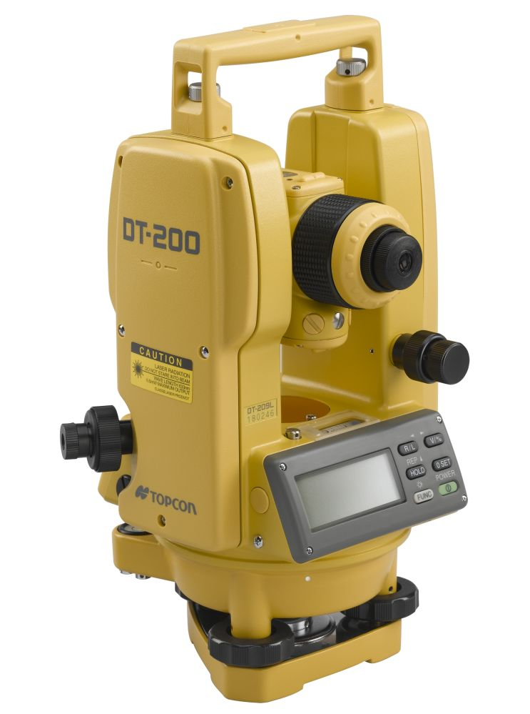
THEODOLITE
Lecture # 6 Part 2

Slide 2
INDEX
INTRODUCTION
Definition
MAIN COMPONENETS OF THEODOLITE

Slide 3
INTRODUCTION
Theodolite is a basic surveying instrument which is use for measuring vertical and horizontal angle.
Theodolite is more precise than magnetic compass.
Magnetic compass measures the angle up to as accuracy of 30’. However a theodolite measures the angles up to and accuracy of 10’’, 20”

Slide 4
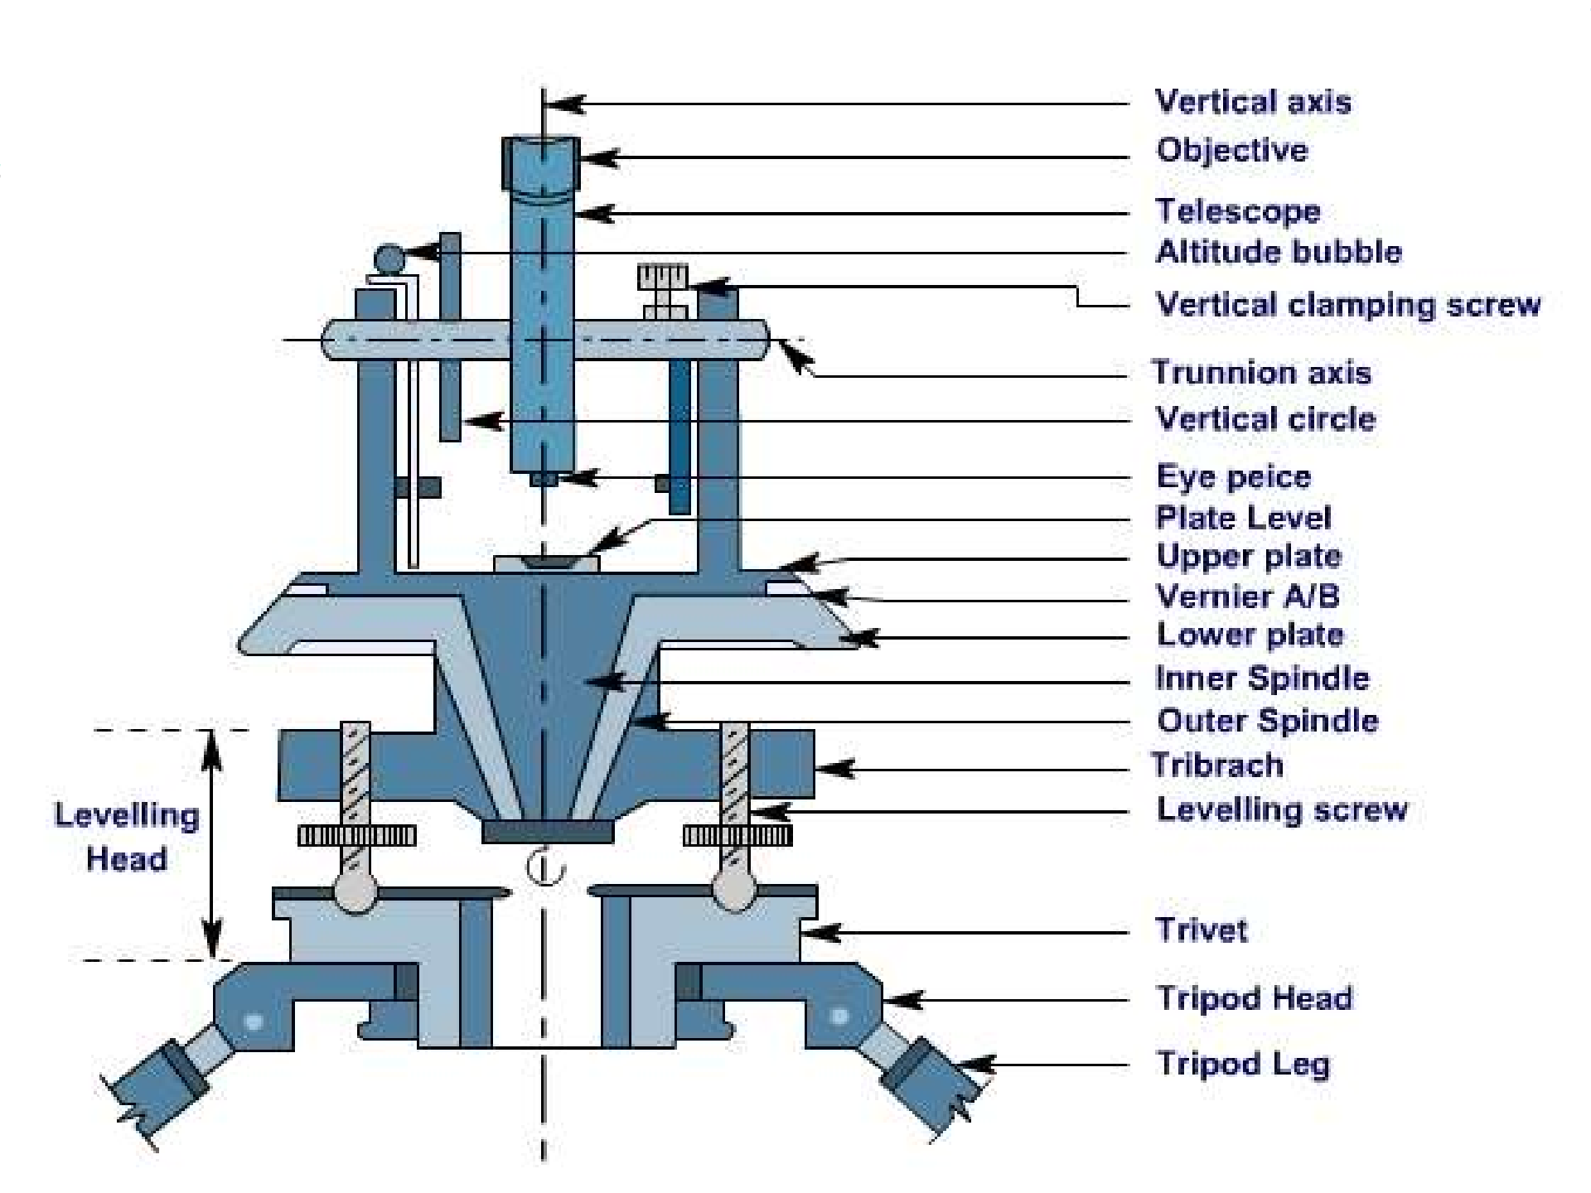

Slide 5
Definition
A transit theodolite is one in which the telescope can be revolved through a complete revolution about its horizontal axis in a vertical plane.

Slide 6
Main Components of Transit Theodolite
Trivet
Foot Screws
Tri Branch
Leveling Head
Spindles
Lower Plate
Upper plate
A Frame
T Frame
Altitude Bubble
Compass
Tripod

Slide 7
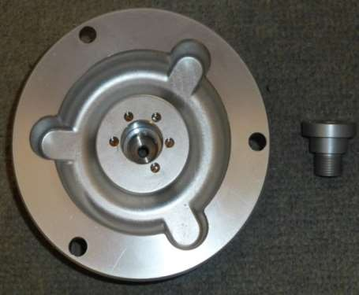
1. Trivet
It is a circular plate having a central, threaded hole for fixing the theodolite on tripod stand.
It is also called the base line.

Slide 8
2. Foot Screws
Lower part – The Trivet
Upper Part – It is passes through the threaded hole in the tribrach plate.
Foot screws is used for leveling the instrument.

Slide 9
3.Tri Branch
The upper parallel triangular plate carrying three foot screws at its ends is called the Tri branch.
4.Levelling Head.
It is consists of two parallel plates separated by the 3 leveling screws.

Slide 10
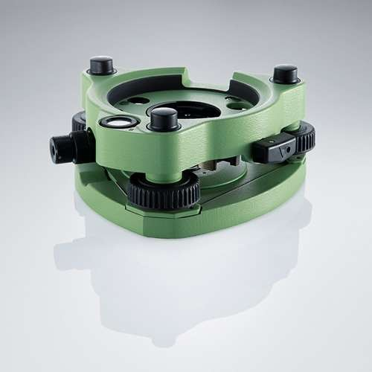
It gives support the upper part of the instrumental and attaches it to the tripod

Slide 11
6. Lower Plate
A horizontal plate with the graduations provided all around, from 0 to 360°, in a clockwise direction.
Horizontal angles are measured with this plate.
The size of the theodolite is defined by the diameter of horizontal circle.

Slide 12
7. Upper plate
Horizontal plate of smaller diameter provided with two venires. on diametrically opposite parts of its circumference.
They are used to read fractions of the horizontal circle plate graduations.
The venires are graduated in 20 min and each minute is divided in 3 to 5 parts making least count 20” or 10”.

Slide 13
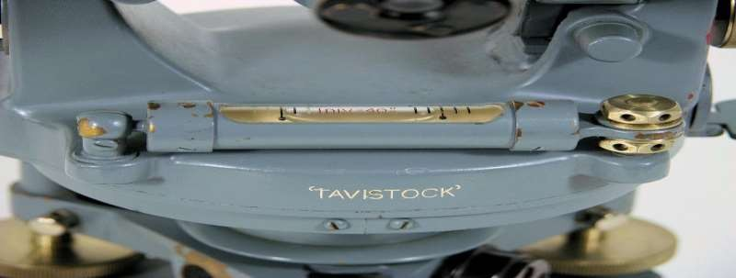
10. Altitude Bubble
A sensitive level tube called altitude bubble, is attached to the top of the T- frame.
This bubble is brought to the center by the clip screw.
A mirror is provided on the top of bubble.

Slide 14
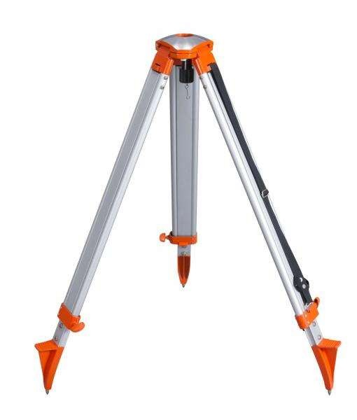
12. Tripod
The theodolite is mounted on a strong tripod when being used in th field.
The legs of the tripod are solid or framed. At the lower ends of the legs, pointed steel shoes are provided to get them pushed into ground.
The tripod head has male screws on which the trivet of the leveling head is screwed.
e

Slide 15
Thank
You….

