Slide 1
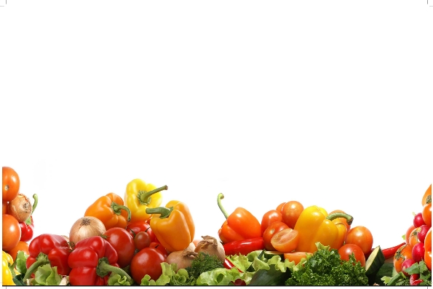
STEEPING TECHNOLOGY FOR PRESERVATION OF VEGETABLES IN PET BOTTLES
Prof. Dr Sarfraz Hussain
Institute of Food Science & Nutrition

Slide 2
NEW TECHNIQUES IN FRUIT AND VEGETABLES PRESEVATION

Slide 3
Introduction to steeping technology
Definition: It is a method of food preservation in which permitted chemical additives having GRAS status are used in water solution just sufficient to prevent browning, mold growth and preserve quality characteristics during storage for at least one year or till next season.

Slide 4
Chemical additives used in steeping
These chemical additives include
Citric acid, potassium metabisulfite, sodium benzoate, ascorbic acid, calcium chloride, sodium chloride, acetic acid,

Slide 5
INTRODUCTION
Through steeping method of preservation, all vegetables can be preserved for at least 1 year.
This type of vegetable is ready to cook.
In this form we can maintain reserve of vegetables.
4. All related machines are available.

Slide 6
Button mashrooms packed in HDPE in China and red carrots packed in Pakistan

Slide 7
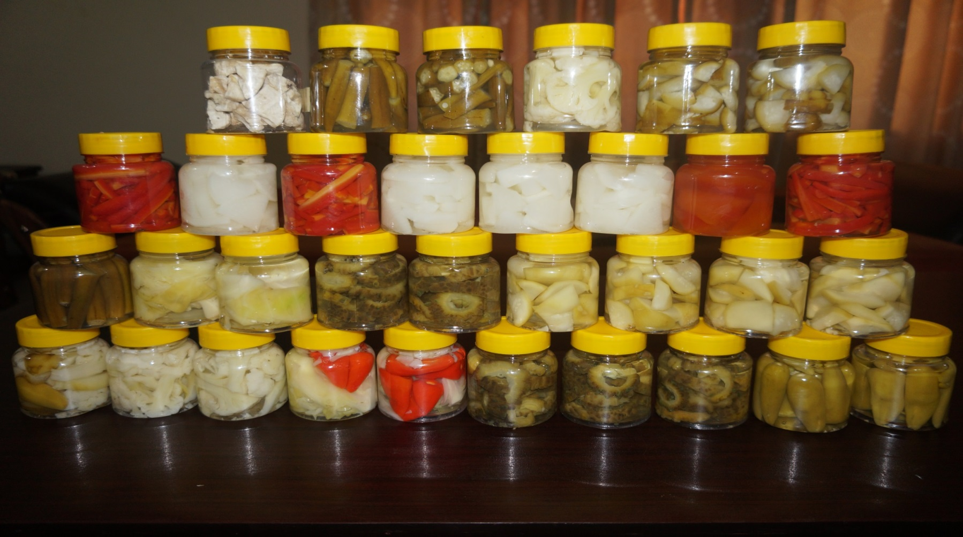
Packing of fresh cut vegetables in PET bottles

Slide 8
Summary of advantages of steeping technology
Very low cost technology
Alternate to canning technology
Light weight & useful for export
Visible and ISO certified product
Near to original quality characteristics
Negligable initial cost on machinery
Reduction in municipal wastes
Time saving in preparation & cooking
Job oppertunities & step towards self sufficiency
Long time storage

Slide 9
Advantages of technology
Step towards self sufficiuency by minimize post harvest losses up to 40%.
Reduction in insecticides and pesticides by washing, peeling up to 90%.
Food additives used have “GRAS” status,
Exert synergistic effect, in 10 time reduced levels than recommended by certifying agencies (FDA-USA).

Slide 10
Advantages of technolgy
Infective microbs reduced effectively, washing & peeling, present on surface as pollutants,
Reduction in muncipal wastes due to processing of vegetables near areas of production & inedibles removed & only edible portion will enter in to the cities.

Slide 11
Advantages of technolgy
Quality characteristics as color, flavor, taste & texture are better preserved for long time.
Vege preparation & cooking time is reduced.
Technology applicable in areas where electricity & natural gas is not available.
Undetectable amounts of chemicals used are further diminish during cooking at high temperature.
Better marketing of short term vegetables year round,

Slide 12
Advantages of technolgy
Initial investment on machinery is negligable.
Small farmers & vegetable growers can install small plants on farms,
Earn more profit.
Provide employment to countrymen.
Vegetables can be exported to distant places,
Earn foreign exchange,
Vegetables can be used in disausters, earth quacks, in famin & military purposes,
Provide variety.

Slide 13
Storage facilities
Shortage of storage facilities can be met through this technology.
Vegetable dehydration Industries can take advantage to meet shortages /breakdown in electricity/natural gas, to keep vegetables in good conditions for many days,
Color bleaching is one advantage in some dried products for better marketing & product requirement.

Slide 14
Storage facilities
Small potato processing plants can store left over prepared raw materials or for next day processing with out any additional storage costs.
Product is stored at ordinary temperature for further processing,
Temporary storage for long time to convert them in to product to save raw material.

Slide 15
Storage facilities
Vegetables preserved in this fassion can avoid start of warranty period of canned foods to meet out season demands & control of expiry date.
Large processing plants making frozen french fries store short season potato crops & can run the plant out of season to earn more profit and provide labor working for extended period and providing employment.

Slide 16
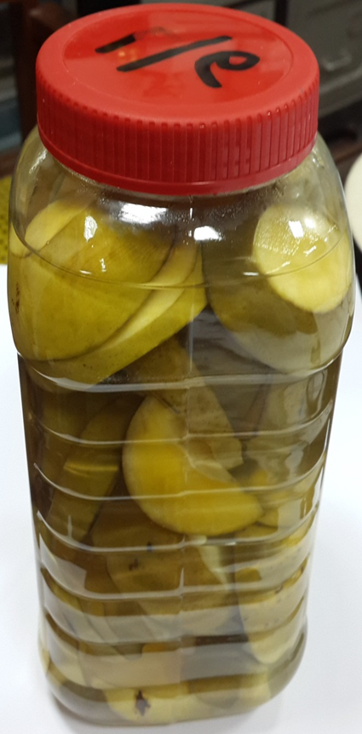
Raw Mango Rings preserved in steeping solution

Slide 17
Uses of raw mango rings
Ready to serve drink (RTD )
Jam, JELLY & marmalade
Chutney
Chewable Leather Candy
Kasundi PICKLE

Slide 18
CHEMICAL PRESERVATION OF VEGETABLES
Goals
Improving the quality and value of fruits and vegetables,
Reducing post harvest losses and improving marketing efficiency
Solving particular problems in vegetables to maintain their quality and safety

Slide 19
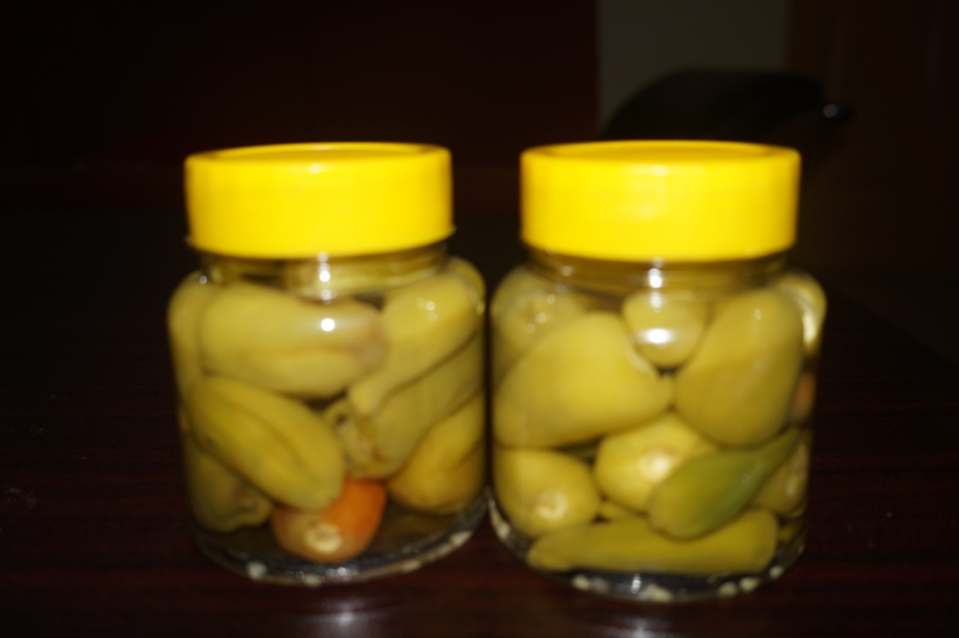
PRESERVATION OF FRESH CUT VEGETABLES
To extend the shelf life of fresh cut vegetables using a formulation comprising;
Citric acid
Sodium benzoate
Ascorbic acid
Acetic acid
Sodium chloride
Sulfur dioxide and sulfites

Slide 20
CITRIC ACID
It inactivates trace metals whish may cause haze or deterioration of colour and flavour
Up to 40g/L can be used for preservation
High acidity tends to reverse the reaction by maintaining a redox potential specially
during the initial stages of oxidation

Slide 21
SODIUM BENZOATE
White granular or crystalline powder
Odorless
Inexpensive
Stored in a cool, dry place in watertight containers
Used at low levels to avoid possible off-flavors in some products

Slide 22
SODIUM BENZOATE
Act as antimicrobial agent
The maximum permitted level by law is 0.1%.
Sodium salt of benzoic acid
180 times more soluble in water as compare to benzoic acid
Works at Lower pH
more effective it is if pH is below 4.5

Slide 23
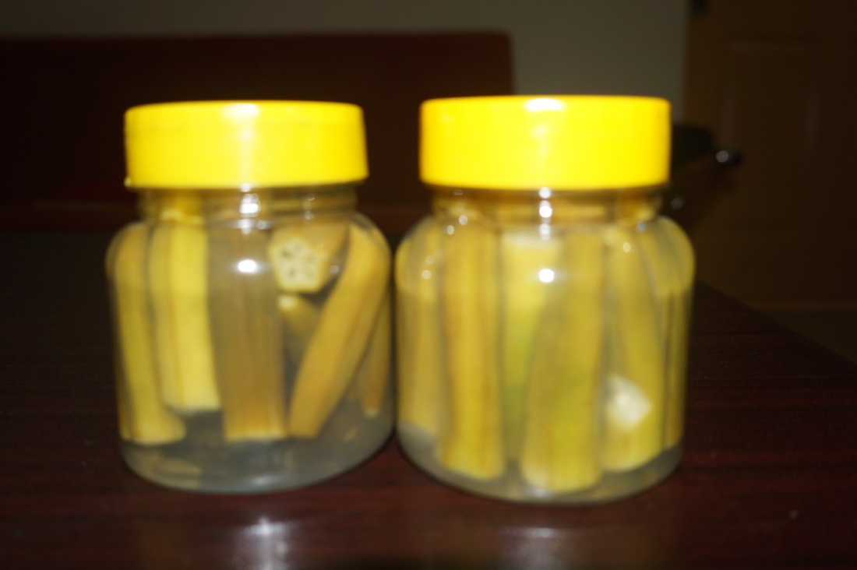
ACETIC ACID
widely employed as food preservative
>0.3% of acid will inhibit Yeasts, molds and bacteria growth
Antimicrobial effect is due to lowering the pH

Slide 24
SODIUM CHLORIDE
Prevent spoilage of vegetables
The antimicrobial activity of salt is related to its ability to reduce the water activity thereby influencing microbial growth
Reduce the solubility of oxygen in water
Salting vegetables increases the heat resistant of molds

Slide 25
SULPHUR DIOXIDE AND SULPHITES
Added to preserved fruit and vegetables
Conserve colour
Act as antioxidants and control microbial growth
Sulphur dioxide and its various sulphites dissolve in water, and at low pH levels yield sulphurous acid, bisulphite and sulphite ions
The various sulphite salts contain 50-68% active sulphur dioxide

Slide 26
SULPHUR DIOXIDE AND SULPHITES
At pH values less than 4.0 the antimicrobial activity reaches its maximum
Sulphur inhibits enzymatic browning
In the past cut fruits and vegetables in salads bars were sprayed or dipped in a solution of sulphites

Slide 27
ADVANTAGES
Low cost Method for Preservation of Fresh cut vegetables
Product must be packed in air tight bags/ containers
Shelf life is approximately upto one year in air tight suitable container at room temperature
Initial trials of Carrots, Bitter gourd, Kaddu, Brinjal, Okra, Chillies, Tinda, Turnips, Cauliflower and cabbage were made

Slide 28
ADVANTAGES
Remarkable reduction in Insecticides and Pesticides concentrations
Food Additives having “GRAS” Status are used in the formulations
Reduction of Infective Microorganisms by washing and peeling

Slide 29
ADVANTAGES
Minimize losses up to 40%
Long term Preservation will naturally help to improve supplies of ready to cook vegetables for Pak Army
Color, Flavor, Texture and other quality characteristics, are better preserved

Slide 30
ADVANTAGES
Preparation and cooking time of vegetables is reduced
Applicable in areas where Electricity and Natural gas is not available
Vegetables preserved in this fashion can be used for military supplies
Steeping solution may be used for cooking purposes in case of water shortage

Slide 31
ADVANTAGES
Proper marketing of Fruits and Vegetables is possible in off season period
Cut Vegetables can be stored at ordinary temperature for further processing
Temporary storage of Vegetables for long time to convert them in to product

Slide 32
ADVANTAGES
Reduced the municipal wastes which enter into the cities
Shortage of storage facilities can be met with this technology. Vegetable dehydration Industries can keep their vegetables in good condition for many days and dehydrate them

Slide 33
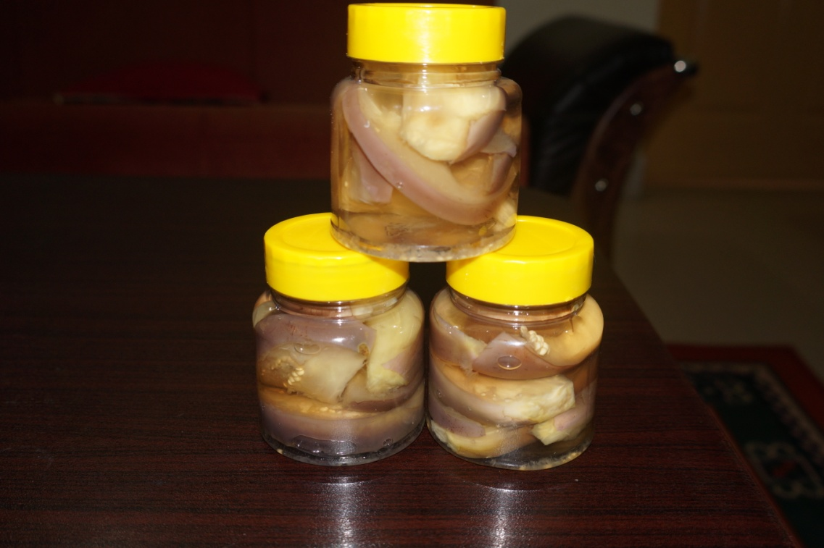
ADVANTAGES
Color bleaching is also one advantage in this technology required in some dehydrated products for better marketing and product requirement

Slide 34
ADVANTAGES
Initial investment on machinery is very minute
Small farmers can install such facilities on or near to the place of their farms
Suitable for Pakistan Army, in areas of earthquake, flood relief and other disasters

Slide 35
GREEN CHILIES

Slide 36
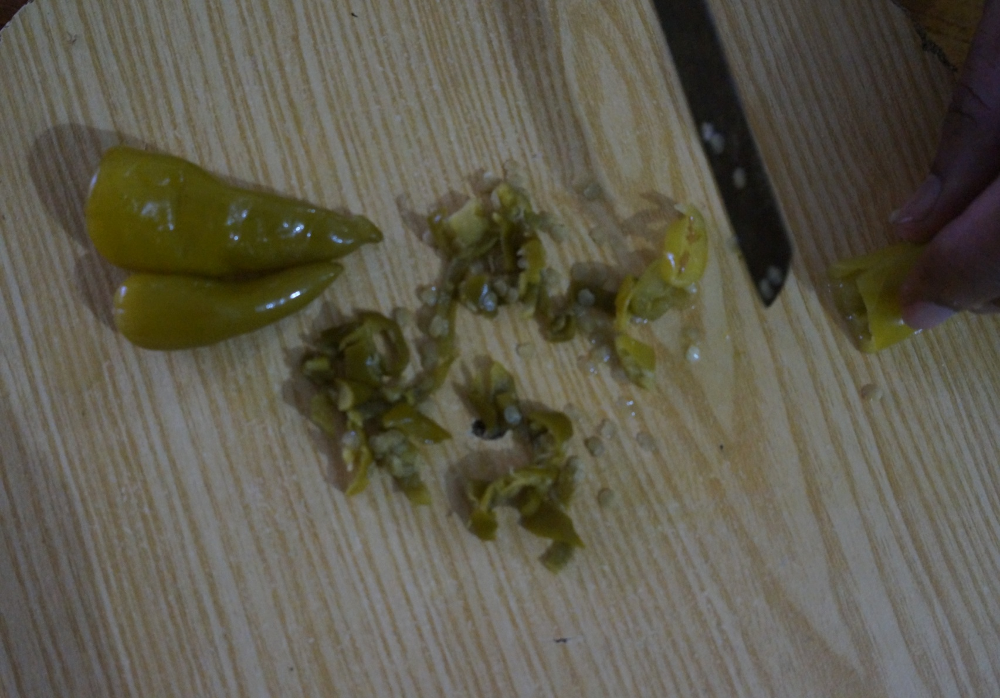
CHOPPED GREEN CHILIES

Slide 37
DRAINING & RINSING OKRA

Slide 38
CLOSE VIEW OF OKRA IN A STRAINER

Slide 39
PRESERVED BRINJAL

Slide 40
COOKING BRINJAL

Slide 41
FINISHED BRINJAL

Slide 42
SERVING BRINJAL WITH RICE

Slide 43
DRAINING & RINSING TURNIPS

Slide 44
CUT TURNIPS WITH RED TOMATOES & GREEN CHILIES

Slide 45
COOKED TURNIPS

Slide 46
WASHED CABBAGE

Slide 47
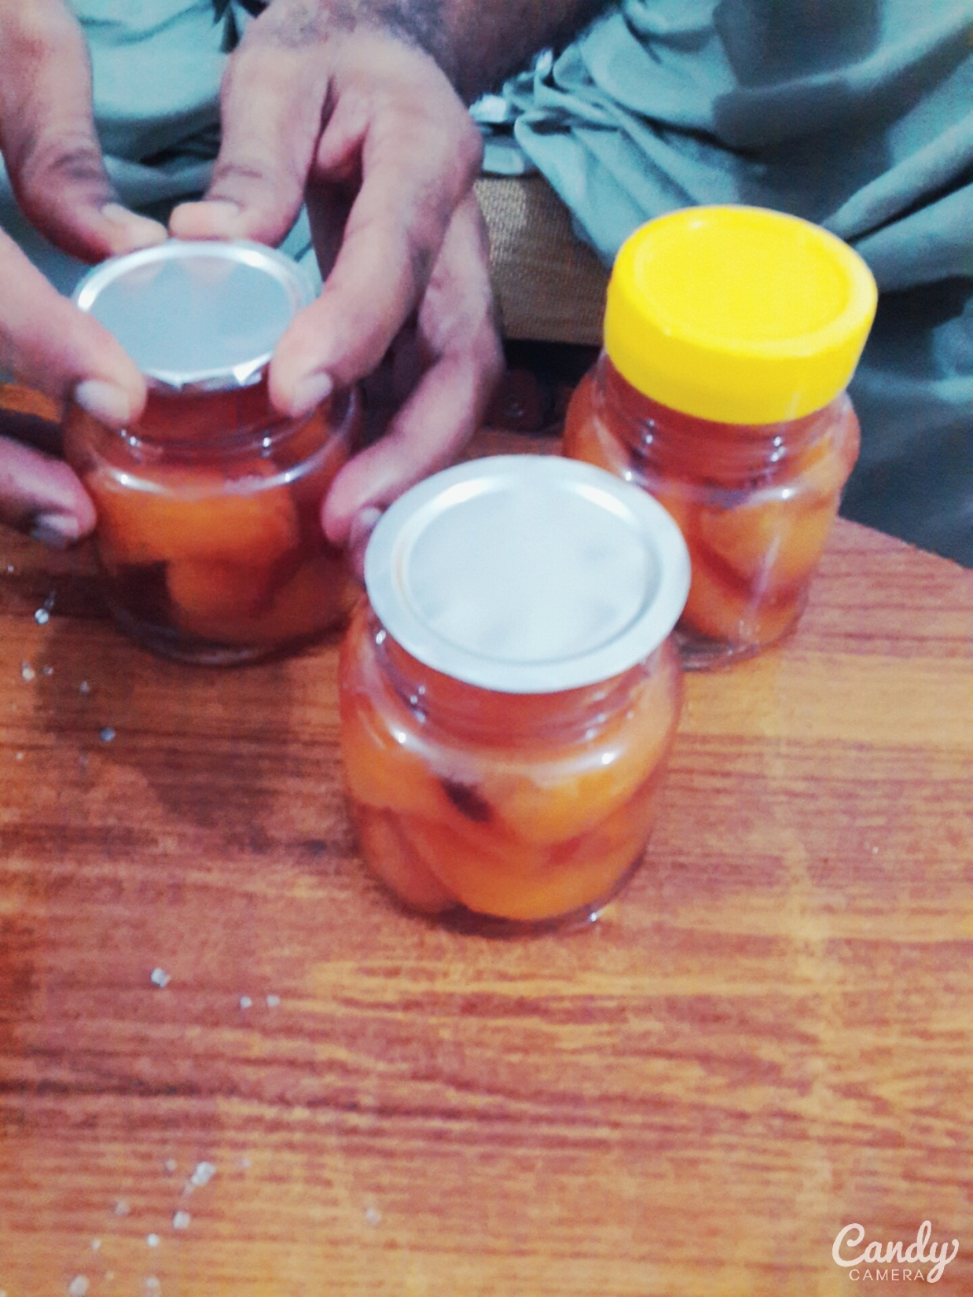
air tight Foil packing

